Slide 1
How to temporarily remove the “request” link from Primo even for requestable items
Yoel Kortick
Senior Librarian

Slide 2
Introduction
An example before the change
Remove the "Request" link
An example after the change
Return the situation to as it was

Slide 3
Introduction

Slide 4
Introduction
There may be an unexpected situation in which for a certain undefined period of time the library needs to prevent end users from making physical item requests.
One option, as explained in separate presentation How to temporarily change all items of a library or institution to be not for loan and not requestable, is to make all items not requestable.
Another option is to leave the item configuration as requestable but remove the “request” link from discovery.

Slide 5
An example before the change

Slide 6
An example before the change
We will look at two examples
The first example is an item which is on loan (not available)
The second example is an item which is available

Slide 7
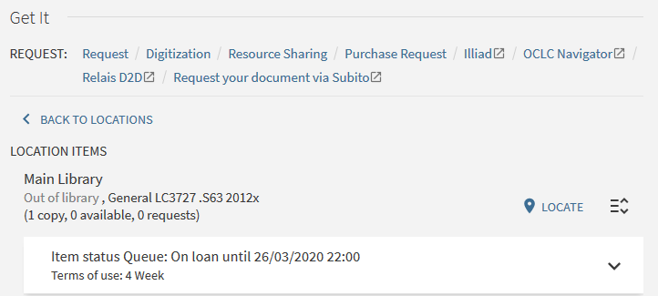
An example before the change
This item is not available and has a link to “request”

Slide 8
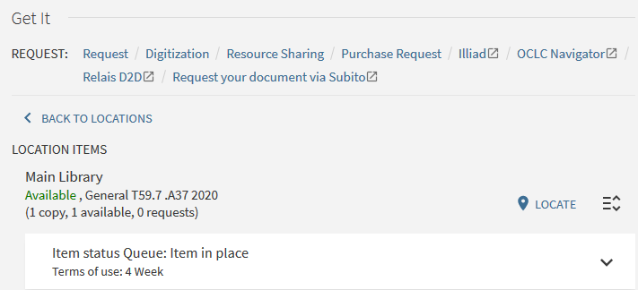
An example before the change
This item is available and has a link to “request”

Slide 9
Remove the "Request" link

Slide 10
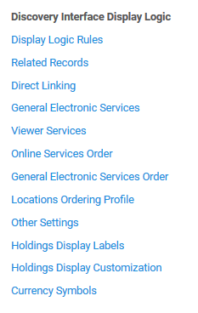
Remove the "Request" link
Access the discovery interface display logic at “Configuration > Fulfillment > Discovery Interface Display Logic > Display Logic Rules”

Slide 11
Remove the "Request" link
Add a rule

Slide 12
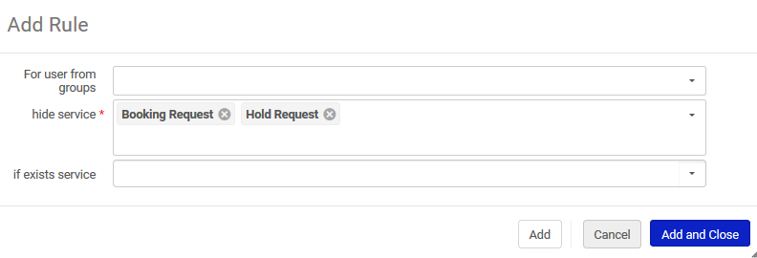
Remove the "Request" link
Hide the service “Hold Request” and “Booking Request” unconditionally

Slide 13
Remove the "Request" link
Drag this rule to the top of the list

Slide 14
An example after the change

Slide 15
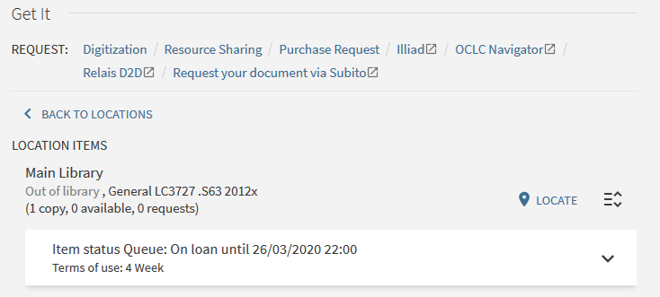
An example after the change
This item is not available and does not have a link to “request”
The “Request” link is gone

Slide 16
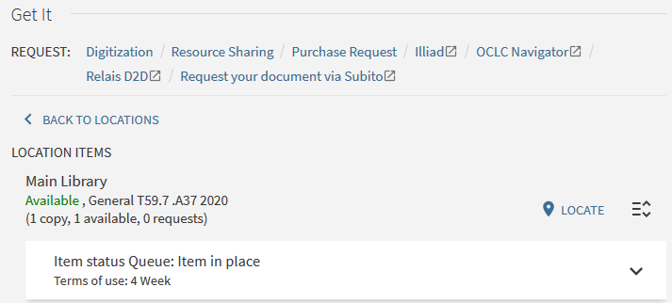
An example after the change
This item is available and does not have a link to “request”
The “Request” link is gone

Slide 17
Return the situation to as it was

Slide 18
Return the situation to as it was
Access the discovery interface display logic rule and either disable it or remove it.
This will remove the rule

Slide 19
Return the situation to as it was
Now we have disabled the rule

Slide 20
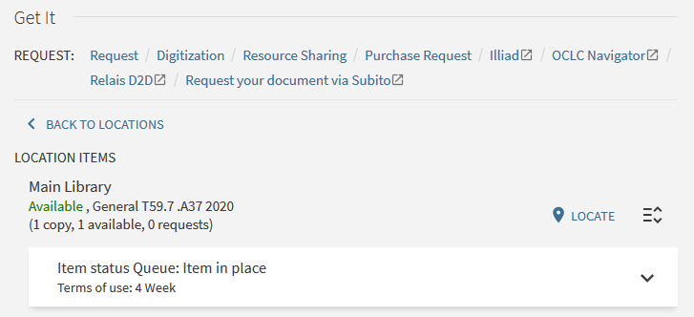
Return the situation to as it was
The “Request” link has returned

Slide 21
Thank you!
xxx@exlibrisgroup.com

