Slide 1
How to activate an electronic collection for a limited time period
Yoel Kortick
Senior Librarian

Slide 2
Introduction
For example ...
How is it done?
The electronic collection in Primo
Removing the electronic collection after the "active until" date passes
Workflow when the electronic collection has already been partially subscribed to

Slide 3
Introduction

Slide 4
Introduction
There are cases where an electronic collection will be accessible for a certain period.
Examples might include the vendor offering a trial period, or due to extenuating circumstances the vendor will offer resources for free for a limited time.

Slide 5
Introduction
In a situation like this it is recommended that the institution will activate the collection for the specific time period.
In addition to this presentation see information regarding the "Active until date" at Managing Electronic Resources.

Slide 6
For example ...

Slide 7
For example ...
As reported in the blog University of Michigan Press COVID 19 Response: Free Access to Scholarly Ebooks:
In response to the request of the International Coalition of Library Consortia (ICOLC) for "creative solutions that allows critical access to publisher content for the research and public health communities," University of Michigan Press will make all content in the University of Michigan Press Ebook Collection (UMP EBC) free-to-read for the remainder of the academic term.

Slide 8
For example ...
So … if an institution wishes to activate this electronic collection (and they otherwise would not have access to it) they should activate it until the end of the academic term

Slide 9
How is it done?

Slide 10
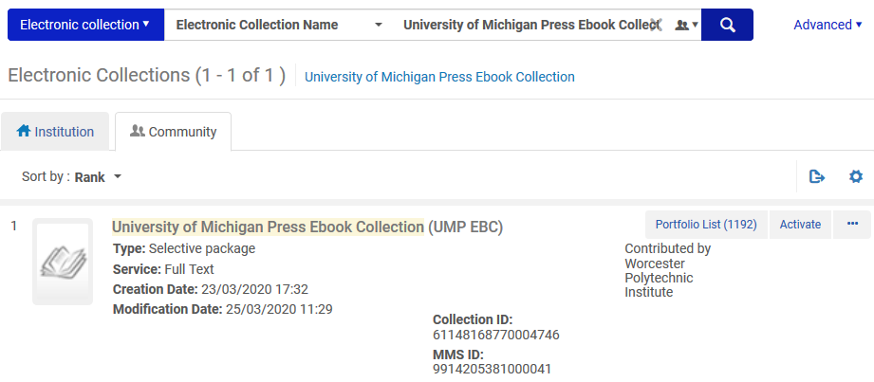
How is it done?
Let’s find University of Michigan Press Ebook Collection (UMP EBC) in the Alma Community Zone and activate it
We will click "Activate"
By the way we see that it was contributed by a member of the Alma Community

Slide 11
How is it done?
When activating the full text service (as part of the activation wizard) we will fill in the "Active Until Date" to be the end of the semester.
It is also a good idea to fill in the public note to explain that it is available for a limited time

Slide 12
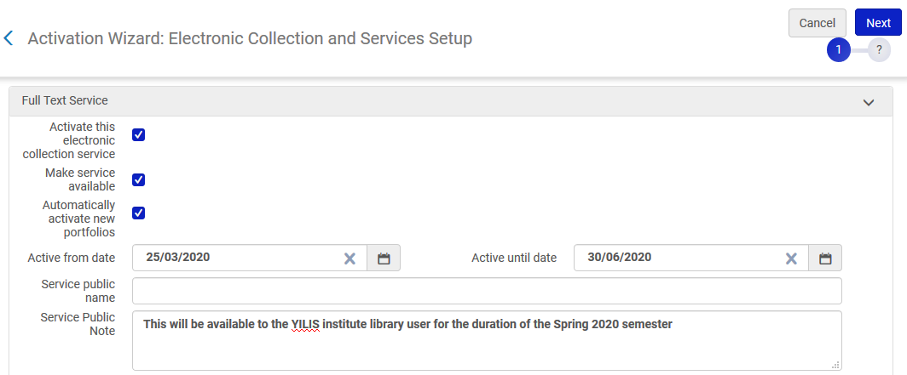
How is it done?
Will be active until the end of the semester
End users will know that it is temporary available

Slide 13
How is it done?
We can see via "Monitor Jobs" that the electronic collection activation job for "University of Michigan Press Ebook Collection (UMP EBC)" has completed

Slide 14
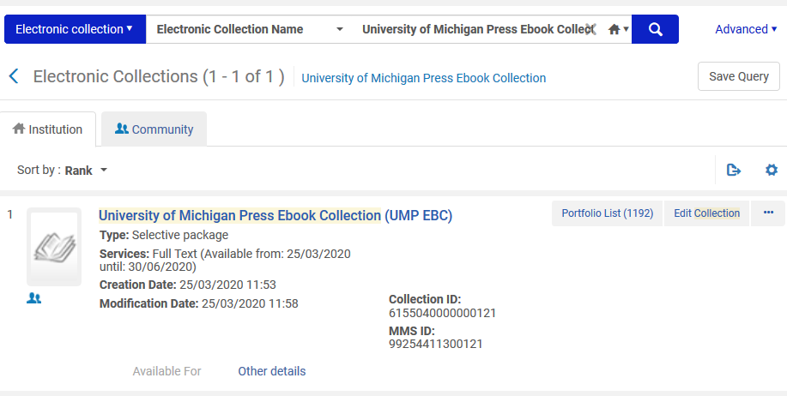
How is it done?
Active in the institution and linked to CZ

Slide 15
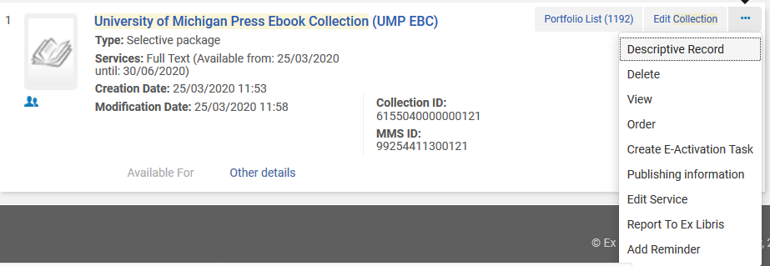
How is it done?
Let’s take a look at the service

Slide 16
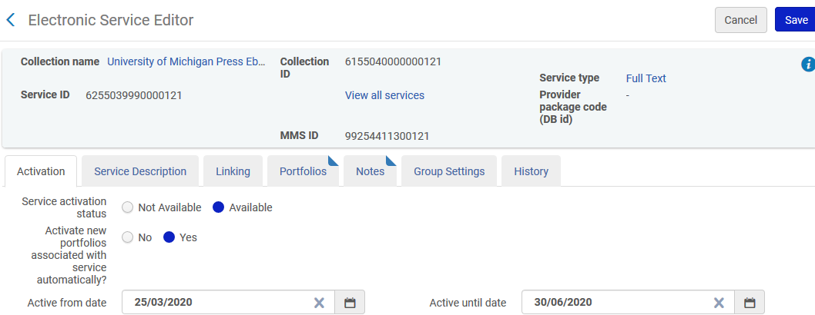
How is it done?
Active until June 30, 2020

Slide 17
The electronic collection in Primo

Slide 18
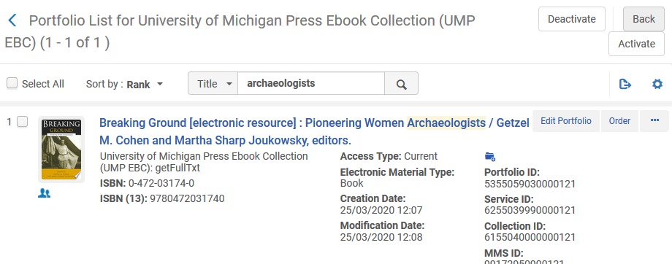
The electronic collection in Primo
In Alma we can see that one of the portfolios in the collection is "Breaking ground: pioneering women archaeologists"

Slide 19
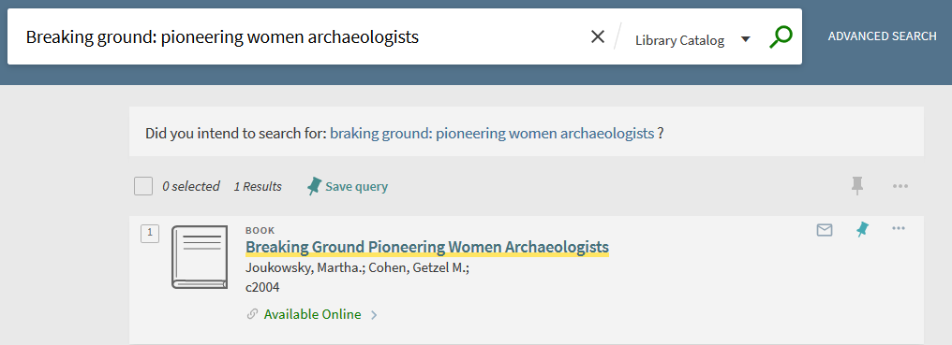
The electronic collection in Primo
Here it is in the Primo search results
We will now click "Available Online"

Slide 20
The electronic collection in Primo
Here it is in the Primo after clicking "Available Online"
We can see both the name of the collection and the public note

Slide 21
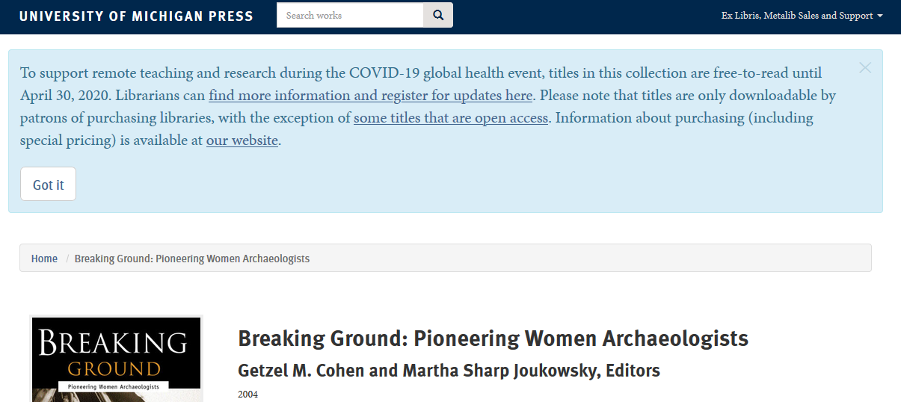
The electronic collection in Primo
After clicking the link (name of the collection) we arrive to the resource

Slide 22
Removing the electronic collection after the "active until" date passes

Slide 23
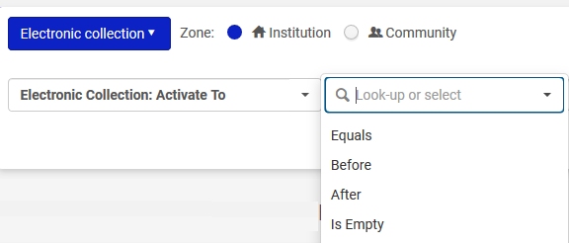
Removing the electronic collection after the "active until" date passes
We can identify all resources which are no longer active by doing an electronic collection advanced search by "Activate To"

Slide 24
Removing the electronic collection after the "active until" date passes
On the next slide we search for all electronic collections which have
"Activate To" before July 1, 2020
A "Public Note" which has keywords "This will be available to the YILIS institute library user for the duration of the Spring 2020 semester"
We find the electronic collection "University of Michigan Press Ebook Collection (UMP EBC)"

Slide 25
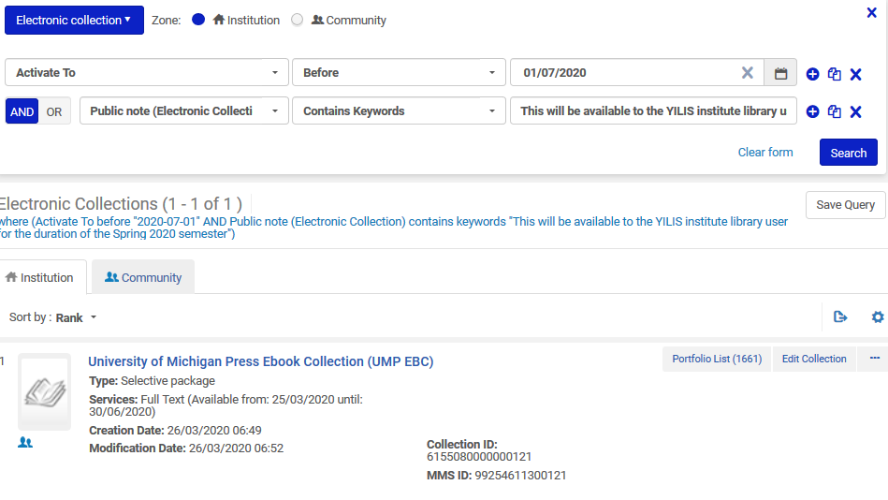
Removing the electronic collection after the "active until" date passes

Slide 26
Removing the electronic collection after the "active until" date passes
We can then (if desired of course) delete the electronic collection and thereby remove it from Primo Discovery

Slide 27
Workflow when the electronic collection has already been partially subscribed to

Slide 28
Workflow when the electronic collection has already been partially subscribed to
For the purposes of this demonstration we will assume that the institution has already subscribed to selected content of the electronic collection "Annual Reviews" which is present in the Alma Community Zone.
We will also assume that this electronic collection has then become free for a limited time. The institution wants to provide to the users not only the selected content to which they already subscribe, but also the remaining content of the collection which has now become free.

Slide 29
Workflow when the electronic collection has already been partially subscribed to
In the Alma Community Zone the electronic collection "Annual Reviews" includes 65 portfolios.

Slide 30
Workflow when the electronic collection has already been partially subscribed to
The institution has subscribed to 40 of the 65 portfolios.

Slide 31
Workflow when the electronic collection has already been partially subscribed to
In order to activate the remaining 25 portfolios (that have become temporarily free and the institution does not already subscribe to) we will do as follows:
Activate the collection from the community zone
Give it a unique name to distinguish it from the existing activated collection
Selectively activate the remaining 25 portfolios.

Slide 32
Workflow when the electronic collection has already been partially subscribed to
Why are we giving the electronic collection a unique name to distinguish it from the existing activated collection?
In this manner we will be able to easily find it and delete it (or deactivate it) when it will no longer be free.
This is easier and more organized than combining the "new and free" portfolios into the existing collection together with the "subscribed to" portfolios.

Slide 33
Workflow when the electronic collection has already been partially subscribed to
From the Community Zone we will activate the collection

Slide 34
Workflow when the electronic collection has already been partially subscribed to
We will confirm that even though it is already activated we will activate it again

Slide 35
Workflow when the electronic collection has already been partially subscribed to
We will give it a unique public name, such as "Annual Reviews (temporary free access)"

Slide 36
Workflow when the electronic collection has already been partially subscribed to
We will give it a full text service "Active until date" and also fill in the service public note

Slide 37
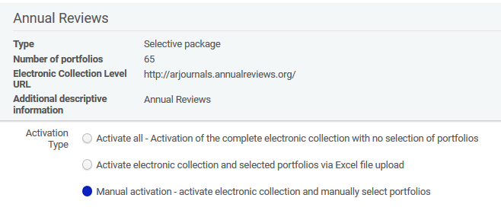
Workflow when the electronic collection has already been partially subscribed to
We will not activate all portfolios (because we already subscribe to and have activated 40 of them).
We will choose "Manual activation – activate electronic collection and manually select portfolios"

Slide 38
Workflow when the electronic collection has already been partially subscribed to
Now in the electronic service editor portfolios tab we will select "Add Portfolios from Community"

Slide 39
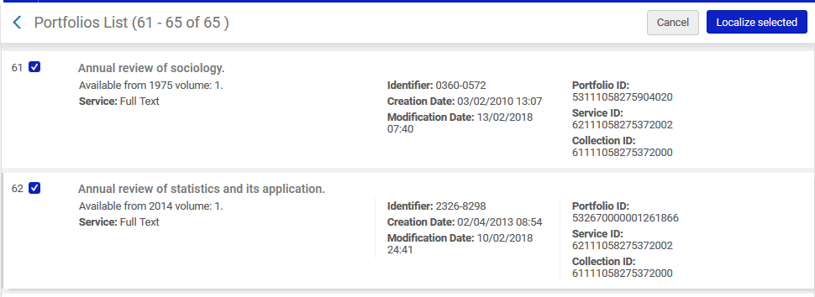
Workflow when the electronic collection has already been partially subscribed to
Select the specific portfolios we want to activate in this collection and click "localize selected“. These are the portfolios we do not already subscribe to.

Slide 40
Workflow when the electronic collection has already been partially subscribed to
On the next slide we see the following:
The institution has two electronic collections for "Annual Reviews":
"Annual Reviews (free access)" which has 25 portfolios and is active until June 20, 2020. It can be deleted (or deactivated) when it will no longer be free
"Annual Reviews" which has 40 portfolios and includes those portfolios which the institution was already subscribed to before the others became free.

Slide 41
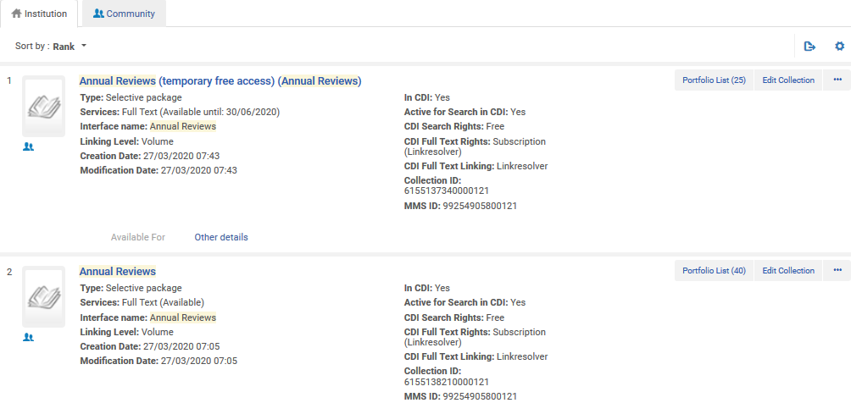
Workflow when the electronic collection has already been partially subscribed to
This is the one which will be deleted or deactivated when no longer free
This is the one the institution subscribes to

Slide 42
Thank you!
xxx@exlibrisgroup.com

