Slide 1
An introduction to title level collections
Yoel Kortick
Senior Librarian

Slide 2
Introduction
Accessing title level collections in Alma via the resources menu
Accessing title level collections in Alma via the repository search
Accessing title level collections in Primo via collection discovery
Accessing title level collections in Primo via search

Slide 3
Introduction

Slide 4
Introduction
This presentation is an introduction to title level collections and primarily, but not only, how they relate to digital resources
In order to avoid any confusion we will state from the start that title level collections and Electronic Collections are different entities.
We will not discuss here the creation and management of title level collections, but rather show "what they are".
For creating and managing title level collections in Alma see Managing Collections.

Slide 5
Introduction
Title level collections can contain bibliographic records which have associated inventory of any type: physical, electronic or digital.
However, bibliographic records which have digital inventory must be associated with a title level collection.
Therefore, title level collections are typically most prevalent with digital inventory.

Slide 6
Introduction
We will make sure here at the outset that it is clear what is meant by "digital resources" as opposed to "electronic resources"
Digital resources are files that are owned by the institution. These may be images, videos, sound recordings, and PDFs.
Electronic resources are resources to which the library subscribes. These may be electronic online journals and newspapers.
Digital resources are owned, electronic resources are subscribed to.

Slide 7
Introduction
Title level collections gather together bibliographic records that have a common characteristic or theme.
In the example here there is a title level collection called "Flowers of Israel".
It has four sub-collections which are more specific than the top level collection and gather together bibliographic records with a more specific common theme.
For example: "Bulbs", "Annuals", "Herbaceous Perennials" and "Scholarly Articles"

Slide 8
Accessing title level collections in Primo via collection discovery
Here is an example from Haifa University Primo

Slide 9
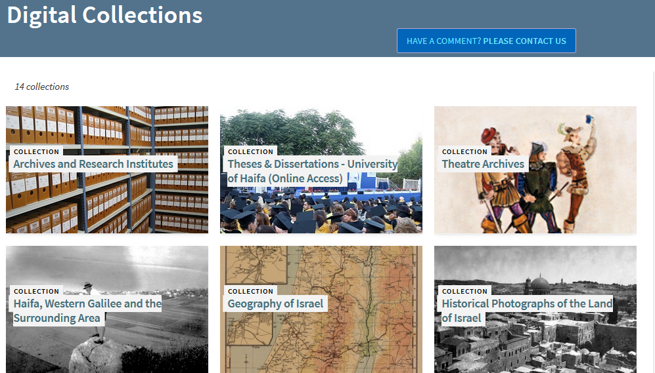
Accessing title level collections in Primo via collection discovery

Slide 10
Accessing title level collections in Alma via the resources menu

Slide 11
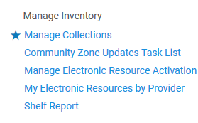
Accessing title level collections in Alma via the resources menu
Collections can be accessed from "Resources > Manage Inventory > Manage Collections"

Slide 12
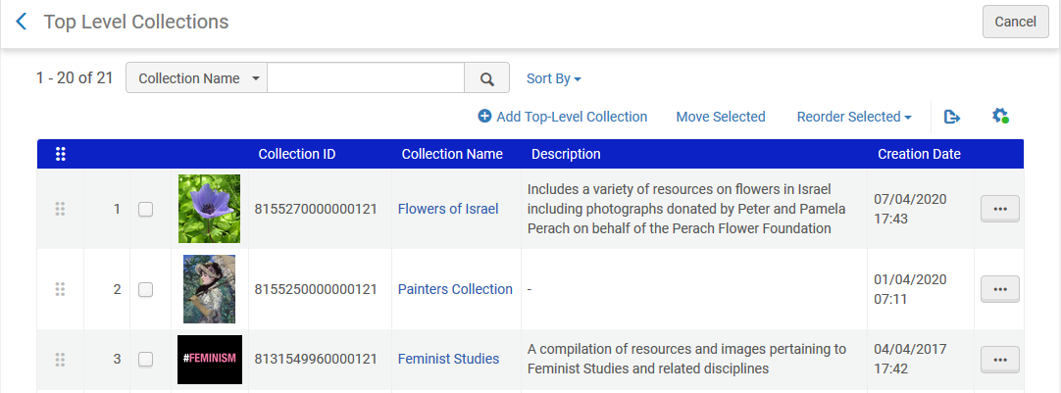
Accessing title level collections in Alma via the resources menu
Our examples will focus on the aforementioned collection "Flowers of Israel"

Slide 13
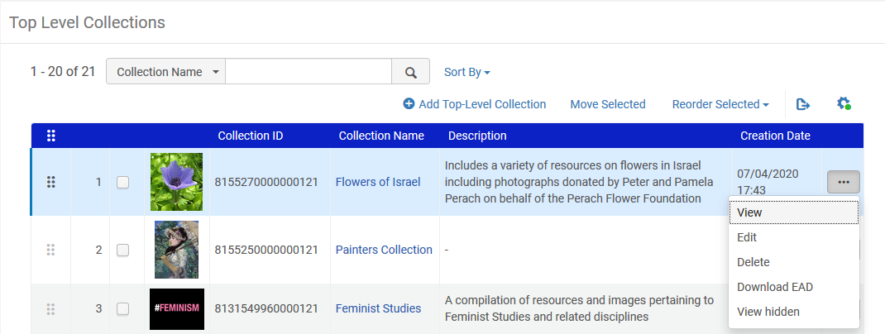
Accessing title level collections in Alma via the resources menu
"Flowers of Israel" is a "top level" collection. Clicking "view" or "edit" allows the user to access collection details as well as the sub-collections.
Users with role "Collection Inventory Operator" or "Collection Inventory Operator extended" can edit collections

Slide 14
Accessing title level collections in Alma via the resources menu
After clicking "edit" (or "view") there are four tabs for the collection.
They are the same tabs for a "top-level" collection as for a "sub-collection".
The tabs are:
General
Sub-collections
Title List
Discovery
History
Rather than describing each one here we just start looking at them.

Slide 15
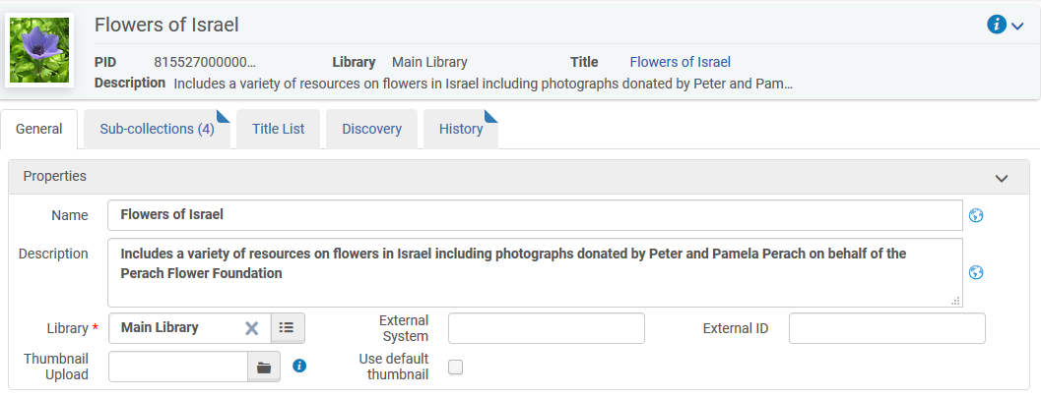
Accessing title level collections in Alma via the resources menu
After clicking "edit" we can see collection details in the "General" tab
Because we entered via "edit" we can not only view these fields but also edit them

Slide 16
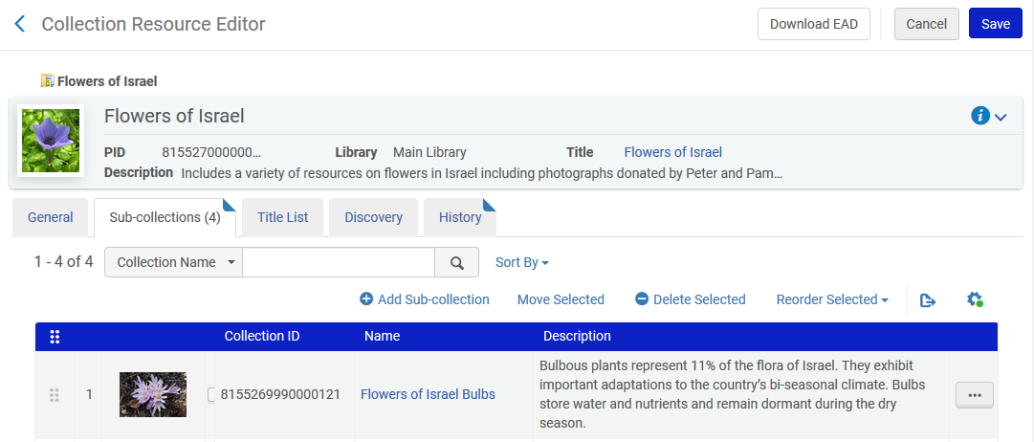
Accessing title level collections in Alma via the resources menu
We will now look at the "sub-collections" tab
This collection has 4 sub-collections

Slide 17
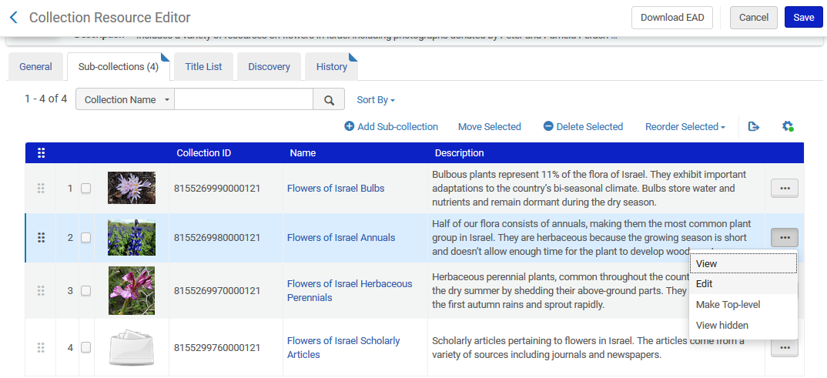
Accessing title level collections in Alma via the resources menu
Here are the four "sub-collections". We will edit "Flowers of Israel Annuals".

Slide 18
Accessing title level collections in Alma via the resources menu
When editing the sub-collection we see the same 5 tabs as we saw for the top-level collection

Slide 19
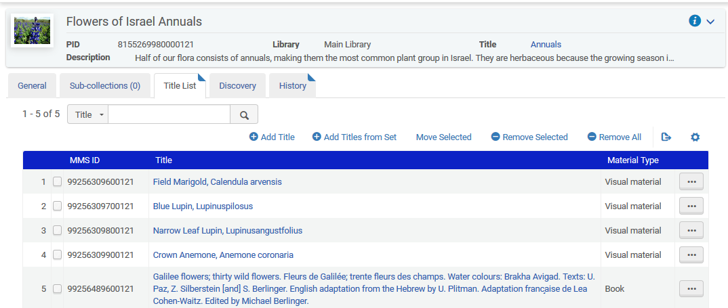
Accessing title level collections in Alma via the resources menu
The "Title List" tab shows those resources which are part of the collection.

Slide 20
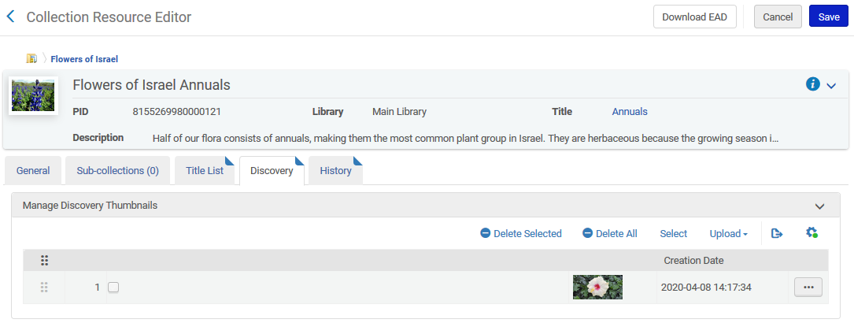
Accessing title level collections in Alma via the resources menu
In the "Discovery" tab the institution can upload images that can display in each collection's and sub-collection's tile on the Collection Discovery page and in the banner on each collection's page. (more about discovery later).

Slide 21
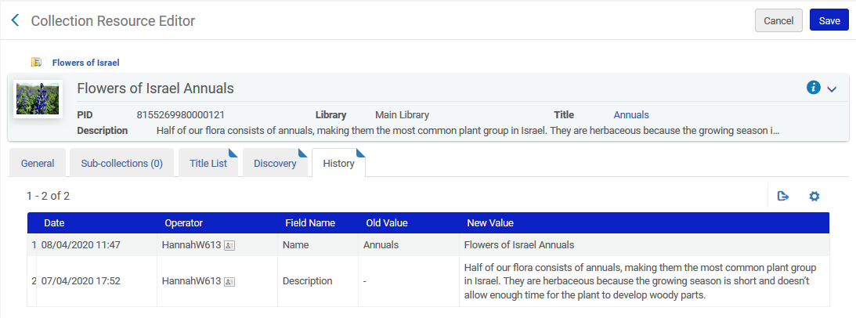
Accessing title level collections in Alma via the resources menu
The "History" tab, as the name suggests, shows historical changes to the collection including the date and user who made the change

Slide 22
Accessing title level collections in Alma via the repository search

Slide 23
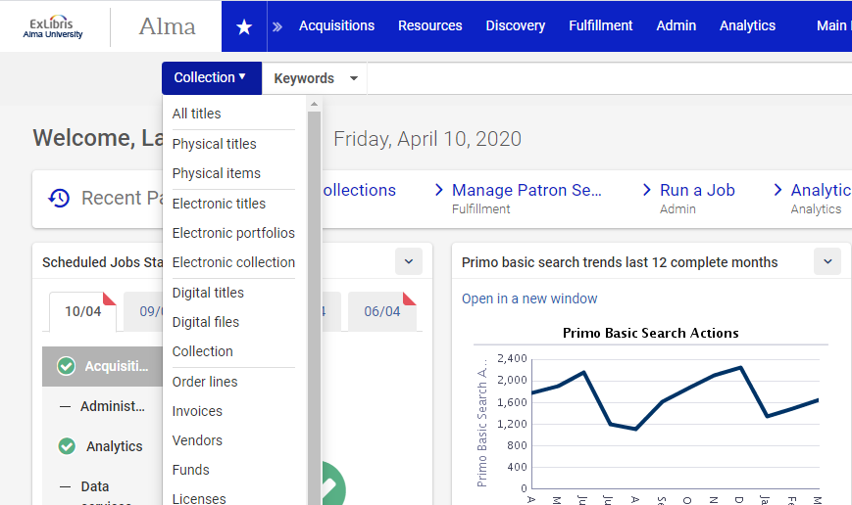
Accessing title level collections in Alma via the repository search

Slide 24
Accessing title level collections in Alma via the repository search
Via the regular and advanced search it is possible to search by attributes of the title level collection

Slide 25
Accessing title level collections in Alma via the repository search
We will search for collection name contains keywords "flowers"

Slide 26
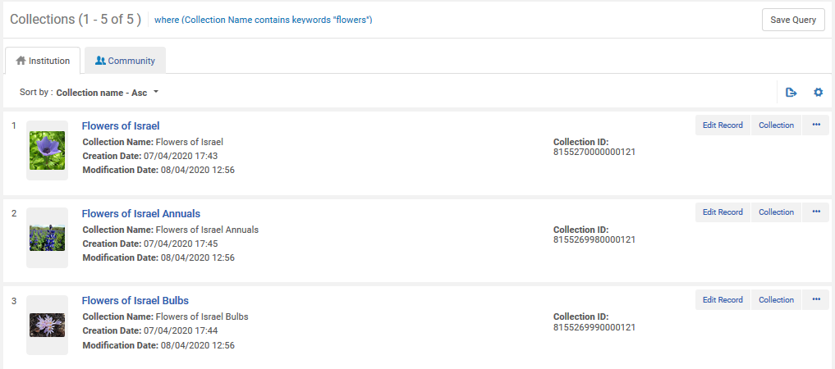
Accessing title level collections in Alma via the repository search
There are five results (the one top level collection and four sub collections from our example)

Slide 27
Accessing title level collections in Alma via the repository search
This is an appropriate place to point out that title level collections (like electronic collections) also have an associated bibliographic record
Title of associated bibliographic record
Name of electronic collection

Slide 28
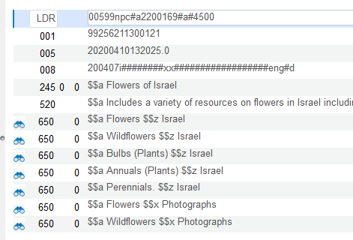
Accessing title level collections in Alma via the repository search
Here is the bibliographic record associated with the top level collection "Flowers of Israel":
Example to be used in next slide
Multiple access points for retrieving the resources in both Alma and Primo

Slide 29
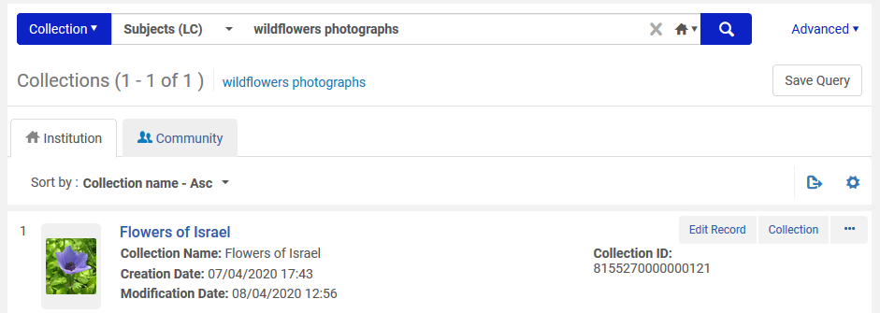
Accessing title level collections in Alma via the repository search
For example we can retrieve the collection via a search by LC Subjects, because the bibliographic record has 650_0 $$a Wildflowers $$x Photographs

Slide 30
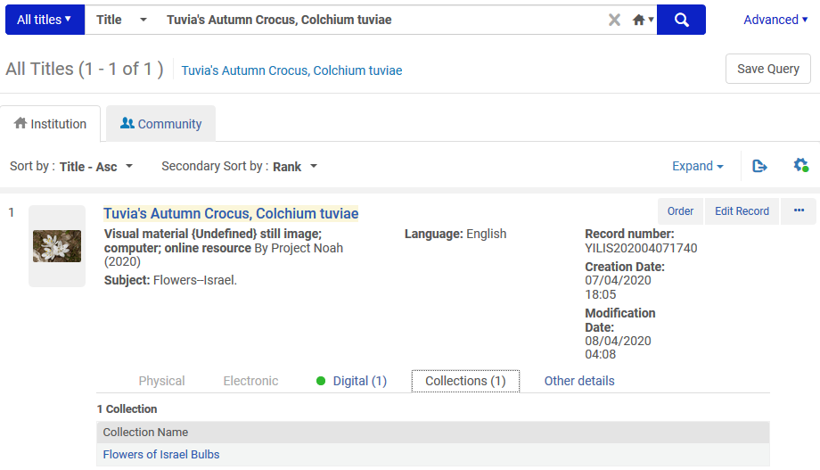
Accessing title level collections in Alma via the repository search
The collection is also accessible from repository search results for searches of other types, such as "All Titles"
And if we click the link with the collection name …

Slide 31
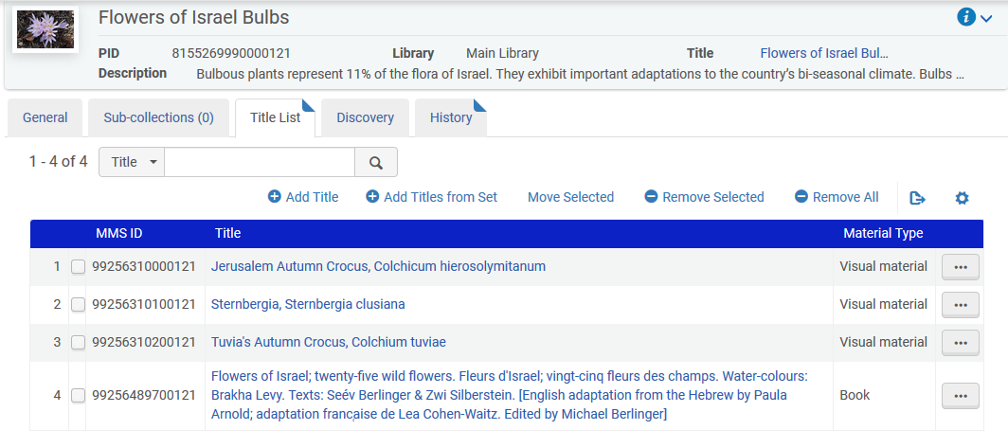
Accessing title level collections in Alma via the repository search
After clicking the collection name from the repository search results we arrive to the title list of the collection.

Slide 32
Accessing title level collections in Primo via collection discovery

Slide 33
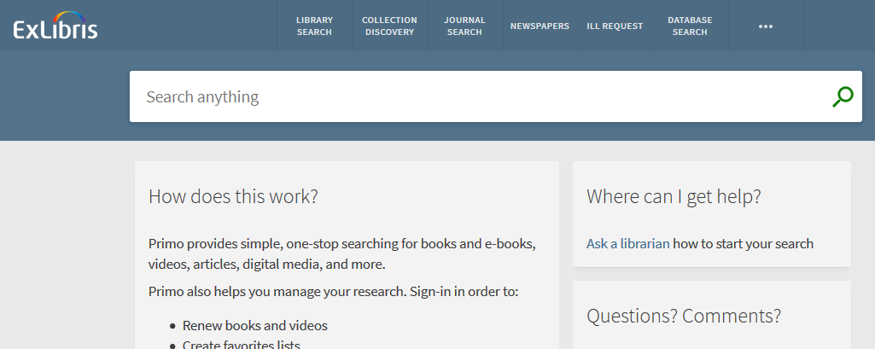
Accessing title level collections in Primo via collection discovery

Slide 34
Accessing title level collections in Primo via collection discovery
The Collection Discovery interface allows end users to browse the title level collections from Alma.
After clicking the "Collection Discovery" link the "Collections Lobby" page opens.
The "Collections Lobby" page displays all top-level collections.
For each collection, up to four images from the collection are displayed. If images are defined in the "Discovery" tab of the collection in Alma then the images come from there, otherwise they will come from resources in the collection.

Slide 35
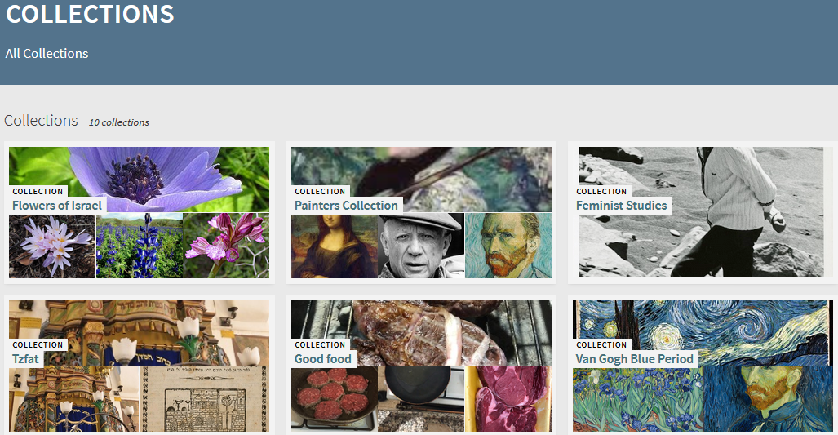
Accessing title level collections in Primo via collection discovery
The collection we have been using
This is the "Lobby Page"

Slide 36
Accessing title level collections in Primo via collection discovery
Doing a "mouse-over" on the collection displays the collection description as defined in Alma (in the "General" tab of the collection).

Slide 37
Accessing title level collections in Primo via collection discovery
Clicking a collection opens the Collections page, which displays a collection's sub-collections and items.
The user can then navigate by clicking an item or a sub-collection.

Slide 38
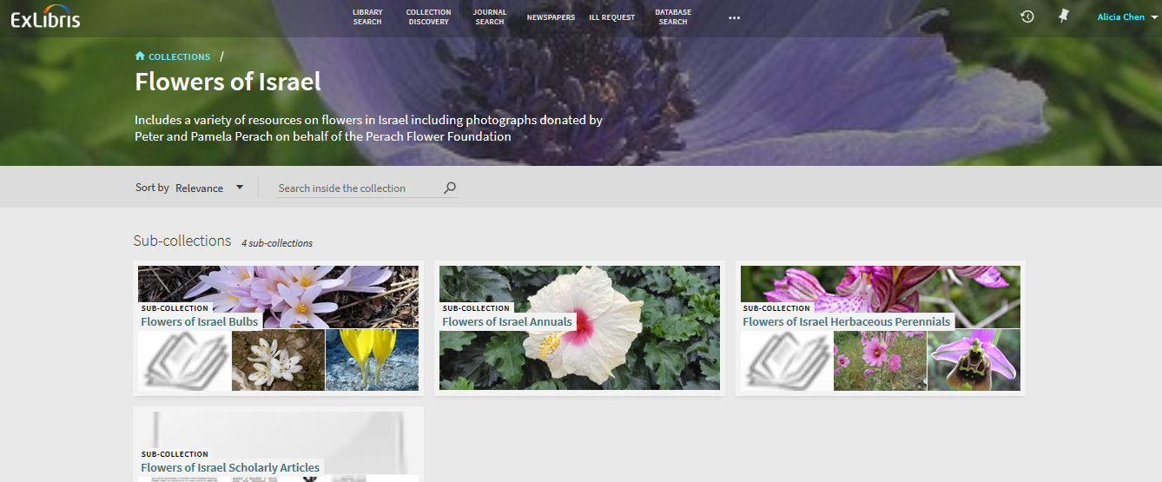
Accessing title level collections in Primo via collection discovery
We will now click the collection "Bulbs"

Slide 39
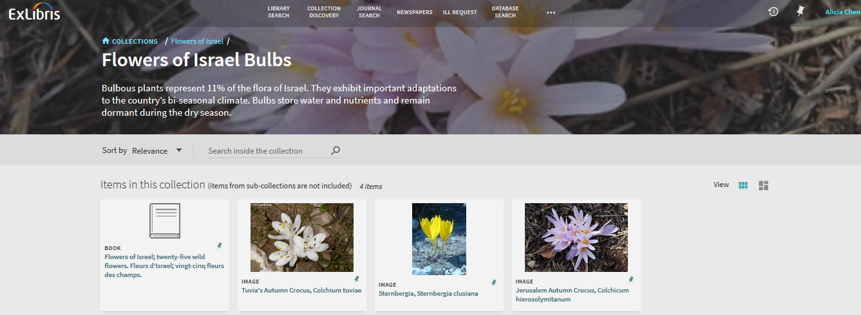
Accessing title level collections in Primo via collection discovery
This sub-collection has three images and one book with a physical item

Slide 40
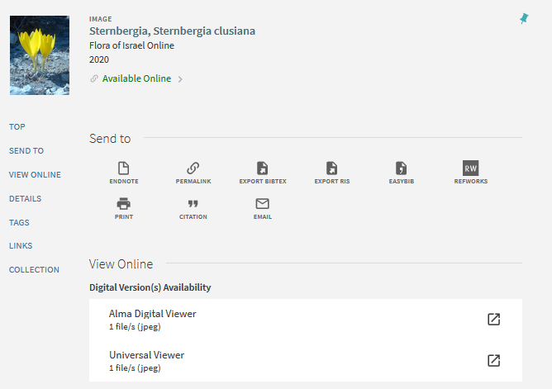
Accessing title level collections in Primo via collection discovery
Clicking an image opens it for viewing. Here is the Sternbergia clusiana
These options are dependent on the Discovery Interface Display Logic Viewer Services defined in Alma

Slide 41
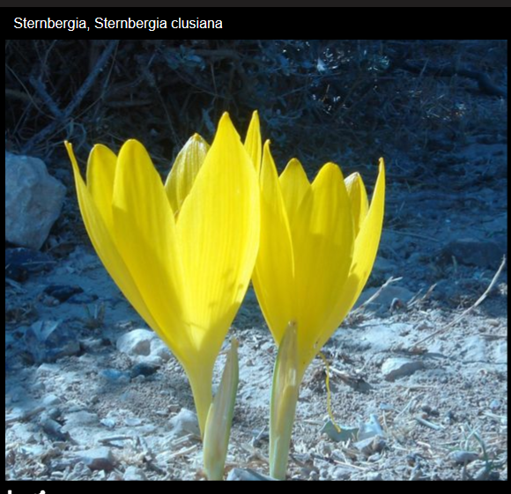
Accessing title level collections in Primo via collection discovery
Here is the Sternbergia clusiana in the Universal Viewer

Slide 42
Accessing title level collections in Primo via collection discovery
On the next slide we have navigated to the sub-collection "Scholarly articles" and we have three pdf articles.
We will click the pdf file for article "Seasonal abundance of the western flower thrips Frankliniella occidentalis in the arava valley of Israel"

Slide 43
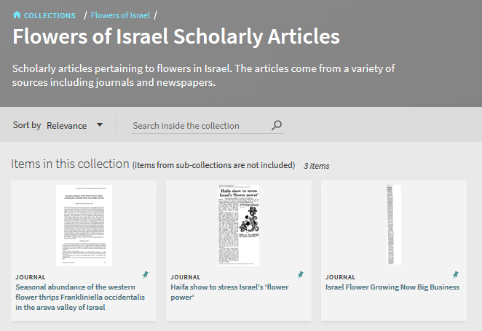
Accessing title level collections in Primo via collection discovery

Slide 44
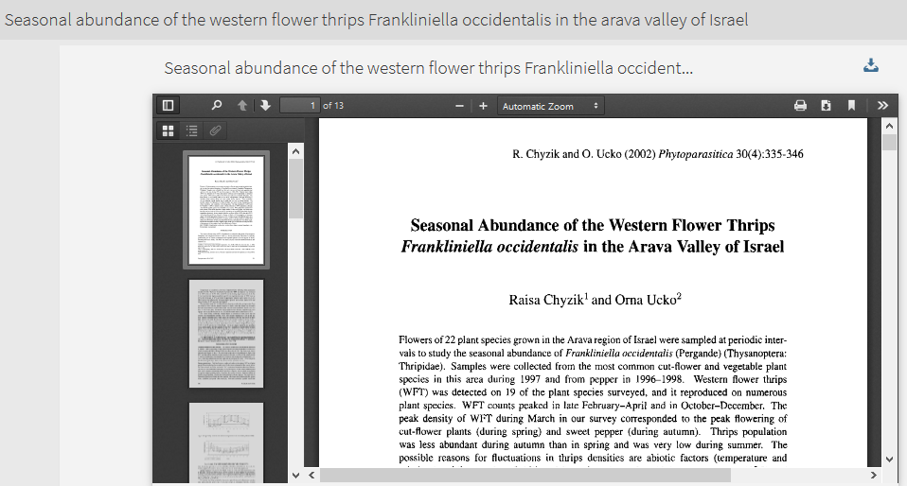
Accessing title level collections in Primo via collection discovery
Now we see the article in the Alma Digital Viewer

Slide 45
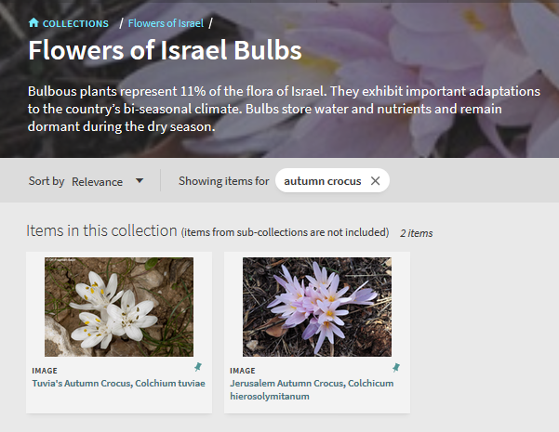
Accessing title level collections in Primo via collection discovery
It is also possible to search within a specific collection or sub-collection

Slide 46
Accessing title level collections in Primo via search

Slide 47
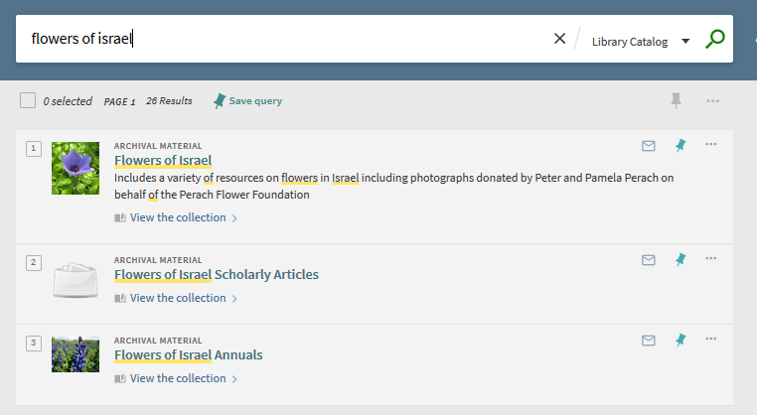
Accessing title level collections in Primo via search
Title level collections can also be found like any other search

Slide 48
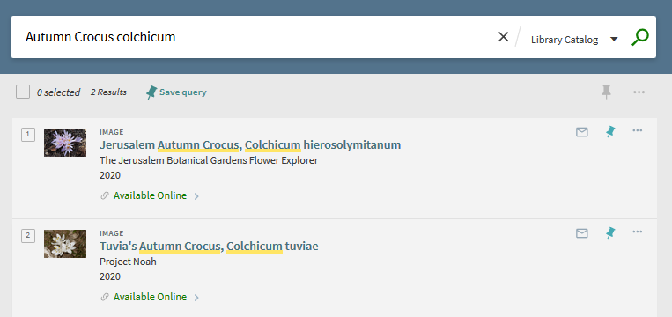
Accessing title level collections in Primo via search
The specific titles can also be found like any other search

Slide 49
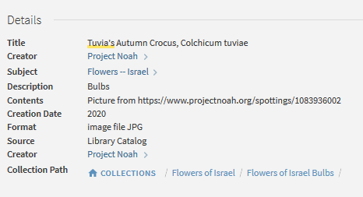
Accessing title level collections in Primo via search
From the details view of the record it is possible to navigate to all collections, the top level collection, or the specific sub-collection

Slide 50
Thank you!
xxx@exlibrisgroup.com

