Slide 1
Patron and staff mediated digital deposits
Yoel Kortick
Senior Librarian

Slide 2
Introduction
The Deposit Profile
Creating Patron Mediated Deposits
Creating Staff Mediated Deposits
Processing and Completing the Digital Deposits

Slide 3
Introduction

Slide 4
Introduction
In addition to this presentation it is recommended to see the On Line Help.
The submission of digital content to Alma with the intention that it become part of the repository is called a digital deposit.
It is possible in Alma for both staff as well as patrons to submit digital deposits.
The digital deposits do become part of the repository, but are suppressed until approved.
This is the case for Patron Deposits but not Staff-Mediated deposits. More on that later.

Slide 5
Introduction
The contents of a digital deposit includes:
A bibliographic record
A digital representation
One or more digital files.

Slide 6
Introduction
There are two ways in which the digital deposit can be created:
Patron Deposits: Patrons create deposits using a dedicated interface provided by Alma
Staff Mediated Deposits: Library staff can create the deposit on behalf of the patrons. This is done within the Alma user interface.

Slide 7
The Deposit Profile

Slide 8
The Deposit Profile
A prerequisite for enabling the creation of digital deposits is to configure at least one deposit profile.
This profile will determine how digital deposits are processed, including the deposit approval process.
The Deposit Operators are responsible for reviewing deposits and can approve, reject, or communicate with patrons to correct their submitted content.

Slide 9
The Deposit Profile
The Deposit Profile is used when
A patron creates a deposit (Patron Deposits)
A staff user creates a deposit on behalf of a patron (Staff-Mediated Deposit).

Slide 10
The Deposit Profile
Our example will be as follows:
The institution has an existing title level collection called “Library and Information Science Scholarly Articles from University staff and students”
Users with user group “Faculty” or “Graduate Student” will be able to deposit digital material to this collection.
For “Faculty” the deposit will be automatically approved
For “Graduate Student” the deposit will not be automatically approved Note that “staff-mediated” deposits are always auto-approved, while “patron-mediated” deposits take the auto-approve definition from the profile.

Slide 11
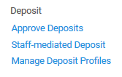
The Deposit Profile
The Deposit Profile is accessed at “Resources > Deposit > manage Deposit Profiles”

Slide 12
The Deposit Profile
Here is the list of the deposit profiles with an option to add a new deposit profile

Slide 13
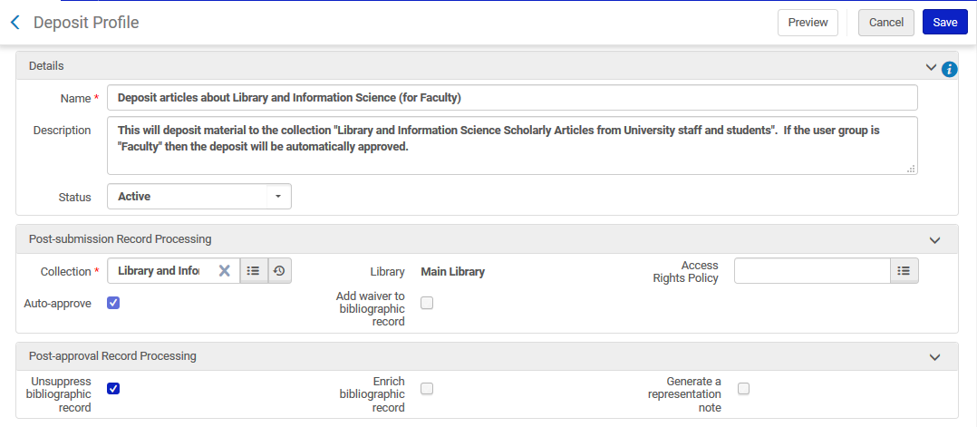
The Deposit Profile (example 1 part 1)
Deposit profile “Deposit articles about Library and Information Science (for Faculty)”
Digital object will go to collection “Library and Information Science Scholarly Articles from University staff and students”
After submission it will be automatically approved and not suppressed

Slide 14
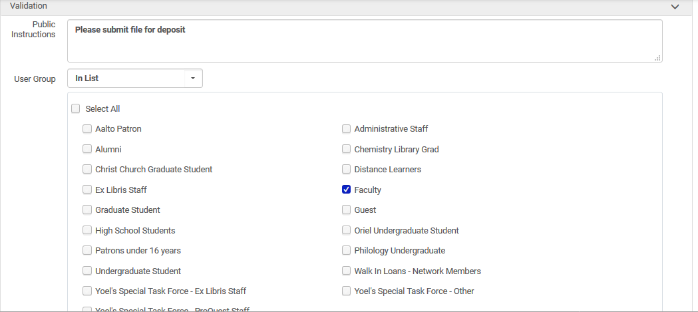
The Deposit Profile (example 1 part 2)
This will apply for users with User group “Faculty”

Slide 15
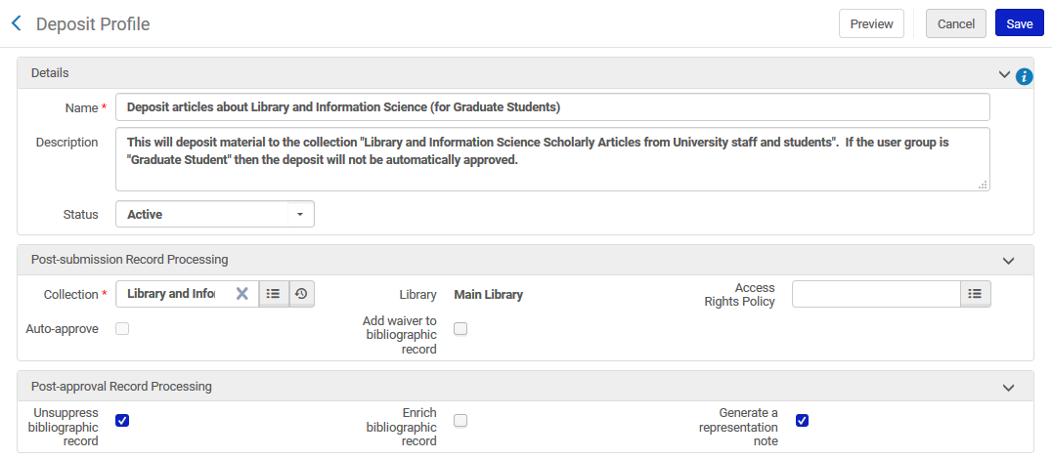
The Deposit Profile (example 2 part 1)
Deposit profile “Deposit articles about Library and Information Science (for Graduate Students)”
Digital object will go to collection “Library and Information Science Scholarly Articles from University staff and students”
After submission it will not be automatically approved and after approval will become unsuppressed (relevant for patron-mediated)

Slide 16
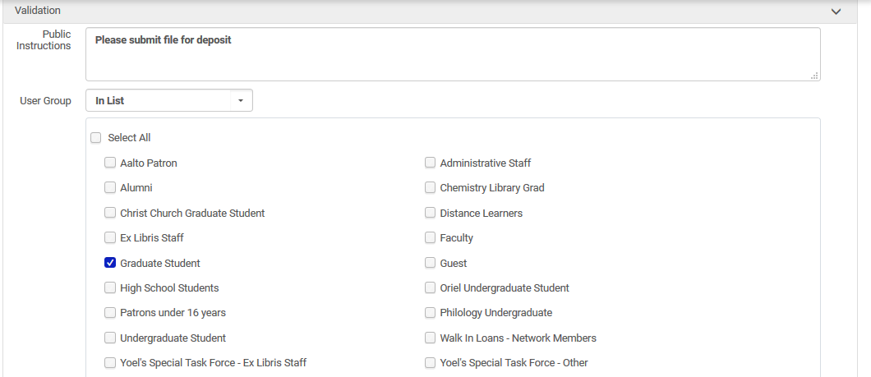
The Deposit Profile (example 2 part 2)
This will apply for users with User group “Graduate Student”

Slide 17
Creating Patron Mediated Deposits

Slide 18
Creating Patron Mediated Deposits
To submit a deposit using the patron-facing interface use one of the following URLs:
For local login and links to social login:
https://<Alma domain>/deposit/<Alma_institution_code>
For social login only:
https://<Alma domain>/deposit/<Alma_institution_code>&auth=social
For login with SAML:
https://<Alma domain>/deposit/<Alma_institution_code>&auth=saml

Slide 19
Creating Patron Mediated Deposits
For example if your Alma URL is https://eu.alma.exlibrisgroup.com/institution/EXLDEV1_INST
Then you can perform patron deposits at https://eu.alma.exlibrisgroup.com/deposit/EXLDEV1_INST

Slide 20
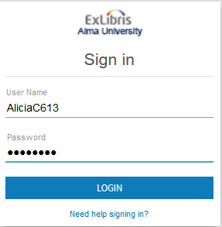
Creating Patron Mediated Deposits
Patron Alicia Chen logs in

Slide 21
Creating Patron Mediated Deposits
Patron Alicia Chen is user group “Faculty”

Slide 22
Creating Patron Mediated Deposits
Alicia clicks “Create Deposit”

Slide 23
Creating Patron Mediated Deposits
After clicking “Create Deposit” Alicia has the option to choose the profile “Deposit articles about Library and Information Science (for Faculty)”

Slide 24
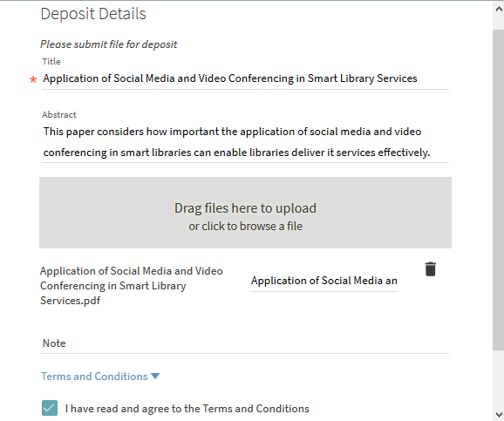
Creating Patron Mediated Deposits
The user
Fills in the details including title and abstract
Loads the files
Agrees to the terms
Submits the deposit

Slide 25
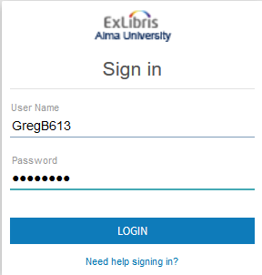
Creating Patron Mediated Deposits
Patron Greg Brady logs in

Slide 26
Creating Patron Mediated Deposits
Patron Grag Brady is user group “Graduate Student”

Slide 27
Creating Patron Mediated Deposits
Greg clicks “Create Deposit”

Slide 28
Creating Patron Mediated Deposits
After clicking “Create Deposit” Greg has the option to choose the profile “Deposit articles about Library and Information Science (for Graduate Students)”

Slide 29
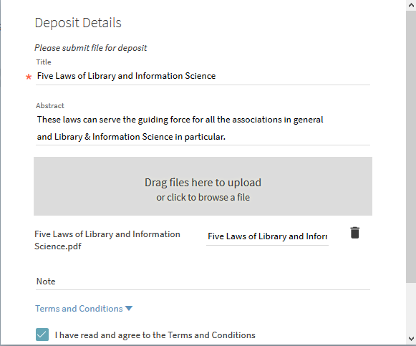
Creating Patron Mediated Deposits
The user
Fills in the details including title and abstract
Loads the files
Agrees to the terms
Submits the deposit

Slide 30
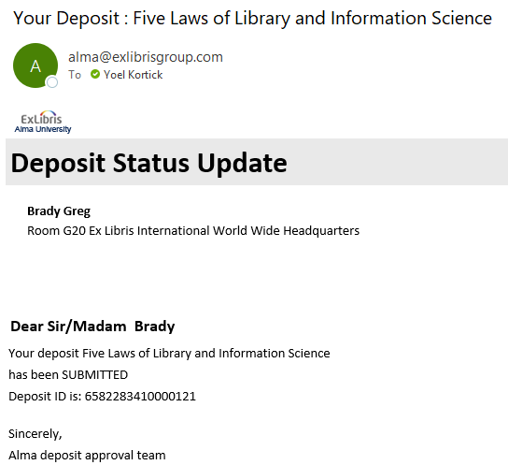
Creating Patron Mediated Deposits
In both cases the user gets a letter that the deposit has been submitted

Slide 31
Creating Patron Mediated Deposits
In both cases the user can track his or her deposits

Slide 32
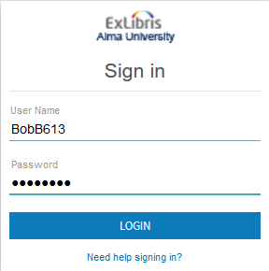
Creating Patron Mediated Deposits
Patron Bob Barker logs in

Slide 33
Creating Patron Mediated Deposits
Patron Bob Barker is user group “Undergraduate Student”

Slide 34
Creating Patron Mediated Deposits
Bob has no option to “Create Deposit” because the rules allow only for “Faculty” and “Graduate Student”

Slide 35
Creating Staff Mediated Deposits

Slide 36
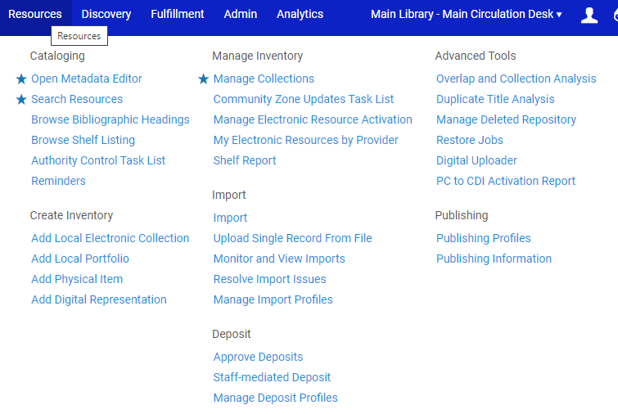
Creating Staff Mediated Deposits

Slide 37
Creating Staff Mediated Deposits
Now we will create a staff mediated deposit on behalf of patron Bjørg Nordli-Mathisen, a Graduate Student

Slide 38
Creating Staff Mediated Deposits
When creating the staff mediated deposit on behalf of patron Bjørg the only deposit profile we can choose is “Deposit articles about Library and Information Science (for Graduate Students)”.
This is the only existing profile relevant for Graduate Students

Slide 39
Creating Staff Mediated Deposits
The collection then gets automatically filled in from the profile

Slide 40
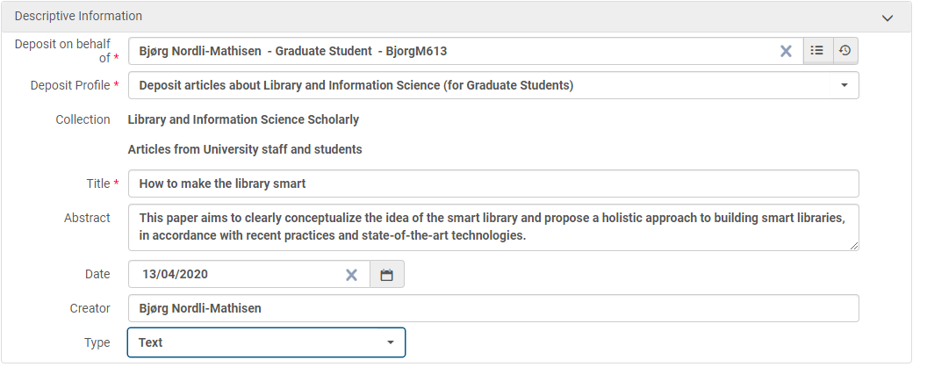
Creating Staff Mediated Deposits
Now we have filled in the descriptive information

Slide 41
Creating Staff Mediated Deposits
And we upload the file and submit

Slide 42
Creating Staff Mediated Deposits
Note (as already stated) that staff-mediated deposits are automatically approved and their contents become part of the repository regardless of what is stated in the deposit profile.
A bibliographic record is created with the representation information and the files uploaded as part of the deposit.
An email is sent to the patron, confirming the deposit.
Staff-mediated deposits are auto-approved whether or not this is set in the deposit profile.

Slide 43
Creating Staff Mediated Deposits
Therefore the deposit of Bjørg has already completed

Slide 44
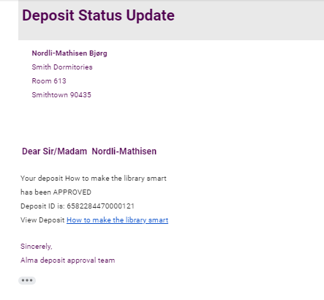
Creating Staff Mediated Deposits
And Bjørg has received a letter stating that the deposit has been approved with a link to it in discovery

Slide 45
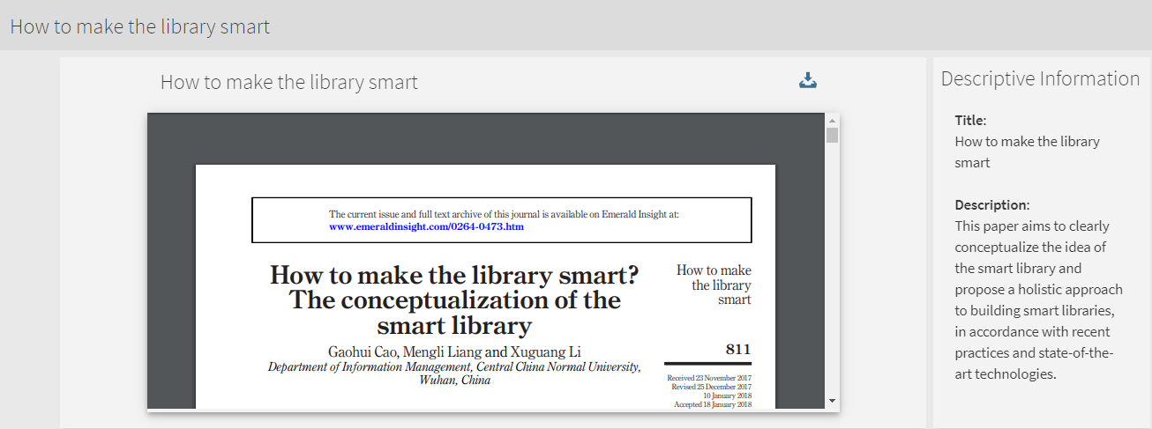
Creating Staff Mediated Deposits
And here it is in discovery

Slide 46
Processing and Completing the Digital Deposits

Slide 47
Processing and Completing the Digital Deposits
In the scenario we did here there should be one deposit awaiting approval.
This is because the profile “Deposit articles about Library and Information Science (for Graduate Students)” requires approval and there was one patron-mediated deposit made by a graduate student (Greg Brady).

Slide 48
Processing and Completing the Digital Deposits
The patron-mediated deposit made by a user with user group faculty (Alicia Chen) for title “Application of Social Media and Video Conferencing in Smart Library Services” has already been approved.
This is because the Deposit Profile for faculty does “auto-approve”

Slide 49
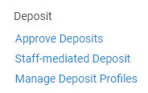
Processing and Completing the Digital Deposits
We will now approve the deposit for Greg Brady.

Slide 50
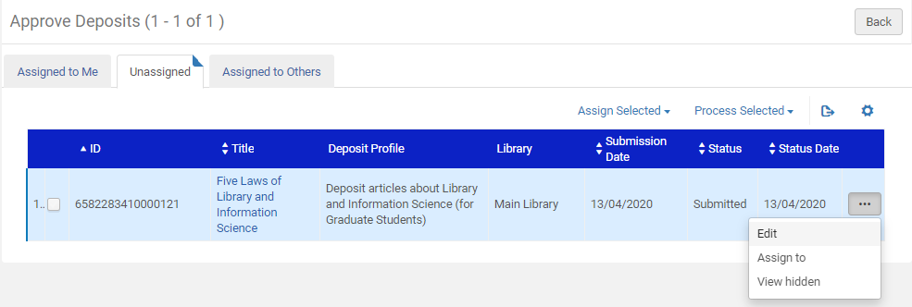
Processing and Completing the Digital Deposits
We will edit the deposit approval record

Slide 51
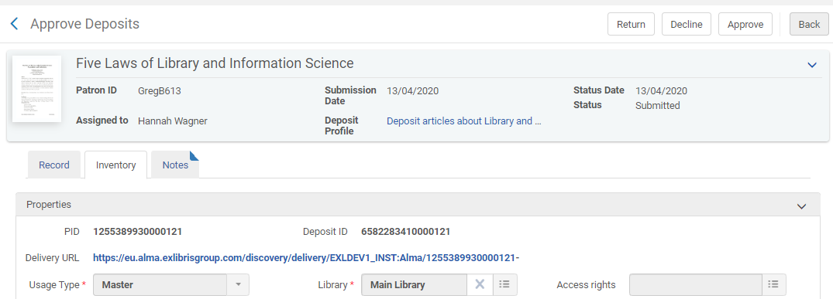
Processing and Completing the Digital Deposits
After viewing the deposit the staff user can “Return” or “Decline” or “Approve”. We will “Approve”.

Slide 52
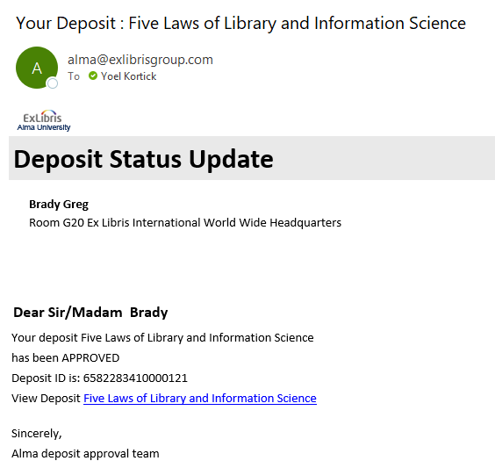
Processing and Completing the Digital Deposits
The patron received notification of the deposit

Slide 53
Processing and Completing the Digital Deposits
On the next slide we can see the collection “Library and Information Science Scholarly Articles from University staff and students”, to which the deposits have been made
We are viewing it in the Primo Collection Discovery

Slide 54
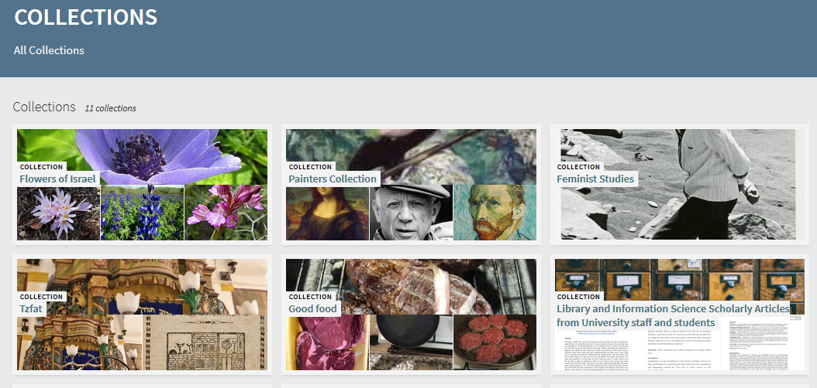
Processing and Completing the Digital Deposits

Slide 55
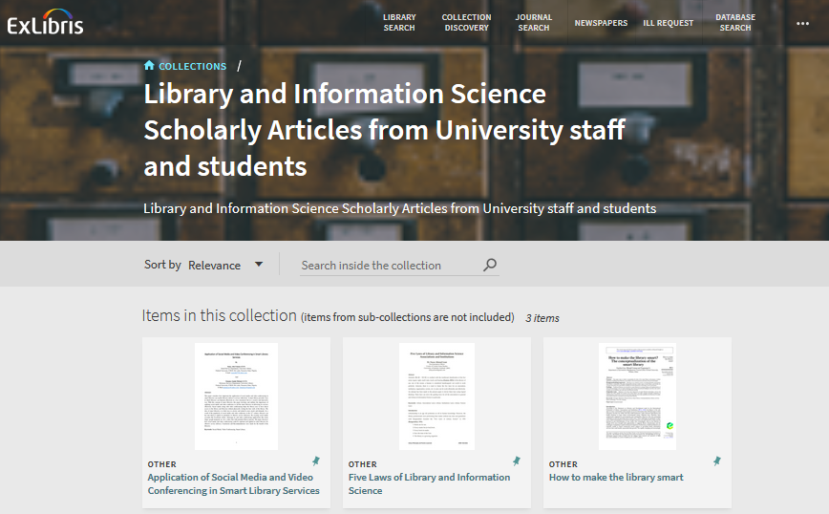
Processing and Completing the Digital Deposits
Here are the deposits in the collection
The three deposits made here in the examples

Slide 56
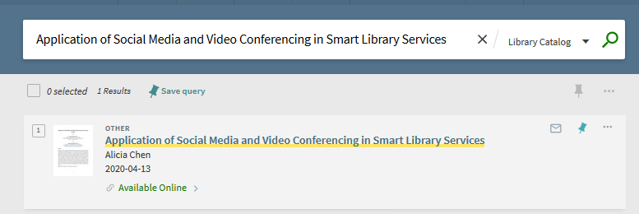
Processing and Completing the Digital Deposits
The resources can of course also be retrieved via regular search

Slide 57
Thank you!
xxx@exlibrisgroup.com

