Slide 1
Best Practices and Q&A for the Ex Libris Community During COVID-19
Collections and Best Practices in Alma Digital
Daniel Greenberg | Product Manager, digital solutions

Slide 2
Overview
The current global situation is forcing staff at libraries and higher education institutions to rethink how they operate; how to manage their daily tasks in the most efficient way possible, while working remotely
In this webinar we will try to answer your questions and share tips on how to operate during this turbulent time
Fee free to send us additional questions during this webinar via the notes area

Slide 3
Agenda
Digitization to Alma Inventory
Collection Hierarchy
Setting Access Rights in Batch

Slide 4

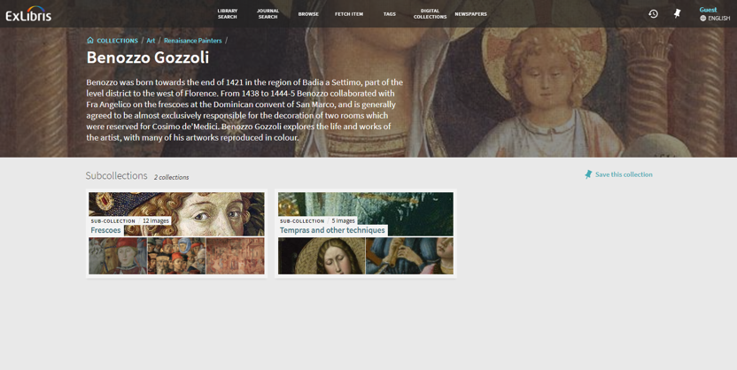
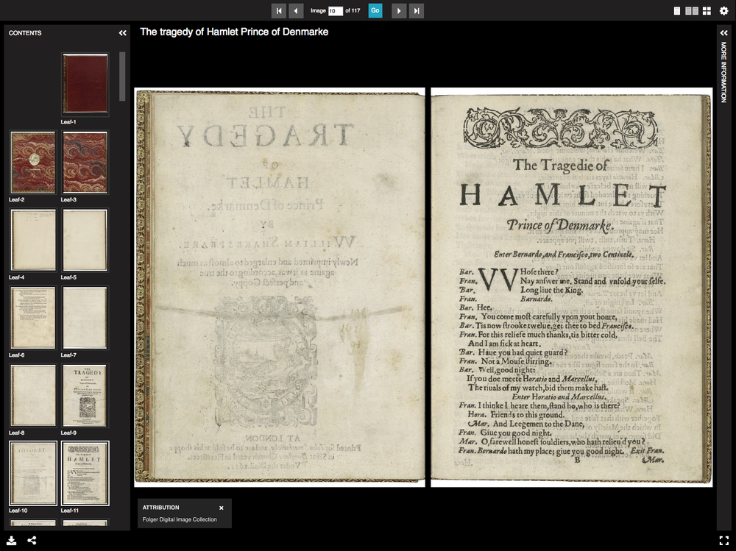


Slide 5
Digitizing physical inventory

Slide 6
Digitization Flow
Digitization Departments
Digitization Rules
Digitization Request (Staff / patron)
Approval / Copyright Clearance
Digitize as inventory / attachment

Slide 7
Collections Hierarchy

Slide 8
What are collections used for?
Reflecting inventory hierarchy
Management Entity for Digital Workflows
Showcasing and increasing exposure

Slide 9
Inventory Hierarchy
Newspaper
Year 2018
Issue 1 - January
Issue 2 – February
Year 2019
Issue 1 – January
…
Issue 2 – February
…
Top-level Collection
Sub-Collection
Title

Slide 10
Collection as a Management Entity
Metadata Schema per collection
Deposit Forms per collection
Owning Library
Collection can be suppressed
EAD import /export

Slide 11
Collection Assignment
Automatic:
Deposit Profile Configuration
Normalization Task “Add BIB to Collection” during import
Batch:
Job: “Add BIB to Collection”
Manual

Slide 12
How to make a batch change to access rights

Slide 13
Introduction
There are sometimes situations which arise necessitating the need to adjust access rights to digital content.
The change may be to enable remote access and possibly limit number of concurrent users accessing a digital representation.
The next slides will show how this may be done as a batch process on a set of digital titles.

Slide 14
Required Steps
Define new AR (access rights policy), if necessary
Define set of digital titles with representations requiring transition to the new AR
Run job – “Global Representation Changes” to change the AR

Slide 15
Required Steps
Access the Access Rights Policy at "Configuration > Fulfillment > Copyright management > Access Rights
Identify an existing policy you will use or create a new one.
On the next slide we see a policy in which
  Access will be denied in case 5 users accessed the representation in the last 15 minutes
  Download, Save As, and Print buttons will not appear in the viewer

Slide 16
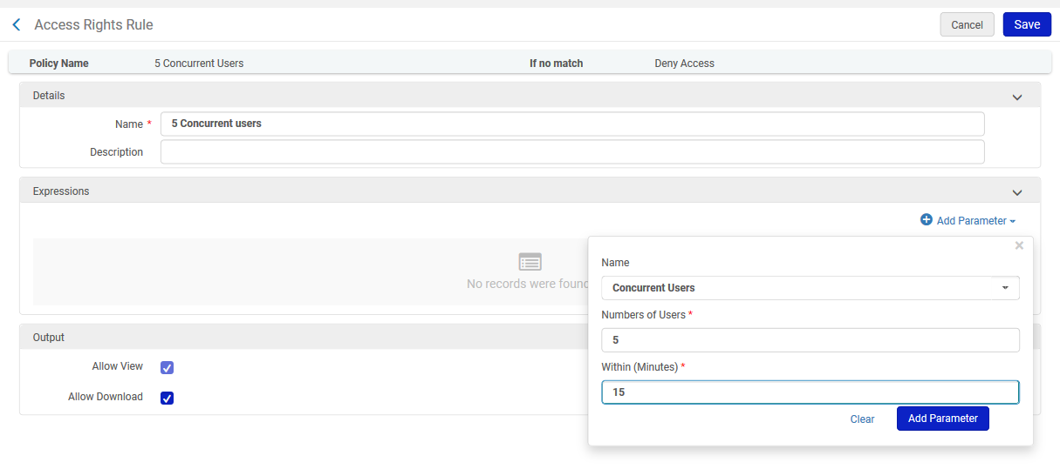
Defining Access Rights Policy - example

Slide 17
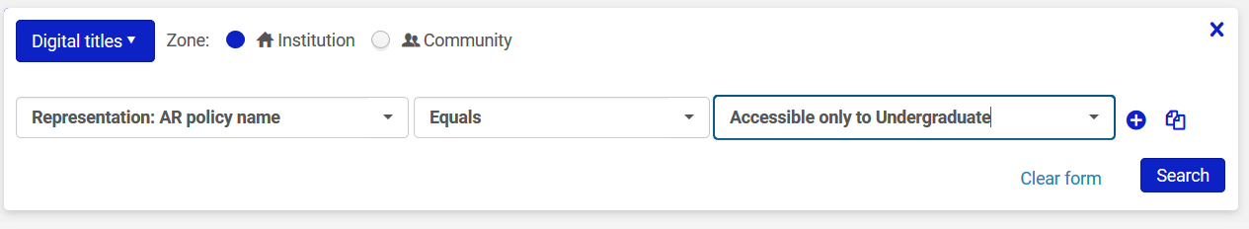
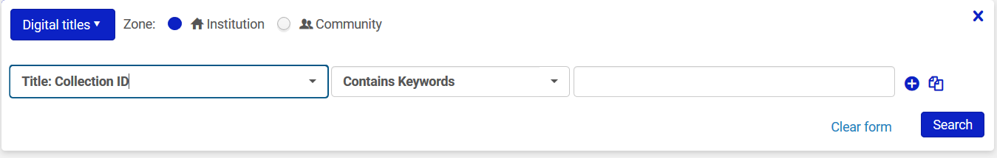
Define Logical Set
Create logical set of titles to be updated. See Creating Logical Sets for more details
Sets which are based on previous AR to be changed or collection ID could prove useful for our use case:

Slide 18
Run Job to change access rights
Run the job “Global Representation Changes” as follows:
  Run on required set of digital titles
  Filter representations according to existing ARs, usage type or other parameters
  Define new Access Rights policy
In the next slide you can see that we are running the job on a set of all derivative representations with AR “Accessible only to Undergraduate”
All representations in this set will be assigned the new AR policy “5 Concurrent Users”

Slide 19
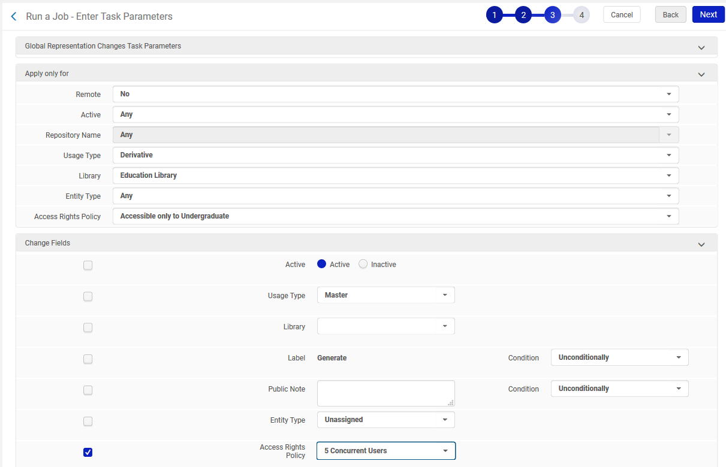
Run Job to change access rights

Slide 20
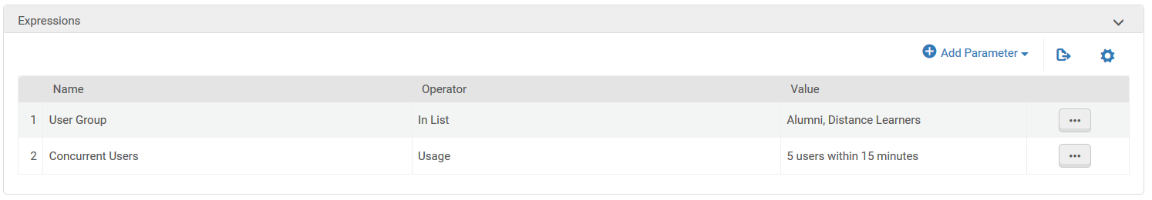
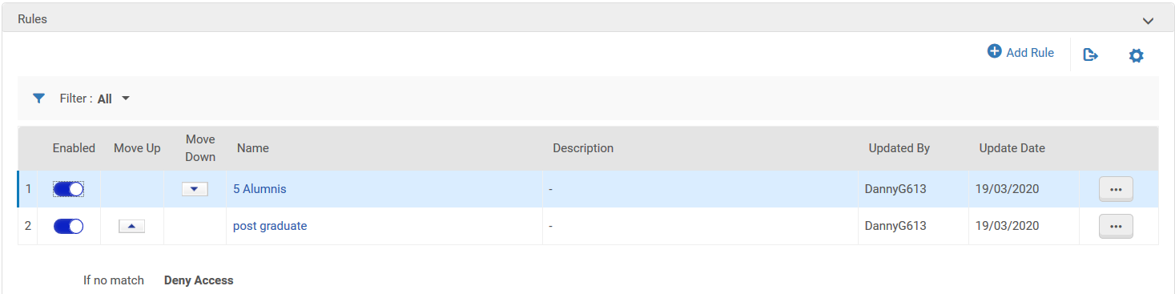
Additional information - multiple conditions
For defining multiple conditions which all need to be met, use multiple parameters per rule:
For defining multiple conditions where it’s enough to meet only one, use multiple rules per policy:

Slide 21

Any additional questions? Send us via the notes section

Slide 22













Ex Libris Higher-Ed Cloud Platform
Students
Librarians
Workflows
AI
Analytics
Campus IT
CONTENT
Researchers
CONTENT
Platform Services
Instructors
Faculty
Platform Services
UX & Mobile
Multi-tenant
Analytics
Open APIs
Shared Content
Security & Privacy
Collaboration
Data Models
Notes:
We do all of this with the Ex Libris Higher-Ed Cloud Platform. An open platform that let’s libraries serve users, connect with other academic systems, relying on shared platform services that make library work (and also the Ex Libris work) much easier to manage.
It provides common cross-product services while ensuring reliability, security, and ease of integration with 3rd-party products and tools.
As such, the Platform provides a shared infrastructure on multiple levels ranging from shared code, developments tools, testing tools and environments, deployment cycle, monitoring and alerts, and 24x7 support.

Slide 23
Additional Sessions
https://knowledge.exlibrisgroup.com/Cross_Product/Best_Practices_for_the_Ex_Libris_Community_During_COVID-19

Slide 24
Thank you!
Daniel.greenberg@exlibrisgroup.com

