Slide 1
Transactional Anonymization in Alma and the effect on Alma Analytics
Yoel Kortick
Senior Librarian

Slide 2
Introduction
Before the anonymization
Configuring the anonymization
After the anonymization

Slide 3
Introduction

Slide 4
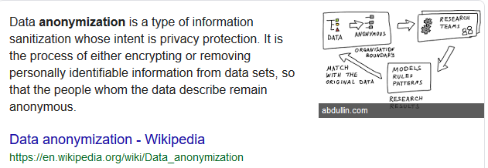
Introduction

Slide 5
Introduction
In addition to this presentation see also
Configuring Anonymization
Data Privacy FAQs
Anonymization in the context of User Management Security and Privacy

Slide 6
Introduction
The anonymization in this presentation is transactional and refers to these four types of transactions:
Loans
Fines and Fees
Request
Resource Sharing Requests
We will look at
Very specific situations before and after the anonymization.
The same exact reports before and after the anonymization.
For the “Loans” we will look not only in Analytics but also in the physical item editor fulfillment activities history

Slide 7
Introduction
Note also:
The analytics reports which we will see include both active as well as complete (closed) transactions.
This is in order to show how the active and closed transactions behave differently during anonymization.
The analytics reports do not include every possible field which gets anonymized, but rather just a sample.

Slide 8
Introduction
In the situation here we are comparing “before” and “after” anonymization. This is merely for explanatory purposes to show what happens
In a real situation there would not be a “before” and “after” anonymization.
In a real situation the data would always be anonymized.

Slide 9
Before the anonymization

Slide 10
Before the anonymization
Loans
Personal Data

Slide 11
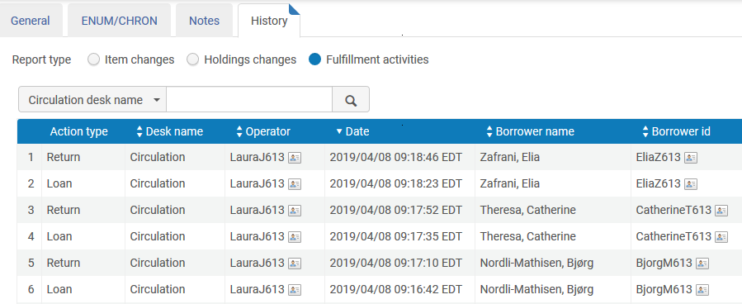
Before the anonymization
Barcode 46578 in physical item editor fulfillment history
Personal Data

Slide 12
Before the anonymization
Fines and Fees
Personal Data

Slide 13
Before the anonymization
Resource Sharing Requests
Personal Data

Slide 14
Before the anonymization
Requests
Personal Data

Slide 15
Configuring the anonymization

Slide 16
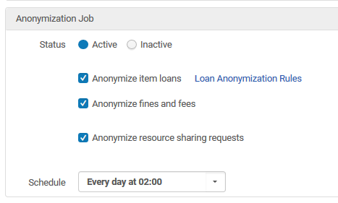
Configuring the anonymization
At “Configuration > Fulfillment > General > Fulfillment Jobs Configuration” in the “Anonymization Job” section we will check the following options:
This means Loans, Fines and Fees, and Resource Sharing Requests will be anonymized

Slide 17
Configuring the anonymization
At “Configuration > Fulfillment > General > Other Settings” we will set parameter should_anonymize_requests to “true”
This means Fulfillment Requests will be anonymized

Slide 18
Configuring the anonymization
It is also possible to configure specific loan anonymization rules to determine which loans will get anonymized.
This can be done according to various parameters such as library, location, user group, and more.
For more information see “To configure the Loan Anonymization Rules” at Configuring Anonymization
In our example all loans will be anonymized

Slide 19
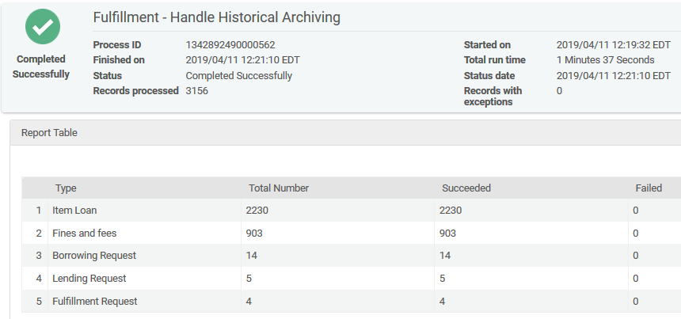
Configuring the anonymization
The daily automatized job “Fulfillment - Handle Historical Archiving” runs

Slide 20
After the anonymization

Slide 21
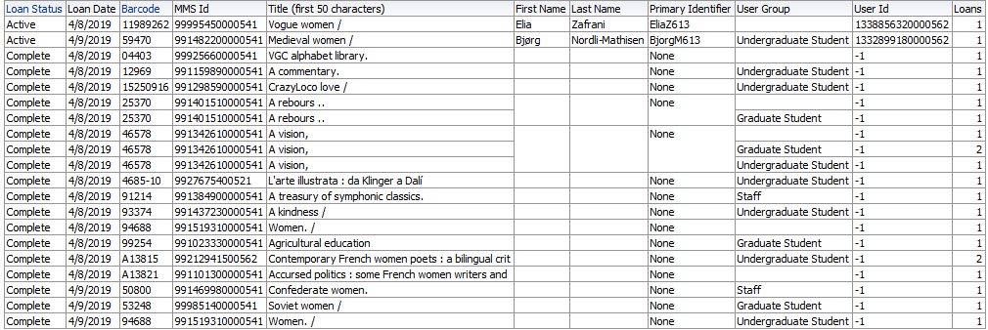
After the anonymization
Loans. Compare with slide 10.
Now “Active “ loans still have personal data. “Complete” loans have no personal data, such as first name, last name, Primary ID and user ID.

Slide 22
After the anonymization
Barcode 46578 in physical item editor fulfillment history.
Compare with slide 11 where Borrower Name and Borrower ID had real values.
Now Empty

Slide 23
After the anonymization
Fines and Fees . Compare with slide 12.
Now “Active “ fines and fees still have personal data. “Complete” loans have no personal data, such as first name, last name, gender, Primary ID and user ID.

Slide 24
After the anonymization
Resource Sharing Requests. Compare with slide 13.
Now “Active“ resource sharing requests still have personal data. “Completed” resource sharing requests have no personal data, such as first name, last name, gender, Primary ID and user ID.

Slide 25
After the anonymization
Requests . Compare with slide 14.
Now “Active“ requests still have personal data. “Completed” requests have no personal data, such as first name, last name, gender and Primary ID.

Slide 26
xxx@exlibrisgroup.com

