Slide 1
Non-Transactional Anonymization in Alma and the effect on Alma Analytics
Yoel Kortick
Senior Librarian

Slide 2
Introduction
Explanation of our example here
Results

Slide 3
Introduction

Slide 4
Introduction
Alma allows for the anonymization of data which is presented in Alma Analytics.
The anonymization can be either transactional or non-transactional.
The transactional anonymization relates to the completion of a transaction such as loans, fines and fees, resource sharing requests, and requests.
The anonymization described in this presentation is not transactional. Data is anonymized regardless of transactions.

Slide 5
Introduction
The non-transactional anonynmization is defined in an internal parameter "analytics_anonymize_user_details"
If "false" the data is not anonymized.
If "true" then all fields listed here are be anonymized.
If "true_limited_01" then all fields listed here are be anonymized except for:
"User Details"."First Name"
"User Details"."Last Name"
"User Details"."Primary Identifier"
Note that "analytics_anonymize_user_details" can be set by Ex Libris and if it is desired to change it then a case should be opened for Ex Libris support.

Slide 6
Explanation of our example here

Slide 7
Explanation of our example here
In the example which follows we are running the same exact report three times.
In the first case we have defined "analytics_anonymize_user_details" = "false"
In the second case we have defined "analytics_anonymize_user_details" = "true"
In the third case we have defined "analytics_anonymize_user_details" = "true_limited_01"

Slide 8
Explanation of our example here
In the first case when "analytics_anonymize_user_details" = "false" we see that all presented fields appear
In the second case when "analytics_anonymize_user_details" = "true" we see all presented fields except for: Primary Identifier, First name, Last Name, Primary Identifier, Address Line 1
In the third case when "analytics_anonymize_user_details" = "true_limited_01" we see all presented fields including Primary ID, First name, Last Name. We do not see User ID or Address Line 1.

Slide 9
Results

Slide 10
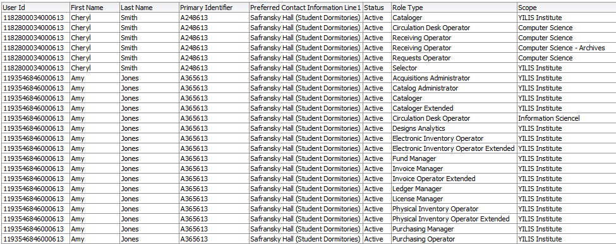
Results
No anonymization

Slide 11
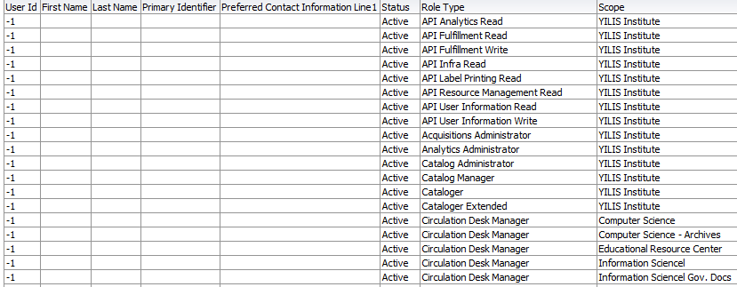
Results
Full anonymization

Slide 12
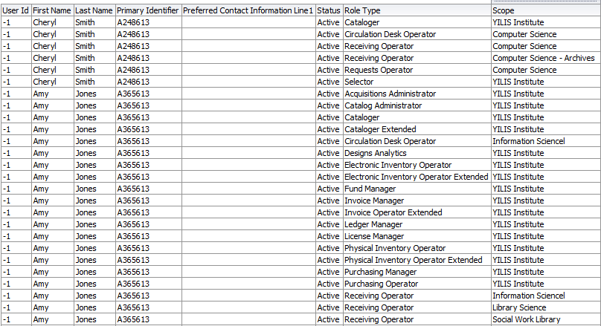
Results
Anonymized but still see Primary Identifier, First Name, last Name. Do not see User ID or address Line 1

Slide 13
Thank you!
xxx@exlibrisgroup.com

