Slide 1
How to create a set of users with items on loan and expiration date in specific range using Alma Analytics
Yoel Kortick
Senior Librarian

Slide 2
Introduction
Creating the Alma Analytics Report
Creating an Alma Set from the Analytics Report

Slide 3
Introduction

Slide 4
Introduction
In this presentation we will focus on creating a set of users with items on loan who have an expiration date in specific range.
This will be done using a report from Alma Analytics.
The set will be created in Alma using the results of the Alma Analytics report.
This might be useful, for example, if the institution wants to change the expiration dates of these users using the job "Update/Notify Users".

Slide 5
Creating the Alma Analytics Report

Slide 6
Creating the Alma Analytics Report
In the example here we will create an Alma Analytics report in the fulfillment subject area containing the Primary Identifier of all users with
An active loan with a due date between Apr. 22, 2020 and Aug. 31, 2020.
An expiration date between Apr. 22, 2020 and Aug. 31, 2020.
These criteria can be changed as per the specific situation.

Slide 7
Creating the Alma Analytics Report
The report will be created as follows:
Display:
"Primary Identifier" from "Patron Details" Folder
Filter by:
"Loans (Not In House)" in "Loans" folder >= 1
"Loan Status" in "Loan Details" folder = 'Active'
"Expiry Date" in "Borrower Details" folder is BETWEEN '2020-04-22' AND date '2020-08-31’
"Due Date" in "Due Date" folder is BETWEEN '2020-04-22' AND date '2020-08-31’

Slide 8
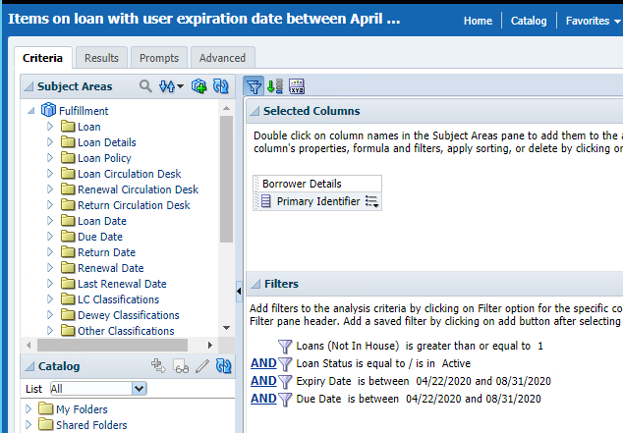
Creating the Alma Analytics Report
Here is the criteria tab of the report

Slide 9
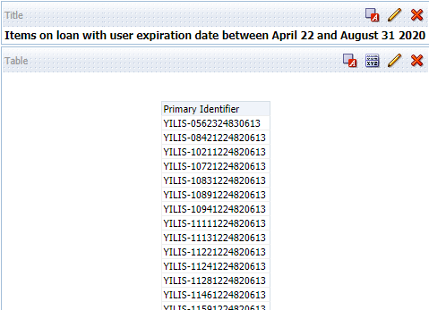
Creating the Alma Analytics Report
Here are results

Slide 10
Creating an Alma Set from the Analytics Report

Slide 11
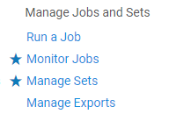
Creating an Alma Set from the Analytics Report
In Alma we access "Manage Sets" under "Admin > Manage Jobs and Sets"

Slide 12
Creating an Alma Set from the Analytics Report
Next we add an itemized set

Slide 13
Creating an Alma Set from the Analytics Report
Give the set a name and make it content type "User"

Slide 14
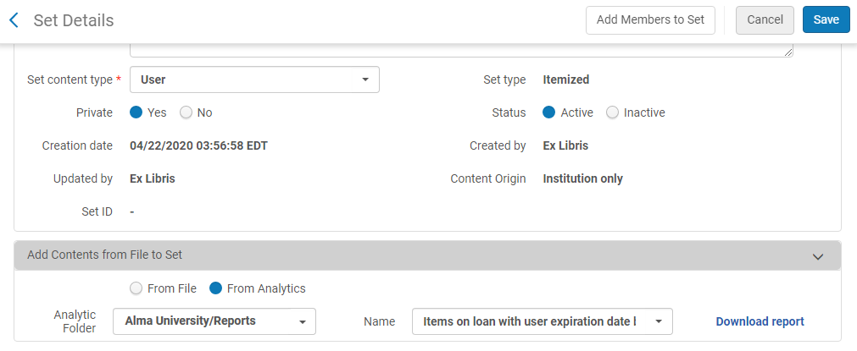
Creating an Alma Set from the Analytics Report
Select "From Analytics", choose the folder and report and click "Save"

Slide 15
Creating an Alma Set from the Analytics Report
The set is created

Slide 16
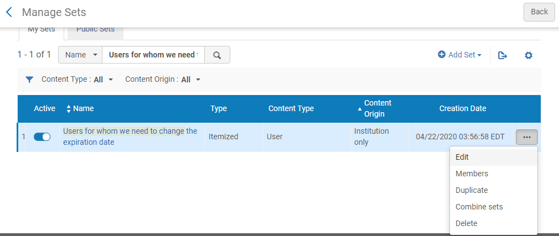
Creating an Alma Set from the Analytics Report
It is possible to verify the contents of the set by viewing the members

Slide 17
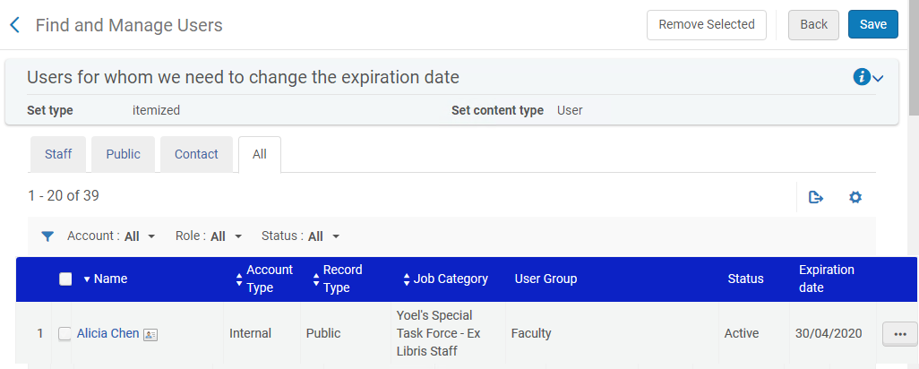
Creating an Alma Set from the Analytics Report
There are 39 users in the set
For example the first user, Alicia, has an expiration date between Apr. 22 and Aug. 31 2020

Slide 18
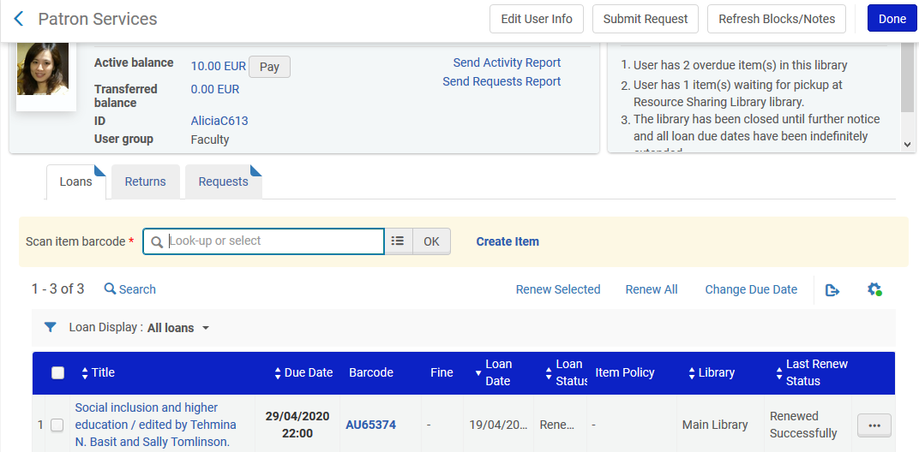
Creating an Alma Set from the Analytics Report
The same user, Alicia, has a loan with a due date between Apr. 22 and Aug. 31 2020

Slide 19
Creating an Alma Set from the Analytics Report
Now the set can be used as input for another job, for example "Update/Notify Users"

Slide 20
Thank you!
xxx@exlibrisgroup.com

