Slide 1
Best of Knowledge Days 2020
Watch recordings of past sessions
May 6th | Using Alma Analytics to Perform Overlap Analysis & Deselection
May 7th & 8th | Reveal Alma Analytics for Resource Management
May 11th & 12th | Investigate Alma Analytics for Acquisitions
May 13th & 14th | Managing Electronic Resources: Advanced Topics
May 14th & 15th | Letter Configuration and XSL Customization
May 18th & 19th | Intro to Primo Analytics
May 20th & 21st | Explore Alma Analytics for Fulfillment
May 21st & 22nd | APIs and Integrations for the Non-Technological
May 27th & 28th | Optimize and Streamline Alma Workflows
May 28th & 29th | Effective Usage of Primo Analytics Reports and Dashboards
Today’s session
Sign up for
upcoming sessions
https://www.exlibrisgroup.com/events/
1

Slide 2
Managing Electronic Resources –
Advanced Topics
Kevin Lane-Cummings
Senior Training and Consulting Partner
Ex Libris – Global Knowledge Delivery
Information and materials shared during the conferences are proprietary to Ex Libris and may contain confidential information. Except for publicly available marketing materials, we ask that you not share information, documentation or other materials provided outside of the Knowledge Days participant group and your Library without the written permission of Ex Libris. Please note that any information shared may be subject to periodic change and updating and there are no warranties of any kind, express or implied.

Slide 3
Welcome and Introductions
Kevin Lane-Cummings
  Senior Training and Consulting Partner
  Product Knowledge – Alma, Summon, 360 Services
  Ex Libris / ProQuest / Serials Solutions for 11 years

Slide 4
Session Overview
Description
Learn advanced tools and tactics for managing electronic resources in Alma. This session will cover topics such as managing trials, creating electronic inventory using import profiles and more.
Objective
Users already experienced in the basics of managing e-resource in Alma will learn even more ways to leverage Alma’s workflows and options.

Slide 5

Audience for this session
Electronic services librarians
Acquisitions staff
Trial Operators/Managers

Slide 6
  Starting and Managing Trials
  Managing E-Resources Using Import Profiles
  Ongoing Management
  Configuration Options

Slide 7
Starting and Managing Trials
    General Workflow
    Set up a Trial

Slide 8
General Workflow of a Trial (a.k.a., Evaluation)
  PO Line must be in review (not yet ordered)
  Trial Details:
    Start and end dates
    Survey form (questionnaire)
    Participants
    Public or private
  Activate service but don’t make it Available
  After trial ends: Analyze results of survey

Slide 9
Set Up a Trial
  Begin Order as usual, but Save and Start Trial
    (or Request Evaluation if you can’t start trial)
  Enter Trial Details (dates)
  Save
  Add survey questions and participants
  Row-action: Activate
    a) Mark Bib as suppressed
    b) Activate Service
    c) Don’t make service Available!
  Later: Read Analysis

Slide 10
  Starting and Managing Trials
  Managing E-Resources Using Import Profiles
  Ongoing Management
  Configuration Options

Slide 11
Managing E-Resources Using Import Profiles
    General Workflow
    Set Up and Run the Import Profile

Slide 12
General Workflow of E-Resources Import Profile
Acquisitions > Import > Manage Import Profiles
New Order / Update Inventory / Repository
Create new import profile > Repository w/Electronic inventory

Slide 13
Set Up and Run an Import Profile
Set up and run an import profile to create electronic inventory
Review key fields
Inventory options, collection w/portfolios, single portfolio
Activate resources

Slide 14
  Starting and Managing Trials
  Managing E-Resources Using Import Profiles
  Ongoing Management
  Configuration Options

Slide 15
Ongoing Management of E-Resources
    Deactivate E-Resources
    Delete E-Resources

Slide 16
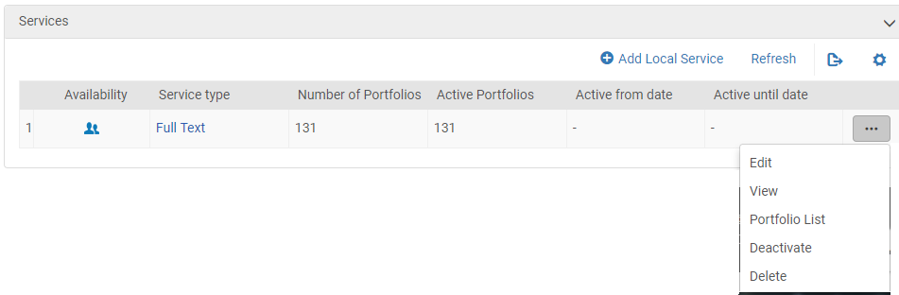
Deactivate Collections - Manually
Search for the collection (in IZ)
Edit Collection
Select Additional Information tab
Services – Row-action: Deactivate

Slide 17
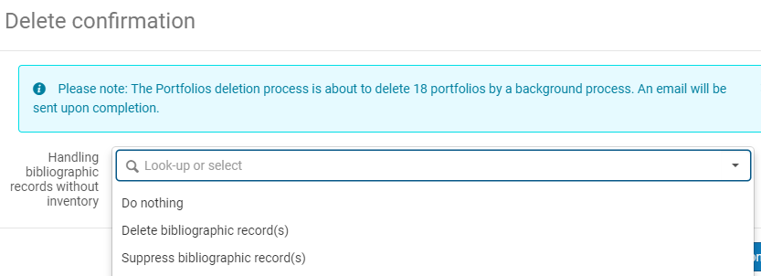
Delete Resources - Manually
Search for the resource
Row-action: Delete
Choose how to handle bibliographic records without inventory:

Slide 18
  Starting and Managing Trials
  Managing E-Resources Using Import Profiles
  Ongoing Management
  Configuration Options

Slide 19
Configuration Options
    Inactive Services
    Inactive Proxies
    Inventory Mgmt. Groups
    Patron Access
    Overlap Analysis
    Community Zone Updates

Slide 20
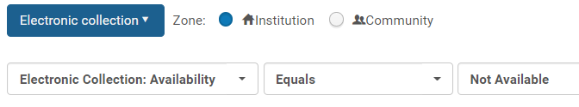
Locate Active Collections w/Inactive Services
Find active collections with inactive services:
Search Institution Zone for Electronic Collection,
where:
Electronic Collection (Availability) – Equals – Not Available

Slide 21
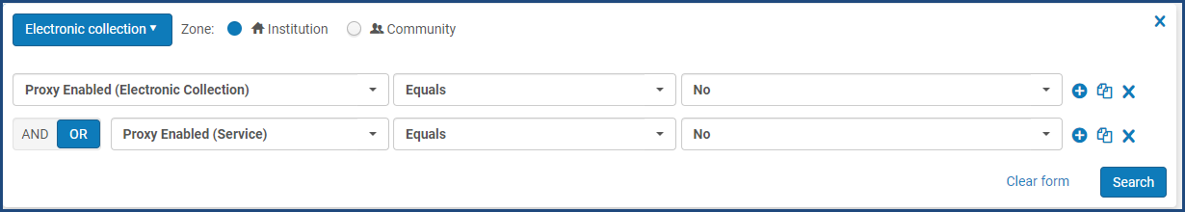
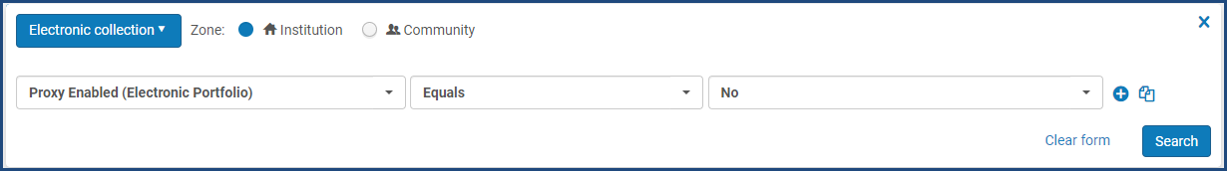
Check for Inactive Proxy Settings
Find collections with inactive proxy for:
  Collection or Service
  Portfolios
Search Institution Zone for Electronic Collection, where:
Proxy Enabled – Equals – No
Notes:
Resolver Proxies (proxy relationships) documentation:
https://knowledge.exlibrisgroup.com/Alma/Product_Documentation/010Alma_Online_Help_(English)/090Integrations_with_External_Systems/030Resource_Management/220Resolver_Proxies

Slide 22
Configuration Options
    Inactive Services
    Inactive Proxies
    Inventory Mgmt. Groups
    Patron Access
    Overlap Analysis
    Community Zone Updates

Slide 23
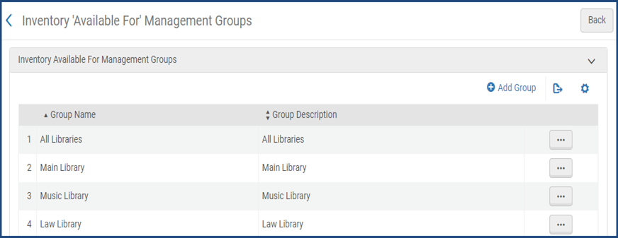
Inventory Management Groups
Libraries or campuses (or both) must have different IP address ranges
Alma must be configured for multi-campus inventory management
  Inventory “Available For” Management Groups

Slide 24
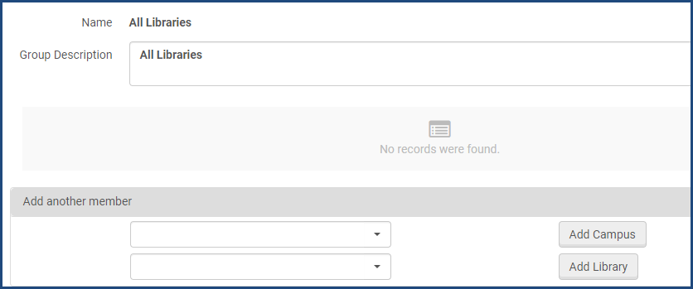
Configure Patron Access by Campus or Library
Configuration Menu > Resources > General > Inventory Network Groups
Choose a Group > Actions > Edit
Add Campus or Library > Save

Slide 25
Overlap Analysis Reports
Menu: Resources > Overlap and Collection Analysis
Submit New Report
Choose Report Type: Set Comparison
Add Source Electronic Collection (must be from IZ)
Add Target Electronic Collection (can be from IZ or CZ)
Choose match method (for example, ISSN, title, 035)
Run the job.

Slide 26
Configuration Options
    Inactive Services
    Inactive Proxies
    Inventory Mgmt. Groups
    Patron Access
    Overlap Analysis
    Community Zone Updates

Slide 27
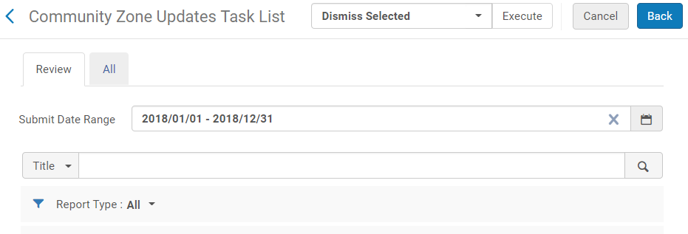
Community Zone Updates
Mostly happen Sunday at midnight (your local time)
Displayed in the Community Zone Updates Task List
  Review tab: Updates that require your action
  All tab: All updates, including automatic

Slide 28
  Starting and Managing Trials
  Managing E-Resources Using Import Profiles
  Ongoing Management
  Configuration Options
  Wrap-Up

Slide 29
Next Steps and Resources
Documentation in the Ex Libris Knowledge Center:
  Managing Electronic Resources
  Electronic Resources – Scenarios and Workflows
Additional support resources from Ex Libris:
  Idea Exchange – ideas.exlibrisgroup.com
  Developer Network – developers.exlibrisgroup.com
  2020 Knowledge Days Webinar Presentations
    (Cross-Product section in Ex Libris Knowledge Center)

Slide 30
Questions?

Slide 31
Thank You!
Please fill out the survey that will appear after you leave the WebEx session

