Slide 1
Chinese Classifications for Taiwan in Alma Analytics
Yoel Kortick
Senior Librarian

Slide 2
Introduction
Where does the Chinese Classifications (Taiwan) data come from?
Sample reports

Slide 3
Introduction

Slide 4
Introduction
In this presentation we will show how it is possible to use the Chinese Classifications for Taiwan to report on various activities via Alma Analytics.
The Chinese Classifications for Taiwan are represented in Alma Analytics in the "Chinese Classifications (Taiwan)" folder in the shared "Other Classifications" folder

Slide 5
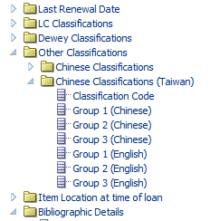
Introduction
The "Chinese Classifications (Taiwan)" folder in the shared "Other Classifications" folder
Here is an example from the Fulfillment subject area.

Slide 6
Introduction
Like the other "Classifications" in Alma Analytics, such as LC Classifications and Dewey Classifications, the "Chinese Classifications (Taiwan)" can be used to gain an in depth understanding of the institutional repository.
For example:
Which subjects are most used (have the most loans)?
From which vendors have which subjects been purchased?
How do the repository content subjects compare to the institutional faculty areas? (are there faculties under-represented in the collection?)

Slide 7
Where does the Chinese Classifications (Taiwan) data come from?

Slide 8
Where does the Chinese Classifications (Taiwan) data come from?
The subjects listed in the Chinese Classifications (Taiwan) folder come from the official Chinese Classifications (Taiwan)
If you cannot access the above link then copy paste the following URL to your browser: https://knowledge.exlibrisgroup.com/@api/deki/files/84910/Chinese_Classifications_for_Taiwan_Table.xlsx

Slide 9
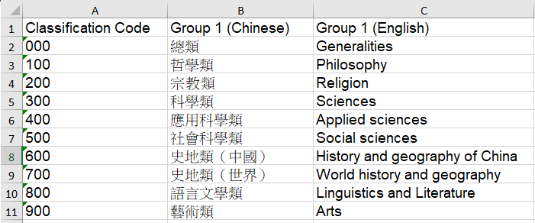
Where does the Chinese Classifications (Taiwan) data come from?

Slide 10
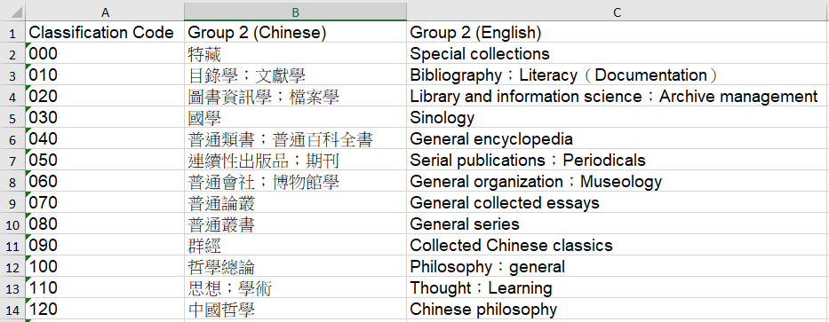
Where does the Chinese Classifications (Taiwan) data come from?

Slide 11
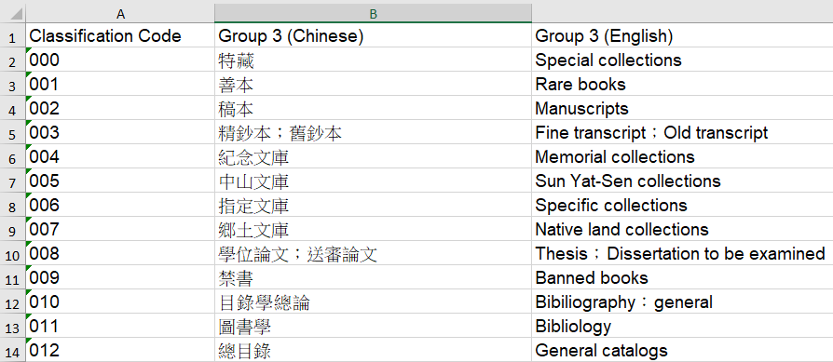
Where does the Chinese Classifications (Taiwan) data come from?

Slide 12
Where does the Chinese Classifications (Taiwan) data come from?
The classification code in column A of the official Chinese Classifications (Taiwan) corresponds to the bibliographic record field 084 subfield a when 084 subfield 2 has value "ncsclt"

Slide 13
Where does the Chinese Classifications (Taiwan) data come from?
For example title 圖書館管理(含槪要) has the following 084 field with subfield 2 "ncsclt" : 084 __ |a 022.022 |2 ncsclt

Slide 14
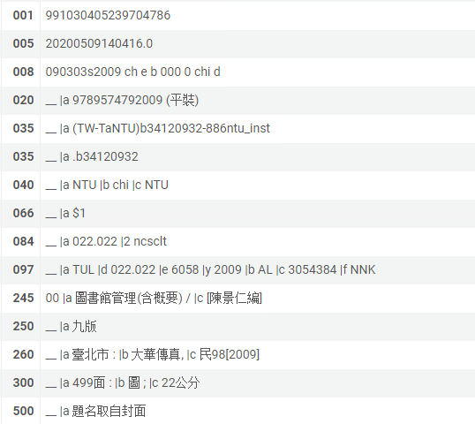
Where does the Chinese Classifications (Taiwan) data come from?
For title 圖書館管理(含槪要) the Chinese Classification (Taiwan) is 022.022
084 subfield a is “022.022"
084 subfield 2 is "ncsclt"

Slide 15
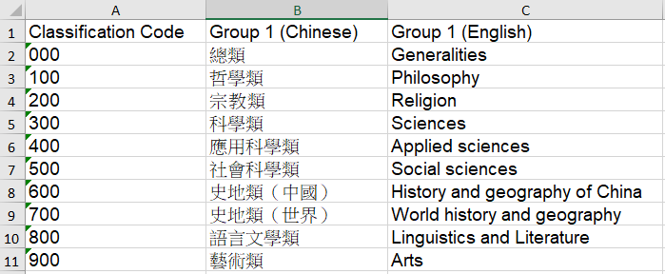
Where does the Chinese Classifications (Taiwan) data come from?
For Chinese Classifications (Taiwan) Group 1:
The classification code 022.022 corresponds to: 總類 Generalities

Slide 16
Where does the Chinese Classifications (Taiwan) data come from?
For Chinese Classifications (Taiwan) Group 2:
The classification code 022.022 corresponds to: 圖書資訊學；檔案學 Library and information science；Archive management

Slide 17
Where does the Chinese Classifications (Taiwan) data come from?
For Chinese Classifications (Taiwan) Group 3:
The classification code 022.022 corresponds to 圖書館管理 Library management

Slide 18
Where does the Chinese Classifications (Taiwan) data come from?
Here we see in an Alma Analytics report the Chinese Classifications (Taiwan) with all three groups:

Slide 19
Sample reports

Slide 20
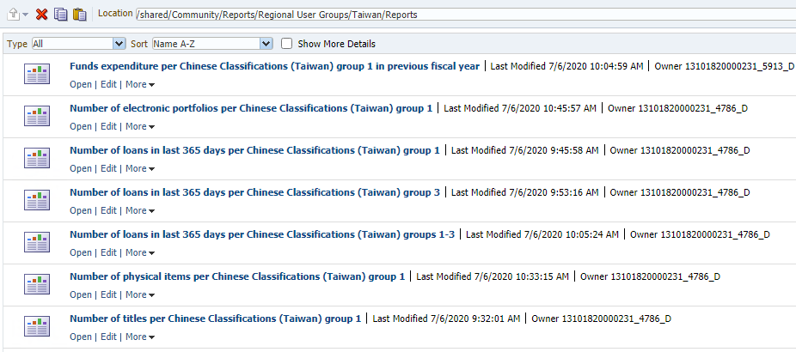
Sample reports – number of titles
All reports presented here are in the “community” folder of Alma analytics in directory “/shared/Community/Reports/Regional User Groups/Taiwan/Reports”.
The reports can be run from there and also viewed in edit mode to see how they are created.

Slide 21
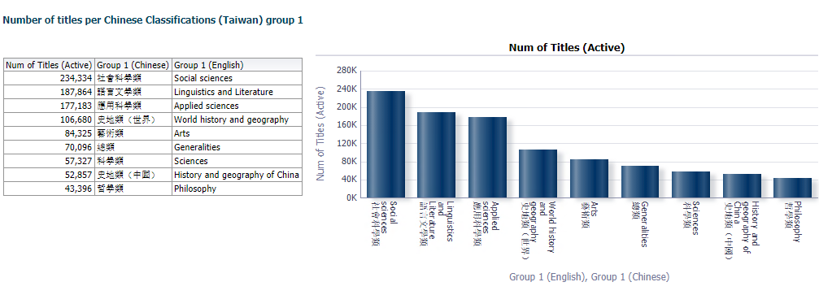
Sample reports – number of titles
Here we can see the number of titles per Chinese Classifications (Taiwan) Group 1. In this way we have an accurate picture of the makeup of the collection.

Slide 22
Sample reports – number of physical items
Here we can see the number of physical items per Chinese Classifications (Taiwan) Group 1. In this way we have an accurate picture of the makeup of the physical inventory in collection.

Slide 23
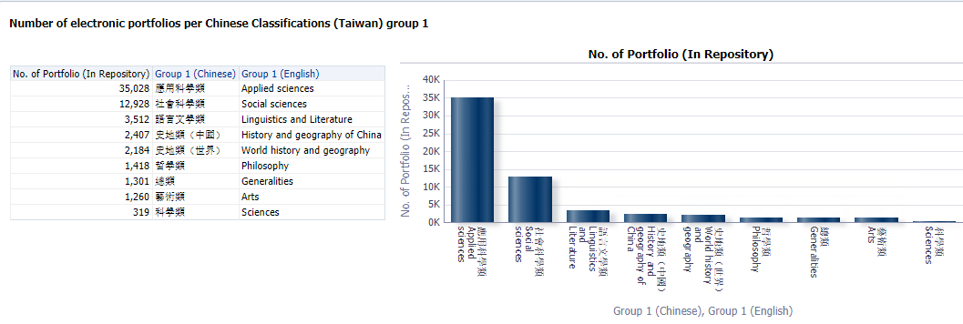
Sample reports – number of electronic portfolios
Here we can see the number of physical items per Chinese Classifications (Taiwan) Group 1. In this way we have an accurate picture of the makeup of the electronic inventory in collection.

Slide 24
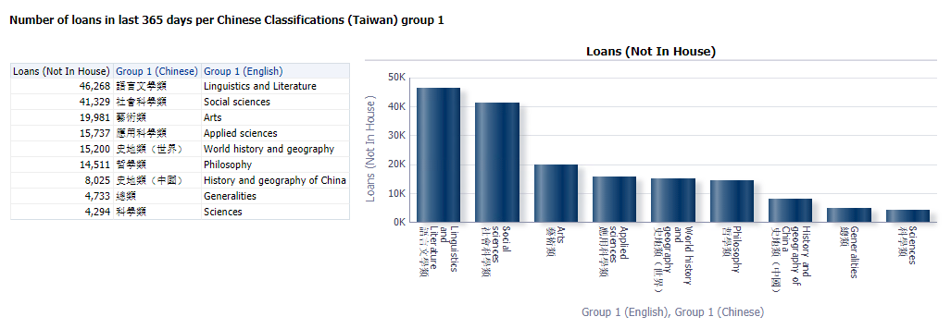
Sample reports – number of loans
Here we can see the Chinese Classifications (Taiwan) group 1 for number of loans. In this way we know what topics are being most used in the repository.

Slide 25
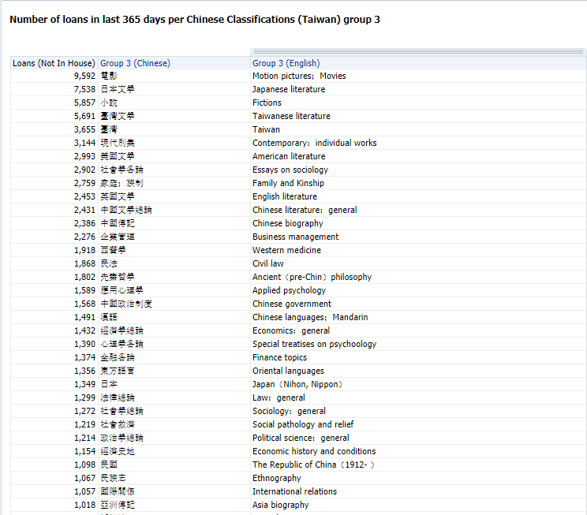
Sample reports – number of loans
Here we can see the Chinese Classifications (Taiwan) group 3 (more detailed than group 1 in previous report) for number of loans.

Slide 26
Sample reports – number of loans
Here is an even more detailed report of loans showing Chinese Classifications (Taiwan) groups 1-3.

Slide 27
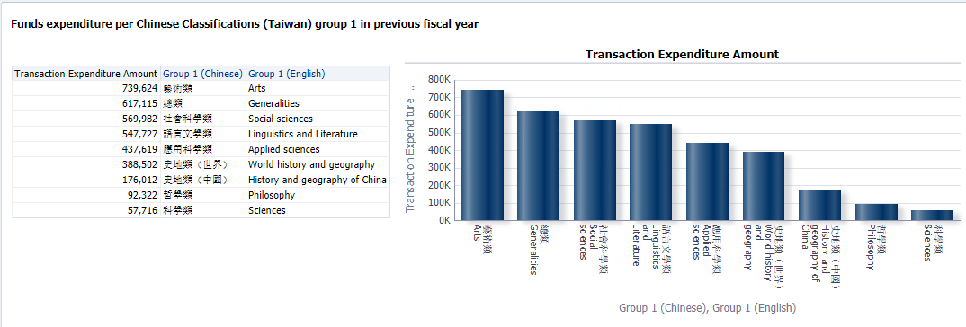
Sample reports – expenditures
It is also useful for the institution to know on what subjects funds are being expended. Here is the funds expenditure per Chinese Classifications (Taiwan) group 1 for previous fiscal year.

Slide 28
Yoel.Kortick@exlibrisgroup.com

