Slide 1
Alma Analytics Quarterly Update For the Analytics SIWG July 2020
Yoel Kortick
Senior Librarian

Slide 2
Introduction
Infrastructure
Recent developments
Selected tentative upcoming developments

Slide 3
Introduction

Slide 4
Introduction
We stated last time:
Alma Analytics development for the remainder of 2020 is focusing on two central areas:
Infrastructure
Ongoing Analytics Developments such as subject areas, fields, etc.

Slide 5
Infrastructure

Slide 6
Infrastructure
The planned infrastructure upgrade is currently happening (and much completed)
The schedule and rollout to upgrade to “Oracle In-Memory” (for faster report running) as described here has already completed on all instances except for CN01 (which is coming soon).
The schedule and rollout to upgrade to “OAS (Oracle Analytics Server) and DV (Data Visualization)” is already underway as described here .

Slide 7
Infrastructure
Specific improvements in time for running of reports can be see in Infrastructure Improvements in 2020. The report running time is way faster.

Slide 8
Infrastructure
Note the extensive documentation to learn more about both OAS and DV and how they interact with Alma, Primo VE, Leganto and Esploro:
YouTube videos about OAS (Oracle Analytics Server) and DV (Data Visualization)
Blogs about OAS (Oracle Analytics Server) and DV (Data Visualization)

Slide 9
Recent developments

Slide 10
Recent developments – May 2020
What follows here is just a small selection of the many powerful new features added to Alma Analytics over the past three months.
For further details see the Release Notes.

Slide 11
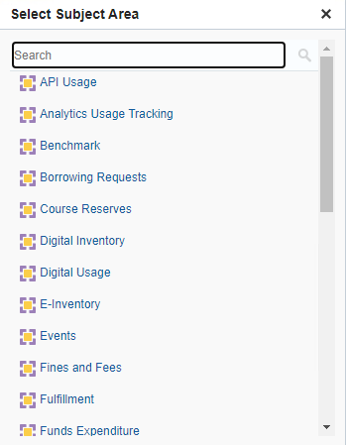
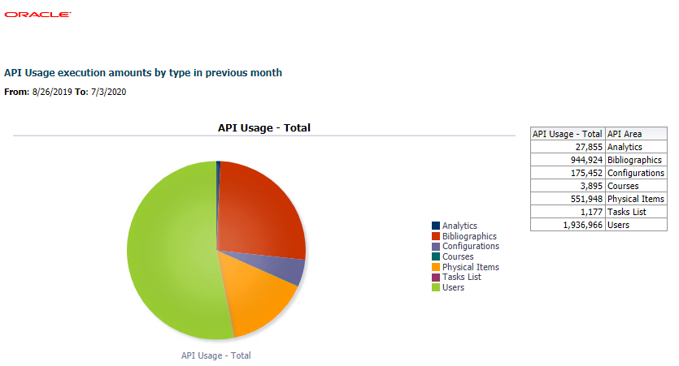
Recent developments – May 2020
API Usage Subject Area. The new API Usage subject area is for creating reports that display usage of Alma Analytics by API. For more information, see API Usage.
In the August release we are coming out with new default reports and a dashboard.

Slide 12
Recent developments – May 2020
Add Roles from Profiles For Widgets and Dashboards. When creating Analytics Widgets and dashboards the user can select a profile of roles to assign to the widget or dashboard.

Slide 13
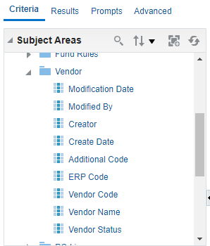
Recent developments – June 2020
The Modified By and Creator fields were added to Funds Expenditure > Vendor.

Slide 14
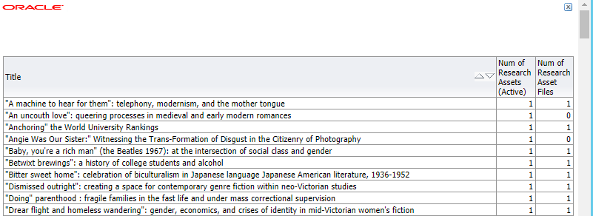
Recent developments – June 2020
The Num of Research Assets (Active) and Num of Research Asset Files fields were added to Titles > Title Measures. These relate to Esploro.

Slide 15
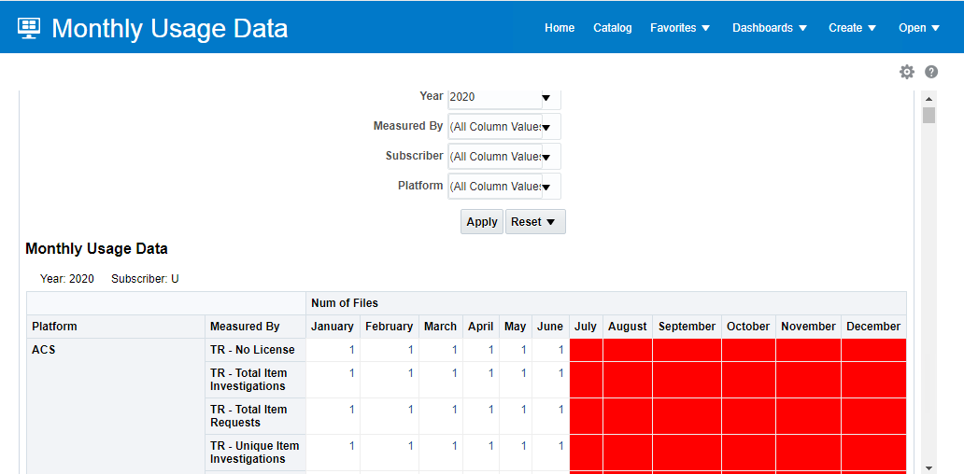
Recent developments – July 2020
The Monthly Usage Data report was added to the Usage Via COUNTER Reports - Release 5 dashboard.

Slide 16
Recent developments – July 2020
The following fields for linked records were added to the Bibliographic Details dimension in every subject area in which it appears:
Link ID – the link ID
Linked to CZ – indicates if the record is linked to the Community Zone
Linked to NZ – indicates if the record is linked to the Network Zone

Slide 17
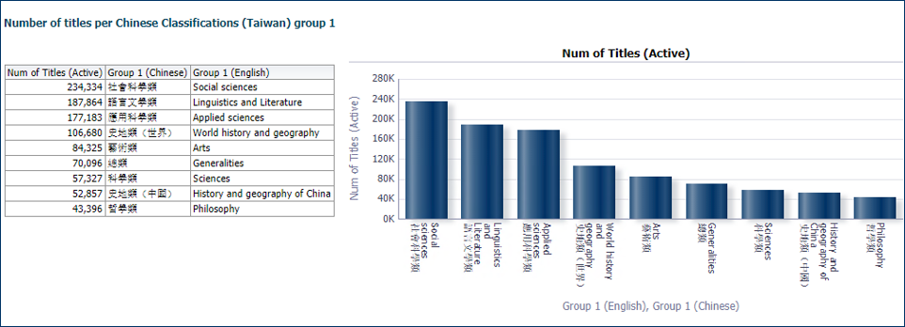
Recent developments – July 2020
The Chinese Classifications (Taiwan) folder was added under the Other Classifications folder in the subject areas in which it appears. This is for creating reports relating to the classification system used for Chinese in Taiwan.

Slide 18
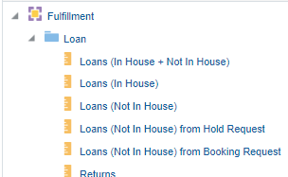
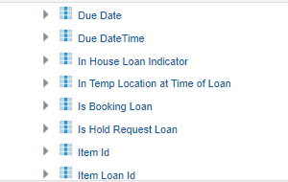
Recent developments – July 2020
The following fields were added to the Fulfillment subject area regarding requests:
Loan Details > Is Hold Request Loan – indicates if the loan was initiated by a hold request
Loans > Loans (Not In House) from Hold Request – the number of not in house loans that came from a hold request
Loans > Loans (Not In House) from Booking Request – the number of not in house loans that came from a booking request

Slide 19
Recent developments – July 2020
The Creation Date and Time and the Modification Date and Time fields were added to Purchase Requests > Purchase Request Details. These fields expand on the existing Creation Date and Modification Date fields by displaying the time together with the date.

Slide 20
Recent developments – July 2020
The following fields were added to E-Inventory > Electronic Collections to support the new Central Discovery Index (CDI):
No. of Electronic Collections (In Repository + In CDI)
No. of Electronic Collections (In Repository + Not In CDI)
In CDI
Active for Fulltext In CDI
Active for Search In CDI
CDI Full Text Linking
CDI Full Text Rights
CDI Newspapers
CDI Number of Records
CDI Resource Types
CDI Search Rights
CDI Update Frequency
CDI Provider Package Code
CDI - Subscribe to only some titles in this collection
CDI - Do not show as full text available even if active in Alma
CDI Local Note

Slide 21
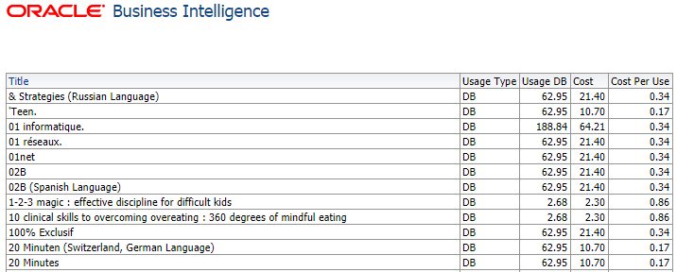
Recent developments – July 2020
Idea Exchange - Database usage is now included in usage statistics in the E-Inventory subject area

Slide 22
Recent developments – July 2020
The documentation for Bibliographic Details now clearly states where each field comes from and differentiates between MARC21 and UNIMARC

Slide 23
Selected tentative upcoming developments

Slide 24
Selected tentative upcoming developments
These are tentative plans with no commitments and subject to change
August: The "Date Key" in the "Event Date" dimension of the "Events" Subject Area will include timestamp and not only date
August: Adding full LDR and full 008 to bibliographic details and holding details folder. Adding specific positions of the 008 to the bibliographic details folder.

Slide 25
Selected tentative upcoming developments
September: In the dashboard "Title level overlap analysis" at "/shared/Alma/Titles/Dashboards" add two new tabs: "Only P" and "Only E"
September: Adding three new bibliographic ID fields to the "Find Overlap By" pull down box of the "Title level overlap analysis" : 1. ISBN single (normalized) 2. ISSN single (normalized) 3. OCLC Control Number single (035a).

Slide 26
Selected tentative upcoming developments
September: Adding default reports and dashboards for the APIs subject area which was added in May.
September: New subject area called "Analytics Objects" which will include information about analytics objects
How many of each object type does the institution have
How many users added a widget to his / her dashboard
How many users subscribed to a scheduled report or scheduled dashboard
Names and locations of each object type

Slide 27
Selected tentative upcoming developments
Oct. – Dec.: Now subject area for local authorities
Oct. – Dec. New fields for 020 subfield a and 022 subfield a
020 a (and no other subfield(s) such as z)
022 a (and no other subfield(s) such as z)
Oct. – Dec. Add resource sharing borrowing request fields Volume, Issue, Pages/Start/End to borrowing requests subject area

Slide 28
Thank you!
xxx@exlibrisgroup.com

