Slide 1
Customizing Query to Patron

Slide 2
Customizing Query to Patron
The Fulfillment ‘Other Settings’ send_query_to_patron_use_xsl parameter must be set to true
The Fulfillment Configuration page allows adding patron query types

Slide 3
Customizing Query to Patron
Up to 30 types may be added

Slide 4
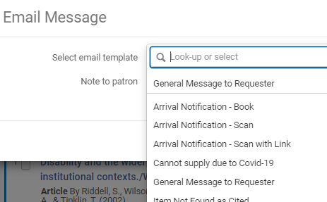
Customizing Query to Patron
The types appear in the drop down when selecting ‘Send Query to Patron’ for a borrowing request

Slide 5
Customizing Query to Patron
All templates use the same Alma letter – ‘Query to Patron Letter’.
Each label in the Labels tab for this letter is duplicated, for example:
Type_1_query_line_1
Type_2_query_line_1
…
Type_1_query_line_2
Type_2_query_line_2

Slide 6
Customizing Query to Patron
Each label in the Labels tab for this letter is duplicated, for example:
Type_1_query_line_1
Type_2_query_line_1
…
Type_1_query_line_2
Type_2_query_line_2
This way, the Alma letter can be configured using XSL ‘if’ statements –
IF ‘template 1’ USE ‘type 1 labels’
IF ‘template 2’ USE ‘type 2 labels’
…
‘Template x’ is the type configured in the code table, e.g. ‘'Type_1_query_name’,’ 'Type_2_query_name’ etc.

Slide 7
XSL example (1)
<xsl:choose>
<xsl:when test="notification_data/query_type = 'Type_1_query_name’”>
<tr>
<td>
<h3>@@Type_1_header@@</h3>
</td>
</tr>
</xsl:when>
<xsl:when test="notification_data/query_type = 'Type_2_query_name’”>
<tr>
<td>
<h3>@@Type_2_header@@</h3>
</td>
</tr>
</xsl:when>
</xsl:choose>

Slide 8
XSL example (2)
<xsl:choose>
<xsl:when test="notification_data/query_type = 'Type_1_query_name'">
<tr>
<td>@@Type_1_query_line_1@@</td>
</tr>
<tr>
<td>@@Type_1_query_line_2@@</td>
</tr>
<tr>
<td>@@Type_1_query_line_3@@</td>
</tr>
</xsl:when>
<xsl:when test="notification_data/query_type = 'Type_2_query_name'">
<tr>
<td>@@Type_2_query_line_1@@</td>
</tr>
<tr>
<td>@@Type_2_query_line_2@@</td>
</tr>
<tr>
<td>@@Type_2_query_line_3@@</td>
</tr>
</xsl:when>
<xsl:choose>

Slide 9
Customizing Query to Patron
The manually entered note is part of the letter, in the field "notification_data/query_note”
See Example Letter Customization: Query to Patron Letter and Configuring Patron Queries

Slide 10
Thank you!
xxx@exlibrisgroup.com

