Slide 1
Designing and Using Normalization Rules
Yoel Kortick
Senior Librarian

Slide 2
Agenda
Introduction
Creating normalization rules and processes
Testing a normalization rule
Adding the normalization rule to a normalization process
Using a normalization processes in an import profile
Using a normalization processes for batch update

Slide 3
Introduction

Slide 4
Introduction
Normalization rules are designed to change or update bibliographic metadata at various stages, for example when the record is:
Saved in the metadata editor
Imported via import profile
Imported from external search resource
Edited via the "enhance the record" menu in the metadata editor
Run on a saved set (global update)
Published (exported) visa a general publishing profile

Slide 5
Introduction
The normalization rules are written in a specific syntax allowing the user to create rules to for example
Add fields
Delete fields
Change text
Change field tags
Change indicators
These operations may be performed
Unconditionally
Conditionally

Slide 6
Introduction
This presentation will not discuss the specific syntax of the normalization rules. We recommend that when you do create a normalization rule you use the extensive list of examples at Alma Normalization Rule Examples.
You can take an existing rule which does something similar to what you want to do and change it accordingly (for example change the field code or the text which is added or used as a condition).
For an explanation of the syntax see Online Help for working with normalization rules.
The focus here will be specifically on how the normalization rules are created as well as how and where the rules may be used.

Slide 7
Creating normalization rules and processes

Slide 8
Creating normalization rules and processes
The normalization rules are created either
In the metadata editor by choosing “Rules” in left pane and then in right pane “New > Normalization”.
From the left pane by doing "duplicate" on an existing normalization rule
By copying (duplicating) an existing rule from the community

Slide 9
Creating normalization rules and processes
In the metadata editor choose “Rules” in left pane and then in right pane “New > Normalization”.

Slide 10
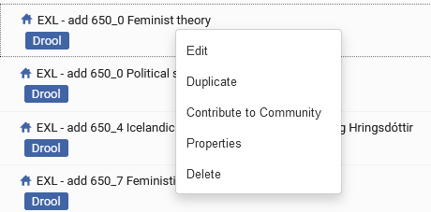
Creating normalization rules and processes
From the left pane by doing right click and "duplicate" on an existing normalization rule

Slide 11
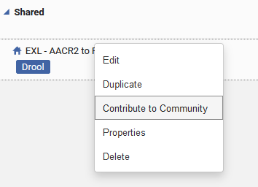
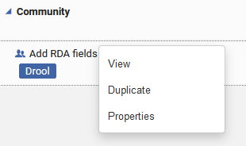
Creating normalization rules and processes
By copying (duplicating) an existing rule from the community
Here we can copy from the community
Here we can contribute to the community

Slide 12
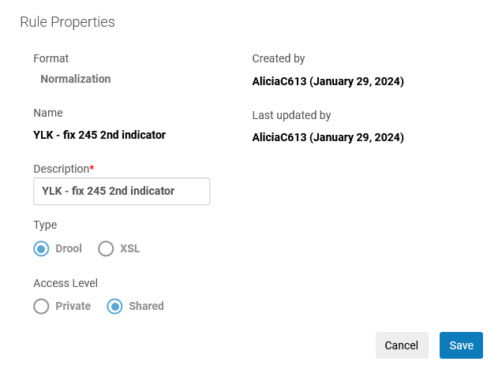
Creating normalization rules and processes
Normalization rule properties
A logical name and description to later know what this rule does
Choose shared if you want other uses to also access this rule
When creating a normalization rule for a MARC record 'Drool' is used. When creating a normalization rule for a DC (Dublin Core) record 'XSL' is used.

Slide 13
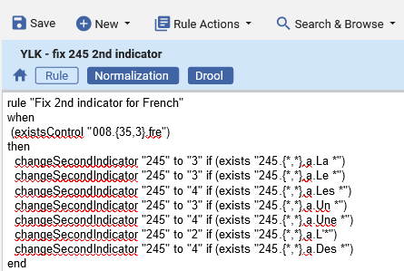
Creating normalization rules and processes
After defining the properties enter (or edit existing) text of the normalization rule and click ‘save’

Slide 14
Testing a normalization rule

Slide 15
Testing a normalization rule
A normalization rule can be tested as follows:
Open a bibliographic record in edit mode
Switch to split editor mode.
Leave the bibliographic record in the left pane of split window
Focus on the right pane of split window
Select the normalization rule and choose "edit"
Click "Preview" on the rule
See what the rule does to the record

Slide 16
Testing a normalization rule
Open a bibliographic record in edit mode and switch to split editor mode.

Slide 17
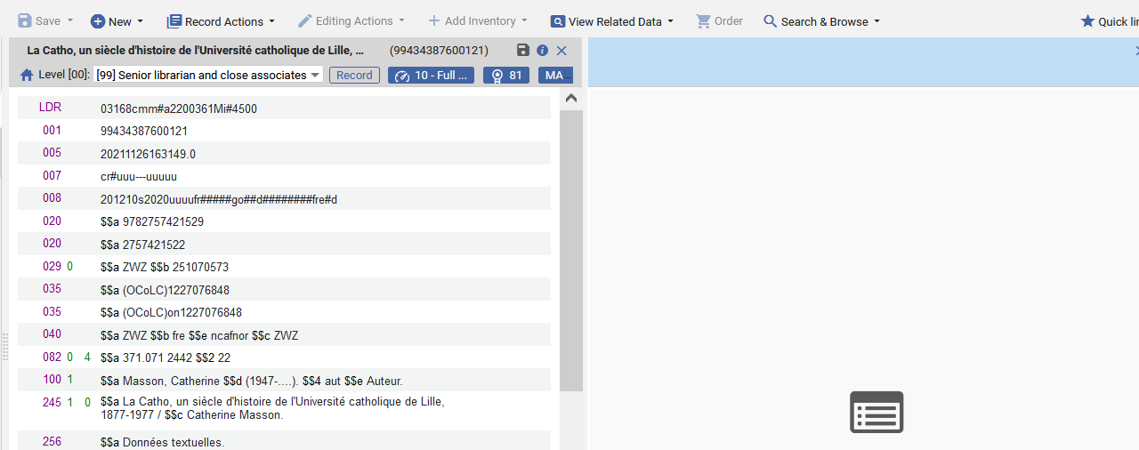
Testing a normalization rule
Leave the bibliographic record in the left pane of split window, Focus on the right pane of split window
Focus here

Slide 18
Testing a normalization rule
Select the normalization rule and choose "edit"

Slide 19
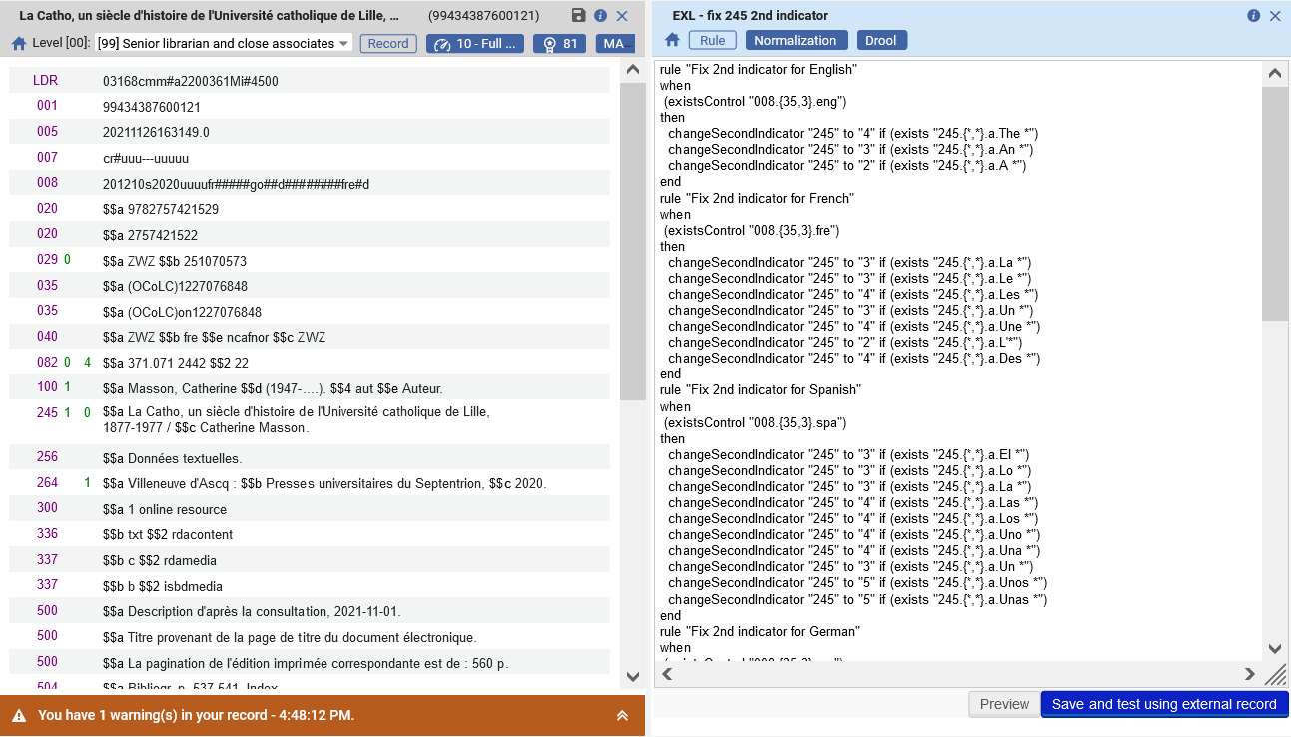
Testing a normalization rule
Click "Preview" on the rule

Slide 20
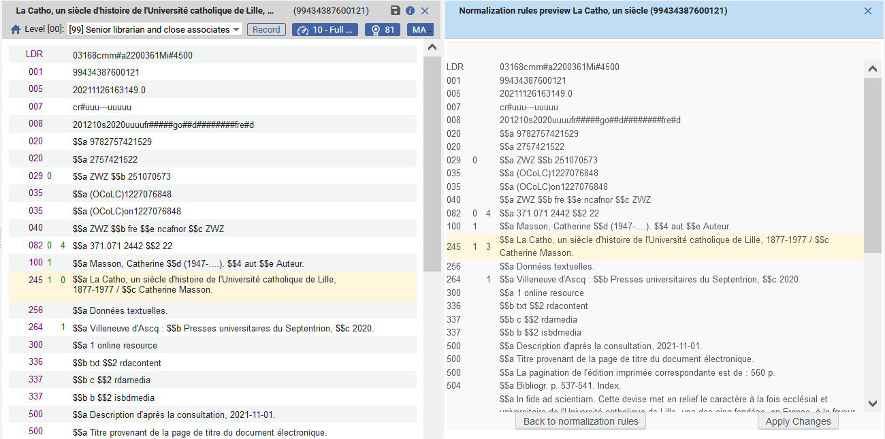
Testing a normalization rule
See what the rule does to the record
Record on right got a new 245 2nd indicator
The normalization rule changed the 245 2nd indicator from 0 to 3
Clicking "Apply changes" will update the record
Clicking "Back to normalization rules" will return the user to the rule for additional editing

Slide 21
Adding the normalization rule to a normalization process

Slide 22
Adding the normalization rule to a normalization process
In order to be able to use the normalization rule in various parts of the system it needs to be added as a process
Each process may include one or more normalization rules.
In this example we will add one normalization rule to a process.
The normalization rule we will add is "EXL - fix 245 2nd indicator"

Slide 23
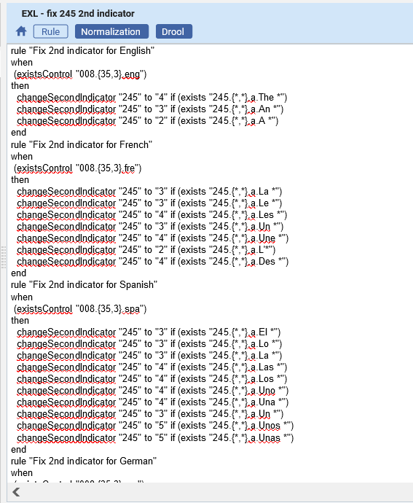
Adding the normalization rule to a normalization process
This is the normalization rule we will add.
It first fixes the 245 2nd indicator depending on the language in the 008 and initial string of the field.

Slide 24
Adding the normalization rule to a normalization process
Access the list of normalization processes from the Resource Management Configuration Menu and navigate to: Cataloging > Configuration > Marc 21 Bibliographic > Normalization Processes
Click “Add Process
To add a new process, click "Add Process"

Slide 25
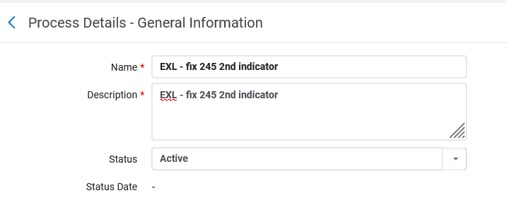
Adding the normalization rule to a normalization process
Give the process a name and click “Next”
We are making the process have the same name as the rule which it will use. This is not mandatory but done here for "organizational" purposes.

Slide 26
Adding the normalization rule to a normalization process
Click “Add Tasks”

Slide 27
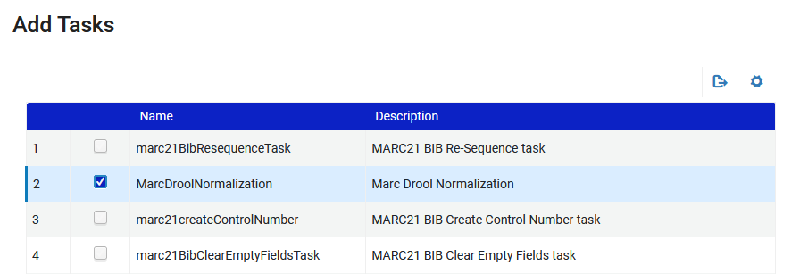
Adding the normalization rule to a normalization process
Choose MarcDroolNormalization
This means that it will use a normalization process

Slide 28
Adding the normalization rule to a normalization process
Click “Add and Close” and then “Next” and then choose the desired normalization rule which will be part of this process.
We will choose "EXL - fix 245 2nd indicator" which we looked at recently.
Click “Save”

Slide 29
Adding the normalization rule to a normalization process
The new normalization process has been added

Slide 30
Using a normalization processes in an import profile

Slide 31
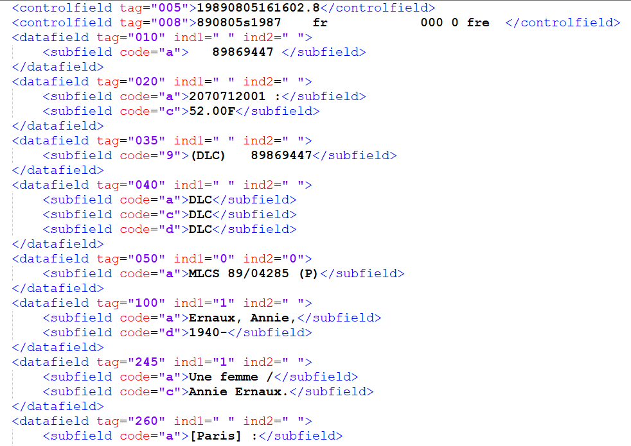
Using a normalization processes in an import profile
Sample record being imported
Language code in 008 is “fre”
245 2nd indicator is empty.
Text starts with “Une”

Slide 32
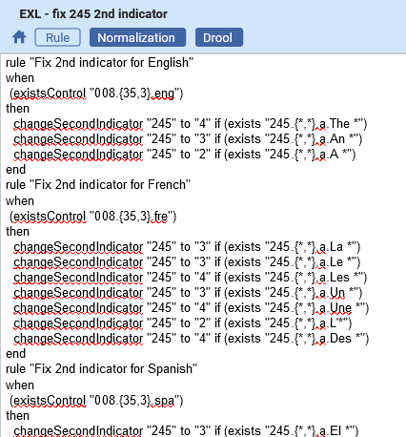
Using a normalization processes in an import profile
Our normalization rule “EXL - fix 245 2nd indicator” which is in normalization process “EXL - fix 245 2nd indicator” should fix this (should change it and make 2nd indicator 4):

Slide 33
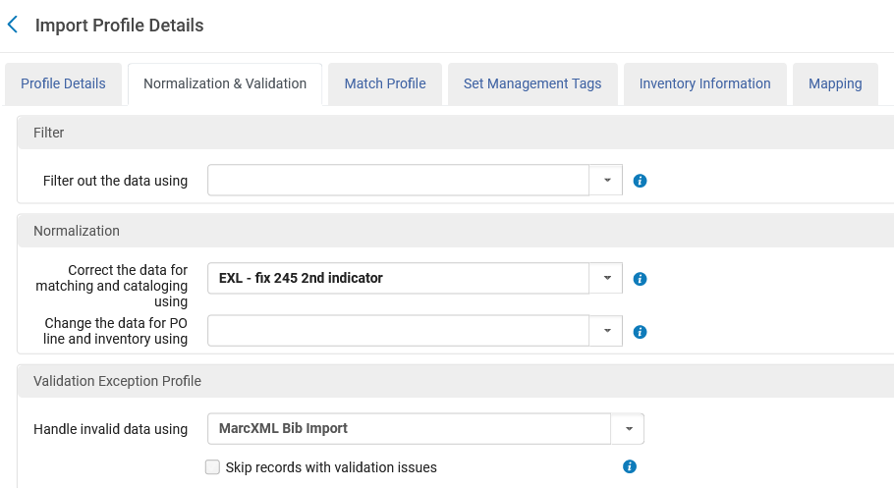
Using a normalization processes in an import profile
The import profile will use normalization process “EXL - fix 245 2nd indicator”

Slide 34
Using a normalization processes in an import profile
We use the import profile to import the file which contains the record

Slide 35
Using a normalization processes in an import profile
The record has been imported and we will view it

Slide 36
Using a normalization processes in an import profile
The record has been imported and we will view it

Slide 37
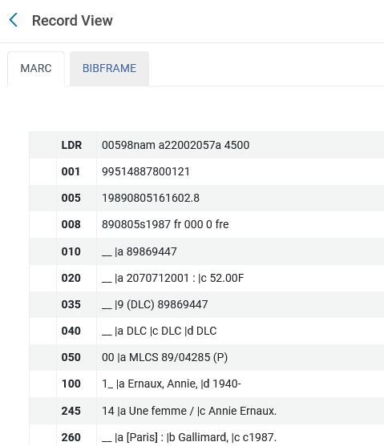
Using a normalization processes in an import profile
The record was changed (2nd indicator was added) as per the normalization rule

Slide 38
Using a normalization processes for batch update

Slide 39
Using a normalization processes for batch update
We will now perform batch update on a set using the same normalization process.
Title "La femme à la fiole" is an example of a record which has a bad 245 2nd indicator
245 2nd indicator should be 3

Slide 40
Using a normalization processes for batch update
Title "La femme à la fiole" begins with ‘La ‘ and has 008 pos 35-37 “fre”.
Therefore 245 2nd indicator should be 3

Slide 41
Using a normalization processes for batch update
Title "La femme à la fiole" is part of a set we are creating called "need to check 245 2nd indicator“
We create the set by retrieving all MARC21 physical titles which start with “La” in the title and then faceting by language French and clicking “Save and Filter Query”

Slide 42
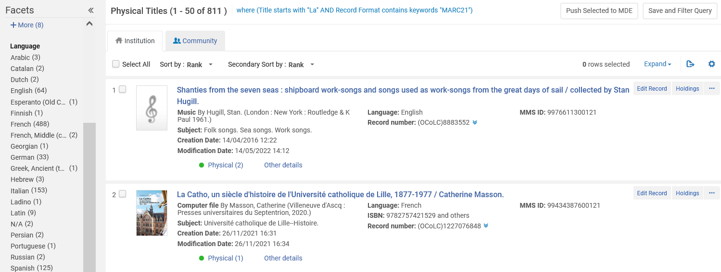
Using a normalization processes for batch update
Here we are faceting by language French

Slide 43
Using a normalization processes for batch update
And now we save the set by clicking “Save and Filter Query”

Slide 44
Using a normalization processes for batch update
The set is called “Check 245 2nd indicator"

Slide 45
Using a normalization processes for batch update
Now we will run the process "EXL - fix 245 2nd indicator" on the set “Check 245 2nd indicator"
We will go to "Run a job" and filter by Marc 21 Bib normalization and then choose the normalization process.
We have a lot of Marc 21 Bib normalization processes, so we also searched by name

Slide 46
Using a normalization processes for batch update
Select the set

Slide 47
Using a normalization processes for batch update
Leave the default normalization rule from the process

Slide 48
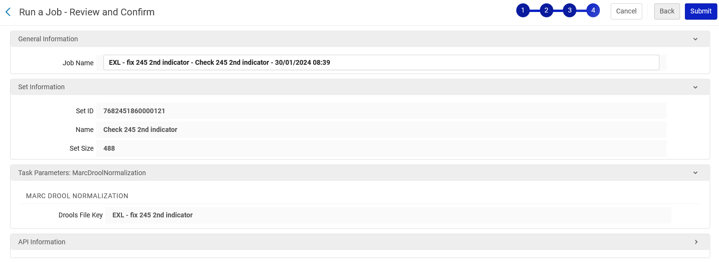
Using a normalization processes for batch update
Submit the job

Slide 49
Using a normalization processes for batch update
The record got updated
245 2nd indicator changed to 3

Slide 50
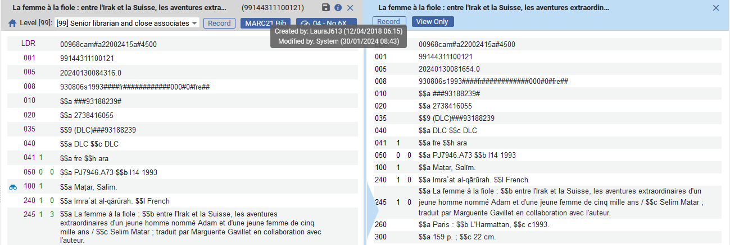
Using a normalization processes for batch update
In the metadata editor ‘View related Data > View Versions’ we can see the previous version and compare
It was updated by “System” (which is the job)
Previous version
Current version

