Slide 1
COUNTER Report Usage in Alma Analytics
Yoel Kortick
Senior Librarian

Slide 2
Where is the COUNTER usage data in Alma Analytics?
Default Reports and Dashboards for Usage Data
Default Reports and Dashboards for Cost Usage
Explanation of the Cost Usage Dashboard
Examples of the Cost Usage Dashboard
Usage and Cost Usage in Data Visualization

Slide 3
Where is the COUNTER usage data in Alma Analytics?

Slide 4
Where is the COUNTER usage data in Alma Analytics?
The COUNTER usage data in Alma Analytics is present in two subject areas:
E-Inventory
Usage Data

Slide 5
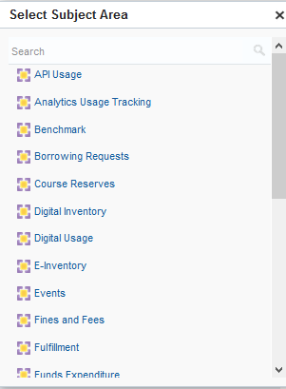
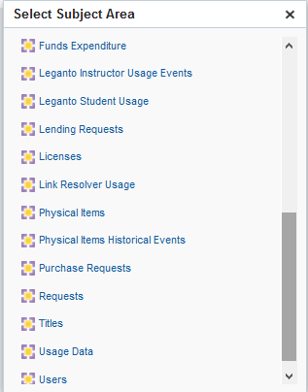
Where is the COUNTER usage data in Alma Analytics?

Slide 6
Where is the COUNTER usage data in Alma Analytics?
Why is usage data in two different subject areas?
What is the difference?

Slide 7
Where is the COUNTER usage data in Alma Analytics?
The E-Inventory subject area contains all COUNTER data which was loaded to Alma either manually or via SUSHI and for which a bibliographic record exists in Alma.
The E-Inventory subject area also includes order and fund information and therefore cost per use reports are also made in the E-Inventory subject area.
The Usage Data subject area contains all COUNTER data which was loaded to Alma either manually or via SUSHI regardless of whether or not a bibliographic record exists in Alma.

Slide 8
Where is the COUNTER usage data in Alma Analytics?
For example, as we see on the next slides …
For platform ProQuest Ebook Central
The Usage data subject area has these two titles:
A Brief History of Genetics
BIOS Instant Notes in Genetics
Of these two titles the E-Inventory subject area has only
A Brief History of Genetics
Title “BIOS Instant Notes in Genetics” is not in the E-Inventory subject area because it is not in the Alma repository. It is only in a loaded COUNTER report.

Slide 9
Where is the COUNTER usage data in Alma Analytics?
In the “E-Inventory” subject area and in the “Usage Data” subject we have report which filters for
Platform = ProQuest Ebook Central
Normalized title “contains any” ‘brief history of genetics;bios instant notes in genetics’
Therefore oif the titles exist they will appear in the report

Slide 10
Where is the COUNTER usage data in Alma Analytics?

Slide 11
Where is the COUNTER usage data in Alma Analytics?
The “Usage Data” subject area shows both titles

Slide 12
Where is the COUNTER usage data in Alma Analytics?
The “E-Inventory” subject area shows only title “A brief history of genetics”

Slide 13
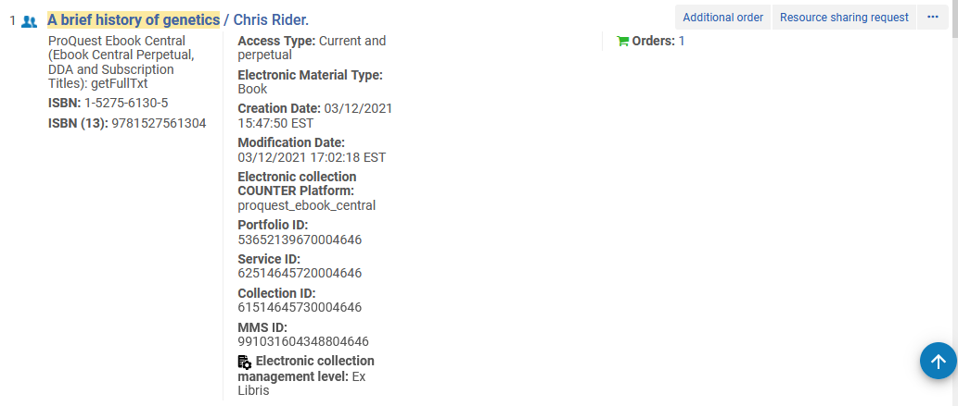
Where is the COUNTER usage data in Alma Analytics?
This is because “A brief history of genetics” is in the repository

Slide 14
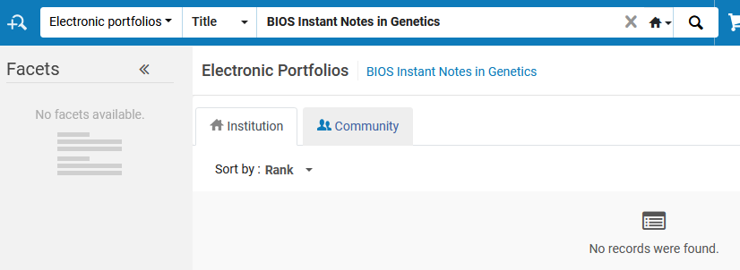
Where is the COUNTER usage data in Alma Analytics?
But “BIOS Instant Notes in Genetics” is not in the repository

Slide 15
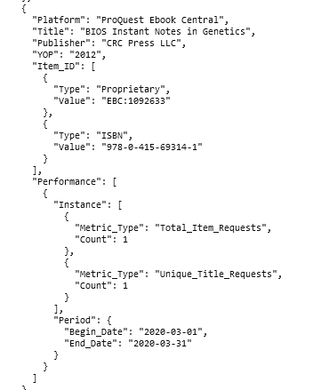
Where is the COUNTER usage data in Alma Analytics?
“BIOS Instant Notes in Genetics” is in the Usage Data subject area because it was loaded via a COUNTER report

Slide 16
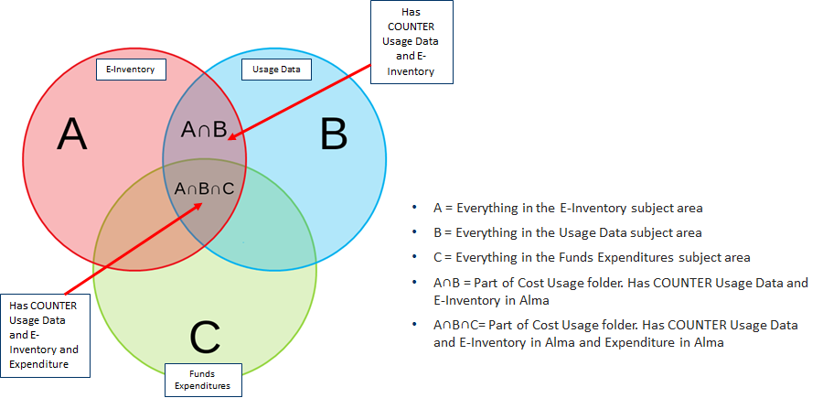
Where is the COUNTER usage data in Alma Analytics?

Slide 17
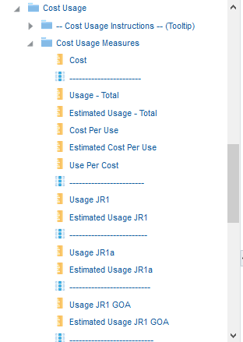
Where is the COUNTER usage data in Alma Analytics?
The usage data in the E-Inventory subject area is in a dedicated subfolder “Cost Usage”.

Slide 18
Where is the COUNTER usage data in Alma Analytics?
The advantage of the usage data being in the E-Inventory subject area is that it can be combined with other fields from this subject area.
Because the Cost Per Use is an integral part of the E-Inventory subject area all of the following fields and more may be included in the Cost Per Use reports:
The licenses
The LC subjects
The Dewey subjects
The resource types
All fields from the "Bibliographic Details" folder

Slide 19
Default Reports and Dashboards for Usage Data

Slide 20
Default Reports and Dashboards for Usage Data
Usage
Several default reports exist in the folders
/shared/Alma/Usage via COUNTER reports/Reports.
/shared/Alma/Usage via COUNTER reports – Release 5 /Reports.
A default dashboard with these reports exists under
/shared/Alma/Usage via COUNTER reports/Dashboards.
/shared/Alma/Usage via COUNTER reports – Release 5 /Dashboards.

Slide 21
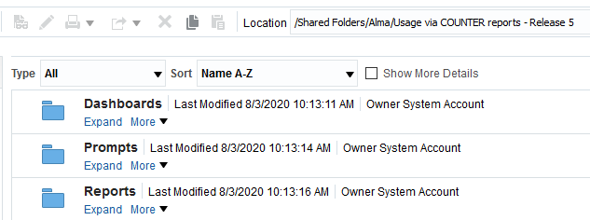
Default Reports and Dashboards for Usage Data
Usage

Slide 22
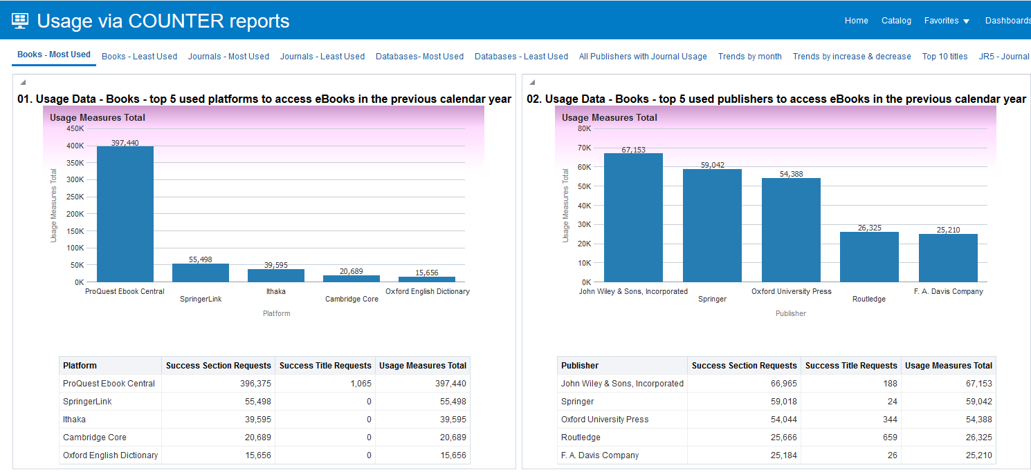
Example of “Usage Via COUNTER Reports” dashboard

Slide 23
Default Reports and Dashboards for Cost Usage

Slide 24
Default Reports and Dashboards for Cost Usage
Cost Per Use
Several default reports exist in the folder:
/shared/Alma/Cost per use via COUNTER reports e-inventory and acquisitions data/Reports.
A default dashboard with these reports exists under:
/shared/Alma/Cost per use via COUNTER reports e-inventory and acquisitions data/Dashboards.

Slide 25
Default Reports and Dashboards for Cost Usage
Cost Per Use

Slide 26
Explanation of the Cost Usage dashboard

Slide 27
Explanation of the Cost Usage dashboard
The "Electronic Cost Usage Dashboard" includes the following tabs:
Titles
A prompt by "Fund Fiscal Period Description" and list of
Most used titles
Least used titles
Most expensive titles
Least expensive titles
Title details
A search box criteria for word from title, ISBN and ISSN.
Results are a list of titles including details of cost per use
A link to the view the same title in the usage data subject area

Slide 28
Explanation of the Cost Usage dashboard
Continuous
A prompt for searching titles with a POL of type "Continuous" by portfolio creation year, minimum cost and minimum usage and a list of titles including details of cost per use
A link to the view the same title in the usage data subject area
One time
Like the "Continuous" tab but searches for titles with a POL of type "One Time"
Resource Types
A prompt by "Fund Fiscal Period Description"
A detailed analysis of the resource types of electronic inventory.
This includes inventory which does and does not necessarily have usage or cost.
There are three pie charts with a detailed explanation.

Slide 29
Explanation of the Cost Usage dashboard
Electronic Collections
A prompt by "Fund Fiscal Period Description" and list of
A list of Cost Usage By Electronic collections
Platforms
A prompt by "Fund Fiscal Period Description" and list of
Most used platforms
Least used platforms
Most expensive platforms
Least expensive platforms
Vendors
A prompt by "Fund Fiscal Period Description" and list of
Most used vendors
Least used vendors
Most expensive vendors
Least expensive vendors

Slide 30
Explanation of the Cost Usage dashboard
Funds
A prompt by "Fund Fiscal Period Description" and list of
Most used funds (highest use)
Most effective funds (highest use per cost)
LC Subjects
A prompt by "Fund Fiscal Period Description" and list of
Most used LC Subjects
Least used LC Subjects
Most expensive LC Subjects
Least expensive LC Subjects
Dewey Subjects
A prompt by "Fund Fiscal Period Description" and list of
Most used Dewey Subjects
Least used Dewey Subjects
Most expensive Dewey Subjects
Least expensive Dewey Subjects

Slide 31
Explanation of the Cost Usage dashboard
Match Points
A prompt by "Fund Fiscal Period Description" and pie charts and a graph explaining if there was a match between the title from the COUNTER report and the title in the Alma E-Inventory and if so according to what criteria
Usage Types
A prompt by "Fund Fiscal Period Description" and pie charts with a detailed analysis of the COUNTER report types in Cost Per Use.

Slide 32
Explanation of the Cost Usage dashboard
Usage By Title Per Electronic Collections
A prompt by "Fund Fiscal Period Description" and a list of electronic collections with:
Number of titles in the collection
Number of titles in the collection which have usage
Percent of titles which have usage
Cost
Usage
Cost Per Use
Cost per title
Very useful for evaluating the value of electronic collections
Titles with multiple portfolios
Includes prompts by title, subject, classification codes, cost and usage.
Allows for filtering by number of collections per title
Useful for evaluating which collections have a lot of overlap (have a lot of the same titles).

Slide 33
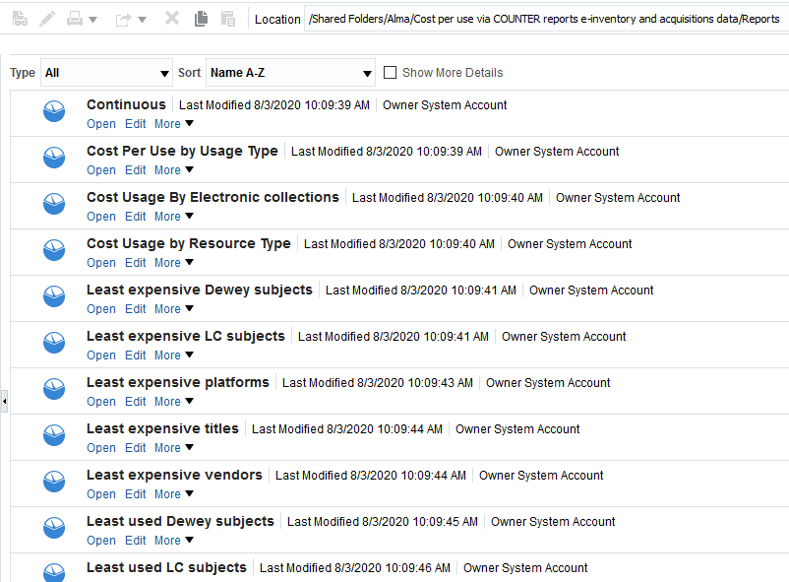
Explanation of the Cost Usage dashboard
All of the reports in the dashboard may be edited and saved locally

Slide 34
Examples of the Cost Usage Dashboard

Slide 35
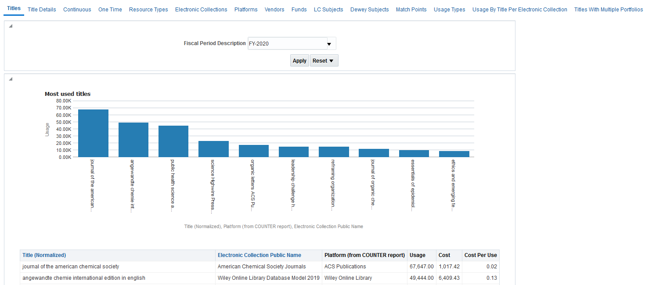
Examples of the Cost Usage Dashboard

Slide 36
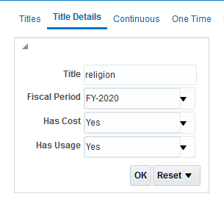
Examples of the Cost Usage Dashboard

Slide 37
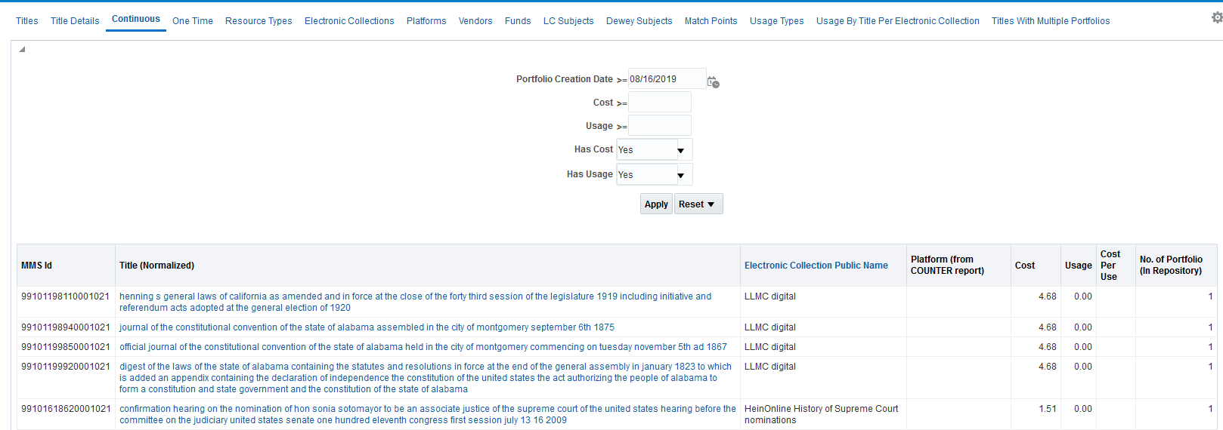
Examples of the Cost Usage Dashboard

Slide 38
Examples of the Cost Usage Dashboard

Slide 39
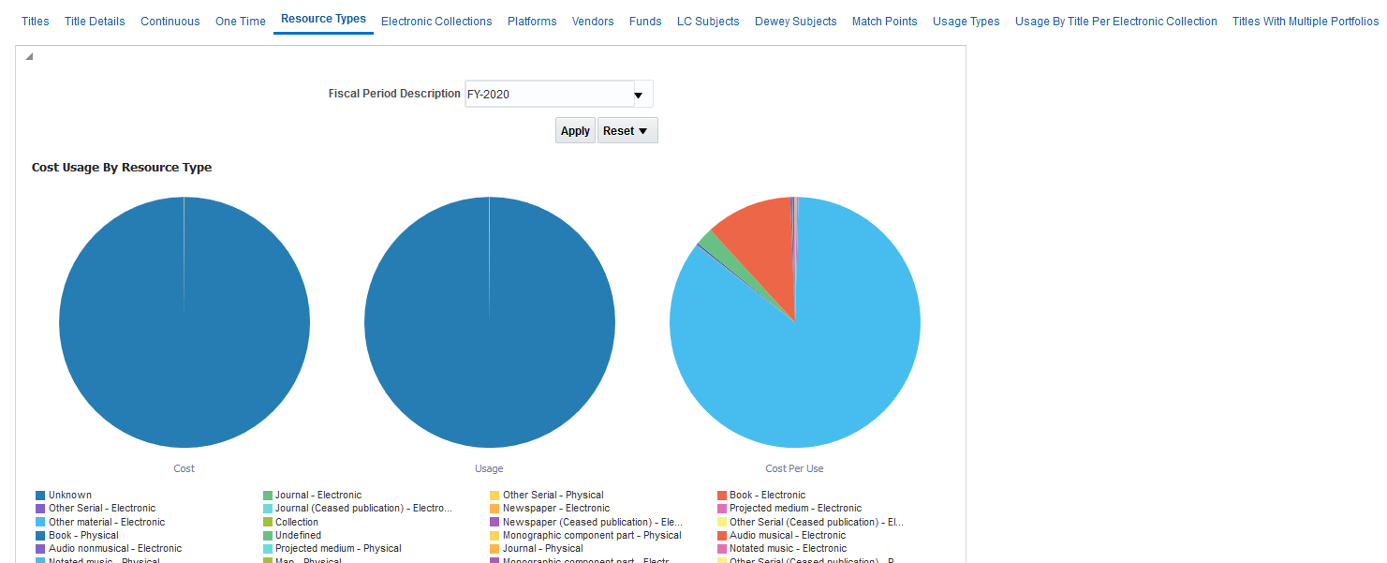
Examples of the Cost Usage Dashboard

Slide 40
Examples of the Cost Usage Dashboard

Slide 41
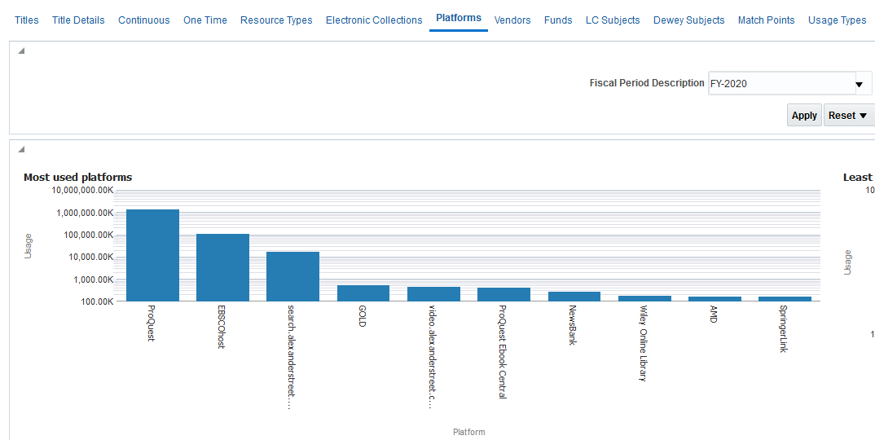
Examples of the Cost Usage Dashboard

Slide 42
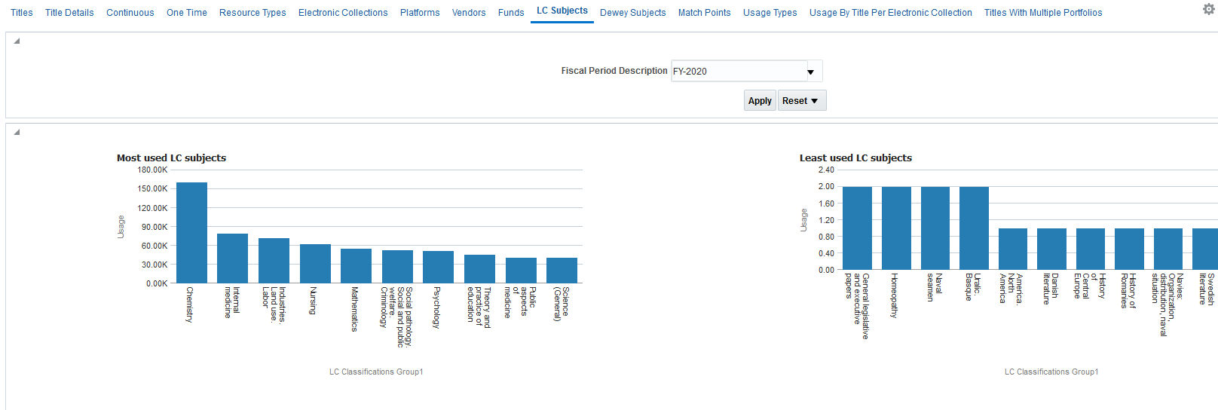
Examples of the Cost Usage Dashboard

Slide 43
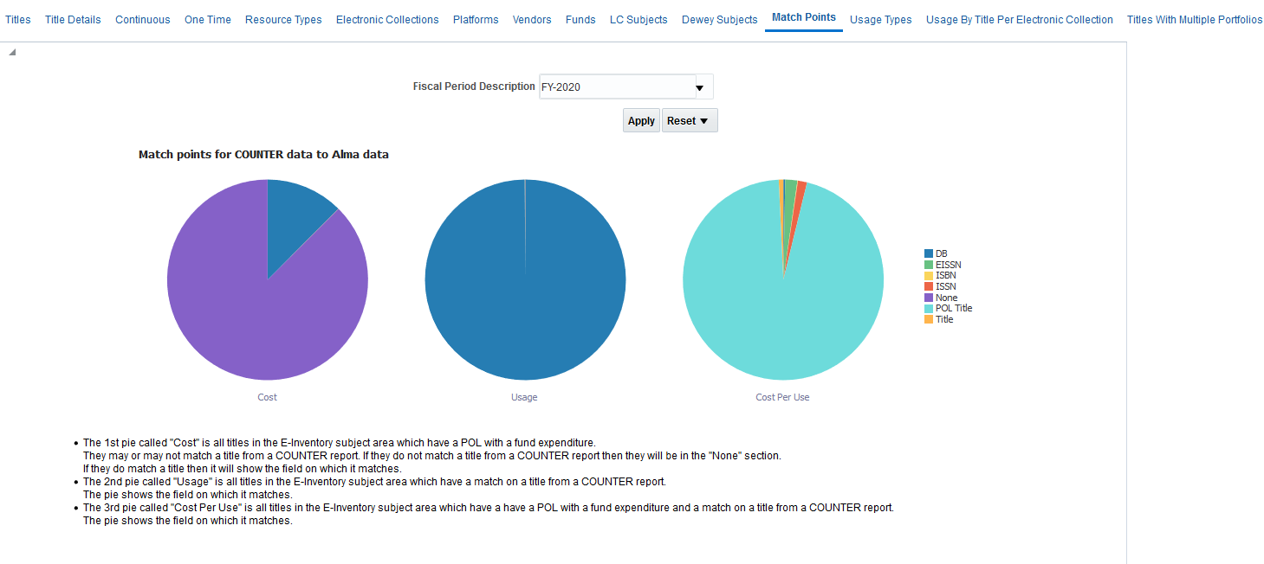
Examples of the Cost Usage Dashboard

Slide 44
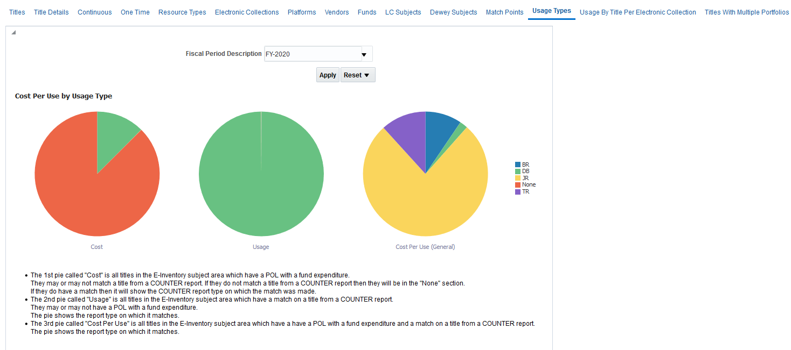
Examples of the Cost Usage Dashboard

Slide 45
Examples of the Cost Usage Dashboard

Slide 46
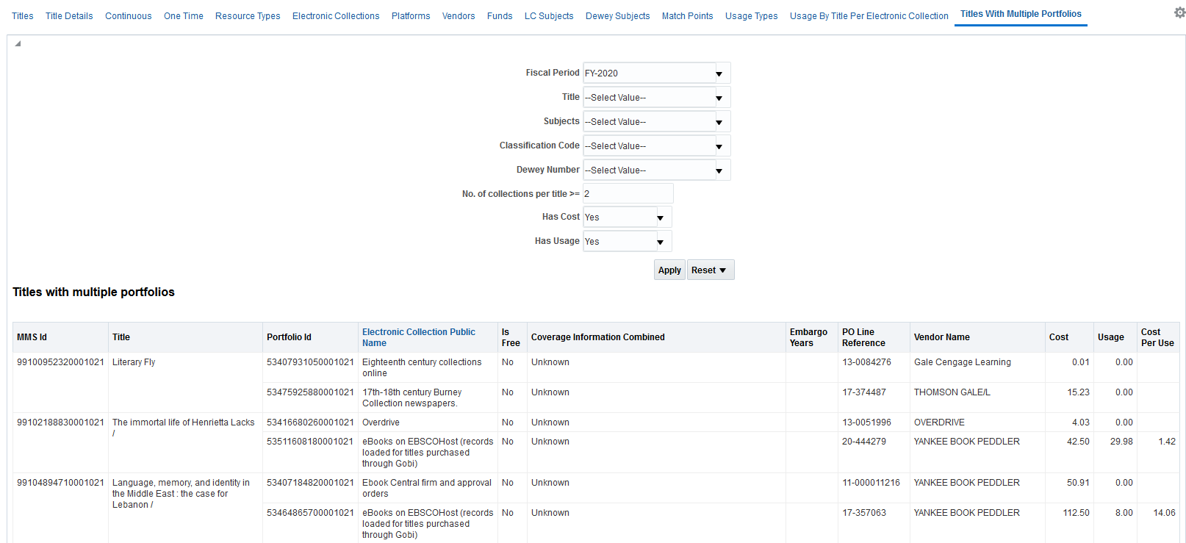
Examples of the Cost Usage Dashboard

Slide 47
Usage and Cost Usage in Data Visualization

Slide 48
Usage and Cost Usage in Data Visualization
The Usage and Cost usage can also be obtained via the Data Visualization.
See:
Video: Alma Analytics: Analyzing Usage and Cost Usage with Alma Analytics Data Visualization
Blog: How to create a bar graph of most used platforms for previous year using Alma Analytics Data Visualization (DV)

Slide 49
xxx@exlibrisgroup.com

