Slide 1
Primo VE Normalization for Search and Display
Moran Vardi
Primo VE Business Analyst

Slide 2
Primo VE Normalization Suite
Manage Local Fields
Normalization of OTB
Display Fields
2

Slide 3
Manage Local Fields
Local fields allow you to map additional information from the bibliographic records to enrich the displayed information, extend search queries, and offer more facets to tweak the results
Primo VE allows to create up to 100 local fields
2 mapping methods are provided:
Bibliographic Local Field Mapping
Normalization Rules

Slide 4
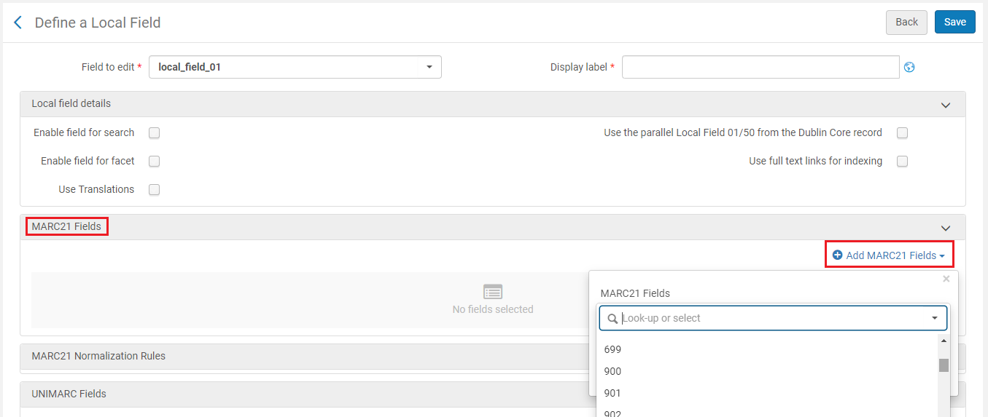
Manage Local Fields
Bibliographic Local Field Mapping
This method provides a closed list of bibliographic LOCAL fields

Slide 5
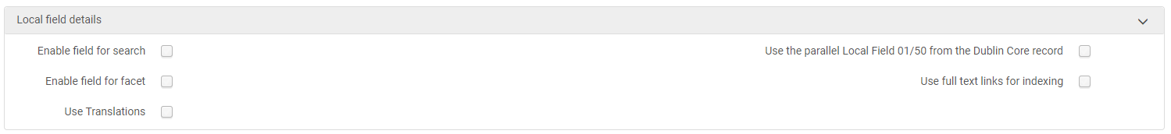
Manage Local Fields - Bibliographic Local Field Mapping
The full field is used, including all sub-fields
Supported formats:
  MARC family: MARC21, UNIMARC, KORMARC and CNMARC
  Dublin Core, by using the parallel Dublin Core Local Field
Configuration is applied to the user interface immediately without needing to recalculate the data

Slide 6
Use Case #1
Display and search field 947 (local field) – without NR

Slide 7
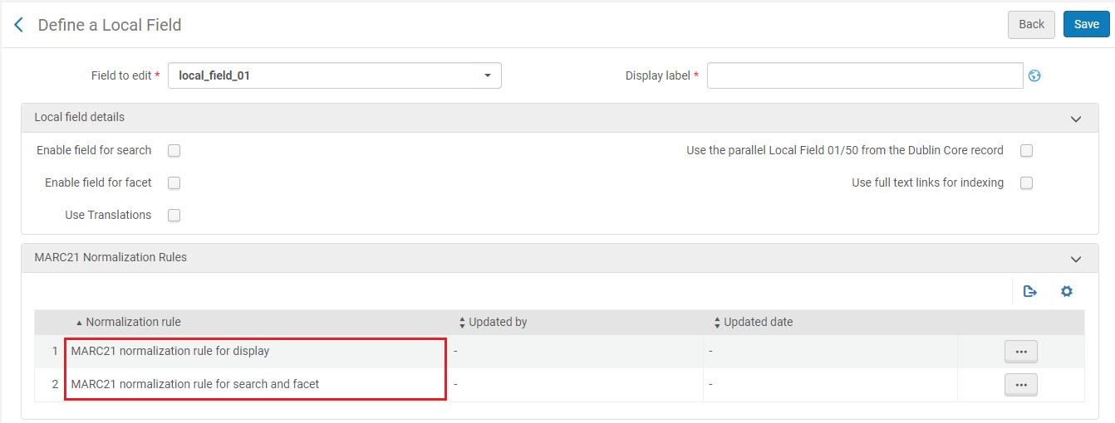
Manage Local Fields
Normalization Rules
This method provides an ability to create a local field from ALL bibliographic fields for display, search and facet

Slide 8
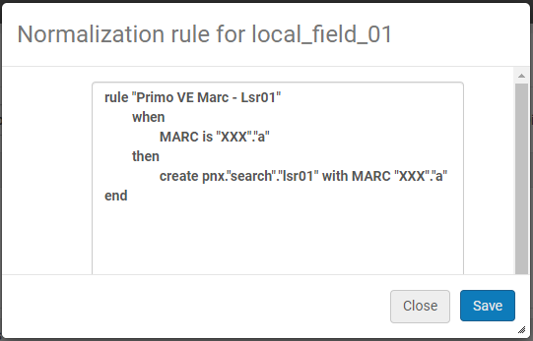
Manage Local Fields - Normalization Rules
Normalization Rules uses the Drools language to support defining conditions, actions, regular expression, etc.
Primo VE provides a normalization template
Example:
rule "Primo VE - Lds13"
when
MARC."091" has any "c,d,e"
then
set pnx."display"."lds13" to
MARC."091" sub without sort "c,d,e"
end

Slide 9
Manage Local Fields - Normalization Rules
Normalization Rules can be used for Display Field or Search and Facet field, each of which has its key functions:
Normalization Rules for Display
Can be used as a combination with both methods:
  Bibliographic Local Field Mapping
  Normalization for Search and Facet
Normalization Rules are applied to the user interface immediately

Slide 10
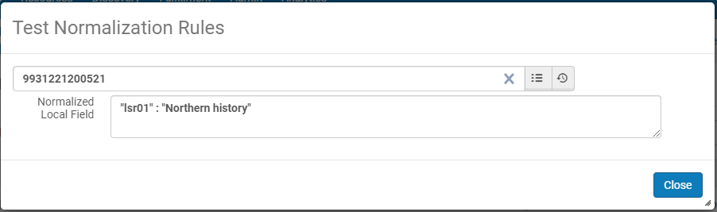
Manage Local Fields - Normalization Rules
Normalization Rules for Search and Facet
Can be used as a combination with Normalization for Display
Allows to define up to 10 local fields
Requires recalculate of the data
Test tool

Slide 11
Manage Local Fields - Normalization Rules

Slide 12
Use Case #2
Display and search field 947 – with NR

Slide 13
Manage Local Fields – Comparison of Methods
Best practices and comparison of both methods
Normalization Rules | Bibliographic Local Field Mapping
Ability to use all MARC tags | Closed list of Local MARC tags Contains MARC local fields: 009, 09X, 490, 5XX, 69X, and 9XX.
Normalization Rules Provide flexibility to use any tags and subfields | Full MARC tag is taken All the subfields are used
Display field Applied immediately Search and Facet field Requires recalculate of the data (Open a case to support) | Applied immediately MARC local fields are indexed automatically and ready to use

Slide 14
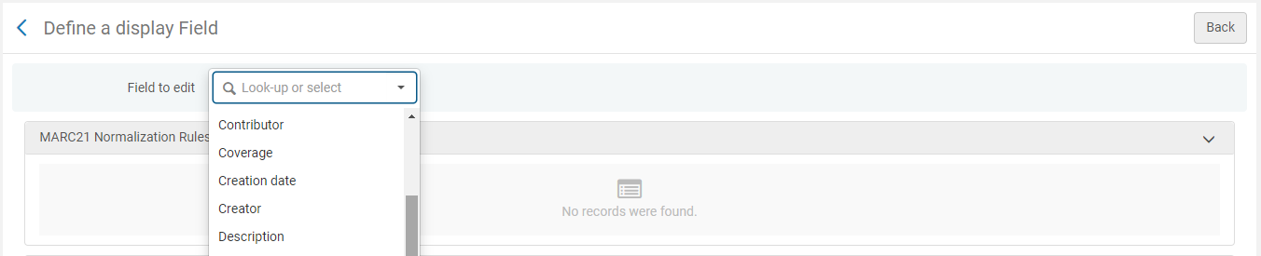
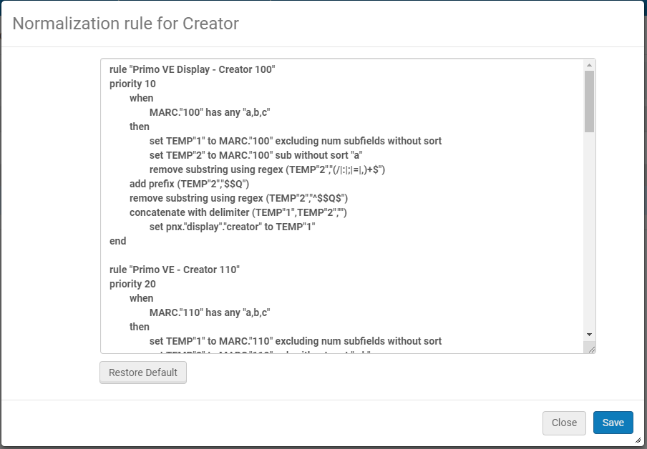
Normalization of OTB Display Fields
Allows to refine the presentation of OTB display fields
View the normalization rules the system uses and modify them
The changes are applied to the user interface immediately

Slide 15
Use Case #3
Edit OTB display field

Slide 16
Tips and Documentation
It is recommended that you start with an existing rule that is similar to the rule that you are looking to define and modify it as needed
See our OTB rules in any display field
Use the documentation and examples from the blog
Local Fields documentation
Normalization Rule Syntax

Slide 17
Thank you!
Moran.Vardi@exlibrisgroup.com

