Slide 1
Best of Knowledge Days 2020
May 6th | Using Alma Analytics to Perform Overlap Analysis & Deselection
May 7th & 8th | Reveal Alma Analytics for Resource Management
May 11th & 12th | Investigate Alma Analytics for Acquisitions
May 13th & 14th | Managing Electronic Resources: Advanced Topic
May 14th & 15th | Letter Configuration and XSL Customization
May 18th & 19th | Intro to Primo Analytics
May 20th & 21st | Explore Alma Analytics for Fulfillment
May 21st & 22nd | APIs and Integrations for the Non-Technological
May 27th & 28th | Optimize and Streamline Alma Workflows
May 28th & 29th | Effective Usage of Primo Analytics Reports and Dashboards
https://www.exlibrisgroup.com/events/

Slide 2
Introduction to Primo Analytics
Jean Dill
Notes:
Hello everyone, and welcome to this session, Introduction to Primo Analytics.
My name is Jean Dill, and today, I’ll be showing you how to access and use Primo Analytics to analyze patron usage and run reports on Primo activities.
Before we get started, I want to thank you all for taking the time to join this session today. We have a lot of folks attending this webinar, if you have questions, please feel free to ask them through the chat or Q&A interface. Please understand that I won’t be able to get to all of your questions today, but we will be following up to ensure that we address as many of the questions as we can.
We’ll also be recording this presentation, and in the next day or so, you’ll be able to access it on the same site you used to register for the session.

Slide 3
Primo Analytics
Dashboards and Reports
Create Your Own
Scheduling Analytics
Notes:
We’ll start with a basic introduction to the Primo Analytics interface itself, and then we’ll take a look at some of the out-of-the-box dashboards and reports that are included by default.
We’ll also see how you can create reports and dashboards of your own. Then we’ll see how you can schedule these reports.

Slide 4
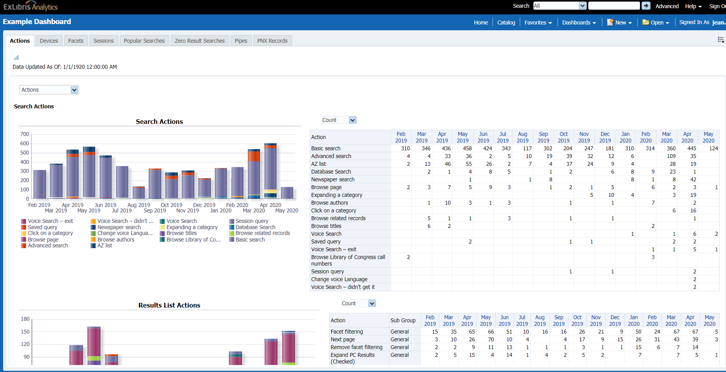
What are Primo Analytics?
Allow us to build, customize, and run reports on Primo activities
Oracle Business Intelligence Enterprise Edition (OBIEE)
Notes:
So what are analytics? Analytics in Primo allow us to build, customize, and run reports on Primo activities, like what your patrons are searching for, how they’re using facets, if they’re using basic or advanced search, and so on.
Primo Analytics is built on the Oracle Business Intelligence Enterprise Edition platform, or OBIEE. It’s a powerful tool for data analysis – which makes it pretty complicated as well. If you’re using Alma Analytics, OBIEE is going to be familiar to you.
If not, that’s OK too. Hopefully today we’ll get you started on the path to understanding how these analytics work, as well as the data that’s available to report on.

Slide 5
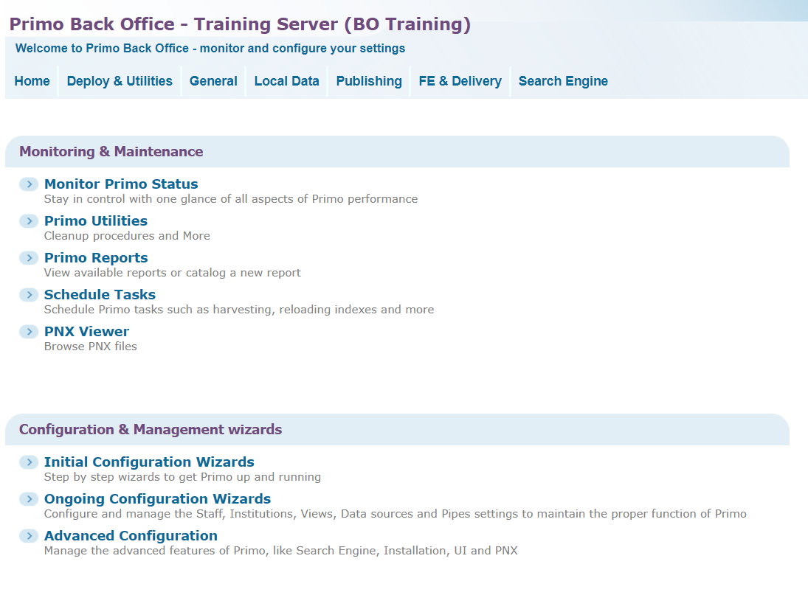
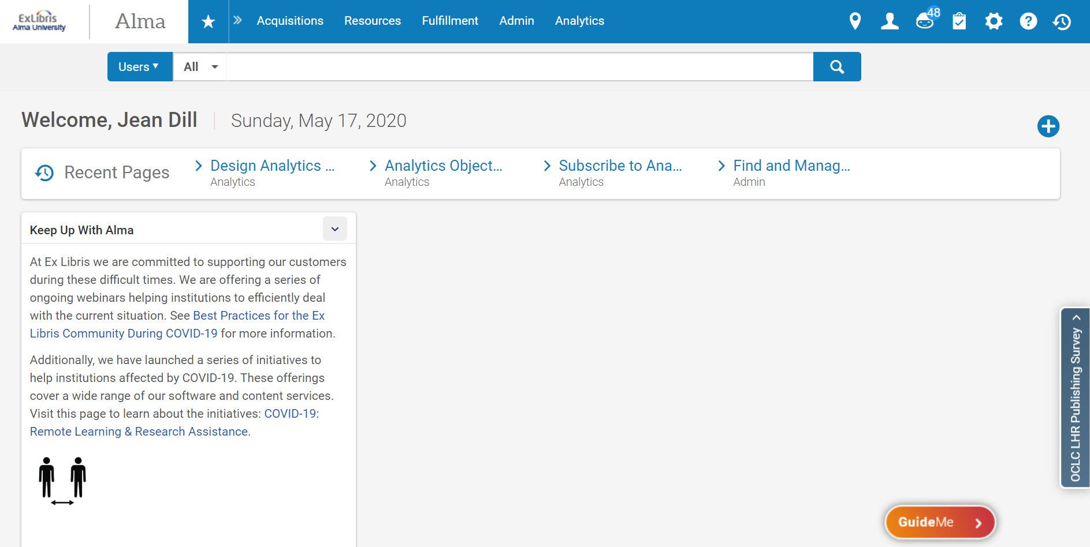
Do you access Primo via
Primo Back Office
Primo VE in Alma
Notes:
Now, we support two different Primo administrative interfaces, and it’s possible to access Analytics from each one. I’d like to conduct a quick poll to see which one you’re using. Let me get WebEx set up to give you the options – if you can, take a moment and select which Primo interface you use to access your Primo configurations. If you don’t know, or don’t have access to Primo yet, don’t worry – just select ‘don’t know’.
If you’re using Primo without Alma, generally you’re going to be accessing the Primo administrative interface using the Back Office. If you have Alma, most likely you’re going to be using Primo VE, unless you had Primo before you implemented Alma and haven’t switched over yet.
OK – thank you!
Now it doesn’t matter how you get to Primo Analytics – the OBI interface is the same. There are a few differences in what’s available to report on, and I’ll point those out as we go, but for the most part, they’re the same.

Slide 6
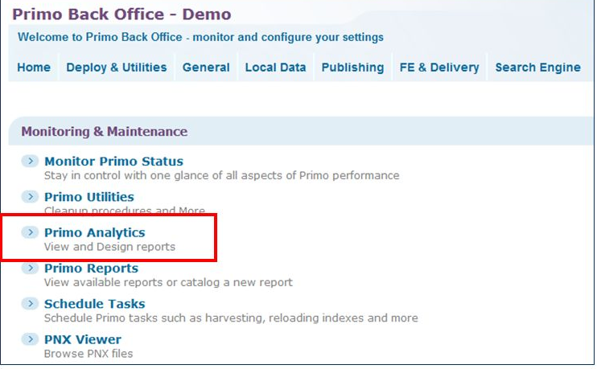
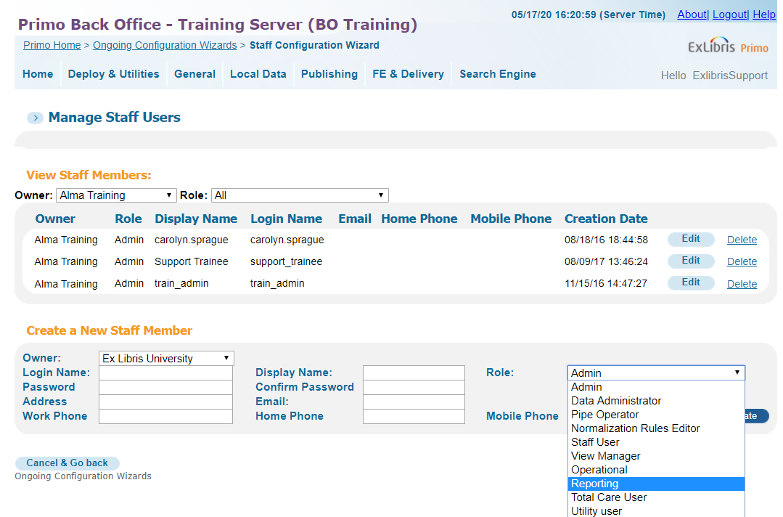
Primo Back Office
Notes:
All right. If you’re using the Primo Back Office to get to Primo Analytics, you would use the Primo Analytics link under Monitoring and Maintenance.
(click) Most of the user roles have access to Primo Analytics – the exception being the Utility User (that’s for the File Utility / Customization Package uploader). The Reporting role is specifically for Analytics – so if you have a user that just needs access to Analytics, that would be the one to choose.

Slide 7
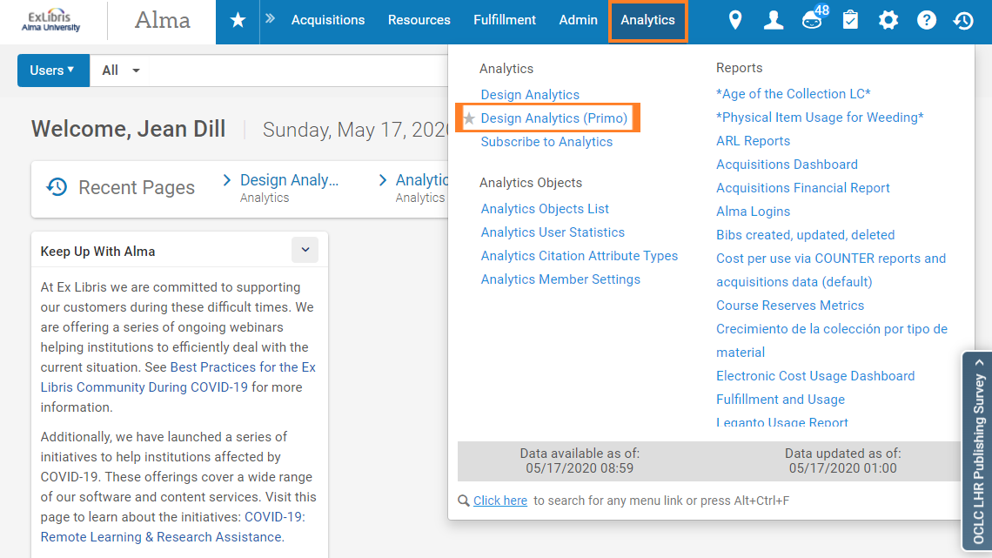
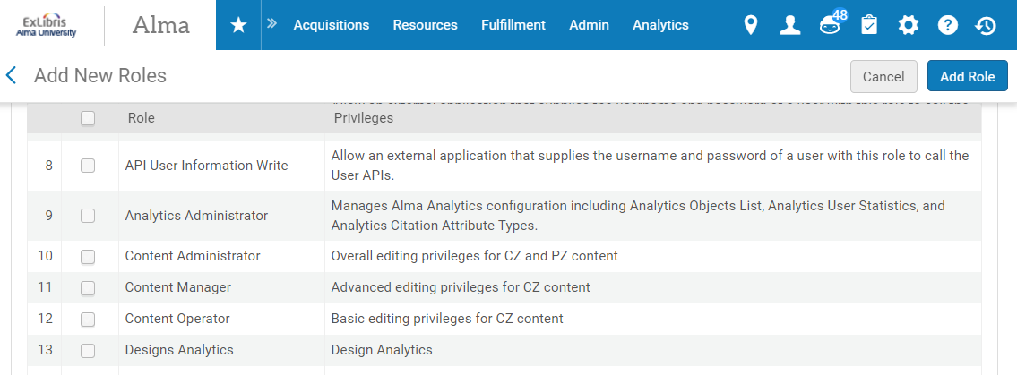
Primo VE in Alma
Notes:
If you have Primo VE in Alma, you go to Analytics in the main menu, then Design Analytics Primo.
(click) You’ll need either the Designs Analytics or the Analytics Administrator role; if you’ll be scheduling reports, you’ll need the Analytics Administrator role.
Today we’re going to go to Primo Analytics using Primo VE.
Let’s go there now.
(go to demo)

Slide 8
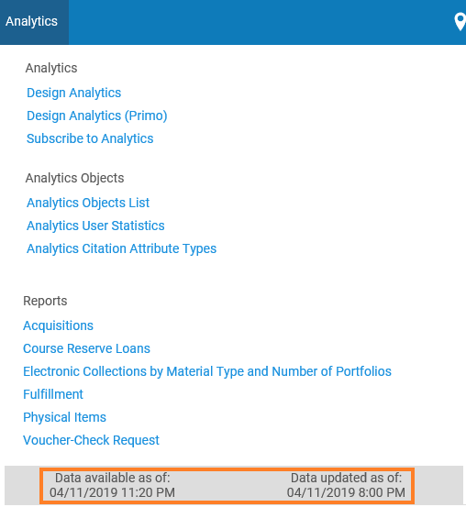
Design Analytics (DEMO)
Data updated as of: Reflects when the extraction process started, so everything that's happened up to this date and time in Alma will be represented in the Analytics
Data available as of: Reflects when this latest extraction became available.
Notes:
To get to Analytics, I'm going to click on the Analytics link. Before we go into the OBIEE platform though, I'd like to point out a few things. Notice the information here in the gray bar? We have two timestamps - and they tell us how up-to-date the data in Analytics is going to be. There is a process that extracts data from Alma, and loads it into the OBIEE environment so that we can generate analytics from it. The Data Updated as of date reflects when this process started, so everything that's happened up to this date and time in Alma will be represented in the Analytics. The Data available as of date reflects when this latest extraction became available.

Slide 9
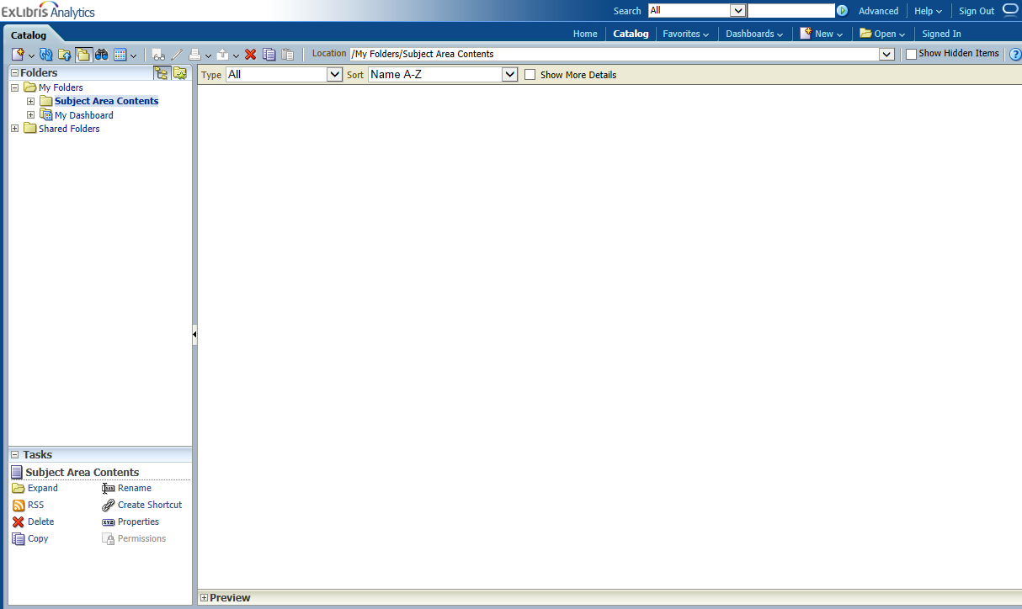
Global Header - Catalog (DEMO)
Catalog – first screen after logging in
Where all reports are saved, including personal and shared
Arranged into Folders (left pane)
  My folders – personal reports and dashboards (your login)
  Shared folders – reports and dashboards shared at various levels in subfolders
    Primo – out of the box, not editable, but can copy & modify
    Primo Community – reports and dashboards created by fellow Primo Customers, shared and updated on Fridays
    Primo Institution – your institutions’ shared reports and dashboards.
Notes:
Catalog is the default screen you’ll come into when you log in.
This is where all reports are saved, including personal and shared reports.
Over here in the left pane, I’m going to expand these folders.
The center of the screen shows me what’s in each folder and will allow me to access any of the objects in that folder.
The first one, My Folders, is going to contain everything that I create that is associated with my login – Primo Analytics User (up here in the right).
This means that I can create my own reports – and they’re separate from other people who may have user accounts for this institution.
In other words, you have your own login, and anything you create in the My Folders area is not shared with anyone else in your library – unless you use the Shared Folders.
The Shared Folders, are objects that are shared, and who they’re shared with depends on which folder you’re in.
The Primo folder contains some out-of-the-box reports and dashboards.
They’re not editable, but we can copy and modify them.
We’ll spend some time in this session going over each of these reports.
The Primo Community folder contains reports and dashboards created by fellow Primo Customers.
If you decide to create and share reports or dashboards with other libraries, you can place them here.
This folder is updated on Fridays.
And last, but not least, we have our Primo Alma University institution.
Any reports or dashboards that you want to share with other staff at your library should go here.
If you create a report that you want to schedule later on, you’ll want to include it here in this shared institution folder.
You can move or copy reports from one folder to another.

Slide 10
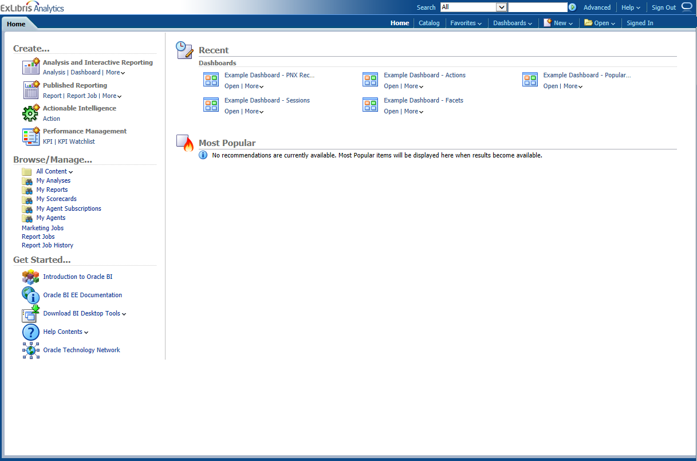
Global Header - Home (DEMO)
Centralized workspace
Recent Activity – where I’ve just been
Most Popular
Create
Browse/Manage
Get Started – Help documentation pertaining to Oracle Business Intelligence (not related to Primo data)
Notes:
The next screen is the Home tab.
The Home tab is a centralized workspace.
Recent activity shows where I’ve just been. The first time you log in, this will be blank, but as you start working, your recent activity will show up here.
Most popular is going to keep track of the places I regularly go.
On the left I can create, browse and manage objects – generally you won’t be doing these things from here when you first start out – there are other ways to get to this content.
The Get Started area, though, will bring you to Oracle’s documentation for the OBI. The help files here are not related to the Primo data itself, they’re documentation on how to implement and use OBI. I’d recommend that you refer to the Primo documentation before going here. Ex Libris has installed and implemented OBI to work with Alma and Primo in specific ways, and the documentation here covers how to do that as well as how to use some of the features within OBI.

Slide 11
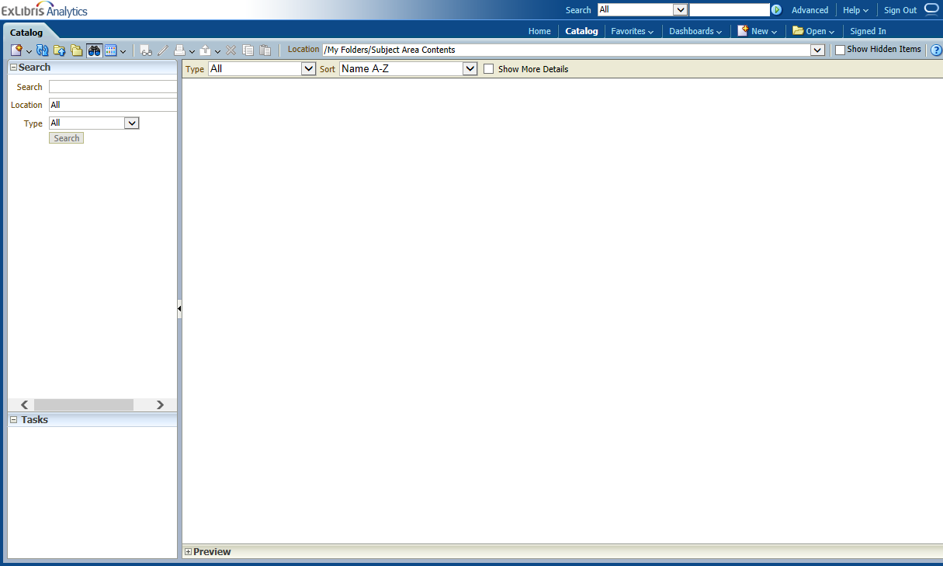
Global Header - Help (DEMO)
Oracle Business Intelligence Enterprise Edition (OBI EE) Help
Not specifically for Primo Analytics
Dynamically changes to display the Help topic for current page
Notes:
You can also get to the Help documentation here in the top right hand corner.
If you use this way to access help, you’ll notice that the help content will change to display the topic for the current page you’re on.

Slide 12
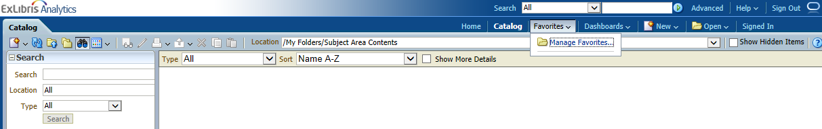
Global Header - Favorites (DEMO)
The favorites functionality allows you to bookmark catalog objects that you view regularly
Notes:
Favorites allows you to bookmark objects so that you can access them quickly over and over again.

Slide 13
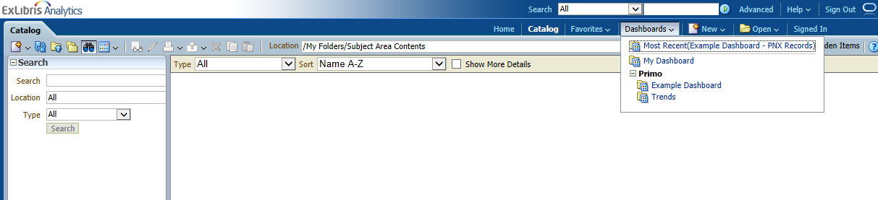
Global Header - Dashboards (DEMO)
A shortcut to all available dashboards that are saved in the dedicated dashboard subfolders
Notes:
And dashboards gives you a shortcut to all available dashboards that are saved in the dedicated dashboard subfolders.

Slide 14
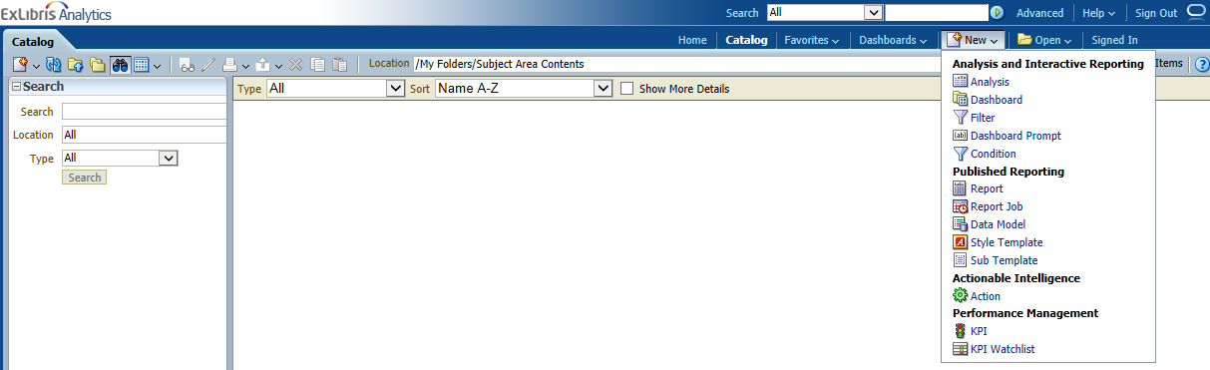
Global Header - New (DEMO)
Displays a list of the OBI objects that can be created.
This document describes the Analysis option (which creates new reports) and the Dashboard option (which creates dashboards).
Notes:
The New option allows you to quickly create new analyses for reports, dashboards, and other objects in the OBI.

Slide 15
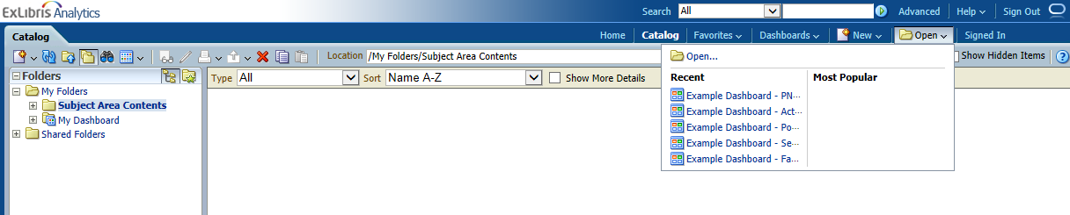
Global Header - Open (DEMO)
Displays
Recently accessed objects (reports, dashboards)
Most popular objects (objects accessed most often)
Notes:
And the Open option provides a shortcut to the Recent and Most Popular activity.

Slide 16
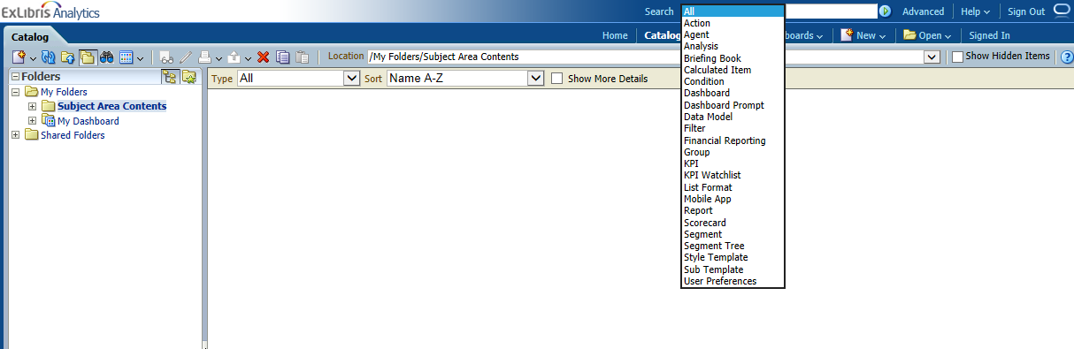
Global Header - Search (DEMO)
Search the Catalog, including all of the objects created in OBI (reports, dashboards, and more)
Notes:
Search allows you to search the Catalog, which includes all of the objects created in OBI.

Slide 17
Global Header - Advanced Search (DEMO)
Displays Catalog page in search mode – search pane (left) shows rather than the Folders pane
Notes:
And the Advanced Search displays the Catalog page in search mode, instead of with the folders pane.
I can get back to the Folders by clicking on this icon here to the left of the binoculars icon just above the pane.

Slide 18
Global Header - Account Information (DEMO)
Sign In/Out
See Account information associated with your login to the Primo Back Office
Specify Time Zone, etc.
Notes:
The last area in the global header I’d like to mention is the Account area.
We can see that I’m signed in as the Primo Analytics User, and I could sign out here if I wanted to.
If I click the dropdown on my account name, I can go to My account where I can specify preferences like my time zone.
(go to ppt)

Slide 19
Primo Analytics
Dashboards and Reports
Create Your Own
Scheduling Analytics
Notes:
Ok- let’s move on to Dashboards and Reports.

Slide 20
What are Dashboards?
Dashboards provide a personalized view of information
Can consist of one or more pages (or tabs)
Can include reports, graphs, and prompts (objects)
Can be shared with other users
Notes:
What are dashboards?
Dashboards provide a personalized view of information
Can consist of one or more pages
Can include reports, graphs, and prompts (objects)
Can be shared with other users

Slide 21
What are Reports?
Reports are responses that return after executing a query
Can be formatted
Presented on a dashboard page
Saved
Shared with other users
Notes:
Reports are responses that return after executing a query.
Can be formatted
Presented on a dashboard page
Saved
Shared with other users
Let’s go ahead and see the out of the box dashboards that are available in Analytics.
(Go to demo)

Slide 22
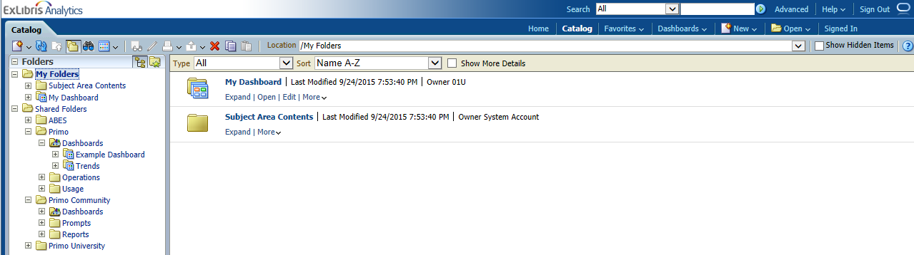
Getting to the Dashboards (DEMO)
Global Header Dashboards Primo – Example Dashboard
Global Header Catalog Folders Shared Folders Primo Dashboards – Example Dashboard
Notes:
Remember that the Example Dashboard contains the out of the box reports

Slide 23
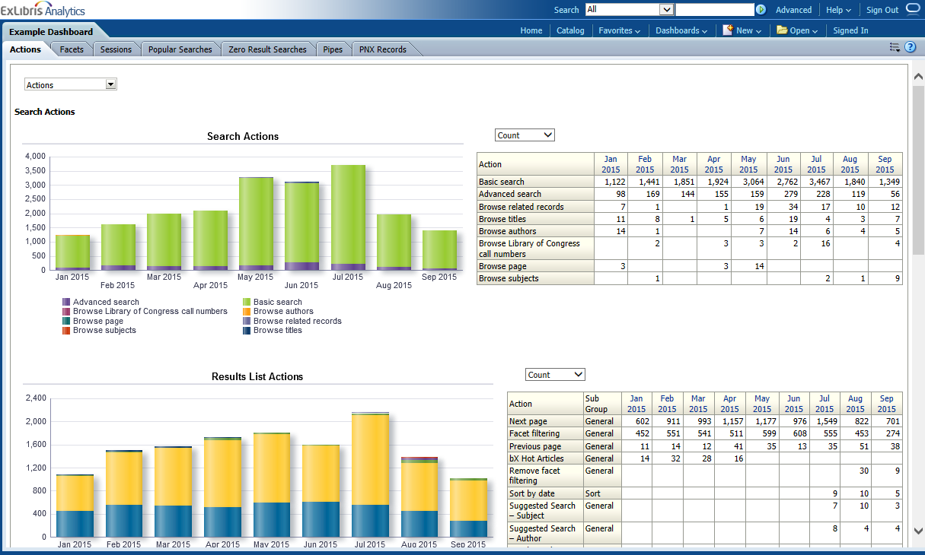
Example Dashboard (DEMO)
Notes:
Contain Multiple reports
Tabs
Information presented in both graphs and tables

Slide 24
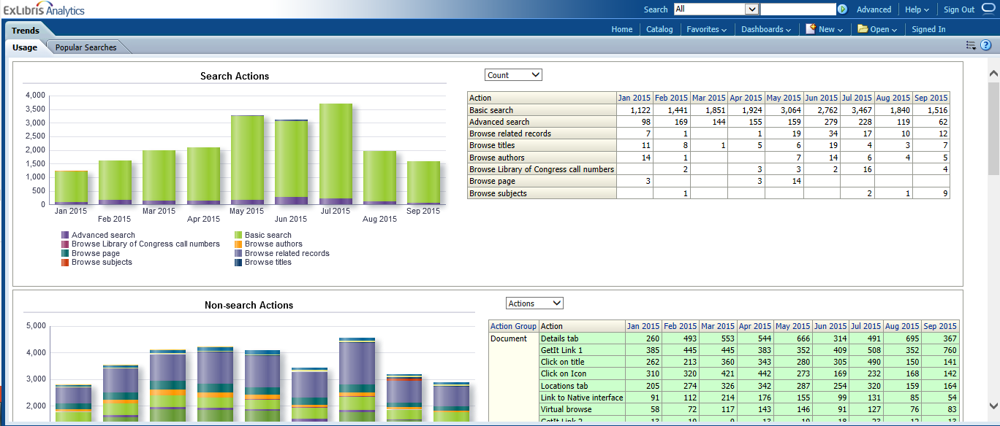
Trends Dashboard (DEMO)
Notes:
Two tabs – usage and popular searches
The Trends dashboard includes the Actions and Popular Searches reports (also in Example dashboard)

Slide 25
Creating Your Own Dashboard (DEMO)
Global Header
Dashboards
My Dashboard
My Dashboard will apply to the login account

Slide 26
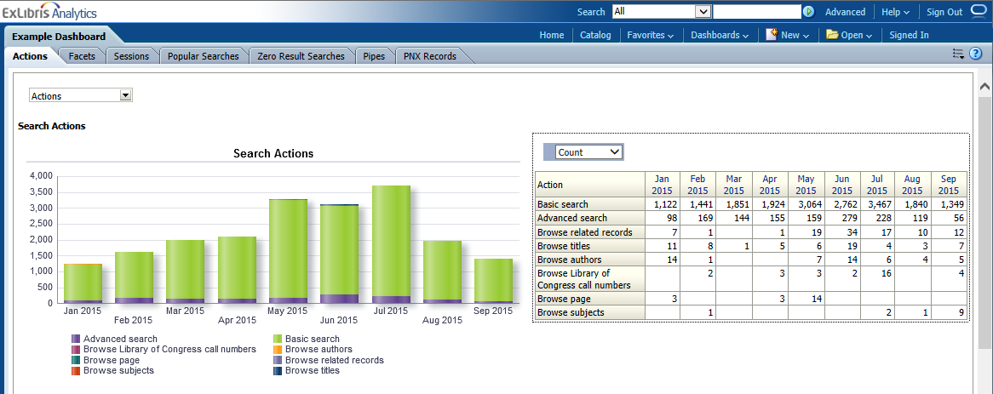
Reports – Actions – Search Actions – Actions – By Count
First report on the actions tab
Monthly report of actions taken by end users related to search
Left prompt options
  Number of actions per month
  Number of sessions in which actions were invoked
  Number of times action was invoked when user signed
Right prompt options
  By count (see the scale/magnitude)
  By percentage (see it in relation to other data)
Notes:
First report on the actions tab
Monthly report of actions taken by end users related to search
Left prompt options
Number of actions per month
Number of sessions in which actions were invoked
Number of times action was invoked when user signed
Right prompt options
By count (see the scale/magnitude)
By percentage (see it in relation to other data)

Slide 27
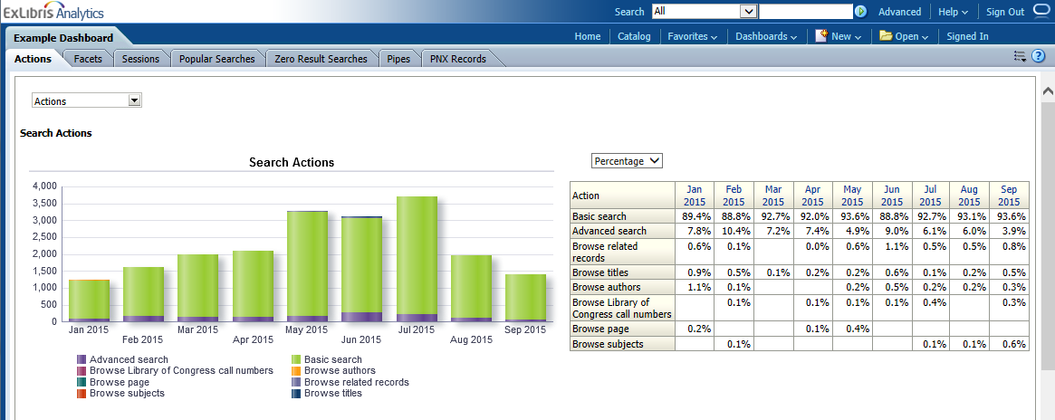
Reports – Actions – Search Actions – Actions – By Percentage
First report on the actions tab
Monthly report of actions taken by end users related to search
Left prompt options
  Number of actions per month
  Number of sessions in which actions were invoked
  Number of times action was invoked when user signed
Right prompt options
  By count (see the scale/magnitude)
  By percentage (see it in relation to other data)
Notes:
First report on the actions tab
Monthly report of actions taken by end users related to search
Left prompt options
Number of actions per month
Number of sessions in which actions were invoked
Number of times action was invoked when user signed
Right prompt options
By count (see the scale/magnitude)
By percentage (see it in relation to other data)

Slide 28
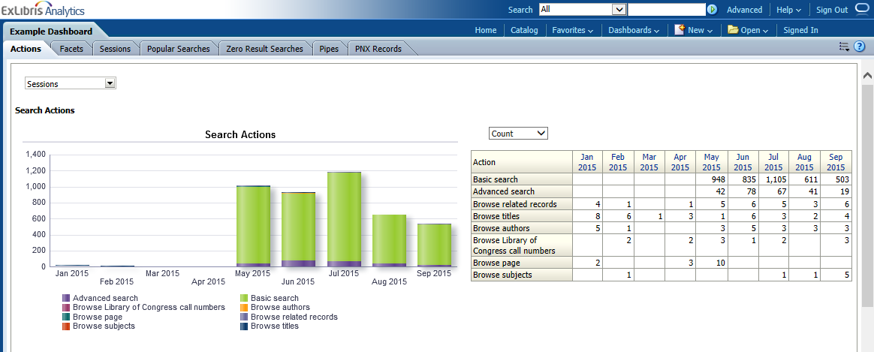
Reports – Actions – Search Actions – Sessions – By Count
First report on the actions tab
Monthly report of actions taken by end users related to search
Left prompt options
  Number of actions per month
  Number of sessions in which actions were invoked
  Number of times action was invoked when user signed
Right prompt options
  By count (see the scale/magnitude)
  By percentage (see it in relation to other data)
Notes:
First report on the actions tab
Monthly report of actions taken by end users related to search
Left prompt options
Number of actions per month
Number of sessions in which actions were invoked
Number of times action was invoked when user signed
Right prompt options
By count (see the scale/magnitude)
By percentage (see it in relation to other data)

Slide 29
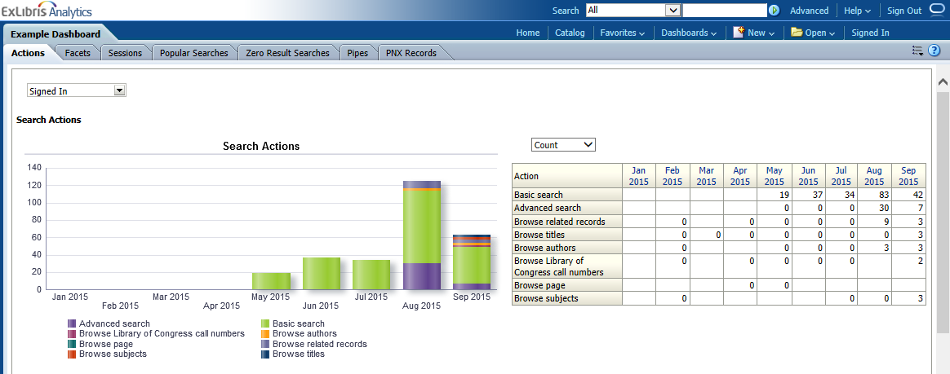
Reports – Actions – Search Actions – Signed In – By Count
First report on the actions tab
Monthly report of actions taken by end users related to search
Left prompt options
  Number of actions per month
  Number of sessions in which actions were invoked
  Number of times action was invoked when user signed
Right prompt options
  By count (see the scale/magnitude)
  By percentage (see it in relation to other data)
Notes:
First report on the actions tab
Monthly report of actions taken by end users related to search
Left prompt options
Number of actions per month
Number of sessions in which actions were invoked
Number of times action was invoked when user signed
Right prompt options
By count (see the scale/magnitude)
By percentage (see it in relation to other data)

Slide 30
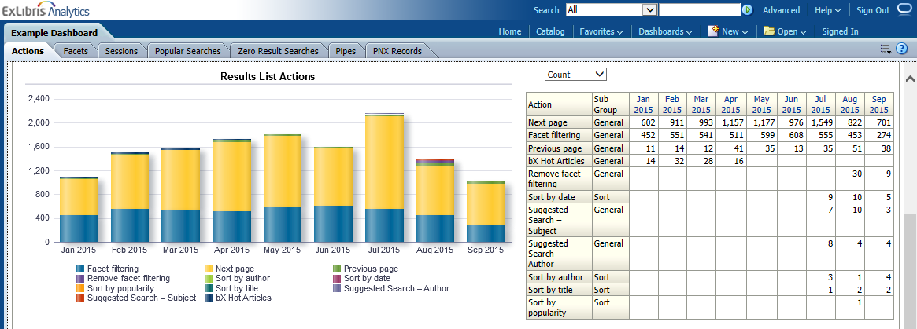
Reports – Actions – Results List Actions – Actions – By Count
Second report on the actions tab
Monthly report of actions taken by end users related to search results
Left prompt options (at the top)
  Number of actions per month
  Number of sessions in which actions were invoked
  Number of times action was invoked when user signed
Right prompt options
  By count (see the scale/magnitude)
  By percentage (see it in relation to other data)
Notes:
Second report on the actions tab
Monthly report of actions taken by end users related to search results
Left prompt options (at the top)
Number of actions per month
Number of sessions in which actions were invoked
Number of times action was invoked when user signed
Right prompt options
By count (see the scale/magnitude)
By percentage (see it in relation to other data)

Slide 31
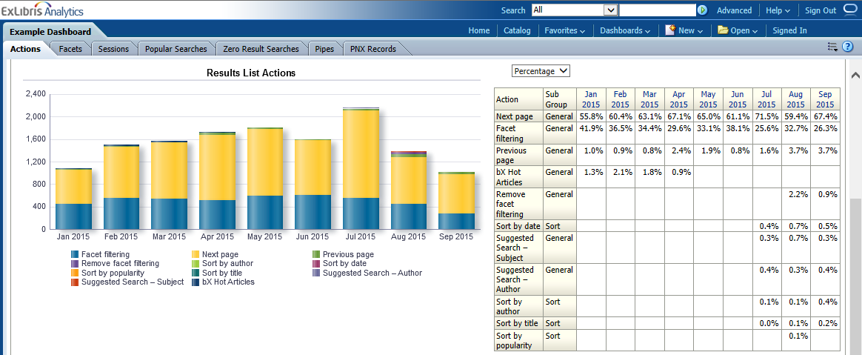
Reports – Actions – Results List Actions – Actions – By Percentage
Second report on the actions tab
Monthly report of actions taken by end users related to search results
Left prompt options (at the top)
  Number of actions per month
  Number of sessions in which actions were invoked
  Number of times action was invoked when user signed
Right prompt options
  By count (see the scale/magnitude)
  By percentage (see it in relation to other data)
Notes:
Second report on the actions tab
Monthly report of actions taken by end users related to search results
Left prompt options (at the top)
Number of actions per month
Number of sessions in which actions were invoked
Number of times action was invoked when user signed
Right prompt options
By count (see the scale/magnitude)
By percentage (see it in relation to other data)

Slide 32
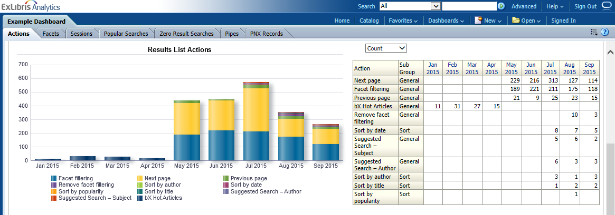
Reports – Actions – Results List Actions – Sessions – By Count
Second report on the actions tab
Monthly report of actions taken by end users related to search results
Left prompt options (at the top)
  Number of actions per month
  Number of sessions in which actions were invoked
  Number of times action was invoked when user signed
Right prompt options
  By count (see the scale/magnitude)
  By percentage (see it in relation to other data)
Notes:
Second report on the actions tab
Monthly report of actions taken by end users related to search results
Left prompt options (at the top)
Number of actions per month
Number of sessions in which actions were invoked
Number of times action was invoked when user signed
Right prompt options
By count (see the scale/magnitude)
By percentage (see it in relation to other data)

Slide 33
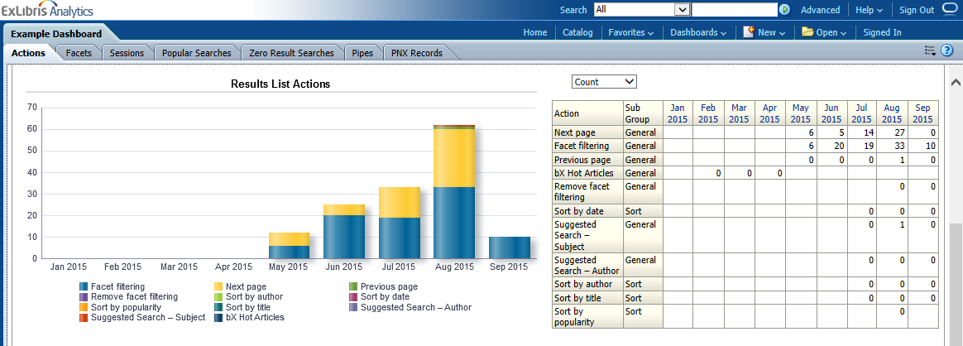
Reports – Actions – Results List Actions – Signed In – By Count
Second report on the actions tab
Monthly report of actions taken by end users related to search results
Left prompt options (at the top)
  Number of actions per month
  Number of sessions in which actions were invoked
  Number of times action was invoked when user signed
Right prompt options
  By count (see the scale/magnitude)
  By percentage (see it in relation to other data)
Notes:
Second report on the actions tab
Monthly report of actions taken by end users related to search results
Left prompt options (at the top)
Number of actions per month
Number of sessions in which actions were invoked
Number of times action was invoked when user signed
Right prompt options
By count (see the scale/magnitude)
By percentage (see it in relation to other data)

Slide 34
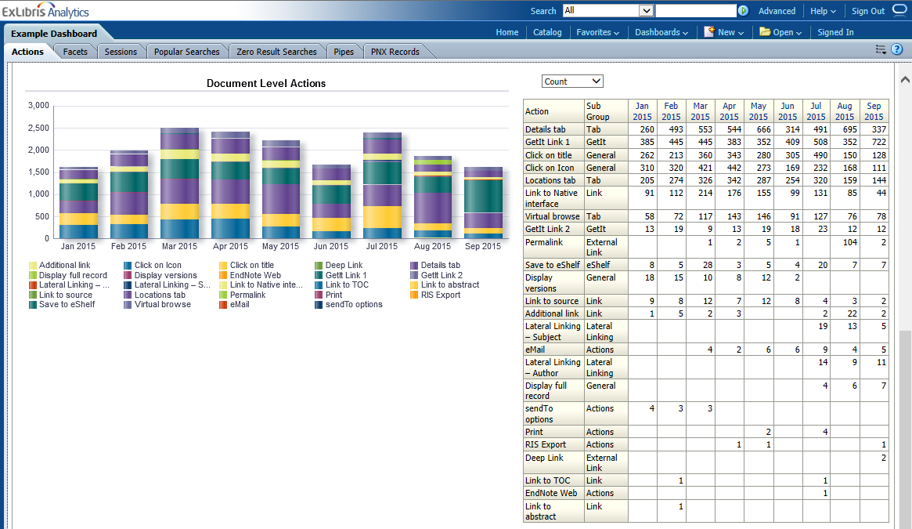
Reports – Actions – Document Level Actions – Actions – By Count
Third report on the actions tab
Monthly report of actions taken by end users related to at the document (resource) level
Left prompt options (at the top)
  Number of actions per month
  Number of sessions in which actions were invoked
  Number of times action was invoked when user signed
Right prompt options
  By count (see the scale/magnitude)
  By percentage (see it in relation to other data)
Notes:
Third report on the actions tab
Monthly report of actions taken by end users related to at the document (resource) level
Left prompt options (at the top)
Number of actions per month
Number of sessions in which actions were invoked
Number of times action was invoked when user signed
Right prompt options
By count (see the scale/magnitude)
By percentage (see it in relation to other data)

Slide 35
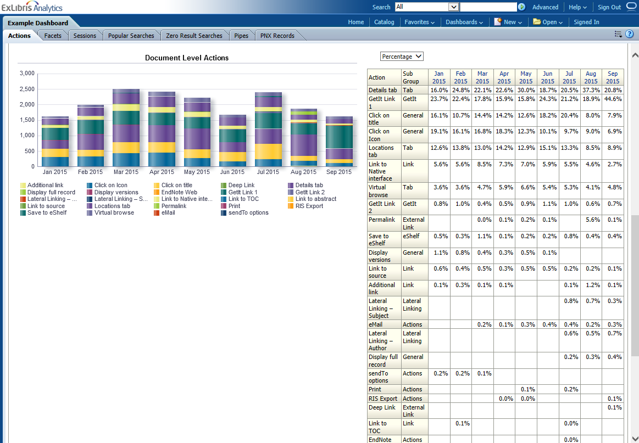
Reports – Actions – Document Level Actions – Actions – By %
Third report on the actions tab
Monthly report of actions taken by end users related to at the document (resource) level
Left prompt options (at the top)
  Number of actions per month
  Number of sessions in which actions were invoked
  Number of times action was invoked when user signed
Right prompt options
  By count (see the scale/magnitude)
  By percentage (see it in relation to other data)
Notes:
Third report on the actions tab
Monthly report of actions taken by end users related to at the document (resource) level
Left prompt options (at the top)
Number of actions per month
Number of sessions in which actions were invoked
Number of times action was invoked when user signed
Right prompt options
By count (see the scale/magnitude)
By percentage (see it in relation to other data)

Slide 36
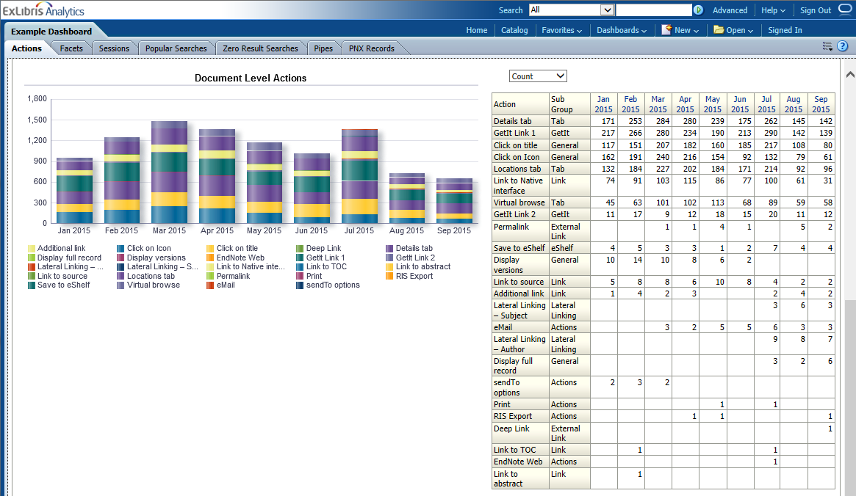
Reports – Actions – Document Level Actions – Sessions – By Count
Third report on the actions tab
Monthly report of actions taken by end users related to at the document (resource) level
Left prompt options (at the top)
  Number of actions per month
  Number of sessions in which actions were invoked
  Number of times action was invoked when user signed
Right prompt options
  By count (see the scale/magnitude)
  By percentage (see it in relation to other data)
Notes:
Third report on the actions tab
Monthly report of actions taken by end users related to at the document (resource) level
Left prompt options (at the top)
Number of actions per month
Number of sessions in which actions were invoked
Number of times action was invoked when user signed
Right prompt options
By count (see the scale/magnitude)
By percentage (see it in relation to other data)

Slide 37
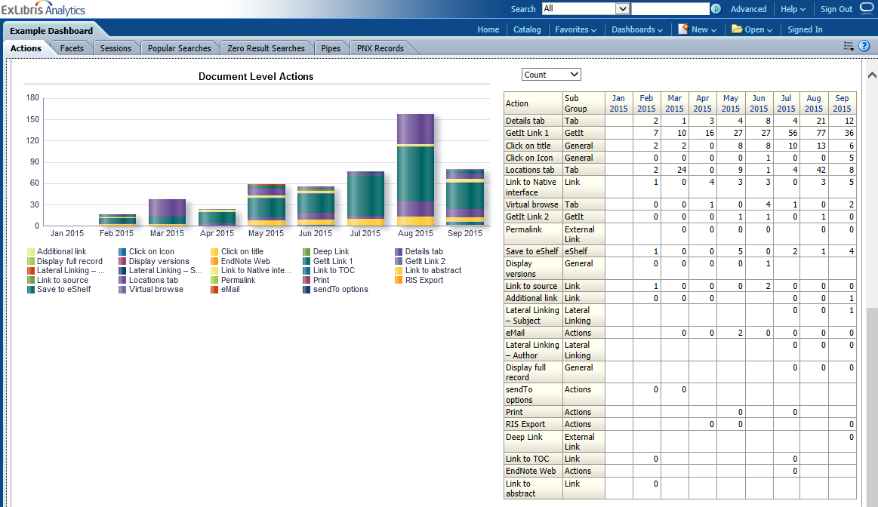
Reports – Actions – Document Level Actions – Signed In – By Count
Third report on the actions tab
Monthly report of actions taken by end users related to at the document (resource) level
Left prompt options (at the top)
  Number of actions per month
  Number of sessions in which actions were invoked
  Number of times action was invoked when user signed
Right prompt options
  By count (see the scale/magnitude)
  By percentage (see it in relation to other data)
Notes:
Third report on the actions tab
Monthly report of actions taken by end users related to at the document (resource) level
Left prompt options (at the top)
Number of actions per month
Number of sessions in which actions were invoked
Number of times action was invoked when user signed
Right prompt options
By count (see the scale/magnitude)
By percentage (see it in relation to other data)

Slide 38
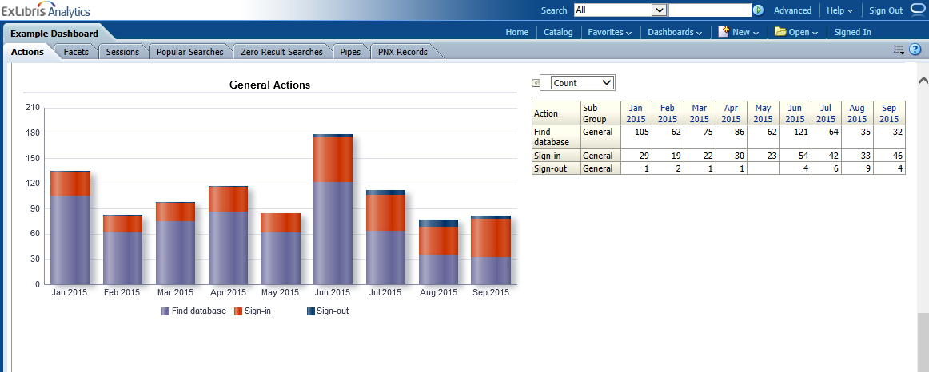
Reports – Actions – General Actions – Actions – By Count
Fourth and last report on the actions tab
Monthly report of actions taken by end users related to general actions like signing in, signing out, and using Find Database (if you have MetaLib)
Left prompt options (at the top)
  Number of actions per month
  Number of sessions in which actions were invoked
  Number of times action was invoked when user signed
Right prompt options
  By count (see the scale/magnitude)
  By percentage (see it in relation to other data)
Notes:
Fourth and last report on the actions tab
Monthly report of actions taken by end users related to general actions like signing in, signing out, and using Find Database (if you have MetaLib)
Left prompt options (at the top)
Number of actions per month
Number of sessions in which actions were invoked
Number of times action was invoked when user signed
Right prompt options
By count (see the scale/magnitude)
By percentage (see it in relation to other data)

Slide 39
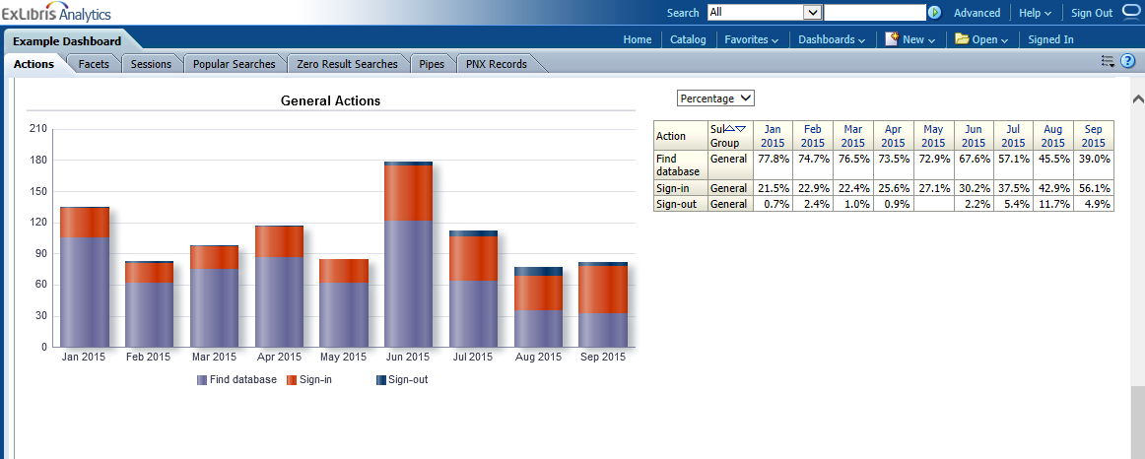
Reports – Actions – General Actions – Actions – By Percentage
Fourth and last report on the actions tab
Monthly report of actions taken by end users related to general actions like signing in, signing out, and using Find Database (if you have MetaLib)
Left prompt options (at the top)
  Number of actions per month
  Number of sessions in which actions were invoked
  Number of times action was invoked when user signed
Right prompt options
  By count (see the scale/magnitude)
  By percentage (see it in relation to other data)
Notes:
Fourth and last report on the actions tab
Monthly report of actions taken by end users related to general actions like signing in, signing out, and using Find Database (if you have MetaLib)
Left prompt options (at the top)
Number of actions per month
Number of sessions in which actions were invoked
Number of times action was invoked when user signed
Right prompt options
By count (see the scale/magnitude)
By percentage (see it in relation to other data)

Slide 40
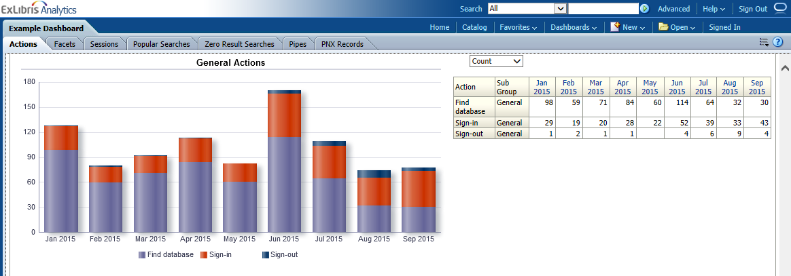
Reports – Actions – General Actions – Sessions – By Count
Fourth and last report on the actions tab
Monthly report of actions taken by end users related to general actions like signing in, signing out, and using Find Database (if you have MetaLib)
Left prompt options (at the top)
  Number of actions per month
  Number of sessions in which actions were invoked
  Number of times action was invoked when user signed
Right prompt options
  By count (see the scale/magnitude)
  By percentage (see it in relation to other data)
Notes:
Fourth and last report on the actions tab
Monthly report of actions taken by end users related to general actions like signing in, signing out, and using Find Database (if you have MetaLib)
Left prompt options (at the top)
Number of actions per month
Number of sessions in which actions were invoked
Number of times action was invoked when user signed
Right prompt options
By count (see the scale/magnitude)
By percentage (see it in relation to other data)

Slide 41
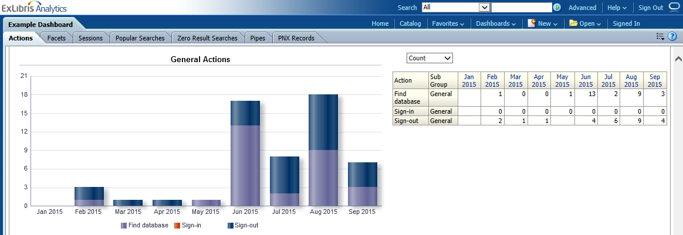
Reports – Actions – General Actions – Sign In – By Count
Fourth and last report on the actions tab
Monthly report of actions taken by end users related to general actions like signing in, signing out, and using Find Database (if you have MetaLib)
Left prompt options (at the top)
  Number of actions per month
  Number of sessions in which actions were invoked
  Number of times action was invoked when user signed
Right prompt options
  By count (see the scale/magnitude)
  By percentage (see it in relation to other data)
Notes:
Fourth and last report on the actions tab
Monthly report of actions taken by end users related to general actions like signing in, signing out, and using Find Database (if you have MetaLib)
Left prompt options (at the top)
Number of actions per month
Number of sessions in which actions were invoked
Number of times action was invoked when user signed
Right prompt options
By count (see the scale/magnitude)
By percentage (see it in relation to other data)

Slide 42
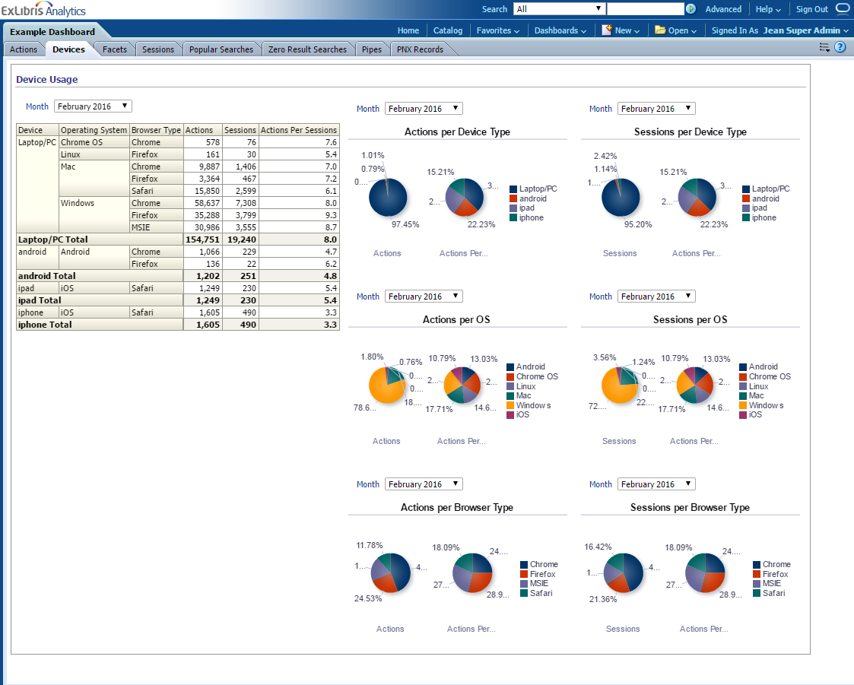
Reports – Devices
Monthly report of devices used to access Primo
Measures actions and sessions by
  Device Type
  Operating System
  Browser Type
Notes:
Monthly report of devices used to access Primo
Measures actions and sessions by
Device Type (laptop, android, ipad, iphone)
Operating System
Browser Type

Slide 43
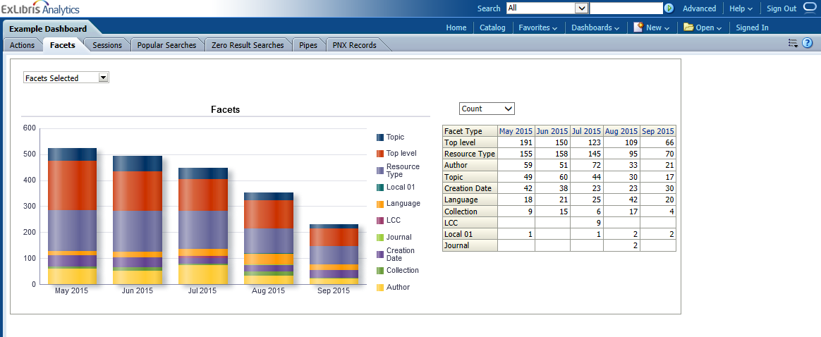
Reports – Facets – Facets Selected – By Count
Monthly report of the number of times specific facets were used
Left prompt options
  Number of times facets were used per month
  Number of sessions in which facets were used
Right prompt options
  By count (see the scale/magnitude)
  By percentage (see it in relation to other data)
Notes:
Monthly report of the number of times specific facets were used
Left prompt options
Number of times facets were used per month
Number of sessions in which facets were used
Right prompt options
By count (see the scale/magnitude)
By percentage (see it in relation to other data)

Slide 44
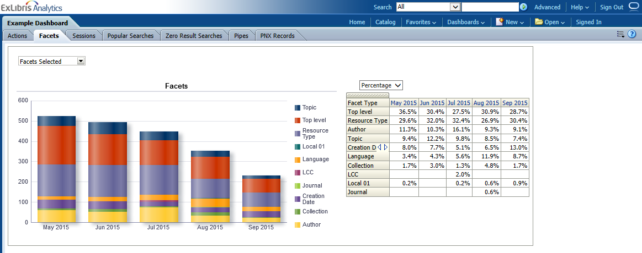
Reports – Facets – Facets Selected – By Percentage
Monthly report of the number of times specific facets were used
Left prompt options
  Number of times facets were used per month
  Number of sessions in which facets were used
Right prompt options
  By count (see the scale/magnitude)
  By percentage (see it in relation to other data)
Notes:
Monthly report of the number of times specific facets were used
Left prompt options
Number of times facets were used per month
Number of sessions in which facets were used
Right prompt options
By count (see the scale/magnitude)
By percentage (see it in relation to other data)

Slide 45
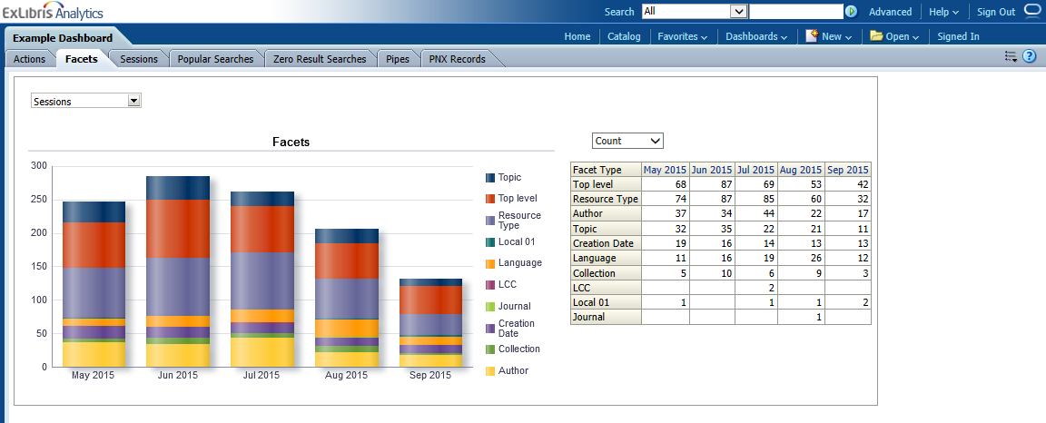
Reports – Facets – Sessions – By Count
Monthly report of the number of times specific facets were used
Left prompt options
  Number of times facets were used per month
  Number of sessions in which facets were used
Right prompt options
  By count (see the scale/magnitude)
  By percentage (see it in relation to other data)
Notes:
Monthly report of the number of times specific facets were used
Left prompt options
Number of times facets were used per month
Number of sessions in which facets were used
Right prompt options
By count (see the scale/magnitude)
By percentage (see it in relation to other data)

Slide 46
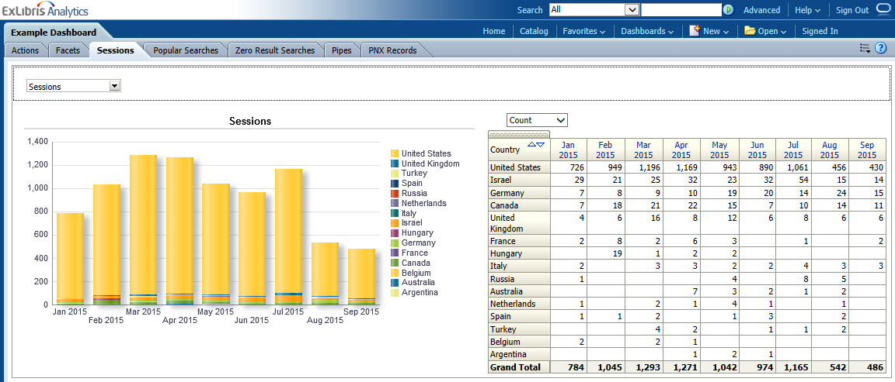
Reports – Sessions – Sessions – By Count
Monthly report of the number of sessions divided by location of end user
Left prompt options
  Number of sessions
  Average duration of sessions
  Total number of actions taken
  Number of times users signed in within a session
Right prompt options
  By count (see the scale/magnitude)
  By percentage (see it in relation to other data)
Notes:
Monthly report of the number of sessions divided by location of end user
Left prompt options
Number of sessions
Average duration of sessions
Total number of actions taken
Number of times users signed in within a session
Right prompt options
By count (see the scale/magnitude)
By percentage (see it in relation to other data)

Slide 47
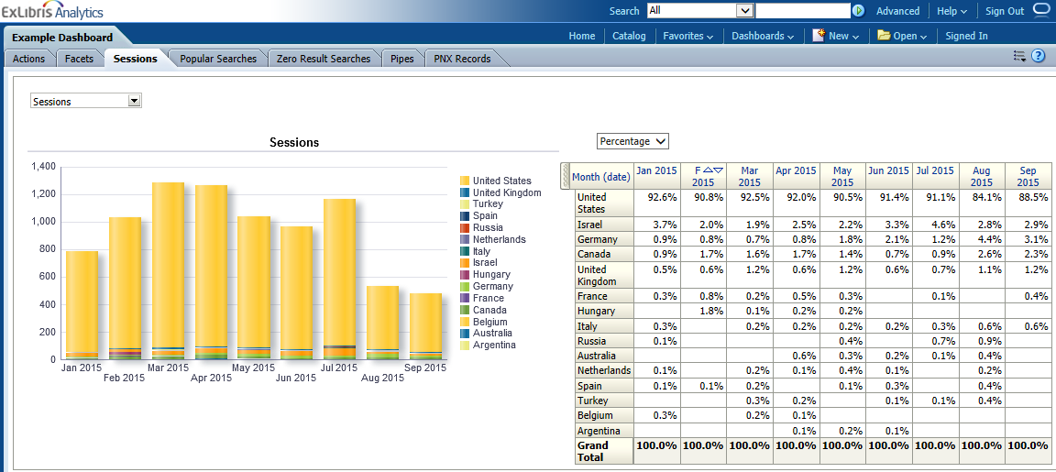
Reports – Sessions – Sessions – By Percentage
Monthly report of the number of sessions divided by location of end user
Left prompt options
  Number of sessions
  Average duration of sessions
  Total number of actions taken
  Number of times users signed in within a session
Right prompt options
  By count (see the scale/magnitude)
  By percentage (see it in relation to other data)
Notes:
Monthly report of the number of sessions divided by location of end user
Left prompt options
Number of sessions
Average duration of sessions
Total number of actions taken
Number of times users signed in within a session
Right prompt options
By count (see the scale/magnitude)
By percentage (see it in relation to other data)

Slide 48
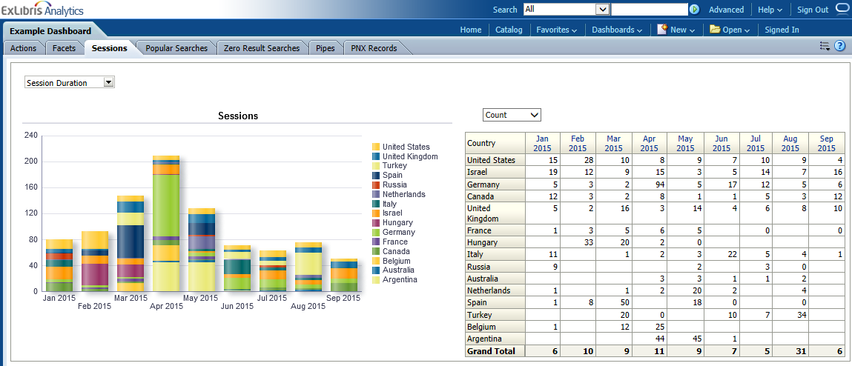
Reports – Sessions – Session Duration – By Count
Monthly report of the number of sessions divided by location of end user
Left prompt options
  Number of sessions
  Average duration of sessions
  Total number of actions taken
  Number of times users signed in within a session
Right prompt options
  By count (see the scale/magnitude)
  By percentage (see it in relation to other data)
Notes:
Monthly report of the number of sessions divided by location of end user
Left prompt options
Number of sessions
Average duration of sessions
Total number of actions taken
Number of times users signed in within a session
Right prompt options
By count (see the scale/magnitude)
By percentage (see it in relation to other data)

Slide 49
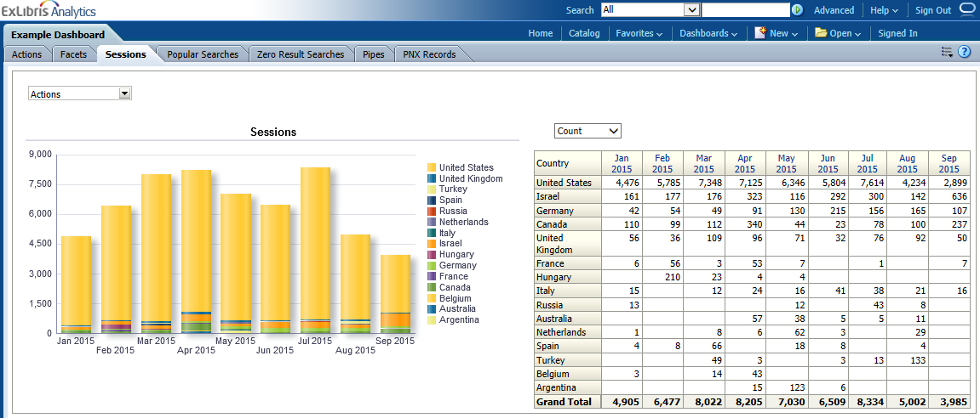
Reports – Sessions – Actions – By Count
Monthly report of the number of sessions divided by location of end user
Left prompt options
  Number of sessions
  Average duration of sessions
  Total number of actions taken
  Number of times users signed in within a session
Right prompt options
  By count (see the scale/magnitude)
  By percentage (see it in relation to other data)
Notes:
Monthly report of the number of sessions divided by location of end user
Left prompt options
Number of sessions
Average duration of sessions
Total number of actions taken
Number of times users signed in within a session
Right prompt options
By count (see the scale/magnitude)
By percentage (see it in relation to other data)

Slide 50
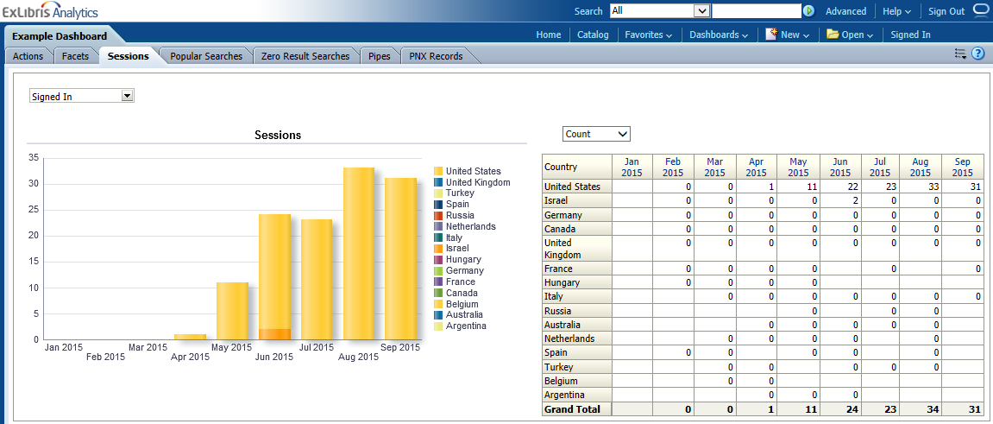
Reports – Sessions – Signed In – By Count
Monthly report of the number of sessions divided by location of end user
Left prompt options
  Number of sessions
  Average duration of sessions
  Total number of actions taken
  Number of times users signed in within a session
Right prompt options
  By count (see the scale/magnitude)
  By percentage (see it in relation to other data)
Notes:
Monthly report of the number of sessions divided by location of end user
Left prompt options
Number of sessions
Average duration of sessions
Total number of actions taken
Number of times users signed in within a session
Right prompt options
By count (see the scale/magnitude)
By percentage (see it in relation to other data)

Slide 51
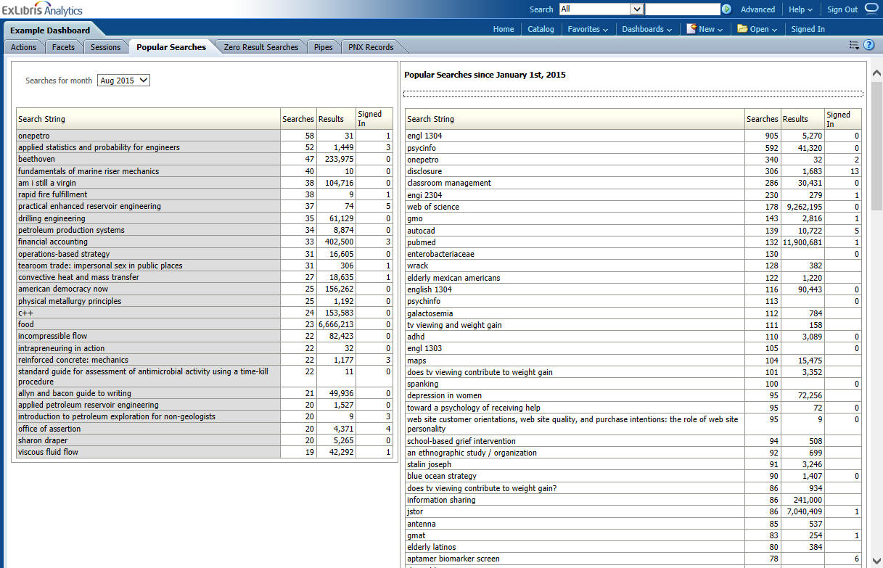
Reports – Popular Searches
Monthly report of the number of sessions divided by location of end user
Left report- see search terms for last full month, adjust to see previous months
Right report - see search terms totals for current year so far
Notes:
Monthly report of the number of sessions divided by location of end user
Left report- see search terms for last full month, adjust to see previous months
Right report - see search terms totals for current year so far

Slide 52
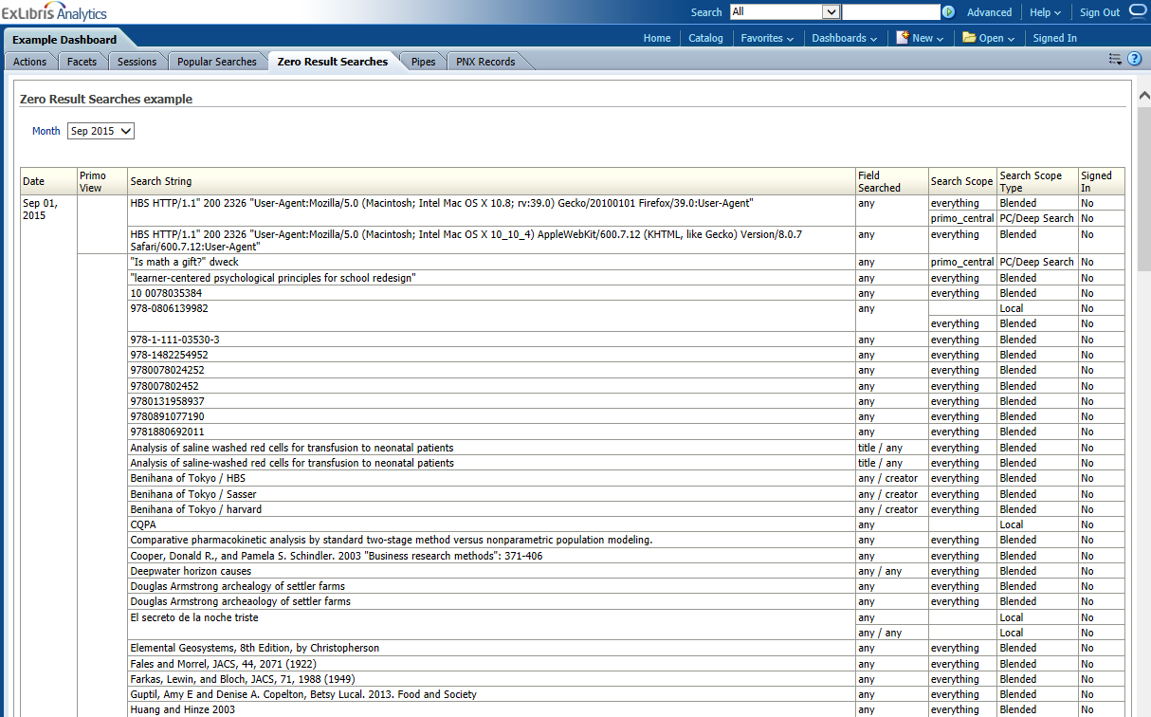
Reports – Zero Result Searches
Report of searches that found no results
Select month in prompt at the top left
Data for this report is available only from the Primo July 2015 release and after
Notes:
Report of searches that found no results
Select month in prompt at the top left
Data for this report is available only from the Primo July 2015 release and after

Slide 53
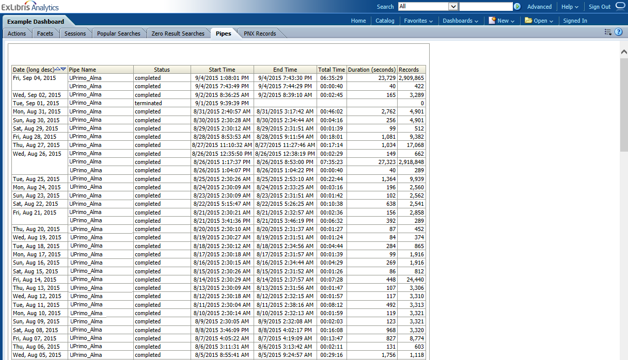
Reports – Pipes
Report of pipes that ran for your institution
Notes:
Report of pipes that ran for your institution

Slide 54
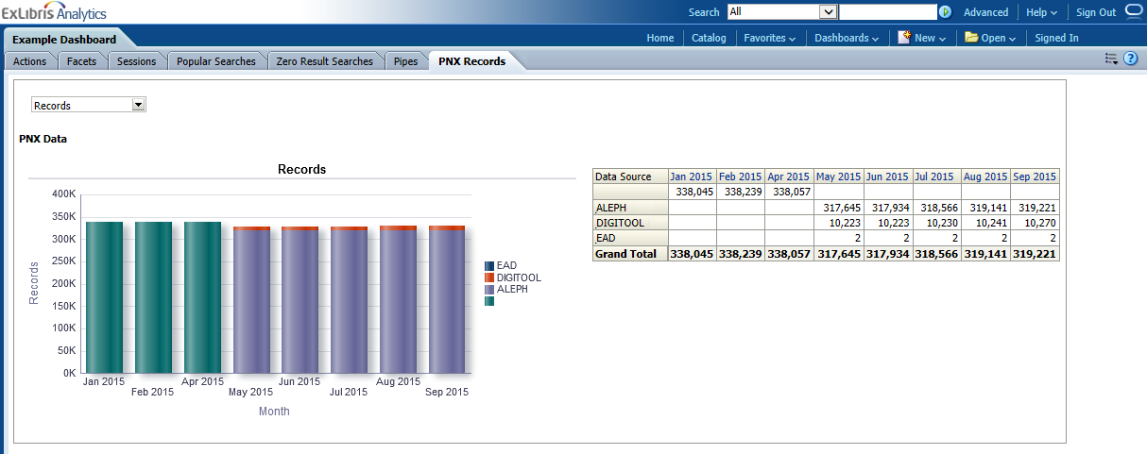
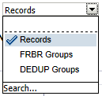
Reports – PNX Records
Monthly report of the number of PNX records per data source
Prompt at top left shows
  Number of records
  Number of FRBR groups
  Number of DEDUP groups
Notes:
Monthly report of the number of PNX records per data source
Prompt at top left shows
Number of records
Number of FRBR groups
Number of DEDUP groups
Go back to ppt

Slide 55
Primo Analytics
Dashboards & Reports
Create Your Own
Scheduling Analytics

Slide 56
Demonstration
Adding an Analysis to My Dashboard
Editing a Copied Analysis
Creating a New Analysis
Notes:
Go to demo

Slide 57
Primo Analytics
Dashboards & Reports
Create Your Own
Scheduling Analytics

Slide 58
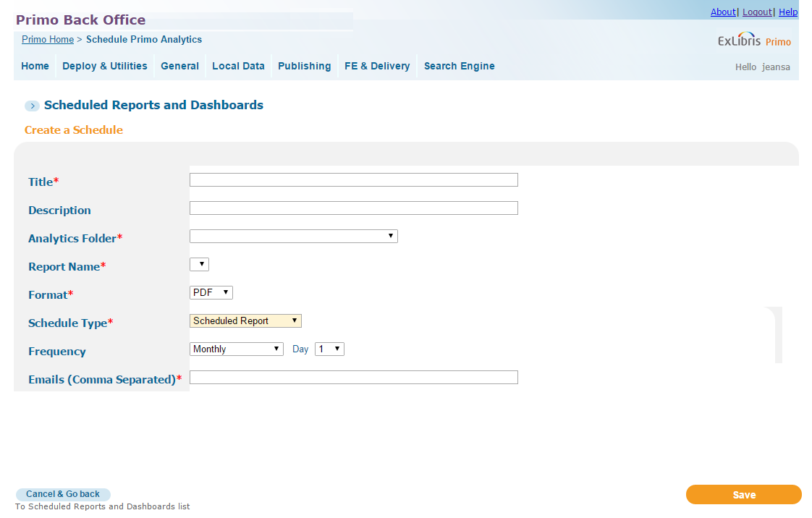
Scheduling Analytics in Primo Back Office

Slide 59

Scheduling Analytics in Primo VE (DEMO)
Notes:
Analytics reports can be made available to Alma users as Scheduled Reports. Users with any of the required roles can subscribe to the report and receive it in an email.
In the main Alma menu, go to Analytics > Analytics Objects List.
We are going to create a new scheduled report, so we will start by clicking Add New Analytics Object, then selecting Add New Alma Analytics Object.
This opens the Alma Analytics Object configuration screen.
We'll enter a Title for the Scheduled Report. This title is displayed at the top of the report when it's delivered. Then we'll select the folder in Analytics that contains the report.
Now we can select the name of the report.
In the “Type” field, we will set that to Scheduled Report. Notice that once the scheduled report option is selected, there are several additional fields that become available.
Here we can provide a description for the Scheduled Report. This description displays in the Analytics Objects List.
We'll select the Format of the report attachment, which can be PDF, excel, or text.
Then we'll select the Status. In order for the reports to be sent to users that subscribe to it, the status needs to be set to “Active.”
We'll select the Schedule - this determines how often the report will be sent out.
And then we will want to determine which user roles will have the option to subscribe to the report. We'll click Add Role, select the roles, and then click Add Role again.
When we are finished, we can Save the object.
And now we can see the new scheduled report in the list.
Since my user has one of the required roles needed to subscribe to this report, I can demonstrate how it's done.
To subscribe to a Scheduled Report, we go to Analytics > Subscribe to Analytics. Then we select the report we want to subscribe to.
Now I'll receive the report via email once a week.

Slide 60
Primo Analytics
Dashboards
Reports
Create Your Own
Scheduling Analytics
Next Steps and Resources

Slide 61
Next Steps and Resources
Links to Documentation on Primo Analytics
  Primo Analytics
  Primo VE Analytics
Additional support resources from Ex Libris:
  Idea Exchange – ideas.exlibrisgroup.com
  Developer Network – developers.exlibrisgroup.com

Slide 62
Best of Knowledge Days 2020
May 6th | Using Alma Analytics to Perform Overlap Analysis & Deselection
May 7th & 8th | Reveal Alma Analytics for Resource Management
May 11th & 12th | Investigate Alma Analytics for Acquisitions
May 13th & 14th | Managing Electronic Resources: Advanced Topic
May 14th & 15th | Letter Configuration and XSL Customization
May 18th & 19th | Intro to Primo Analytics
May 20th & 21st | Explore Alma Analytics for Fulfillment
May 21st & 22nd | APIs and Integrations for the Non-Technological
May 27th & 28th | Optimize and Streamline Alma Workflows
May 28th & 29th | Effective Usage of Primo Analytics Reports and Dashboards
https://www.exlibrisgroup.com/events/

Slide 63
Thank you!

