Slide 1
Best of Knowledge Days 2020
May 6th | Using Alma Analytics to Perform Overlap Analysis & Deselection
May 7th & 8th | Reveal Alma Analytics for Resource Management
May 11th & 12th | Investigate Alma Analytics for Acquisitions
May 13th & 14th | Managing Electronic Resources: Advanced Topic
May 14th & 15th | Letter Configuration and XSL Customization
May 18th & 19th | Intro to Primo Analytics
May 20th & 21st | Explore Alma Analytics for Fulfillment
May 21st & 22nd | APIs and Integrations for the Non-Technological
May 27th & 28th | Optimize and Streamline Alma Workflows
May 28th & 29th | Effective Usage of Primo Analytics Reports and Dashboards
https://www.exlibrisgroup.com/events/

Slide 2
Letter Configuration and XSL Customization
Knowledge Days Webinar 2020
Information and materials shared during the conferences are proprietary to Ex Libris and may contain confidential information. Except for publicly available marketing materials, we ask that you not share information, documentation or other materials provided outside of the Knowledge Days participant group and your Library without the written permission of Ex Libris. Please note that any information shared may be subject to periodic change and updating and there are no warranties of any kind, express or implied.

Slide 3
Welcome
Steven.Burke@exlibrisgroup.com
  Team member for NA Alma Support Tier 2
  Started at Ex libris in June 2018
  MLIS from Florida State University

Slide 4
Session Objectives
Session Description:
  We will show how to add fields to the letters which are not in the default versions. We will also use advanced xsl features to add fields on condition, change the formatting of the text, concatenate fields, and add conditions in the xsl whether or not to print the letter. While making these changes we will see how to preview configuration changes to the xsl before actually sending the letter.
Session Objective(s):
  By the end of this session, you will know, understand and/or be able to:
    Use the new Letters Configuration Menu
    Add customized sections to your letter XSLs

Slide 5
General Letter Management
Configuring Letter Labels
Retrieving XML
Configuring Letter XSL
Previewing XSL Changes

Slide 6
General Letter Management

Slide 7
General Letter Management
PERMISSIONS:
To configure Alma letters, you must have one of the following roles:
  General System Administrator
  Letter Administrator

Slide 8
General Letter Management
XSL Processor
XSL Stylesheet
XSL Output
XML Document
Notes:
XML – is a way to structure information. Descriptive tags are placed before and after text values. It uses a standard syntax but the tags are not standardized, you can define tags.
XSL - takes XML and styles it to a more readable format for the end user.

Slide 9
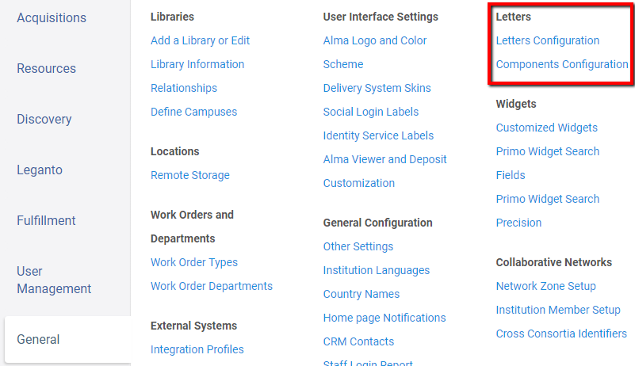

General Letter Management
Configuration Menu > General > Letters Configuration
Notes:
Letters Configuration = Allows staff to enable or disable a letter, configure the labels (text), configure the XSL, test the output of a letter, receive the XML of a specific letter, and determine how long letters are retained in attachments tab of the user
Components Configuration = Allows staff to customize templates and other components shared between letters. Components can be made up of labels and/or the template (XSL style sheet).

Slide 10
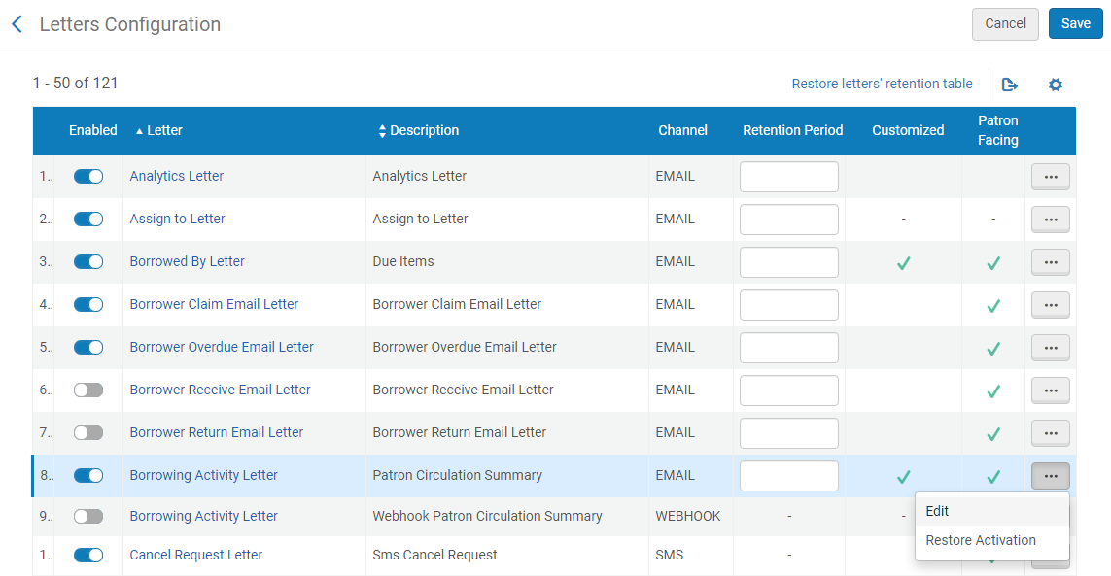
General Letter Management
Notes:
Letters Configuration = Allows staff to enable or disable a letter, configure the labels (text), configure the XSL, test the output of a letter, receive the XML of a specific letter, and determine how long letters are retained in attachments tab of the user

Slide 11
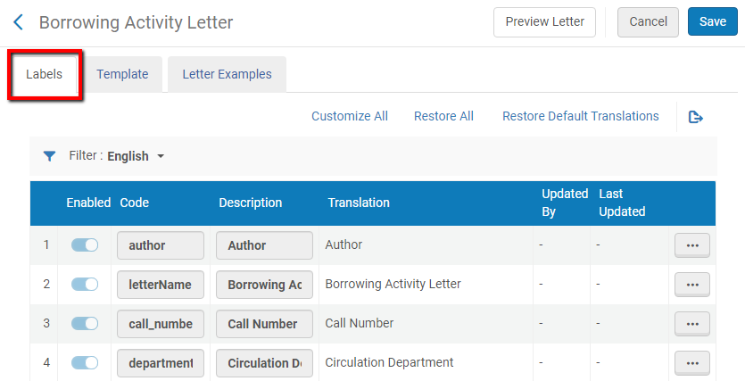
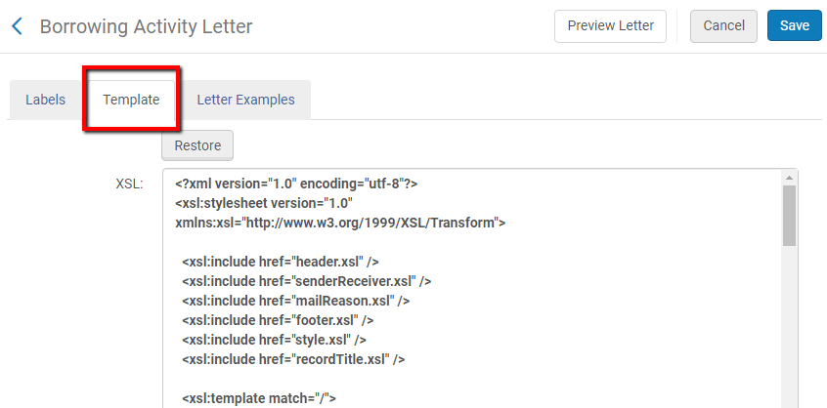
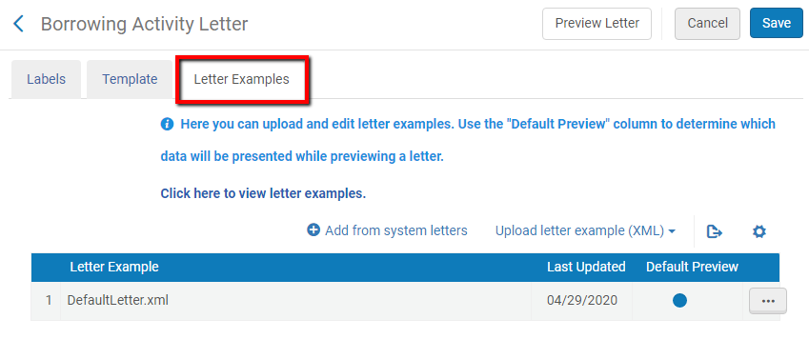
General Letter Management
Notes:
Letters Configuration = Allows staff to enable or disable a letter, configure the labels (text), configure the XSL, test the output of a letter, receive the XML of a specific letter, and determine how long letters are retained in attachments tab of the user

Slide 12
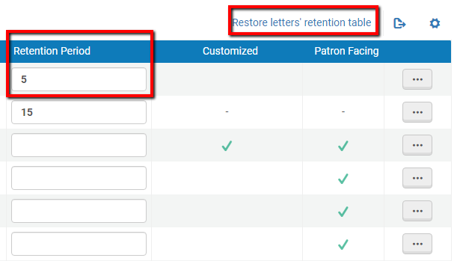
General Letter Management
Notes:
Letters Configuration = Allows staff to enable or disable a letter, configure the labels (text), configure the XSL, test the output of a letter, receive the XML of a specific letter, and determine how long letters are retained in attachments tab of the user
By default, letters sent by Alma are retained indefinitely and available on the Attachments tab of the User Details (see Managing User Attachments).
On the Letters Configuration table, you can add and/or enable letters so that they are deleted after a certain number of days. For more information about mapping tables, see Mapping Tables.
A weekly job, Letters Purge with Retention, deletes all enabled letters, if they were created more than the configured number of days ago.
Restore letters’ retention table will restore the column, emptying all values.

Slide 13
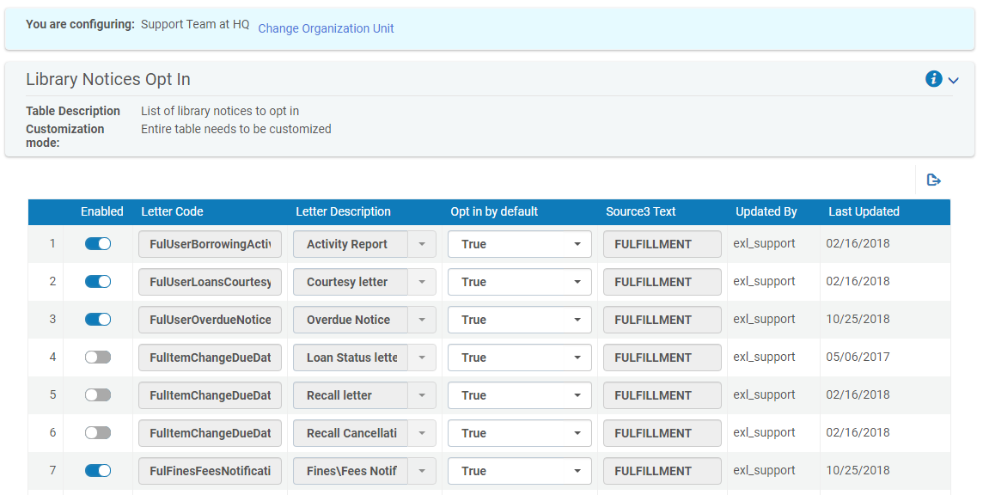
General Letter Management
Configuration > User Management > User Details > Library Notices Opt In
Notes:
Opt in/out
Some notifications may be disabled for specific users or for bulk sets of users

Slide 14
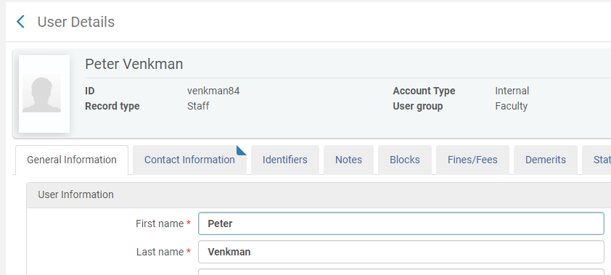
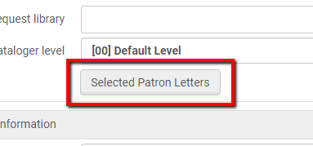
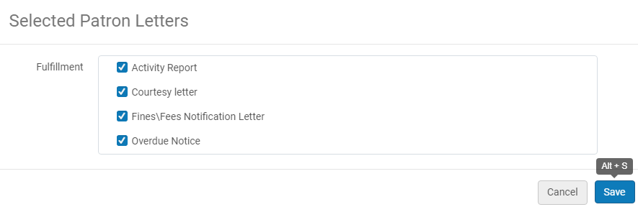
General Letter Management
Notes:
Opt in/out
Some notifications may be disabled for specific users or for bulk sets of users

Slide 15
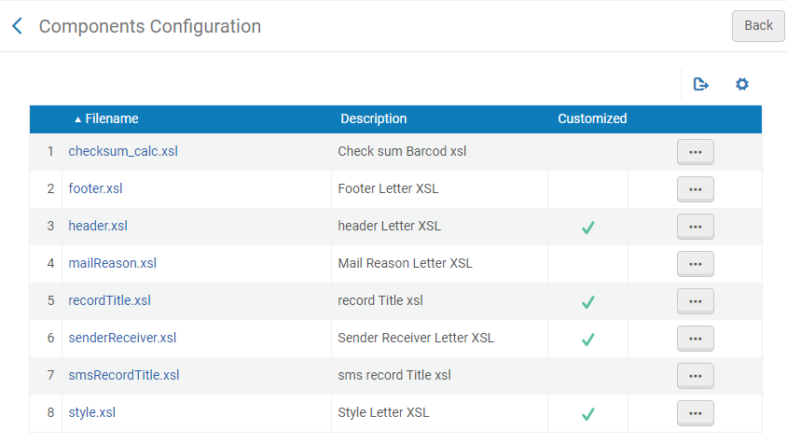
General Letter Management
Notes:
Components Configuration = Allows staff to customize templates and other components shared between letters. Components can be made up of labels and/or the template (XSL style sheet).

Slide 16
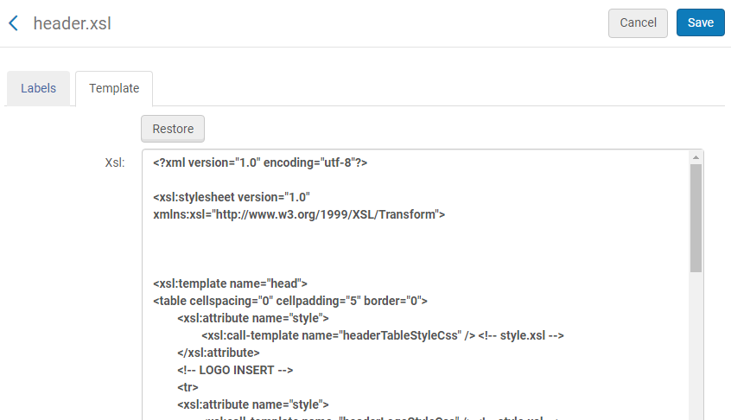
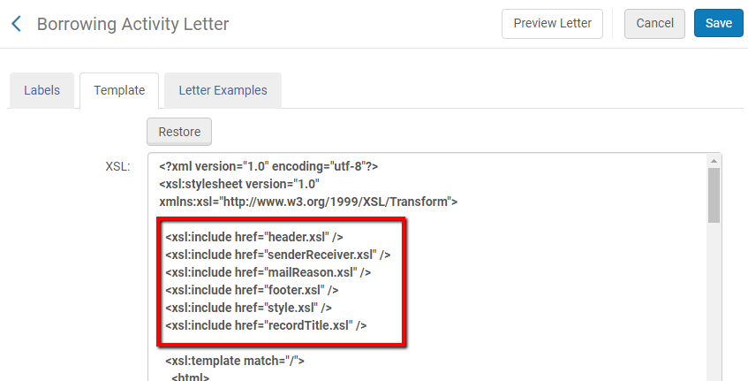
General Letter Management
Notes:
Components Configuration = Allows staff to customize templates and other components shared between letters. Components can be made up of labels and/or the template (XSL style sheet).

Slide 17
Configuring Letter Labels

Slide 18
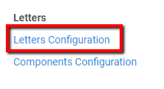
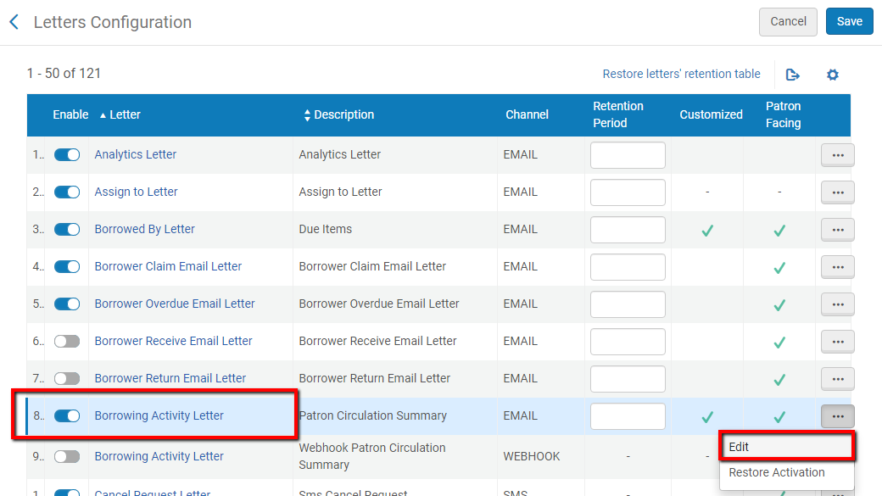
Configuring Letter Labels
Configuration > General > Letters

Slide 19
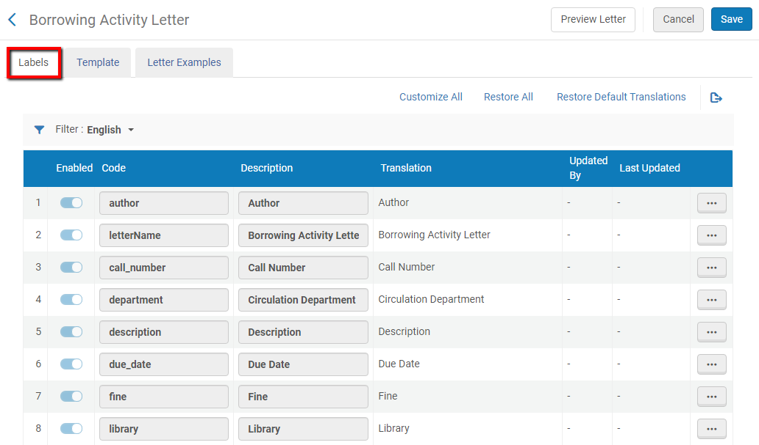
Configuring Letter Labels
Notes:
From the Letters Configuration link the full list of letters appears. We will edit “Borrowing Activity Letter”

Slide 20
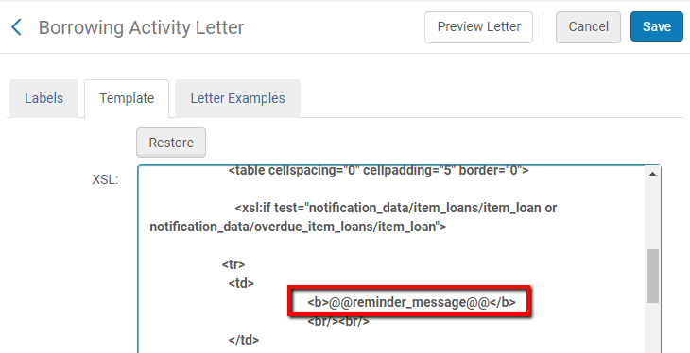
Configuring Letter Labels
Notes:
In the the xsl of the letter (which we can see via the ‘Customize Letters’ link and is discussed in depth in separate presentation) each label appears.
Whenever a label appears it has two @ signs before and after it.
When the letter is produced Alma takes the text for each label in the xsl from the list of labels.
In this way users can easily change standardized text without needing to edit the actual xsl.

Slide 21
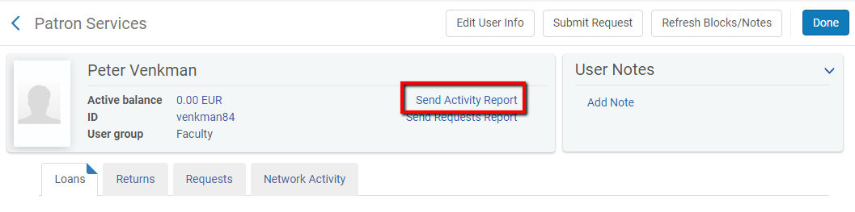
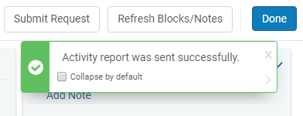
Configuring Letter Labels
Notes:
As an example of how the “Letter emails” functionality works we will take a look at the letter “Borrowing Activity Letter” which has code FulUserBorrowingActivityLetter
This letter is sent to patrons with activity and contains a list of all the patron’s loans, overdue items, and active fines. It is sent either by a job (Notifications – Send Periodic Fulfillment Activity Report) or manually by click “send activity report” from the patron services screen.
**2nd click shows acknowledgment

Slide 22
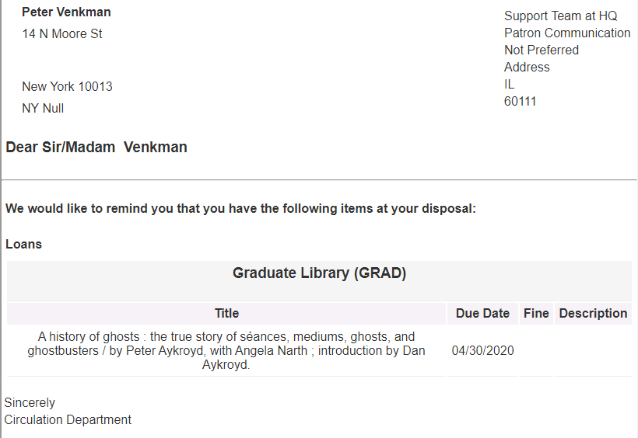
Configuring Letter Labels
Notes:
As an example of how the “Letter emails” functionality works we will take a look at the letter “Borrowing Activity Letter” which has code FulUserBorrowingActivityLetter
This letter is sent to patrons with activity and contains a list of all the patron’s loans, overdue items, and active fines. It is sent either by a job (Notifications – Send Periodic Fulfillment Activity Report) or manually by click “send activity report” from the patron services screen.
**2nd click shows acknowledgment

Slide 23
Configuring Letter Labels
The institution decides that it wants to change the text:
“We would like to remind you that you have the following items at your disposal: ”
To:
“We are bringing to your attention that you have the following items from the library:”.
Notes:
As an example of how the “Letter emails” functionality works we will take a look at the letter “Borrowing Activity Letter” which has code FulUserBorrowingActivityLetter
This letter is sent to patrons with activity and contains a list of all the patron’s loans, overdue items, and active fines. It is sent either by a job (Notifications – Send Periodic Fulfillment Activity Report) or manually by click “send activity report” from the patron services screen.
**2nd click shows acknowledgment

Slide 24
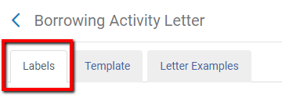
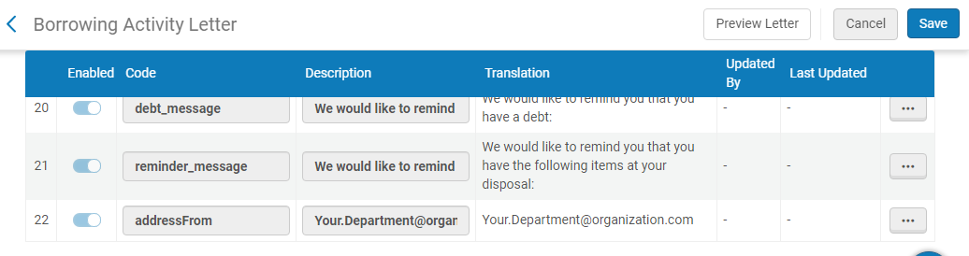
Configuring Letter Labels
Ensure you are on the Labels tab
The specific text we saw in the letter comes from this line in the table with label “reminder_message”:

Slide 25
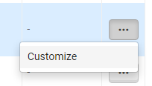
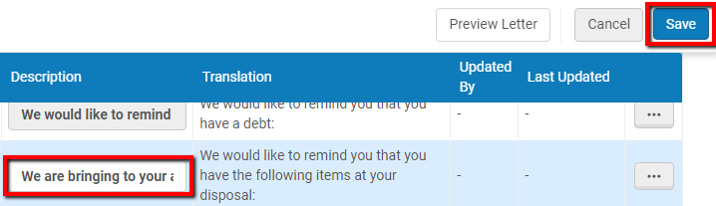
Configuring Letter Labels
We replace the original text with the new text and Save

Slide 26
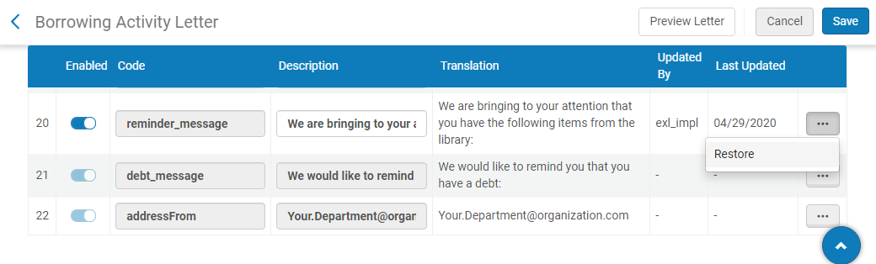
Configuring Letter Labels
Once update and saved it will show who and when it was customized, note that it can be restored

Slide 27

Configuring Letter Labels
Now we will send the letter again and we see that the text has changed

Slide 28
Retrieving XML

Slide 29
Retrieving XML
XSL Processor
XSL Stylesheet
XSL Output
XML Document
Notes:
Now we are going to look at how to view the XML that is used to created Alma letters
The reason for retrieving the XML is two fold:
The XML aid in configuring the XSL
The XML can be used to test a letter without sending it

Slide 30

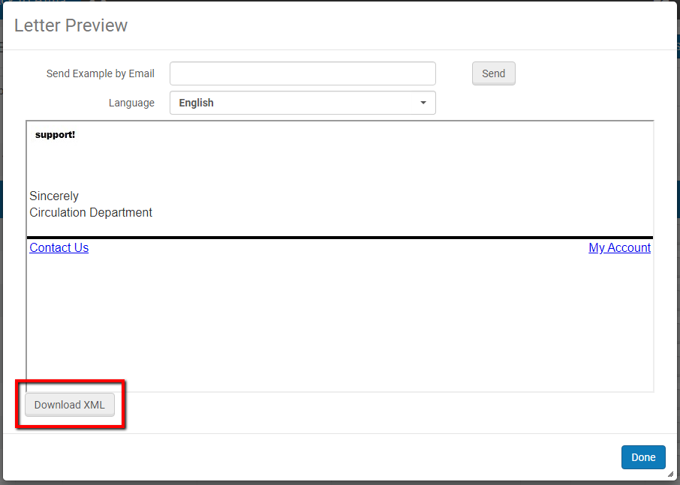
Retrieving XML
Getting the Default “blank” XML:

Slide 31
Retrieving XML
Getting the Default “blank” XML:
<root>
<notification_data>
<receivers>
<receiver>
<user>
<user_address_list>
<user_address>
<country>country</country>
<city>city</city>
<state_province>state_province</state_province>
<postal_code>postal_code</postal_code>
<line2>line2</line2>
<line1>line1</line1>
</user_address>
</user_address_list>
<last_name>last_name</last_name>
<first_name>first_name</first_name>
</user>
</receiver>
</receivers>
<general_data>

Slide 32
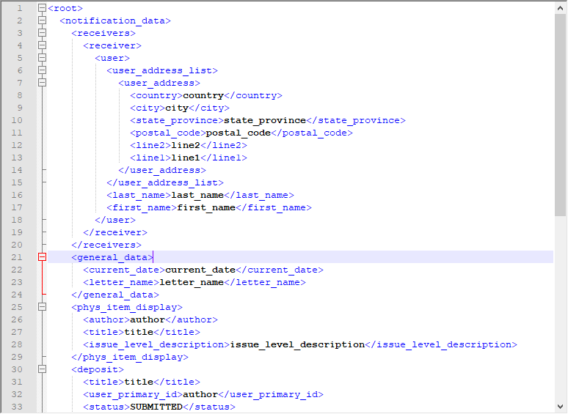
Retrieving XML
Notes:
Using an advanced text reader, such as Notepad++, can make working with XML files much easier

Slide 33
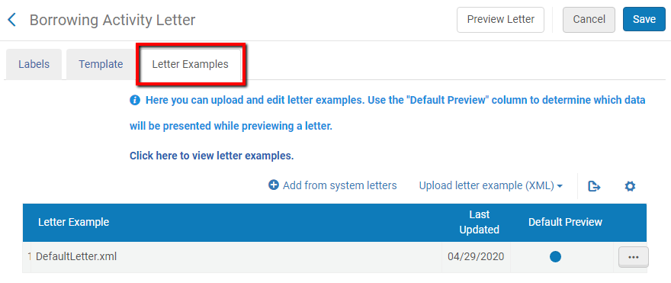
Retrieving XML
Getting an XML from an actual letter:

Slide 34
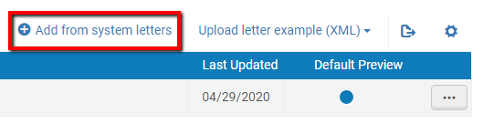
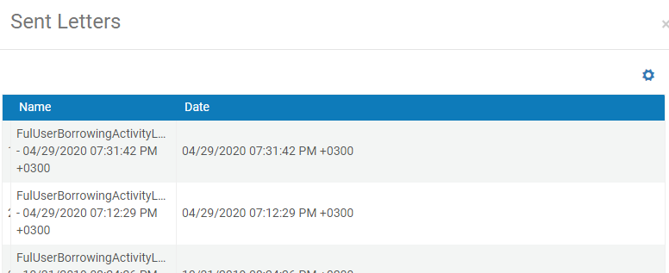
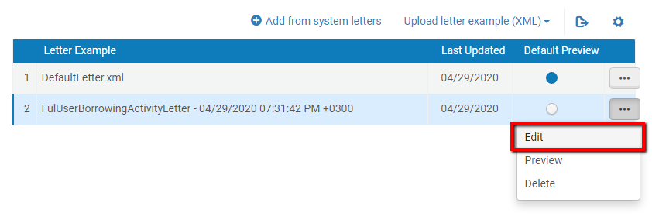
Retrieving XML
Getting an XML from an actual letter:
Notes:
This same process can be used for the Default letter XML.

Slide 35
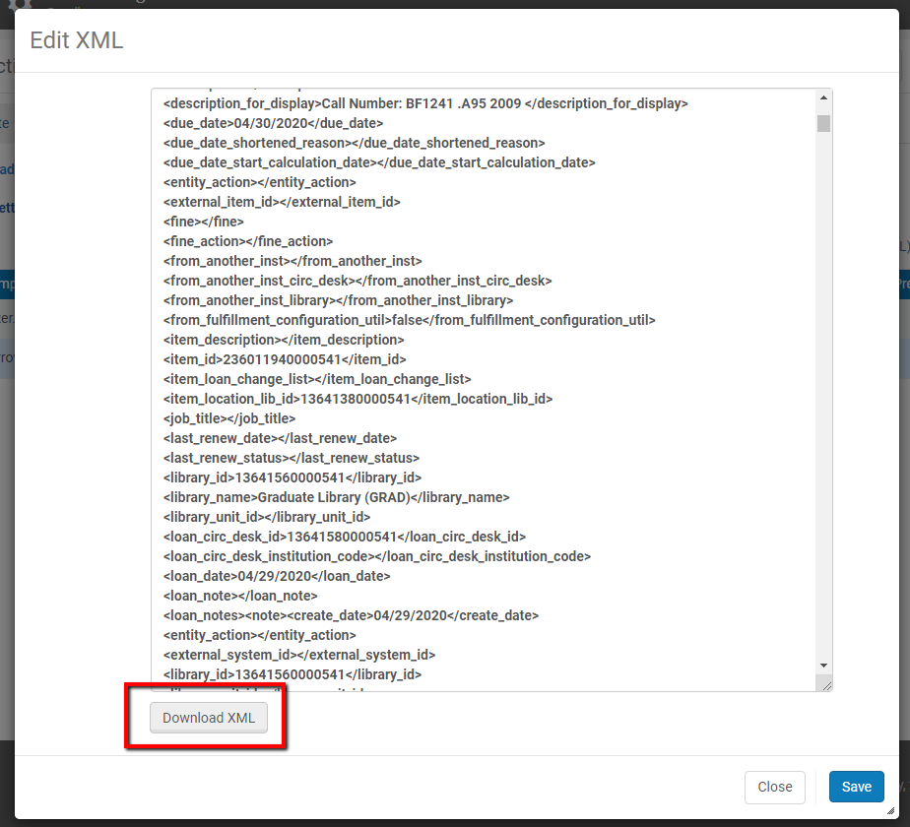
Retrieving XML
Getting an XML from an actual letter:
Notes:
This same process can be used for the Default letter XML.

Slide 36
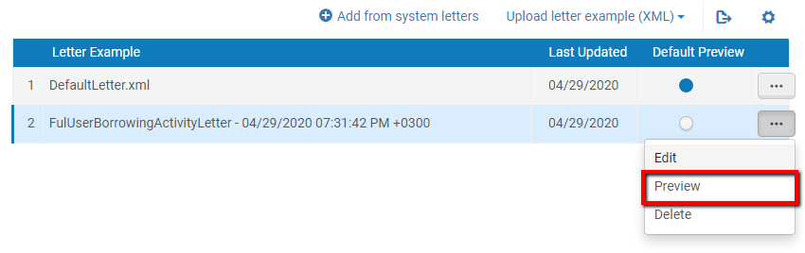
Retrieving XML
Getting an XML from an actual letter:
Notes:
This same process can be used for the Default letter XML.

Slide 37
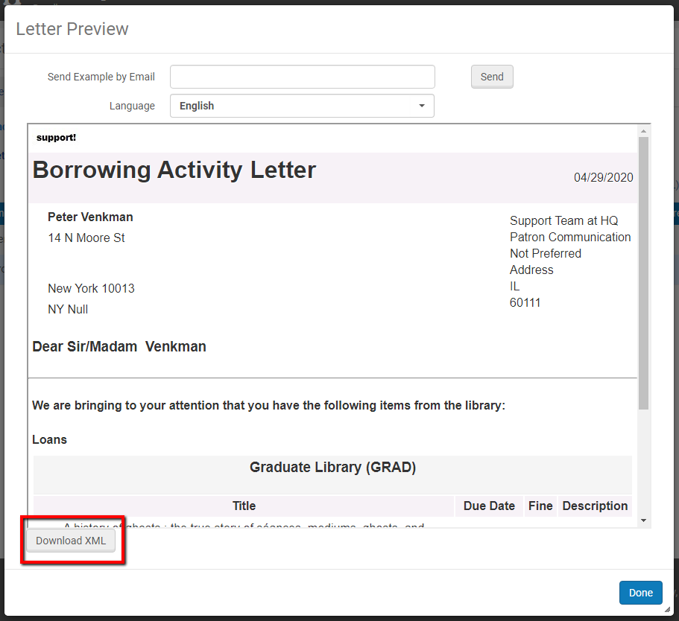
Retrieving XML
Getting an XML from an actual letter:
Notes:
This same process can be used for the Default letter XML.

Slide 38
Configuring Letter XSL

Slide 39
Configuring Letter XSL
Current Borrowing Activity Letter
Notes:
We’ll be using the downloaded XML from the previous section

Slide 40
Configuring Letter XSL
Institution would like to make a change such that:
If the letter recipient has the “Faculty” user group, then there should be a red bold line stating “Please do not forget to check your email.” in the letter.
If the user group is not “Faculty,” then there should be no change.
Notes:
We’ll be using the downloaded XML from the previous section

Slide 41
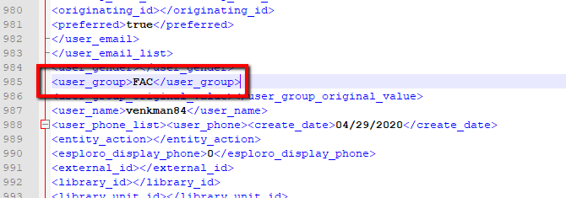
Configuring Letter XSL
In the XML we see the User Group (the value used is the Code, rather than Name):
The path of the User Group is /notification_data/receivers/receiver/user/user_group
We can get the path by looking at the XML or using a notepad plugin

Slide 42
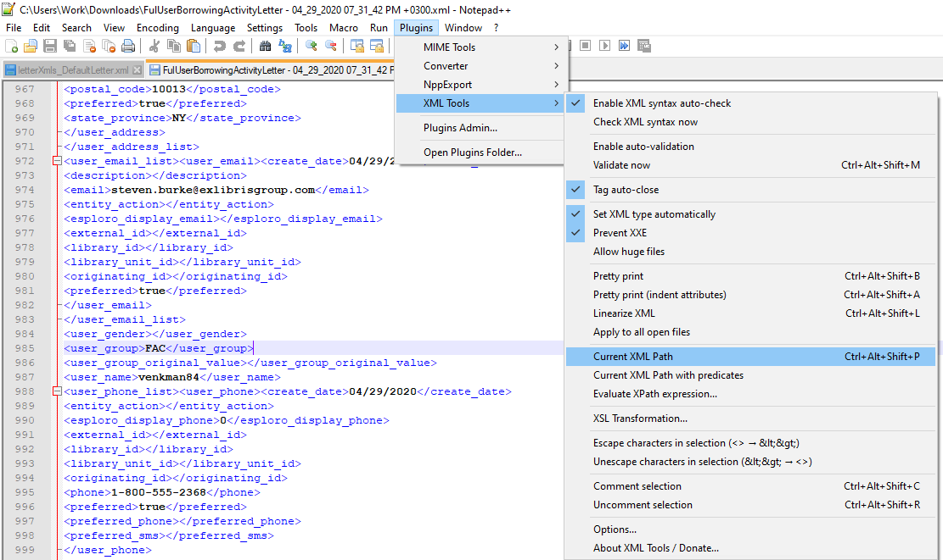
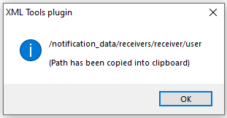
Configuring Letter XSL

Slide 43
Configuring Letter XSL
In the Borrowing Activity Letter XSL we will add a condition.

Slide 44
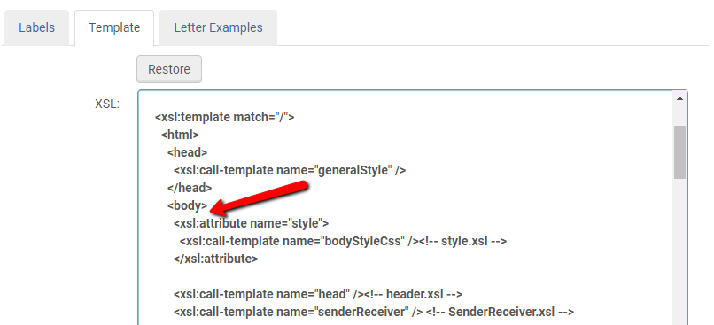
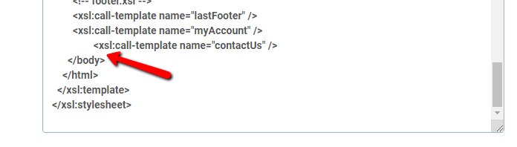
Configuring Letter XSL
We will add it after the Reminder Message label.
Be sure it is inside the <body> element

Slide 45
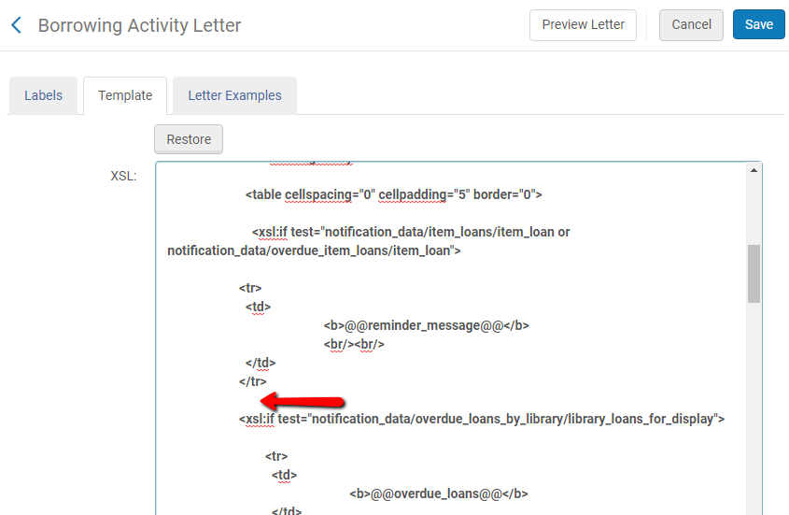
Configuring Letter XSL
Be sure it is inserted “outside” of any other closing tags

Slide 46
Configuring Letter XSL
<!-- Begin New Code -->
<xsl:for-each select="notification_data">
<!-- Make condition for user group "FAC" (the code for "Faculty")-->
<xsl:choose>
<xsl:when test="//notification_data/receivers/receiver/user/user_group ='FAC’”>
<table>
<tr><font color="red" size="4"><b>Please do not forget to check your <u>email</u>.</b></font></tr>
</table>
</xsl:when>
<!--For all else -->
<xsl:otherwise>
<table>
<tr></tr>
</table>
</xsl:otherwise>
</xsl:choose>
</xsl:for-each>
<br />
<!-- End New Code -->
Notes:
Any text between <!-- and --> is treated as a Comment – it does not affect the performance of any code before/after

Slide 47
Configuring Letter XSL
<!-- Begin New Code -->
<xsl:for-each select="notification_data">
<!-- Make condition for user group "FAC" (the code for "Faculty")-->
<xsl:choose>
<xsl:when test="//notification_data/receivers/receiver/user/user_group ='FAC’”>
<table>
<tr><font color="red" size="4"><b>Please do not forget to check your <u>email</u>.</b></font></tr>
</table>
</xsl:when>
<!--For all else -->
<xsl:otherwise>
<table>
<tr></tr>
</table>
</xsl:otherwise>
</xsl:choose>
</xsl:for-each>
<br />
<!-- End New Code -->
Notes:
Any text between <!-- and --> is treated as a Comment – it does not affect the performance of any code before/after

Slide 48
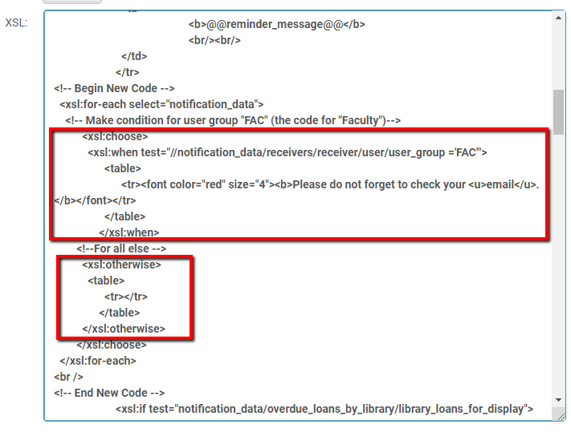
Configuring Letter XSL

Slide 49
Previewing XSL Changes

Slide 50
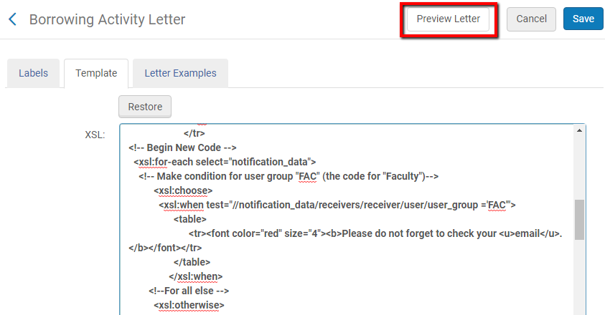
Previewing XSL Changes
Before saving changes made to the XSL, they can be previewed to see if they work

Slide 51
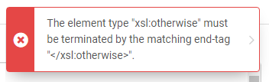
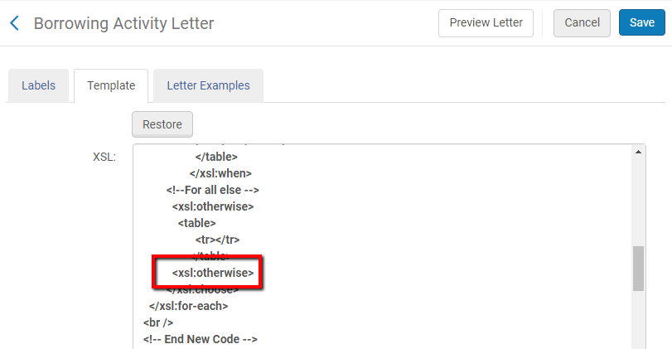
Previewing XSL Changes
Preview Letter will also notify you if there is an error in the code:

Slide 52
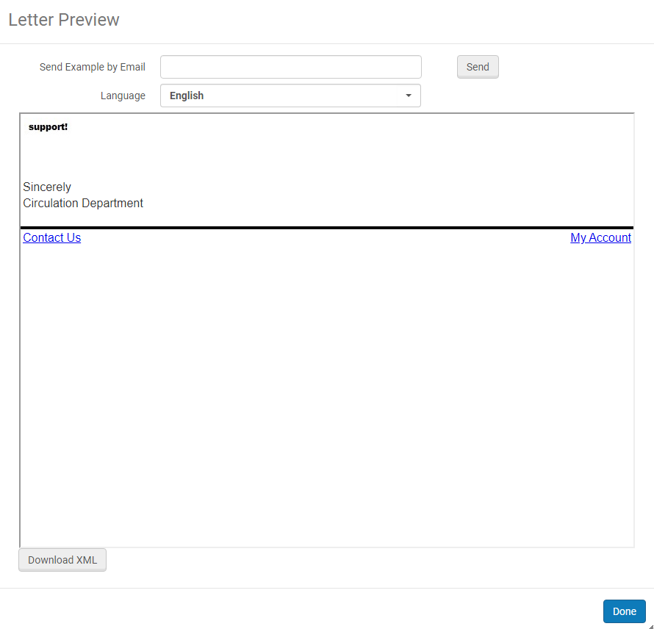
Previewing XSL Changes
The Default Letter preview:
This also confirms our code worked – no red text
  DefaultLetter.xml does not have “FAC” in its User Group

Slide 53
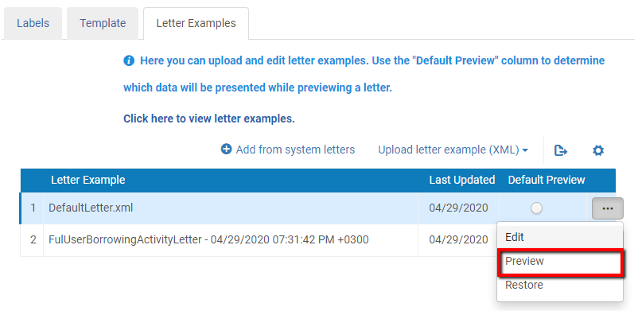
Previewing XSL Changes
Specific letter examples can also be previewed

Slide 54
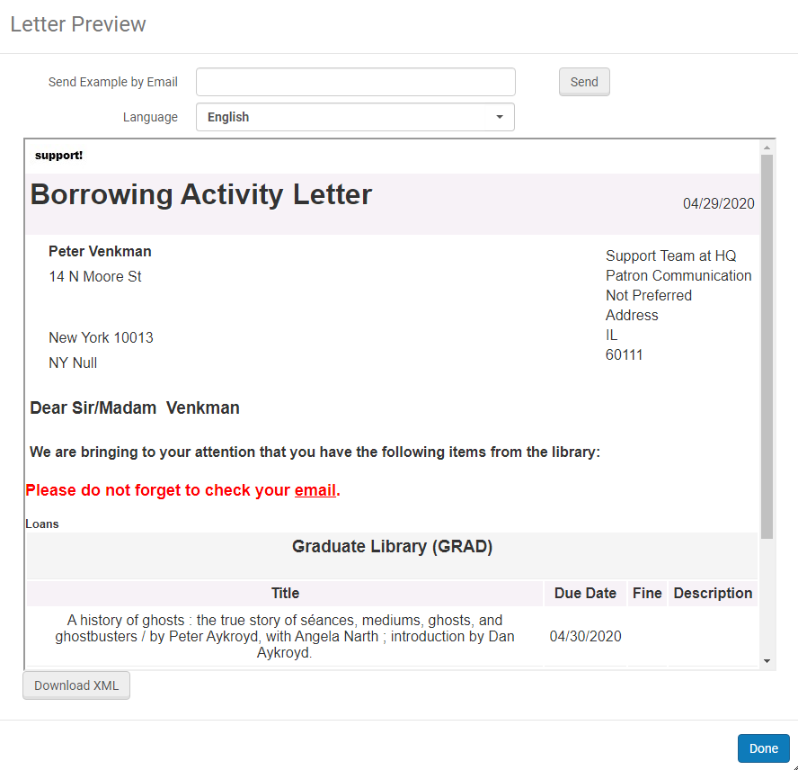
Previewing XSL Changes

Slide 55
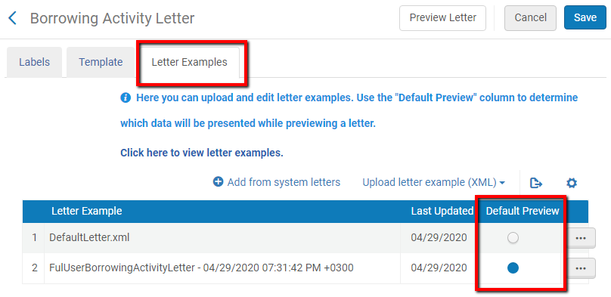
Previewing XSL Changes
The XML used for the preview depends on what has been selected as the default

Slide 56
Documentation
For a full list of all Alma letters see the “Alma Letters” table:
https://knowledge.exlibrisgroup.com/Alma/Product_Documentation/010Alma_Online_Help_(English)/050Administration/050Configuring_General_Alma_Functions/070Configuring_Alma_Letters

Slide 57
Documentation
For full list of many examples of XSL changes and detailed explanations, see:
https://knowledge.exlibrisgroup.com/Alma/Training/Extended_Training/Presentations_and_Documents_-_Letters

Slide 58
Documentation
A .zip file containing many “blank” letter XML files can be found on the Developers Network:
https://developers.exlibrisgroup.com/blog/alma-letters-xml-samples-for-working-on-xsl-customization/

Slide 59
Questions?
steven.burke@exlibrisgroup.com

Slide 60
Thank you!
Knowledge Days Webinar 2020

