Slide 1
How to add an additional process type to Alma using the Work Order functionality
Yoel Kortick
Senior Librarian

Slide 2
Agenda
Introduction
The work order types and the process type
Applying the new process type to an item
The process type in Alma and Primo search results

Slide 3
Introduction

Slide 4
Introduction
This presentation will focus on the relationship between the work order type, work order department and physical item process status.
Specifically, it will investigate how additional process types can be created via the work order type functionality.

Slide 5
Introduction
This presentation will not focus in depth and breadth on the entire work order functionality.
For that it is very highly recommended to see separate presentation Defining and managing work orders in Alma.pptx

Slide 6
The work order types and the process type

Slide 7
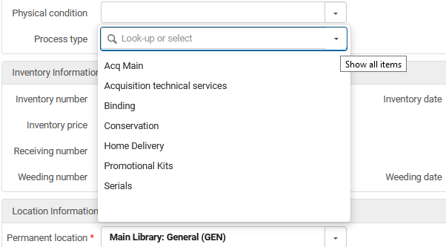
The work order types and the process type
These are the current process statuses which are currently available in a specific institution of Alma as seen in the physical item editor:

Slide 8
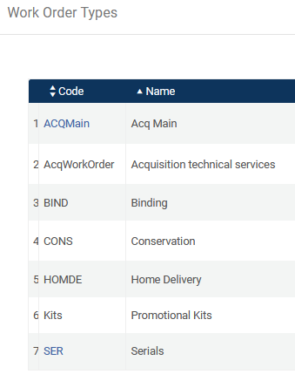
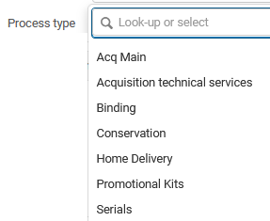
The work order types and the process type
Soon we will see the list of work order types (and add a new one). Meanwhile take note that the list of Work Order Types is the same list of Process Types in the physical item editor.

Slide 9
The work order types and the process type
We want to add a new process type which will be called “Being Disinfected”.
We will add a work order with this name as follows:
Configuration > General > Work Orders and Departments > Work order Types > Add Work Order Type > Fill in details

Slide 10
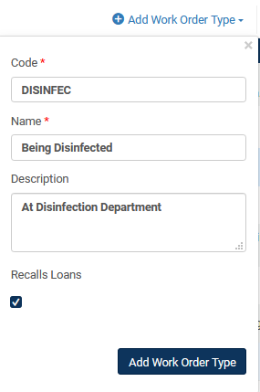
The work order types and the process type
From the list of work order types click “Add Work Order Type” and add the new work order type

Slide 11
The work order types and the process type
Add a work order department for the new work order type.
Configuration > General > Work Orders and Departments > Work order Departments > Add Department > Choose Corresponding Type

Slide 12
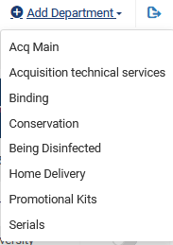
The work order types and the process type
Select “Add Department” and choose the work order type.

Slide 13
The work order types and the process type
Add the Department

Slide 14
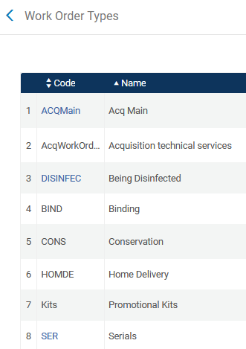
The work order types and the process type
The new work order type appears in the list of work order types in the configuration

Slide 15
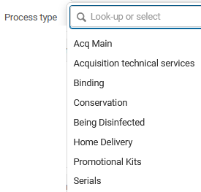
The work order types and the process type
The new work order type appears as a process type in the physical item editor

Slide 16
Applying the new process type to an item

Slide 17
Applying the new process type to an item
Here we have given the new process type to item barcode AU65473 title “Academic library development and administration in Taiwan”

Slide 18
The process type in Alma and Primo search results

Slide 19
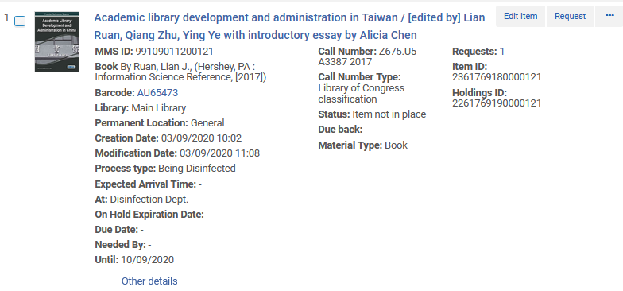
The process type in Alma and Primo search result
The process type is seen in the repository search results

Slide 20
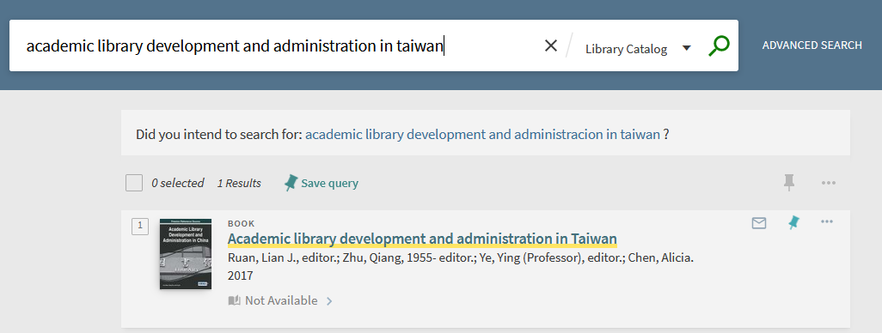
The process type in Alma and Primo search results
In Primo the item appears as not available. It does not get suppressed when it has the process status, but appears as not available

Slide 21
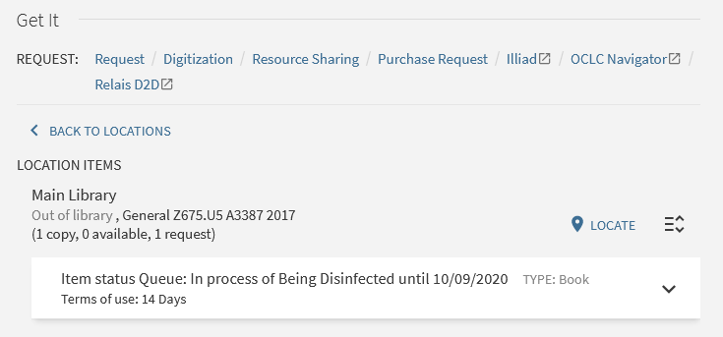
The process type in Alma and Primo search results
The GetIt tab shows that it is being disinfected

