Slide 1
Search Resources (Search External Resources)
Yoel Kortick
Senior Librarian

Slide 2
Introduction
Adding a Search Resource and Search Profile
Search Resources not from within the metadata editor
Search Resources from within the metadata editor

Slide 3
Introduction

Slide 4
Introduction
This presentation is called “Search Resources (Search External Resources)” because currently the functionality is called “Search Resources” but it used to be called “Search External Resources”.
In addition to this presentation see Search Resources on the Ex Libris Knowledge Center

Slide 5
Introduction
The “Search Resources” functionality allows the staff user to search, from within Alma
Local resources such as the Institution Zone, Network Zone (where applicable), and the Community Zone
Any external database supported by Ex Libris Data Services and implemented by the institution.
By integrating the search and import of records located in external databases directly into the MD Editor, Alma supports copy cataloging.

Slide 6
Introduction
The “Search Resources” functionality can be activated
Not from within the metadata editor
Staff user can search for record(s) and if desired import
From within the metadata editor
Staff user can search for another version of the record which is currently being edited and then merge or overlay the retrieved record with the record being edited.

Slide 7
Adding a Search Resource and Search Profile

Slide 8
Adding a Search Resource and Search Profile
First search resources are added.
Then search profiles are created containing one or more search resources.

Slide 9
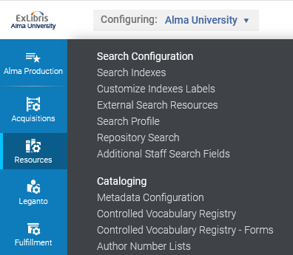
Adding a Search Resource and Search Profile
Add a search resource at “Configuration > Resources > Search Configuration > External Search Resources”

Slide 10
Adding a Search Resource and Search Profile
Click “Add External Search Resources”

Slide 11
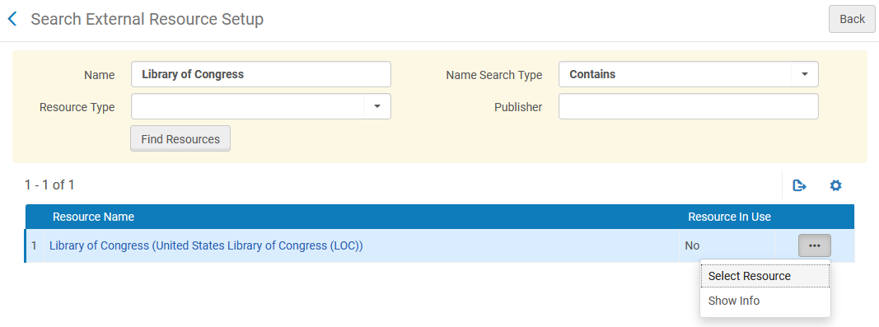
Adding a Search Resource and Search Profile
Search for the resource and select it

Slide 12
Adding a Search Resource and Search Profile
Add, as needed, a normalization process, merge method or credentials and then save. This resource does not require credentials.

Slide 13
Adding a Search Resource and Search Profile
Add a search profile at “Configuration > Resources > Search Configuration > Search Profile”

Slide 14
Adding a Search Resource and Search Profile
Click “Add Search Profile”

Slide 15
Adding a Search Resource and Search Profile
Give the profile a name and description

Slide 16
Adding a Search Resource and Search Profile
Select the resource (or multiple resources) and add to selection

Slide 17
Adding a Search Resource and Search Profile
Save the profile

Slide 18
Search Resources not from within the metadata editor

Slide 19
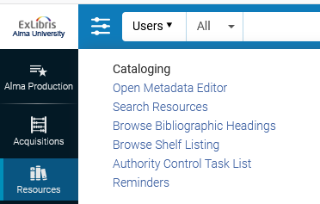
Search Resources not from within the metadata editor
Resources can be searched not from within the metadata editor and also from within the metadata editor.
We will first show not from within the metadata editor.

Slide 20
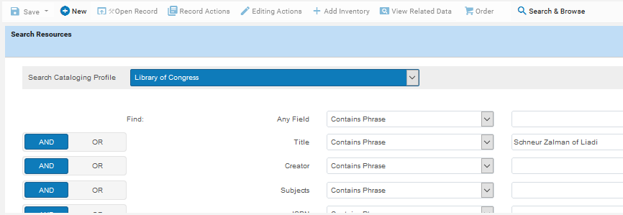
Search Resources not from within the metadata editor
The metadata editor will open. Select profile, enter search phrase or keywords and click “Search”

Slide 21
Search Resources not from within the metadata editor
From results list choose “View” or “Import”. We will “Import” record “Rabbi Schneur Zalman of Liadi / by Nissan Mindel”.

Slide 22
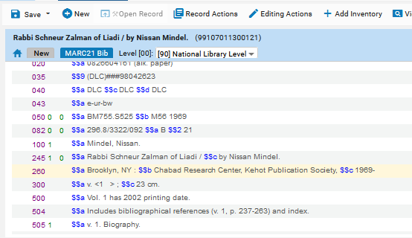
Search Resources not from within the metadata editor
The record is opened in the metadata editor and can be edited and saved like any other record. We will save it.

Slide 23
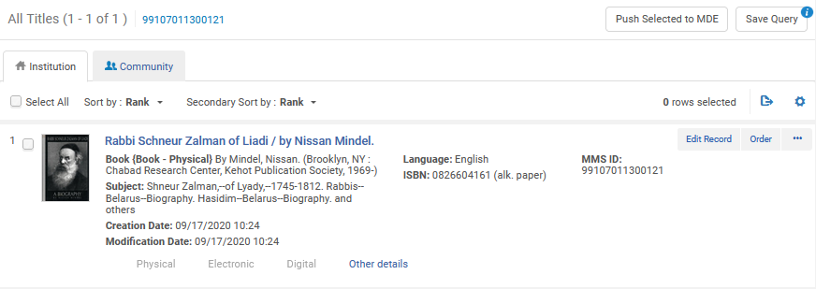
Search Resources not from within the metadata editor
The record is now part of the repository

Slide 24
Search Resources from within the metadata editor

Slide 25
Search Resources from within the metadata editor
It is also possible to search resources from within the metadata editor with a record in editing mode.
When this happens the search screen for the search profile is automatically filled in with information from the record which is being edited.
This way it is easy to find an identical record for the purpose of overlaying or merging with the record being edited.
On the next slide we have title “Alter Rebbe [videorecording] : marking 200 years from The Alter Rebbe's passing : 573-773” open and we search resources

Slide 26
Search Resources from within the metadata editor

Slide 27
Search Resources from within the metadata editor
The record being edited is on the left. The search screen is on the right. Information from the bibliographic record is automatically filled and can be cleared or selectively deleted.

Slide 28
Search Resources from within the metadata editor
From the search results the retrieved record can be copied and overlaid (on the record being edited) or copied and merged (with the record being overlaid).

Slide 29
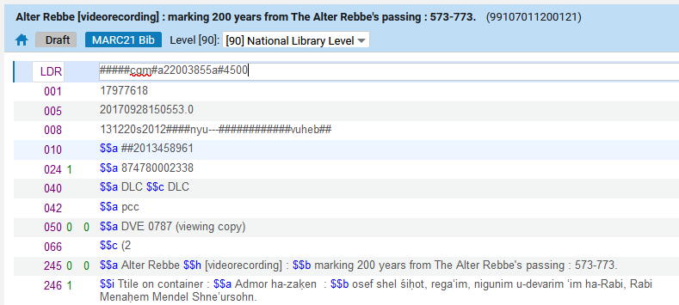
Search Resources from within the metadata editor
We chose “copy and overlay” and therefore our record which was being edited has now been replaced with the one retrieved from Library of Congress

Slide 30
xxx@exlibrisgroup.com

