Slide 1
Alma Analytics
Update on New and Upcoming Features
Yoel Kortick
Senior Librarian

Slide 2
H1 2020 – Improved Performance with "In Memory"
H2 2020 – Upgrade to OAS and DV
May 2020 – New API Usage subject area
Sept. 2020 – Reports and dashboard for API usage subject area
Sept. 2020 – New Analytics Objects subject area

Slide 3
2021 – Renovations on the default reports and dashboards
2021 – Reports and Dashboard for Analytics Objects subject area
2021 – Subject area for local authority records
2021 – Subject area for DARA Recommendations
2021 – Default DV Projects
2021 – Comparative Collection Analysis
2021 – Support full Dublin Core in Bibliographic details

Slide 4
The session
We have been given 25 minutes, and thus will only very briefly touch upon a select few of the many already completed as well as planned developments
This presentation contains more features than will be covered in the 25 minute session

Slide 5
The session – Proprietary Information
The information provided in this presentation gives a high-level view of Alma’s planned future roadmap and functional offerings. The information in this document is proprietary to Ex Libris.
Neither this document nor its contents can be forwarded to a third-party without the expressed written permission from Ex Libris.
The content in this document is informational and may be subject to change without prior notice at the sole discretion of Ex Libris.

Slide 6
H1 2020 – Improved Performance with "In Memory"

Slide 7
H1 2020 – Improved Performance with "In memory"
The purpose of the move to Oracle Database In Memory is to improve performance.
The In Memory architecture includes optimizations to make running complex queries much faster than was previously possible.

Slide 8
H1 2020 – Improved Performance with "In memory"
The table below shows some specific reports run by network zone institutions where "Before" the report failed and "After" it succeeded.
To state that this is a major improvement is an understatement.
Report | Second to run before | Second to run after | Seconds Improve | % Improve
All titles with LC Classification Code HQ in titles subject area includes institution | Timed out | 53 | Not applicable | 100
All titles with subject engineering in titles subject area | Timed out | 35 | Not applicable | 100
High Request Load | Timed out | 109 | Not applicable | 100
All titles with LC Classification Code HQ in titles subject area includes institution | Timed out | 30 | Not applicable | 100
High Request Load | Timed out | 479 | Not applicable | 100

Slide 9
H1 2020 – Improved Performance with "In memory"
The table below shows some specific numbers from the institutions that are not network zone institutions.
Again, surely you will agree that the improvement in time to run the reports is extremely encouraging.
Report | Seconds to run before | Seconds to run after | Seconds Improve | % Improve
Title level overlap analysis Dashboard. Tab: Overlap P and E with "word from subject" "engineer" and all other defaults | 595 | 25 | 570 | 96
All titles with subject engineering in titles subject area | 116 | 10 | 106 | 91
Music Assigned to Missing | 2,274 | 2 | 2,272 | 100
Music Due In 30 Days Report | 2,273 | 4 | 2,269 | 100
Recent Acquisitions that Need Replacement Cost | 1,738 | 5 | 1,733 | 100
Bib Records without Holdings | 2,417 | 960 | 1,457 | 60

Slide 10
H1 2020 – Improved Performance with "In memory"
Feedback

Slide 11
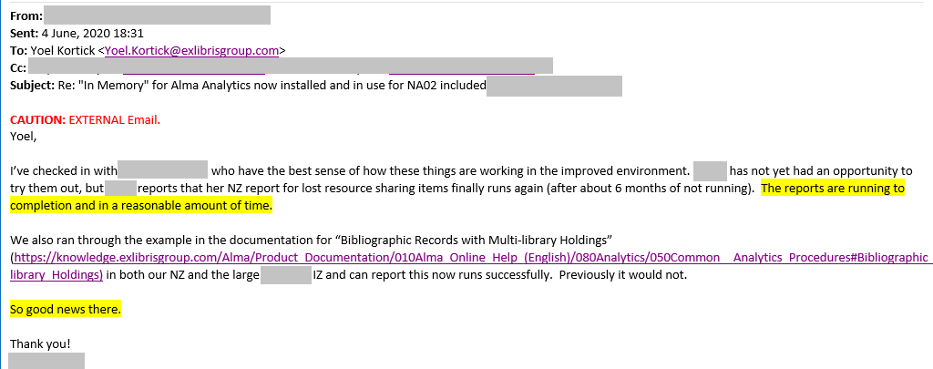
H1 2020 – Improved Performance with "In memory"
More Feedback

Slide 12
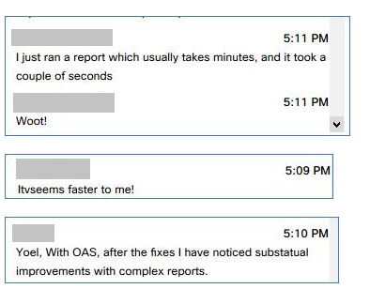
H1 2020 – Improved Performance with "In memory"
Feedback during a webinar

Slide 13
H2 2020 – Upgrade to OAS and DV

Slide 14
H2 2020 – Upgrade to OAS and DV
The purpose of the upgrade to OAS (Oracle Analytics Server) and Data Visualization (DV) is to provide a more modern and extensive set of tools for evidence based decision making.
Many new features are included, such as (but not only)
The ability to use an input file with Alma and Primo data in analytics
Perform Forecasts
Identify Trends
Many new visualizations

Slide 15
H2 2020 – Upgrade to OAS and DV
To learn more about both OAS and DV and how they interact with Alma, Primo VE, Leganto and Esploro, see:
YouTube videos about OAS (Oracle Analytics Server) and DV (Data Visualization)
Blogs about OAS (Oracle Analytics Server) and DV (Data Visualization)
To view the rollout plan, click here and view the September 2020 release notes

Slide 16
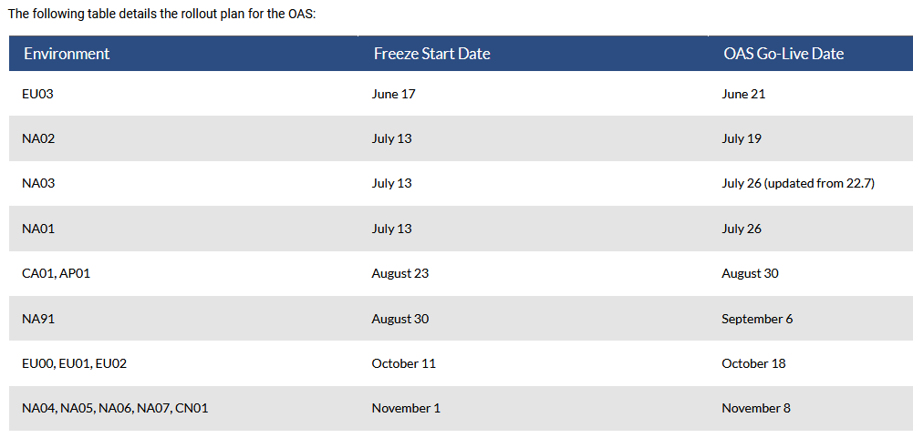
H2 2020 – Upgrade to OAS and DV

Slide 17
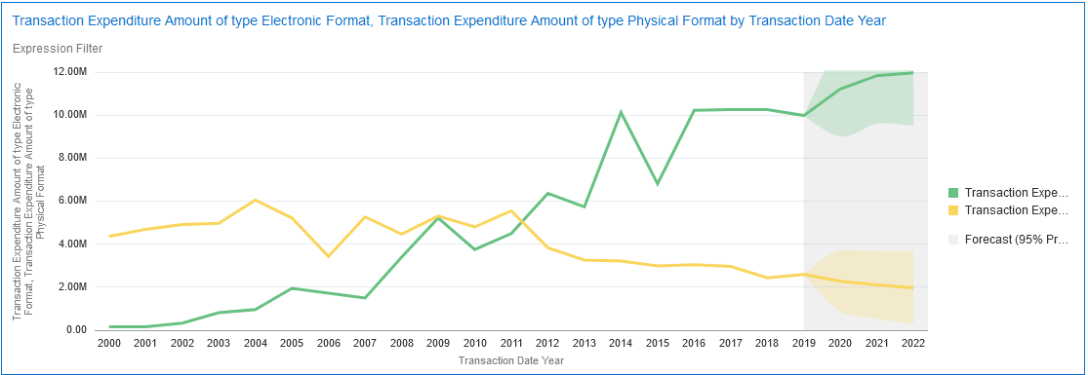
H2 2020 – Upgrade to OAS and DV
Physical and Electronic expenditure with forecast in DV

Slide 18
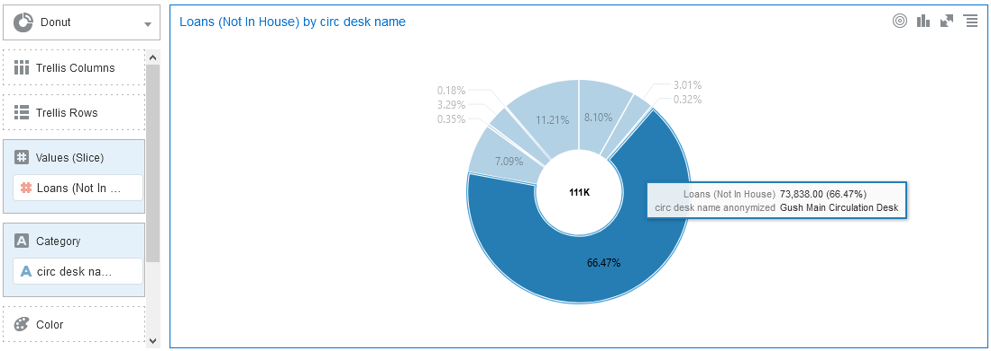
H2 2020 – Upgrade to OAS and DV
Interactive Visualizations in DV

Slide 19
May 2020 – New API Usage subject area

Slide 20
May 2020 - API Usage Subject Area
As of May 2020 the new API Usage subject area was officially released.
Fields in this subject area can be used to create reports that display usage of Alma Analytics by API.
This enhances the previous set of reports which were available via the Developers Network and did not use Alma Analytics.
For more information, see API Usage.

Slide 21
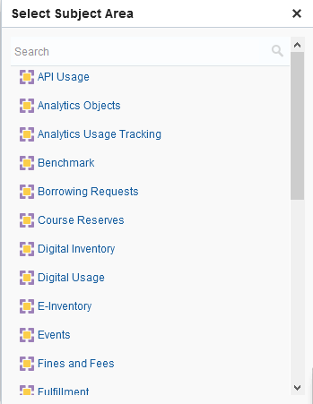
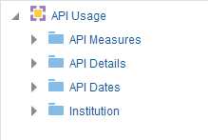
May 2020 - API Usage Subject Area

Slide 22
Sept. 2020 – Reports and dashboard for API usage subject area

Slide 23
Sept. 2020 – Reports and Dashboard for API Usage Subject Area
An out-of-the-box dashboard and extensive set of reports were made available for the API Usage subject area.
For more information, see Out-of-the-Box Reports.

Slide 24
Sept. 2020 – Reports and Dashboard for API Usage Subject Area
Report Name | Description
API method by area in last 365 days | Displays the API method by area in last 365 days
API usage by application name | Displays the API usage by application name
API usage by application name in last 365 days | Displays the API usage by application name in last 365 days
API usage by application name in last 365 days - top 10 | Displays the top 10 API usage by application name in last 365 days
API usage by area | Displays the API usage by area
API usage by area and method | Displays the API usage by area and method
API usage by area in last 365 days | Displays the API usage by area in last 365 days
API usage by key | Displays the API usage by key
API usage by URL | Displays the API usage by URL

Slide 25
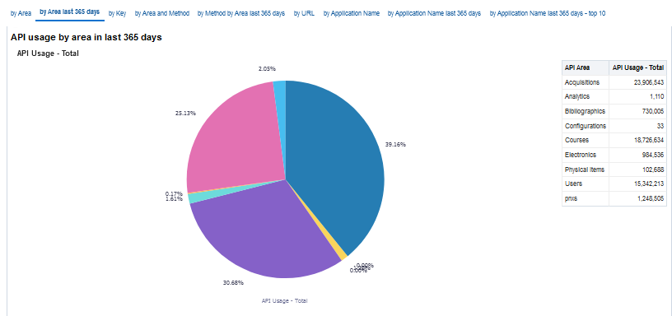
Sept. 2020 – Reports and Dashboard for API Usage Subject Area

Slide 26
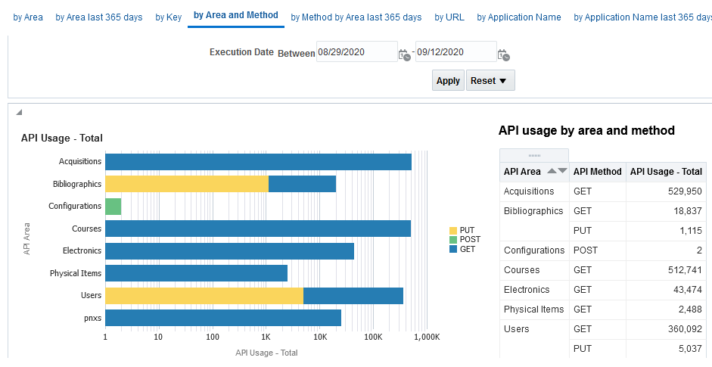
Sept. 2020 – Reports and Dashboard for API Usage Subject Area

Slide 27
Sept. 2020 – New Analytics Objects subject area

Slide 28
Sept. 2020 – New Analytics Objects subject area
A new subject area on “Analytics Objects” (widgets, scheduled reports, dashboards, etc.).
Allows the institution to analyze which objects are and are not being used.
Provided a starting pointing for cleaning up unused objects and seeing what areas staff users are interested in.

Slide 29
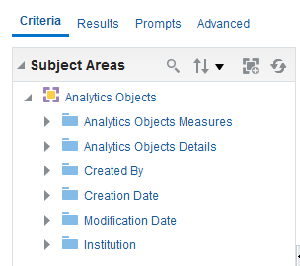
Sept. 2020 – New Analytics Objects subject area

Slide 30
2021 – Renovations on the default reports and dashboards

Slide 31
2021 – Renovations on the default reports and dashboards
We would like to make the reports "ready to use as they are" for the maximum number of institutions.
Many of the default reports and dashboards were created several years ago and have never been "revisited" in light of years of developments in Alma and Alma analytics.
Perhaps new fields should be added, others removed, and default values added to the prompts.

Slide 32
2021 – Reports and updates for Analytics Objects subject area

Slide 33
2021 – Reports and updates for Analytics Objects subject area
A new set of reports and a dashboard will be made available utilizing the Analytics Objects subject area which was released in September 2020.

Slide 34
2021 – Subject area for local authority records

Slide 35
2021 – Subject area for local authority records
Comes from ideas exchange

Slide 36
2021 – Subject area for local authority records
Will answer questions such as:
How many local authority records are created, deleted, and updated on a monthly and yearly basis.
How were the records created (import?, manual?)
Will include measures such as:
Num of Authority Records (All)
Num of Authority Records (Active)
Num of Authority Records (Deleted)

Slide 37
2021 – Subject area for local authority records
Will include details such as:
MMS ID
Example: [98……………....3936]
Creator
Create date (Calendar)
Modification date (Calendar)
Modified by
Heading type

Slide 38
2021 – Subject area for DARA Recommendations

Slide 39
2021 – Subject area for DARA Recommendations
Ability to filter recommendations using a "Recommendation Details" folder by
Category
Status
Library
Create Date
Update Date
Update By
Dismiss reason
Has Notes
Has Attachments
Will include the shared bibliographic details folder so that, for example, user will be able to see the bibliographic records of the high request items

Slide 40
2021 – Default DV Projects

Slide 41
2021 – Default DV Projects
Premade DV projects will be created and placed in relevant folders as are analytics reports today.

Slide 42
2021 – Comparative Collection Analysis

Slide 43
2021 – Comparative Collection Analysis
Comparative Collection Analysis will focus on depth of comparison, using a small number of predefined mutually-consenting institutions.
The overall goal and idea of the Comparative Collection Analytics is for the institution to be able to understand the collection relative to a set of peer institutions

Slide 44
2021 – Comparative Collection Analysis
Peer institutions have agreed (mutually) to work together in a known and identified manner.
This will enable the institution to, for example
Create weeding (withdrawal) plans.
Effectively create a collection development policy by knowing what subjects are held by other institutions which are my peers and thus accessible to my patrons.

Slide 45
2021 – Comparative Collection Analysis
Bibliographic and inventory data is compared with that of other predefined peer institutions.
Example ‘queries’:
How much overall overlap is there between your collection and those of your peers?
How many of your items are unique among your set of predefined peers?
How old is your collection compared to those of your peers?

Slide 46
2021 – Support full Dublin Core in Bibliographic details

Slide 47
2021 – Support full Dublin Core in Bibliographic details
Currently only a select few Dublin Core fields are mapped to fields in the shared "Bibliographic details" folder.
This will be expanded and many more Dublin Core fields will be mapped to "Bibliographic Details" fields.
This will allow more extensive reporting for institutions with Dublin Core collections.

Slide 48
Thank you!

