Slide 1
Alma Analytics Q3 2020 Quarterly Update
Delivered October 13, 2020
Covering Q3 2020 July, August and Sept. 2020
Yoel Kortick – Senior Librarian

Slide 2
Upgrade to OAS and DV
"In memory" analytics
July 2020 selected highlights
August 2020 selected highlights
September 2020 selected highlights
What's expected for 2021?
Questions

Slide 3
Upgrade to OAS and DV

Slide 4
Upgrade to OAS and DV
At the current time (week of Oct. 11 to 17) the following environments are upgrading to OAS and DV: EU00, EU01, EU02. These environments will be live Oct. 18
The following environments will upgrade the week of Nov. 1 to 7, and be live Nov. 8: NA04, NA05, NA06, NA07, CN01: Freeze on November 1, go live on November 8
All other environments are already live.

Slide 5
Upgrade to OAS and DV
To learn more about both OAS and DV and how they interact with Alma, Primo VE, Leganto and Esploro, see:
YouTube videos about OAS (Oracle Analytics Server) and DV (Data Visualization)
Blogs about OAS (Oracle Analytics Server) and DV (Data Visualization)
On Nov. 13 there will be a webinar about "Data Visualization with Oracle Analytics Server"

Slide 6
"In memory" analytics

Slide 7
"In memory" analytics
Complete for all environments except CN01 (coming soon).
It has seriously improved reports running time by utilizing Oracle In-Memory component
Cross-consortia reports as well as reports of "large" institutions now run and complete much more quickly than was previously the case

Slide 8
"In memory" analytics – Testimonials

Slide 9
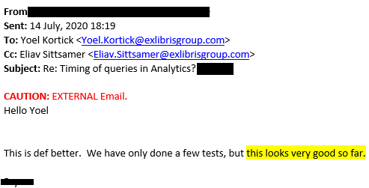
"In memory" analytics – Testimonials

Slide 10
"In memory" analytics – Testimonials

Slide 11
"In memory" analytics – Testimonials
Translation: Following your correspondence with …, I checked many of the reports that in the past ran very slowly and I am happy to announce that there is indeed a significant improvement. The reports now run much faster even when it comes to very large and multi-line reports.

Slide 12
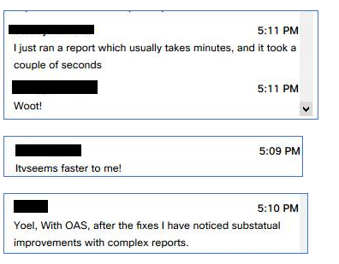
"In memory" analytics – Testimonials
Chat comments during a webinar in which "In memory" was discussed.

Slide 13
July 2020 selected highlights

Slide 14
July 2020 selected highlights
The Monthly Usage Data out-of-the-box report was added to the Usage Via COUNTER Reports - Release 5 folder.
It is based on the information displayed in the Monthly Usage Data tab of Alma (Acquisitions > Import > Load Usage Data) and displays for each platform what data was and was not loaded for each month.
This is useful for the institution to know which reports from which vendors may be missing.

Slide 15
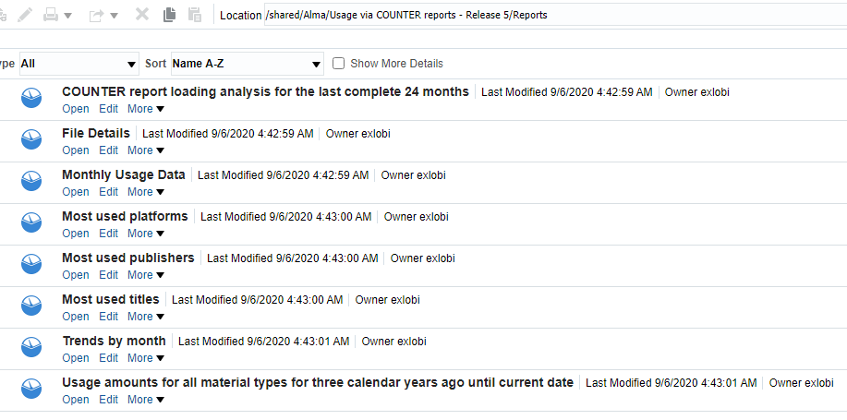
July 2020 selected highlights

Slide 16
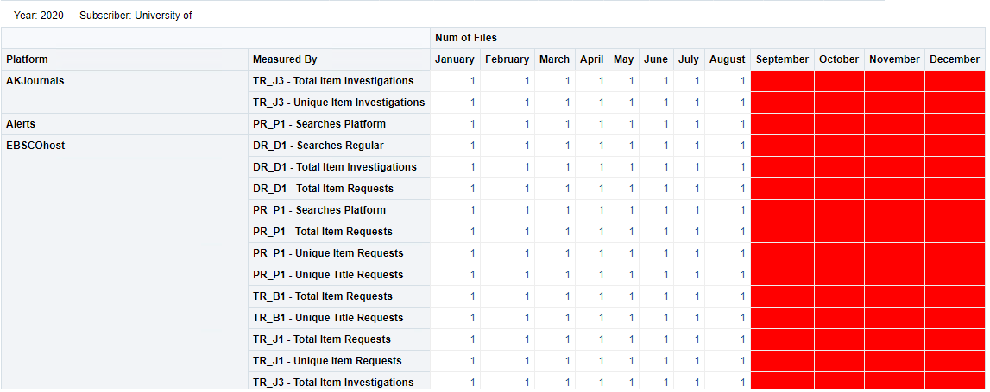
July 2020 selected highlights

Slide 17
July 2020 selected highlights
The following fields for linked records were added to the Bibliographic Details dimension:
Link ID – the link ID
Linked to CZ – indicates if the record is linked to the Community Zone
Linked to NZ – indicates if the record is linked to the Network Zone
This is useful for the institution in checking which records could be linked but are not.

Slide 18
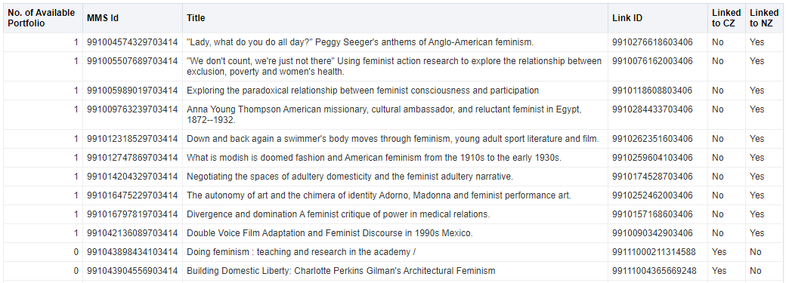
July 2020 selected highlights

Slide 19
July 2020 selected highlights
The following fields were added to the Fulfillment subject area regarding requests:
Loan Details > Is Hold Request Loan – indicates if the loan was initiated by a hold request
Loans > Loans (Not In House) from Hold Request – the number of not in house loans that came from a hold request
Loans > Loans (Not In House) from Booking Request – the number of not in house loans that came from a booking request
Identifying items which were loaned after a request was made can aid the institution in determining which items and topics are in high demand.

Slide 20
July 2020 selected highlights

Slide 21
August 2020 selected highlights

Slide 22
August 2020 selected highlights

Slide 23
August 2020 selected highlights

Slide 24
August 2020 selected highlights
The Bibliographic IDs dimension was added to the Titles subject area. It contains the following fields that display one number per row for each MMS ID:
ISBN single (Normalized)
ISSN single (Normalized)
OCLC Control Number single (035a)
In Sept. 2020 (to be discussed soon) these fields were added to the "Find Overlap By" drop-down list in the Title level overlap analysis dashboard

Slide 25
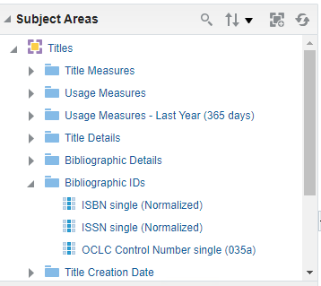
August 2020 selected highlights

Slide 26
August 2020 selected highlights
Instead of being strung together and semicolon delimited, the IDs each appear separately, which is beneficial for filtering and overlap analysis.

Slide 27
September 2020 selected highlights

Slide 28
September 2020 selected highlights
New Analytics Objects Subject Area
The Analytics Objects subject is used to create reports concerning analytics objects, such as scheduled reports and widgets.
This can be a useful tool for "cleaning up" unused analytics objects from the list, and also for knowing which areas are most used by the staff. For example see report "Customized Objects with no users" later in this presentation"
For more information, see Analytics Objects.

Slide 29
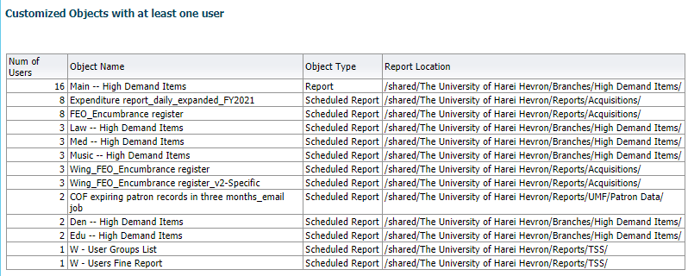
September 2020 selected highlights

Slide 30
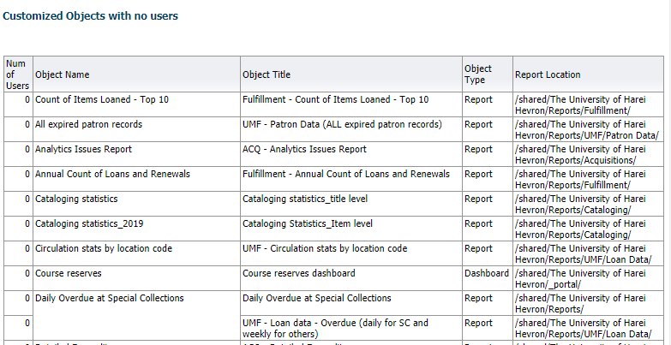
September 2020 selected highlights

Slide 31
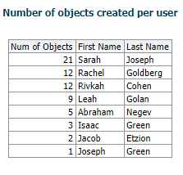
September 2020 selected highlights

Slide 32
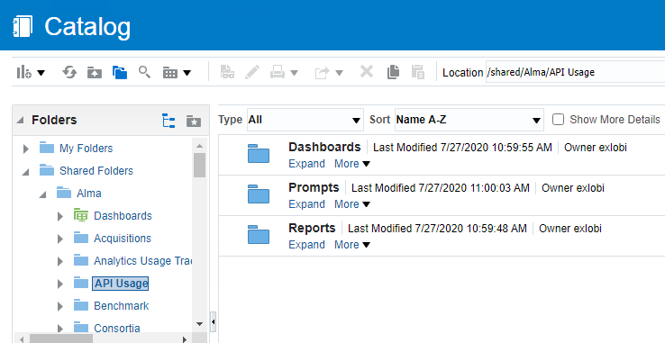
September 2020 selected highlights
An out-of-the-box dashboard and reports are now available for the API Usage subject area.

Slide 33
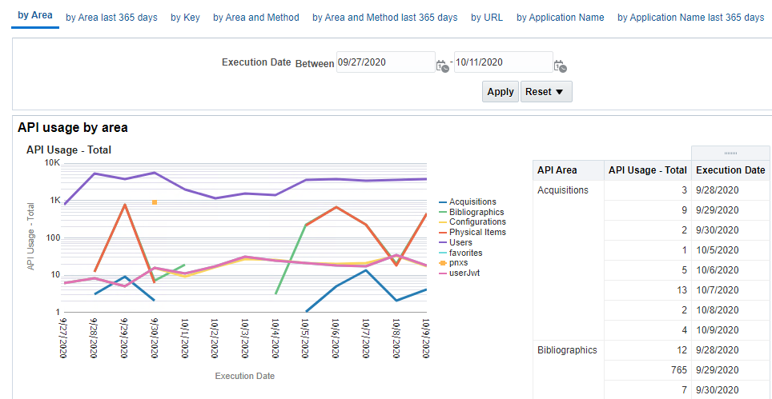
September 2020 selected highlights

Slide 34
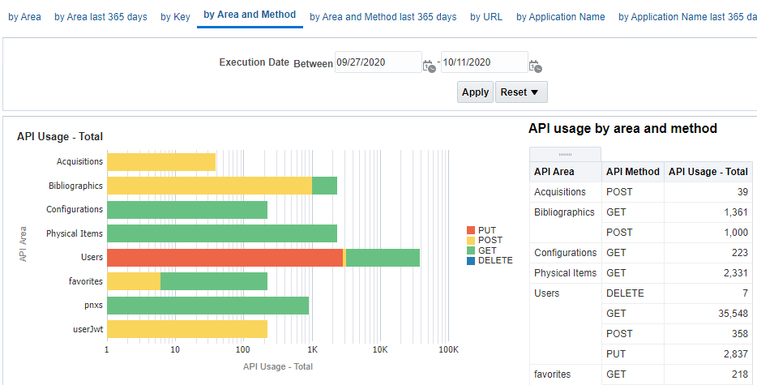
September 2020 selected highlights

Slide 35
September 2020 selected highlights
The following new options were added to the Find Overlap By drop-down list in the Title level overlap analysis dashboard by which you can determine the overlap:
ISBN single (normalized)
ISSN single (normalized)
OCLC Control Number single (035a)

Slide 36
September 2020 selected highlights

Slide 37
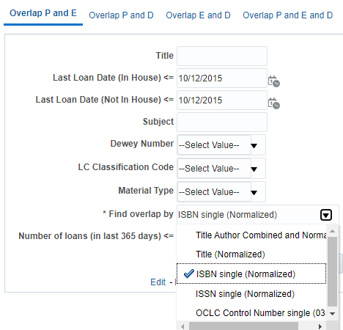
September 2020 selected highlights

Slide 38
September 2020 selected highlights
Here is an overlap analysis based on ISBN

Slide 39
What's expected for 2021?

Slide 40
2021 –reports and dashboards for YoY "Year over year".

Slide 41
2021 –reports and dashboards for YoY "Year over year".
A new set of reports and dashboards focusing on YoY "Year over year".
Compares current calendar year with one year ago and two years ago.
Checks the increase and decrease percentage of current year and one year ago.
Displays all data in line graphs and tables.
Useful for identifying trends for evidence based decision making.

Slide 42
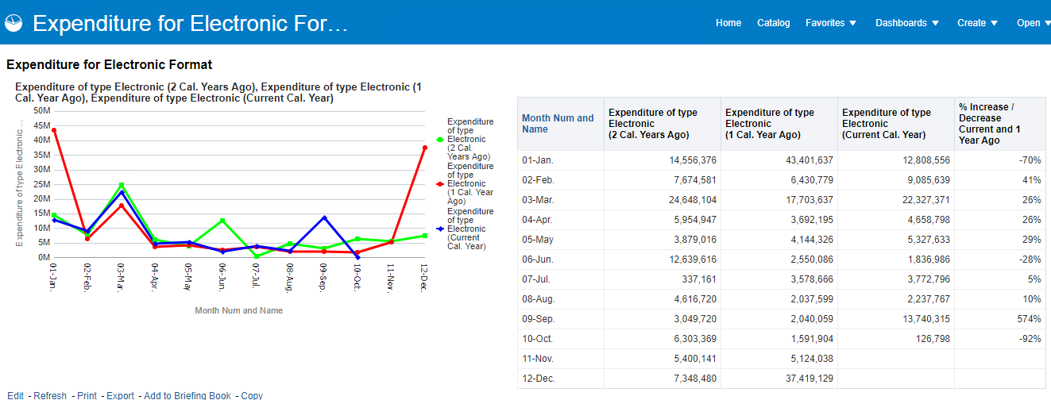
2021 –reports and dashboards for YoY "Year over year".

Slide 43
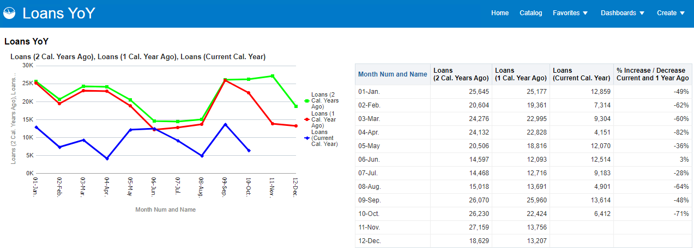
2021 –reports and dashboards for YoY "Year over year".

Slide 44
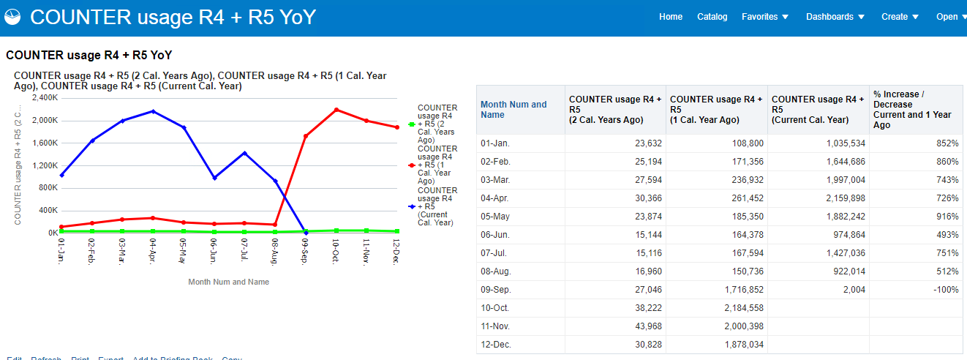
2021 –reports and dashboards for YoY "Year over year".

Slide 45
2021 – Renovations on the default reports and dashboards

Slide 46
2021 – Renovations on the default reports and dashboards
We would like to make the reports "ready to use as they are" for the maximum number of institutions.
Many of the default reports and dashboards were created several years ago and have never been "revisited" in light of years of developments in Alma and Alma analytics.
Perhaps new fields should be added, others removed, and default values added to the prompts.

Slide 47
2021 – Renovations on the default reports and dashboards
A group is now being formed to collaborate in this project.
Already volunteered:
Kristy Lee, Sojourner Truth Library. SUNY New Paltz
Michael Johnson, University of Minnesota Libraries
Sandrine Berthier, Université de Bordeaux

Slide 48
2021 – Reports and updates for Analytics Objects subject area

Slide 49
2021 – Reports and updates for Analytics Objects subject area
A new set of reports and a dashboard will be made available utilizing the Analytics Objects subject area which was released in September 2020.

Slide 50
2021 – Subject area for local authority records

Slide 51
2021 – Subject area for local authority records
Comes from ideas exchange

Slide 52
2021 – Subject area for local authority records
Will answer questions such as:
How many local authority records are created, deleted, and updated on a monthly and yearly basis.
How were the records created (import?, manual?)
Will include measures such as:
Num of Authority Records (All)
Num of Authority Records (Active)
Num of Authority Records (Deleted)

Slide 53
2021 – Subject area for local authority records
Will include details such as:
MMS ID
Example: [98……………....3936]
Creator
Create date (Calendar)
Modification date (Calendar)
Modified by
Heading type

Slide 54
2021 – Subject area for DARA Recommendations

Slide 55
2021 – Subject area for DARA Recommendations
Ability to filter recommendations using a "Recommendation Details" folder by
Category
Status
Library
Create Date
Update Date
Update By
Dismiss reason
Has Notes
Has Attachments
Will include the shared bibliographic details folder so that, for example, user will be able to see the bibliographic records of the high request items

Slide 56
2021 – Default DV Projects

Slide 57
2021 – Default DV Projects
Premade DV projects will be created and placed in relevant folders as are analytics reports today.

Slide 58
2021 – Comparative Collection Analysis

Slide 59
2021 – Comparative Collection Analysis
Comparative Collection Analysis will focus on depth of comparison, using a small number of predefined mutually-consenting institutions.
The overall goal and idea of the Comparative Collection Analytics is for the institution to be able to understand the collection relative to a set of peer institutions

Slide 60
2021 – Comparative Collection Analysis
Peer institutions have agreed (mutually) to work together in a known and identified manner.
This will enable the institution to, for example
Create weeding (withdrawal) plans.
Effectively create a collection development policy by knowing what subjects are held by other institutions which are my peers and thus accessible to my patrons.

Slide 61
2021 – Comparative Collection Analysis
Bibliographic and inventory data is compared with that of other predefined peer institutions.
Example ‘queries’:
How much overall overlap is there between your collection and those of your peers?
How many of your items are unique among your set of predefined peers?
How old is your collection compared to those of your peers?

Slide 62
2021 – Support full Dublin Core in Bibliographic details

Slide 63
2021 – Support full Dublin Core in Bibliographic details
Currently only a select few Dublin Core fields are mapped to fields in the shared "Bibliographic details" folder.
This will be expanded and many more Dublin Core fields will be mapped to "Bibliographic Details" fields.
This will allow more extensive reporting for institutions with Dublin Core collections.

Slide 64
Questions?

Slide 65
Questions?

Slide 66
xxx@exlibrisgroup.com

