Slide 1
Alma Resource Sharing
Broker models
Rapid ILL

Slide 2
The “flavors” of Alma resource sharing
The advantages of working with Alma & Rapid
The Alma twist – how we’ve improved on the Alma/Rapid workflow
Configuring Alma and Rapid
Q&A

Slide 3
Alma resource sharing “flavors” (combos available)
 | Classic | Fulfillment Network | Automated FN | Broker Integration
Partners | Any | Consortium members | Consortium members | External provider
Loan owned & managed by | Patron’s home library | Item owner | Item owner | Patron’s home library
Pickup | Patron’s home library | Anywhere | Anywhere | Patron’s home library
Patron experience | RS request (Automated ROTA locates item) | Direct requesting from item owner | RS request (Automated ROTA locates item) | External provider
Library workflows | RS request (supports multiple protocols) | Uses regular hold request workflows | Combines RS abilities with hold workflows | Can be combined as partner of last resort
Totally in Alma/Primo !
First resort!

Slide 4
Why choose Rapid ILL resource sharing with Alma?
Rapid ILL is a solution for fast and cost-effective document delivery, created by resource sharing librarians at CSU to answer the unique needs of article and book chapter loans.
The product has been fine tuned for accurately identifying libraries that can supply the requested article or book chapter scan, while considering copyrights and other library policies
With very high (over 95%) success rate and quick turnaround time (avg <12 hours), it is a highly efficient tool that connects over 350 libraries in a network of document delivery services

Slide 5
Why choose Rapid ILL resource sharing with Alma?
Rapid ILL is an independent product that integrates with other resource sharing systems such as ILLiad, Clio, Relais.
After having been acquired by Ex Libris, extensive work has been done to strengthen the Alma/Rapid ILL integration.
Today, the powerful Rapid engine is fully integrated with Alma for all steps of the resource sharing workflow on both borrower and lender side.

Slide 6
Why choose Rapid ILL resource sharing with Alma?
Patrons can have a single requesting experience regardless of whether their request is physical (fully managed in Alma) or digital (involves Rapid)
Staff can process all lending requests using the same Alma interface and workflows, regardless of whether Rapid is working behind the scenes or not
No need for maintenance of an additional third-party tool
Setting up the integration is simple and minimal
Rapid ILL is an engine used by Rapido as well. Any configuration and workflow that is set up for Rapid can be re-used if and when Rapido is adopted by the library

Slide 7
The Alma twist
Automation options - different steps of the workflow can be automated or mediated
Seamless configuration of Rapid into the Alma RS configurations
Smooth integration with the other RS models

Slide 8
Borrowing and lending workflow
resubmit
Borrower actions
Lender actions
New request
Cancel
Bad citation
Pending
Ship digitally (called filled in Rapid)
Reject (called unfilled in Rapid)
Not as cited
Receive
8

Slide 9
Configuring Alma and Rapid (Borrower Perspective)
Borrower
Lender
Rapid
Partner A
Partner B
Other Resource Sharing System

Slide 10
Configuring Alma and Rapid (Lender Perspective)
Borrower
Lender
Rapid partner
Other Resource Sharing System

Slide 11
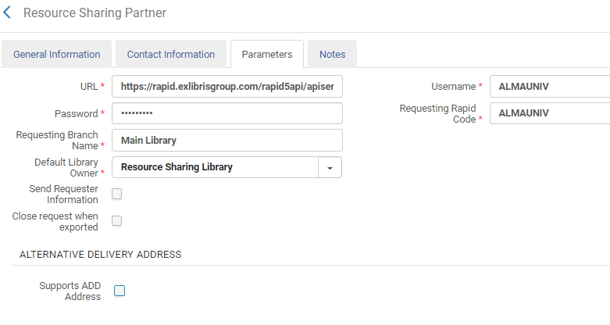
Configuring Alma and Rapid
Rapid credentials
The “Default Library Owner” field is the resource sharing library in which lending requests will be created in Alma
Rapid account/branch code and name

Slide 12
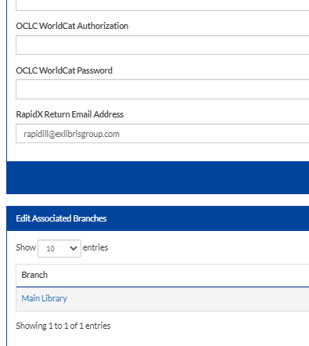
Configuring Alma and Rapid
https://rapid.exlibrisgroup.com/

Slide 13
Workflow Profile (optional)

Slide 14
Rota Template
Use the Fulfillment>Resource Sharing>Rota Templates menu to create the Rapid ‘rota’.

Slide 15
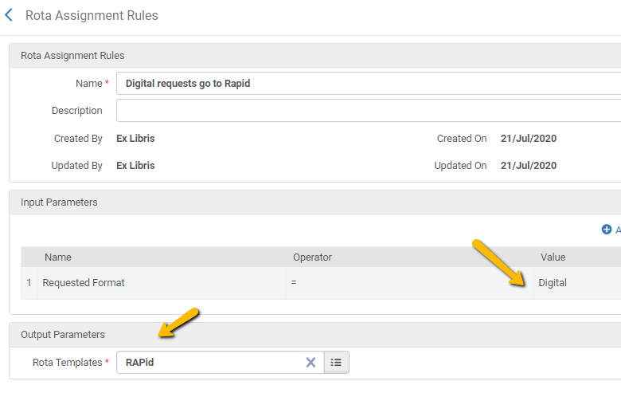
Rota Assignment Rules
Use the Fulfillment Configuration>Resource Sharing>Rota Assignment Rules menu
The rota assignment rule will automatically assign any digitally requested borrowing request to the Rapid rota template

Slide 16
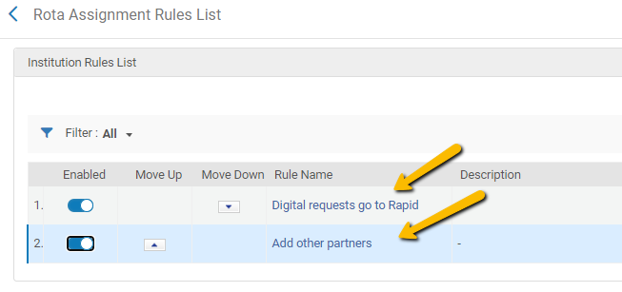
Rota Assignment Rules
It is recommended that this rule is sequenced to be first in your list of rota assignment rules.

Slide 17
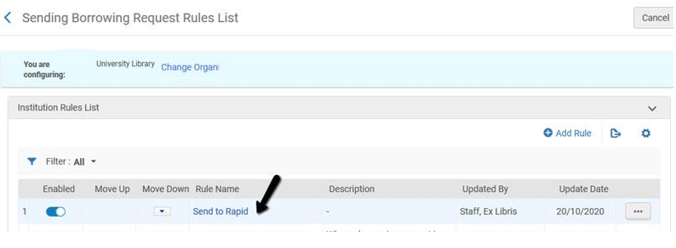
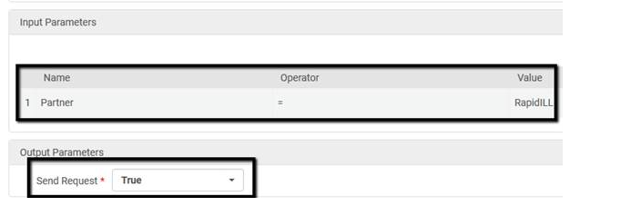
Auto Send Rules
Use the Configuration > Fulfillment > Resource Sharing > Sending Borrowing Request Rules to automatically send to Rapid

Slide 18
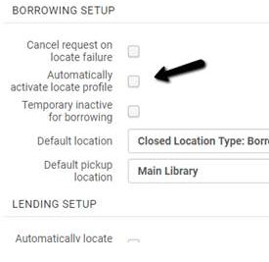
Auto Send Rules
The Sending Borrowing Request Rule is activated only if the library is set up to automatically locate. The Automatically activate locate profile option should be selected at the Resource Sharing Library configuration (General > Add a Library or Edit Library Information).

Slide 19
Other Settings
We recommend that you set the parameter “Keep rejected request” as “borrowing” (under fulfilment configuration-> other settings)
This will make sure the request will not be closed when it is rejected by Rapid
borrower_document_delivery_maximum_views
This parameter defines the number of times patrons will be able to access the link. The parameter defaults to 2
borrower_document_delivery_send_automatically
This parameter defines whether the email to the patron will be sent automatically when a document is received on the borrower side. The default is set to true
Delivery_cleanup_days
This parameter defines the number of days after which digital file will be automatically removed. The default is 30 and maximum is 90 days

Slide 20
Configuring Alma and Rapid
Set rapidill_extended_borrowing_integration to true for the borrower side integration
Set rapidill_extended_integration to true for the lender side integration
Contact Ex Libris Support for the Rapid side activation

Slide 21
The Patron Notification
Alma sends the Document Delivery Notification Letter to the patron. Refer to the zip file on the Developers Network blog for an example of the letter.
From Configuration > General > Letters > Letters Configuration, select Upload letter example from the Letter Examples tab of the letter to upload this example.

Slide 22
The Patron Notification

Slide 23
The Patron Notification

Slide 24
Setting Up Rapid as a Lender
Rapid requires knowledge about your inventory for two purposes:
Properly allocate lending requests to your library
Block borrowing requests if you own the resource locally
Therefore, it is recommended that you upload all inventory to Rapid, not just the lendable inventory

Slide 25
Setting Up Rapid as a Lender
Setting up to be a lender requires 3 configurations elements to be in place:
OAI integration profile
Sets
Publishing profiles for sets
Ex Libris has provided publishing profile templates you can localize and use

Slide 26
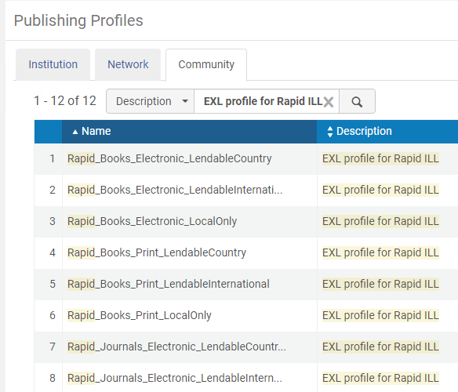
Setting Up Rapid as a Lender
Ex Libris has created profiles in the community zone.
You can localize and use them
You will need to update the Link Resolver Base URL field, as explained in the document

Slide 27
Setting Up Rapid as a Lender
Preferably, you will create separate sets for lendable and for non-lendable titles
In case of physical items, this is likely to depend on the locations of the items, so that the sets depend on the locations

Slide 28
Setting Up Rapid as a Lender
Preferably, you will create separate sets for lendable and for non-lendable titles
In case of electronic items, the basic query is where (Material Type equals "Journal" AND Availability (Electronic Portfolio) equals "Available")

Slide 29
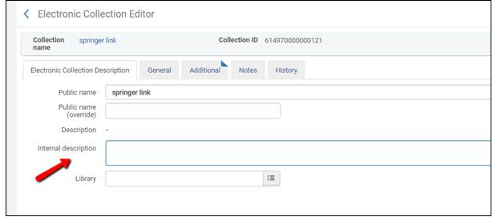
Setting Up Rapid as a Lender
Preferably, you will create separate sets for lendable and for non-lendable titles
In case of electronic items, it is recommended to manage another attribute on the collections that identifies whether the collection is lendable or not, for example the Internal Description

Slide 30
Setting Up Rapid as a Lender
Preferably, you will create separate sets for lendable and for non-lendable titles
This way you will be able to maintain a logical set that is always up to date

Slide 31
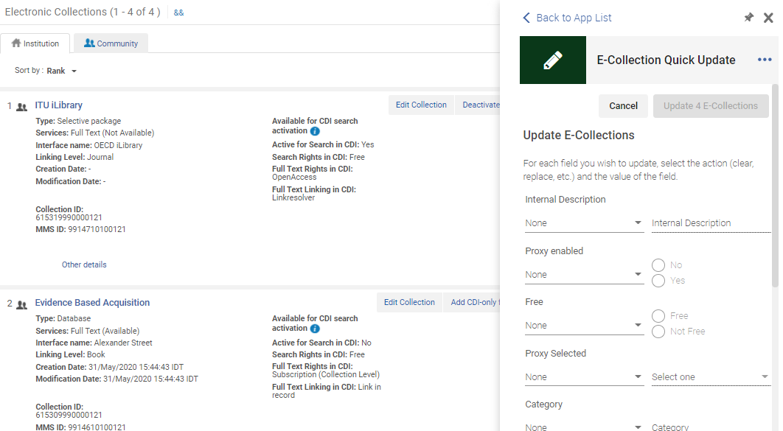
Setting Up Rapid as a Lender
An e-collections quick update cloud app can be used to quickly update e-collections with this attribute

Slide 32
Workflow

Slide 33
Q&A
Q: Can this setup be tested in the sandbox ?
A: The Rapid account is a production account. All requests processed with this account are ‘real’ requests. While technically it is possible to set up the sandbox in Alma to work with this account, it will still be production requests. This is not recommended.
Rapid can be set to start ‘slow’, i.e. minimize the number of lending requests that will be assigned to you until you’re comfortable with going full steam.
In Alma, it is also possible to manually route borrowing requests to Rapid, so you can test their full workflow before you activate the automated set up.

Slide 34
Q&A
Q: What is the process for activating the Alma/Rapid integration?
A: Activating the integration requires Ex Libris support activation in addition to doing your own Alma setup. One does not depend on the other.
It is easiest to turn on the borrowing side. The setup is minimal. This can be done in parallel to working on the holdings harvest before activating the lender side.

Slide 35
Q&A
Q: What is the process for activating the Alma/Rapid integration ? I am already using Rapid with Relais ILL.
A: We are in the process of formulating the recommended workflow for the migration process. Heads up !

Slide 36
Q&A
Q: Can the integration work with multiple Rapid ILL branches/accounts ?
A: Yes. You can set up multiple Rapid ILL partners in Alma. You can (but don’t have to) link them to multiple RS libraries.
The partners may be added to library level rotas. So, for example, a patron assigned to RS Library A will have the rota of RS Library A, which will include the relevant Rapid account.

Slide 37
Q&A
Q: Can I set up off lending times in Alma/Rapido ?
A: Currently they are set up in Rapid. The Rapid Lending Off Times are not affected by the Alma RS library ‘Inactive Time’ set up.

Slide 38
Coming soon to an Alma near you…
It will be possible to override the Rapid self ownership check from Alma
It will be possible to set the Rapid Lending Off Time from Alma

Slide 39
Thank you!
Moshe.shechter@exlibrisgroup.com

