Slide 1
What's new in Alma Acquisitions
November 2020
Noam Fass | Acquisitions product manager
Notes:
Env for Demo: https://na02.alma.exlibrisgroup.com/mng/login?institute=EXLDEV1_INST&auth=local

Slide 2
Survey summary
  PO line management
  SUSHI experience
What’s new!
  Real time ordering (functional)
  Change vendor in order (functional)
  Manage acquisitions alerts (UX)
  More…?
What’s next?
  Sneak peek on 2021 plans

Slide 3
Survey summary

Slide 4
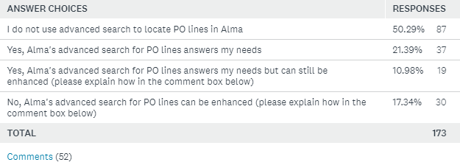
PO line management – survey summary
175~ responses – Thanks!
When using Alma's Advanced Search option to find PO lines, do you have all the search indexes needed in order to find what you need?

Slide 5
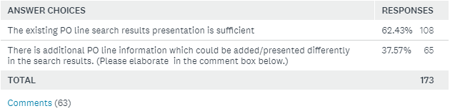
PO line management – survey summary
When reviewing the PO line search results, Alma presents general bibliographic and order information. Is there any additional information which needs to be added in order to improve the efficiency of the person reviewing the PO line search result?

Slide 6
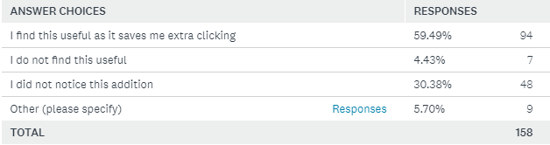
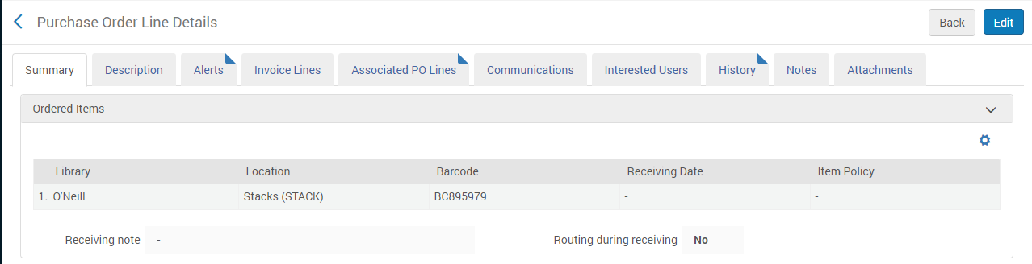
PO line management – survey summary
A recently added feature allows to edit a PO line which is in 'View' mode using a new 'Edit' button. How did you find this enhancement?

Slide 7
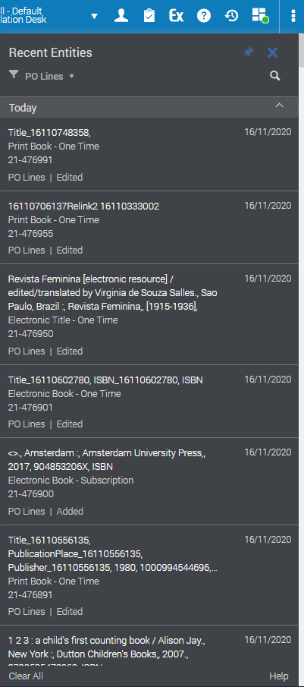
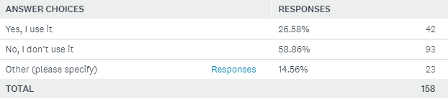
PO line management – survey summary
Alma's 'Recent entities' panel presents PO lines which were recently edited by the user. Do you find this effective in your day to day work?

Slide 8

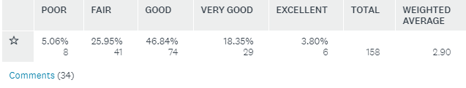
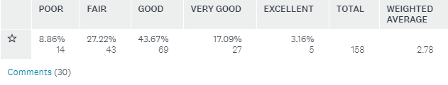
PO line management – survey summary
How would you rate your overall satisfaction with the PO line creation and management in Alma?
How would you rate Ex Libris Support regarding PO line management?
How would you rate Ex Libris documentation regarding PO line management?

Slide 9
Ordering in Alma
A PO line enters Alma, typically via:
  EOD - embedded order data (EOD) import
  Real-time API through a Library Service Provider (LSP)
  Manually as a result of the creation of a PO line.
Notes:
Activate a CZ collection
Create order via API for a CZ record with access provider EBC
Show that the resource was found in the CZ and a portfolio was created under the relevant collection

Slide 10
API workflow
External LSP
Order sent for a title which is part of the CZ activated collection
1
Alma
Alma creates a CZ linked portfolio within the correct CZ linked collection
2
CZ collection
CZ linked portfolio
Alma associated the electronic resource to the relevant CZ activated collection and linked is to the CZ

Slide 11
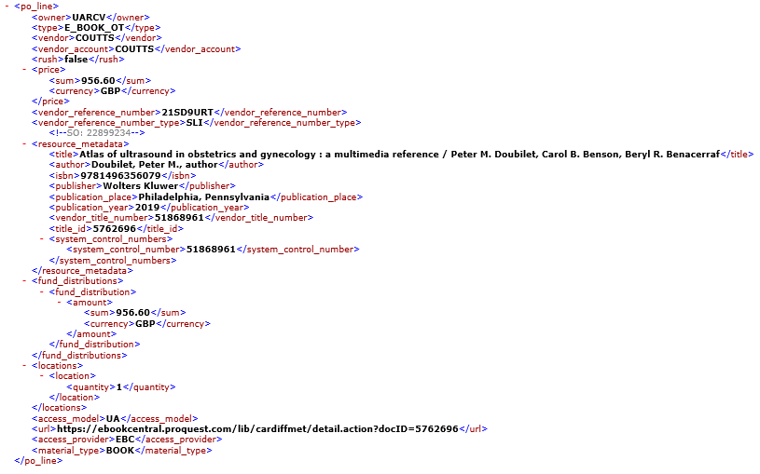
API body
Manual

Slide 12
Use Cases

Slide 13
Scenario 1:
User purchased an ebook The complete Jane Austen Addict from External LSP with Access Model – 3U (Three concurrent users)

Slide 14
Scenario 1
Existing state- A desired portfolio does not exist within the institution’s catalog, the desired title from this collection does exist in Alma’s community zone
Test – An order will be from OASIS to Alma with the desired portfolio’s ISBN
  Order details:
    Purchase type: e-book one time
    ISBN: 1408819813
    Price: 1 Pound UK Sterling
    Fund code: MLGEN3-RES (Collection Development & Research Materials” fund)
    Vendor Code: Coutts
    Access Model: 3U (Three concurrent users) – see last slide for more information
Expected result:
  Alma will search the ISBN for an existing portfolio in the institution’s collection, when it will not find it there it will search for the title in the community zone and create the portfolio within the institution’s collection (linked to the community zone)
  A PO line will be created as “Main” and associated with the new portfolio
  The newly created PO line will state the “Access Model” which was sent with the order (e.g. 1U / 3U / UA)
  The portfolio’s access model field will be populated with the “public access model” value
An actual order was sent from external LMS into Alma creating POL – 15111 in the institution’s Alma
See full results in the next slides

Slide 15
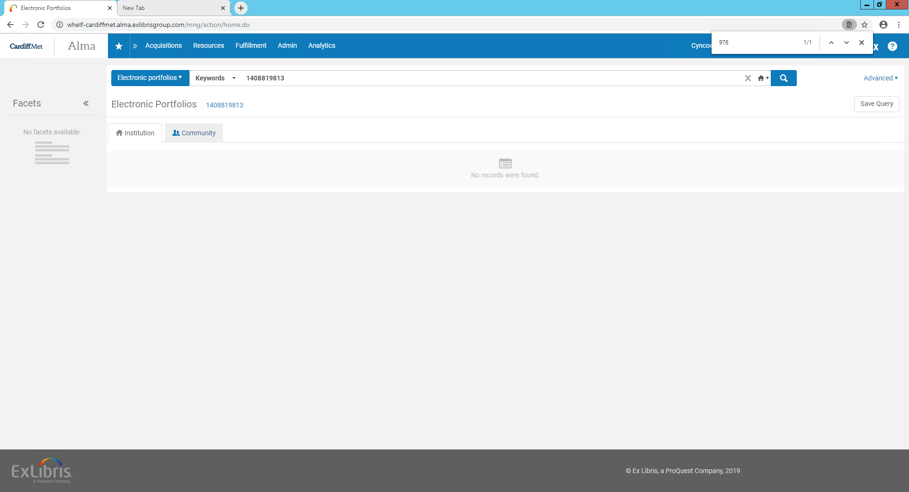
Initial status – Portfolio’s ISBN = 1408819813 Does not exist in the institution’s collection
Searching for this ISBN did not find any results in the institution’s catalog

Slide 16
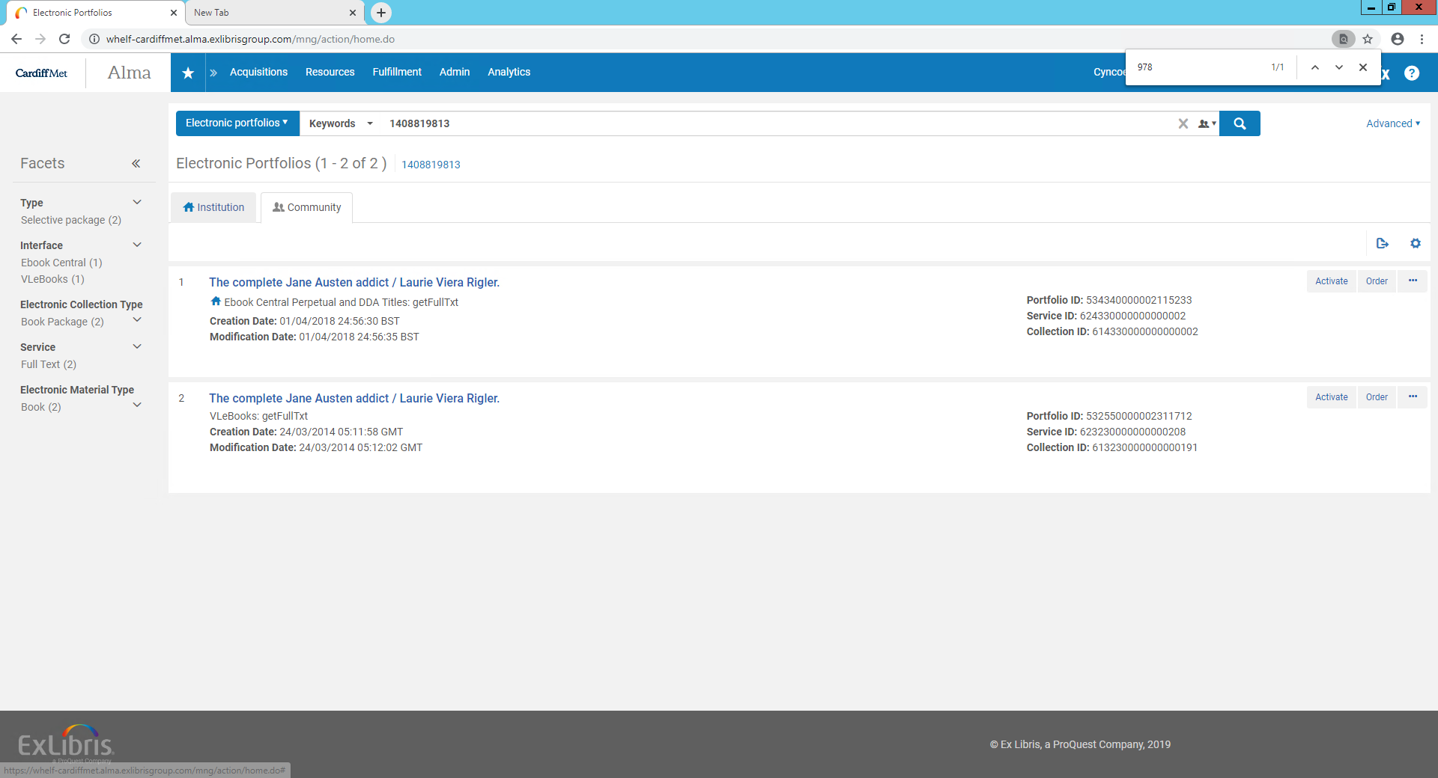
Initial status – Portfolio’s ISBN = 1408819813 Does exist in the Community Zone
Searching for this ISBN did find results in the community zone
No indication that the title is available in the institution
Indication that the collection is active in the institution

Slide 17
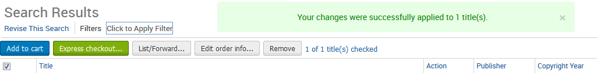
An order was sent from external LMS into Alma
Creating POL – 15111 in the institution’s Alma

Slide 18
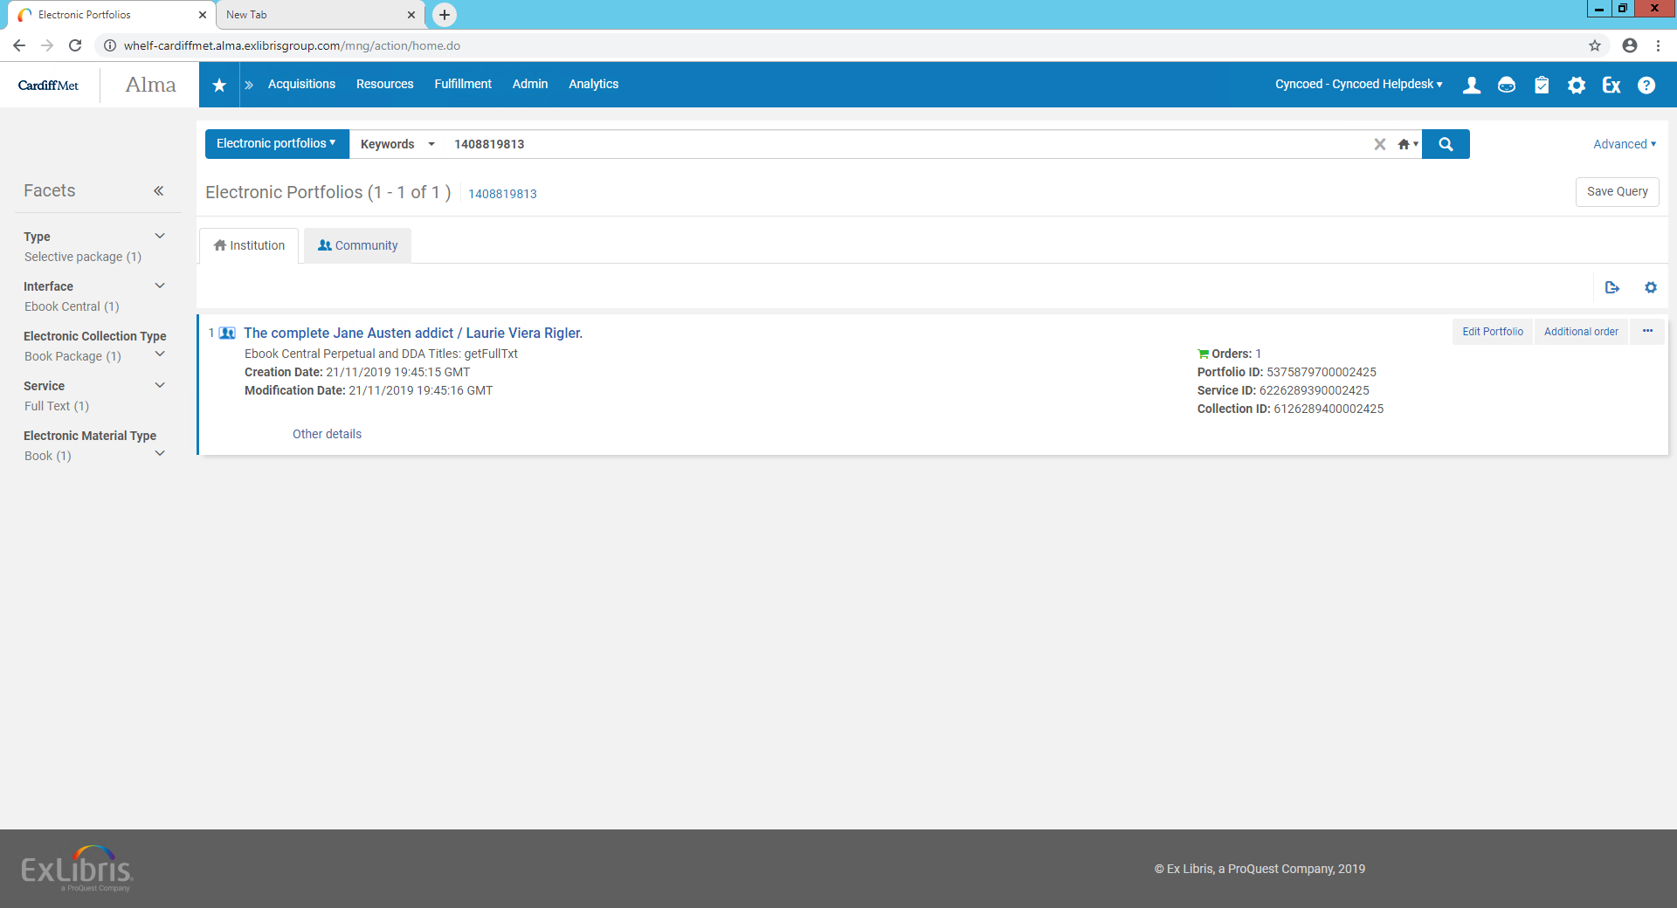
State after the order was sent – A Portfolio was created
Alma created the portfolio within the institution’s collection (linked to the community zone) with full marc record

Slide 19
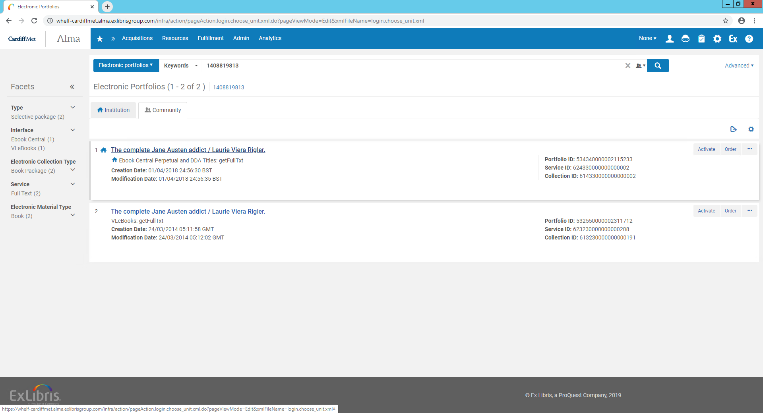
State after the order was sent – Indication was added to the community zone
Indication that the title is now available in the institution

Slide 20
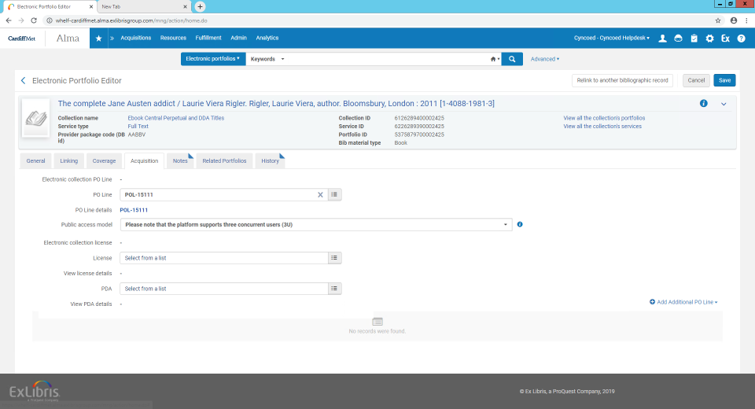
State after the order was sent –Portfolio page
Newly created PO line as “Main”
  The portfolio’s “Public note” field was populated with the “public” access model text

Slide 21
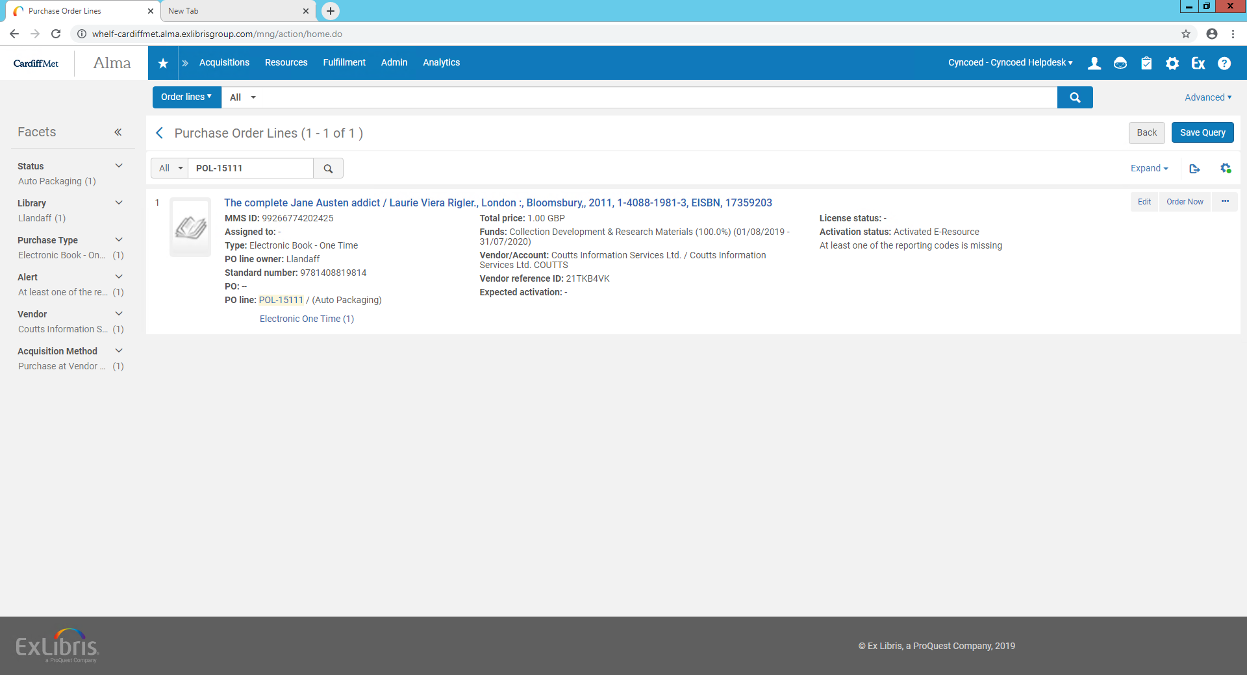
State after the order was sent – PO line

Slide 22
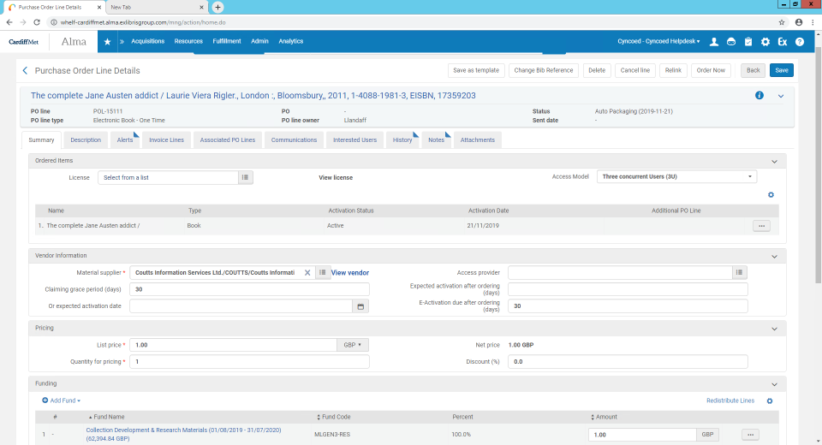
State after the order was sent – A Portfolio was created
  New PO line is in “Auto Packaging” status
  Newly created PO line has the “Access Model” which was sent with the order (3U)

Slide 23
Scenario 2 – Ordered portfolio already exists
A *DDA activated portfolio (via the automatic upload) has reached the access threshold, OASIS automatically created an ebook order Doing inclusive education research with Access Model - UA (unlimited access)
*DDA program - The upload Electronic holdings from EBC created the portfolio within the collection to be made available at the discovery system, after a threshold was reached, an order is automatically sent to Alma

Slide 24
Existing state before test - A portfolio exists within the institution’s collection 'Ebook Central Perpetual and DDA collection’, is linked to Alma’s community zone and has a ”technical” PO line
Test – An order will be sent from OASIS to Alma with the existing portfolio’s ISBN
  Order details:
    Purchase type: e-book one time
    ISBN: 9789087904197 (already exists in the istitution)
    Price: 1 Pound UK Sterling
    Fund code: MLGEN3-RES (Collection Development & Research Materials” fund)
    Vendor Code: Coutts
    Access Model: UA (unlimited access) – see last slide for more information
Expected result:
  Alma will find the existing portfolio under the specific collection and will associate to it the newly created PO line as “Main”
  The newly created PO line will have a note stating the “Access Model” which was sent with the order (e.g. 1U / 3U / UA)
  Previous “technical” PO line on the portfolio will become additional
  The portfolio’s “Public note” field will be populated with the “public access model” text

Slide 25
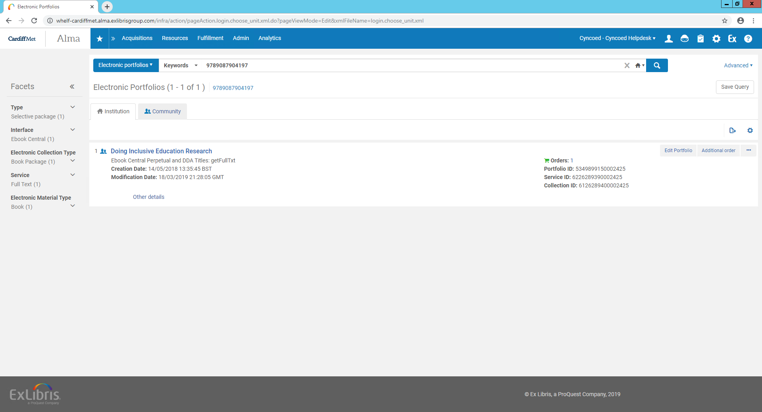
Initial status – Portfolio’s ISBN = 9789087904197 exists in the institution’s collection

Slide 26
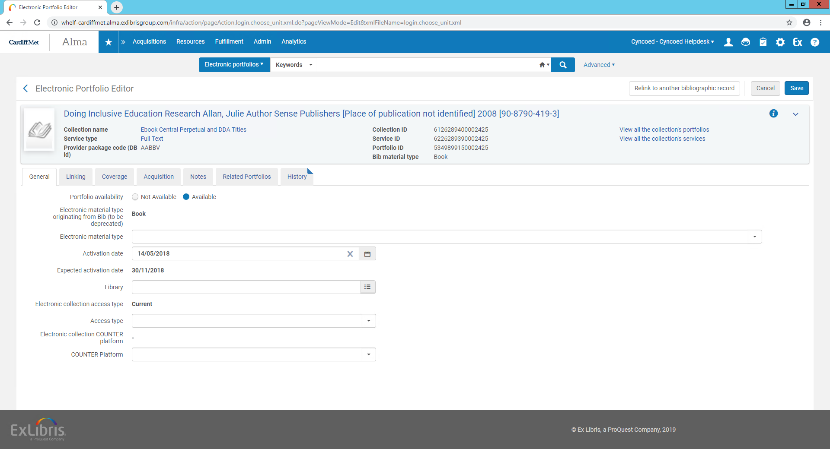
Initial status – Portfolio’s ISBN = 9789087904197 exists in the institution’s collection (Edit – General tab)

Slide 27
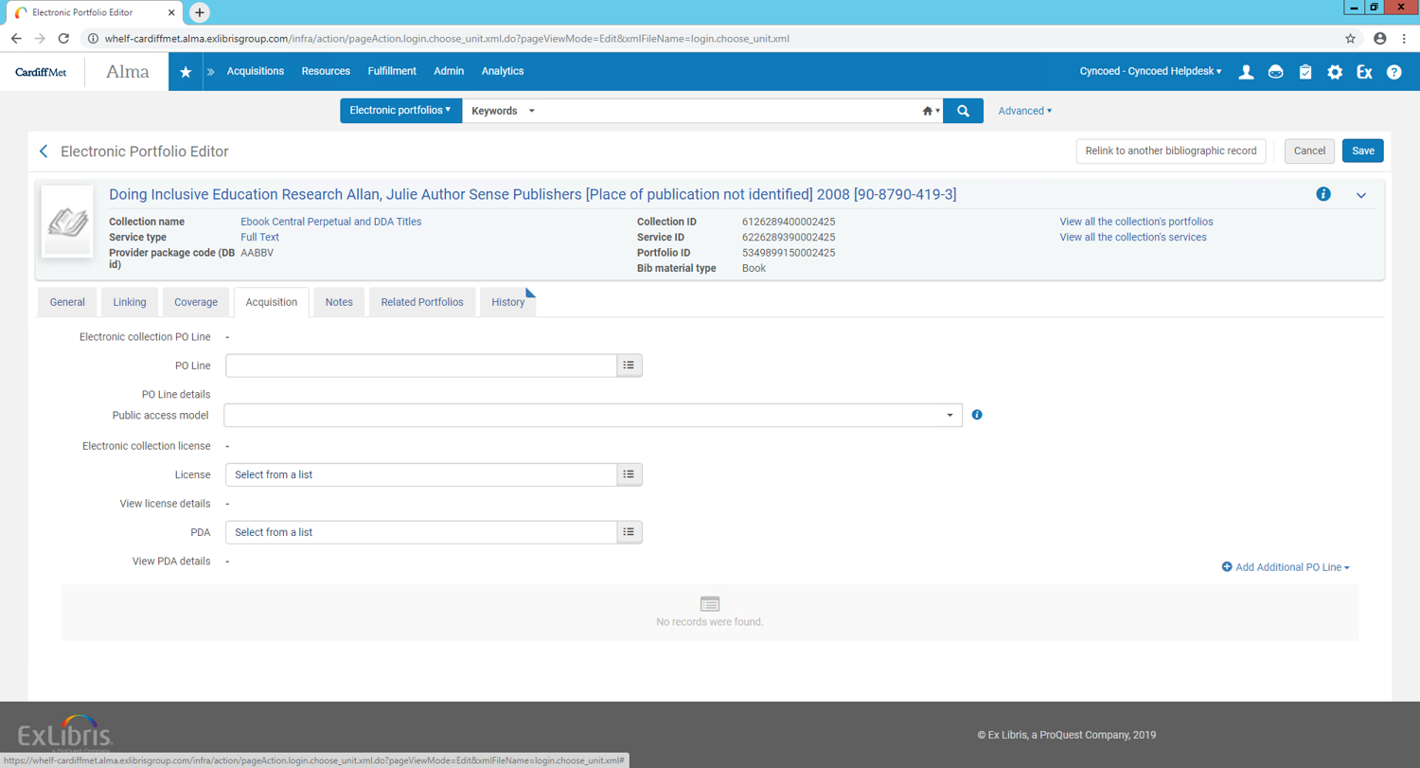
Initial status – Portfolio’s ISBN = 9789087904197 exists in the institution’s collection (Edit – Acquisitions tab)

Slide 28
An order was sent from external LMS into Alma creating POL – 15110 in the institution’s Alma

Slide 29
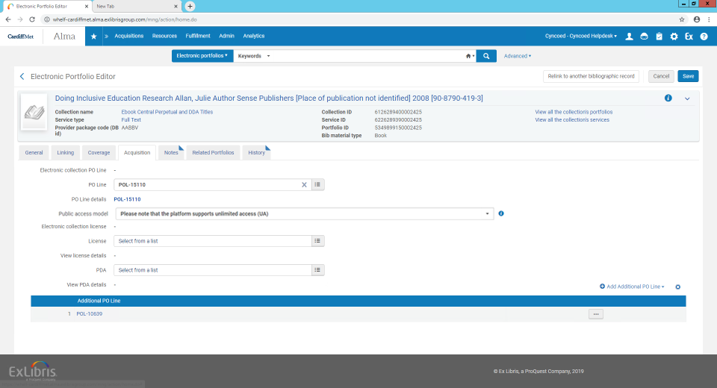
State after the order was sent – Portfolio page
  Alma found the existing portfolio under the specific collection and associated to it the newly created PO line
  The portfolio’s “Public access model” field was populated with the “public” access model
  Previous “technical” PO line on the portfolio became additional

Slide 30
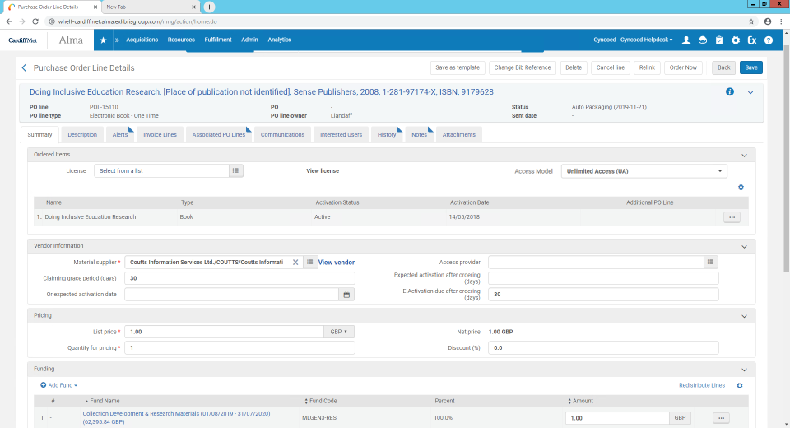
State after the order was sent – PO line page
  New PO line is in “Auto Packaging” status
  Newly created PO line stating the “Access Model” which was sent with the order (UA)

Slide 31
FAQ
  What happens if the EBC title ordered is not in the Community Zone
    Alma will create a local portfolio under the collection and associate the order to it
    Once title is added to the Community Zone the portfolio will be linked to the Community Zone
  What if the RTO activated a portfolio from the CZ but the vendor did not grant access to it yet?
    The portfolio will be activated from the Community Zone as not available

Slide 32
What’s new – Change vendor in order

Slide 33
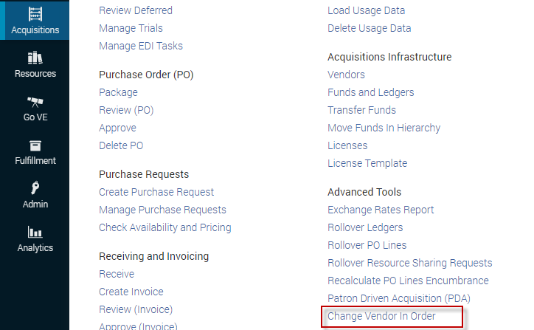
Change vendor in order
Alma offers users the option to modify the name of the vendor on an order in bulk.
This option was enhanced to allow the sending of the order to the new (target) vendor, there are 2 main use cases:
Use Case 1 : Tender
  Vendor A and vendor B participate in a tender. Vendor B wins and takes over the open purchase orders from vendor A.
Use Case 2 : Insolvency
  Vendor A is insolvent, Vendor B takes over the open orders from vendor A.

Slide 34
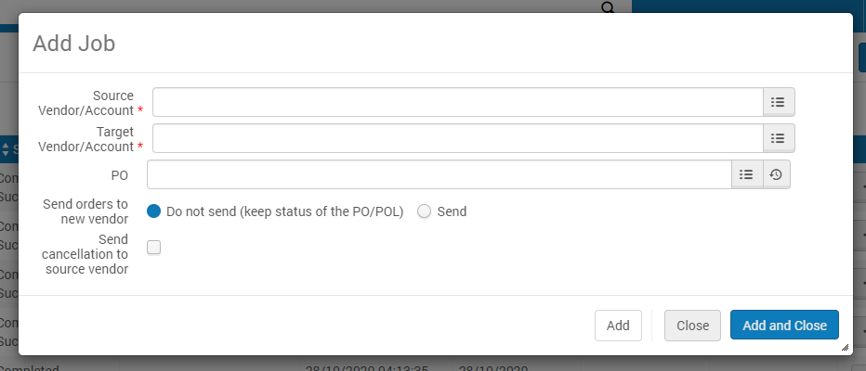
Change vendor in order - General
When selecting the +Add Job operation, Alma opens a pop-up window:
The vendor which will be removed from the order
The new vendor which will be associated to the order
There is an option to select a specific PO – in this case the “Source vendor” field will be populated automatically by the vendor associated with the PO
Do not send - existing functionality of ‘simply’ changing the vendor name on the PO line
Send - Associate the order with the new vendor and send it as well

Slide 35
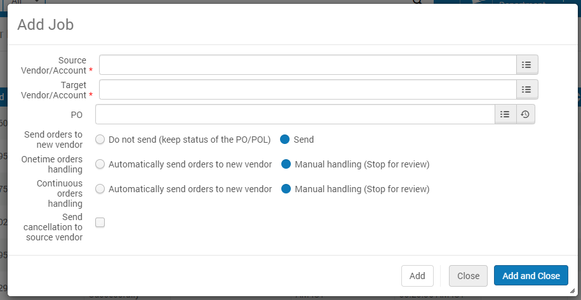
Change vendor in order - General
-
Once the “Send” option was selected, user can decide whether to stop orders for review OR send the order to the target vendor immediately
If selected, a cancellation letter will be sent to the source vendor holding the information regarding the cancelled purchase orders

Slide 36
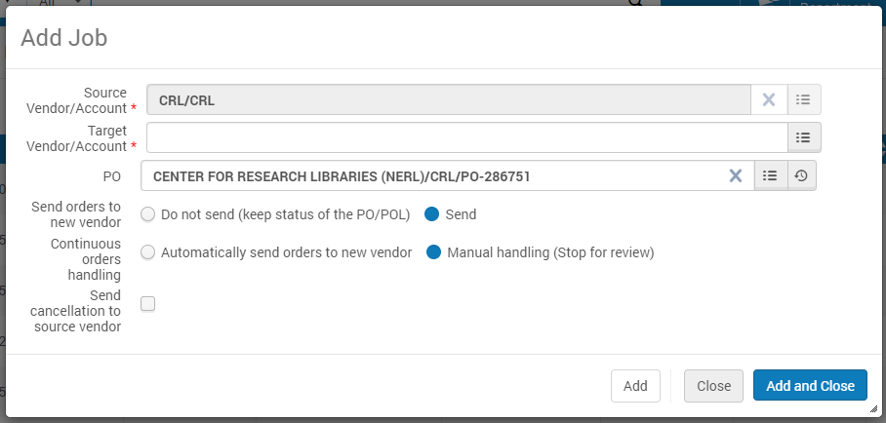
Change vendor in order – Continuous order
-
In case a specific PO was selected, the source vendor will be populated automatically and the ‘Order handling’ will be limited to the PO line type within the PO (OT/CO)

Slide 37
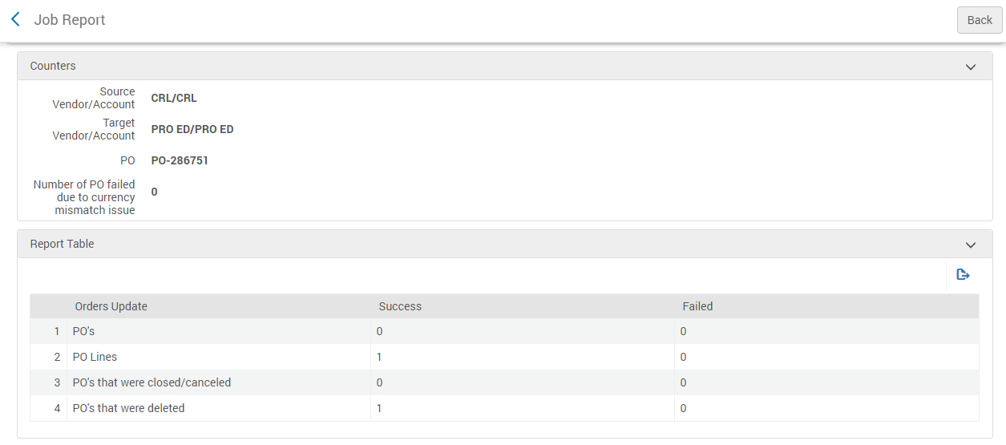
Change vendor in order – Job report
Once the job ran – a report will indicate the PO/PO lines which were modified, the report will only include PO/PO lines which were modified and not the newly created PO/PO lines
Number of PO lines which were modified via the job
Number of PO’s which were modified via the job

Slide 38
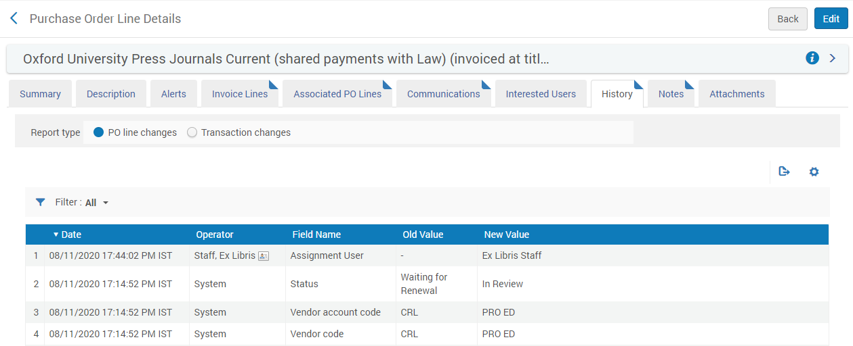
Change vendor in order – PO line history
In the PO line history tab we see the vendor and the status changes which took place as a result of the job

Slide 39
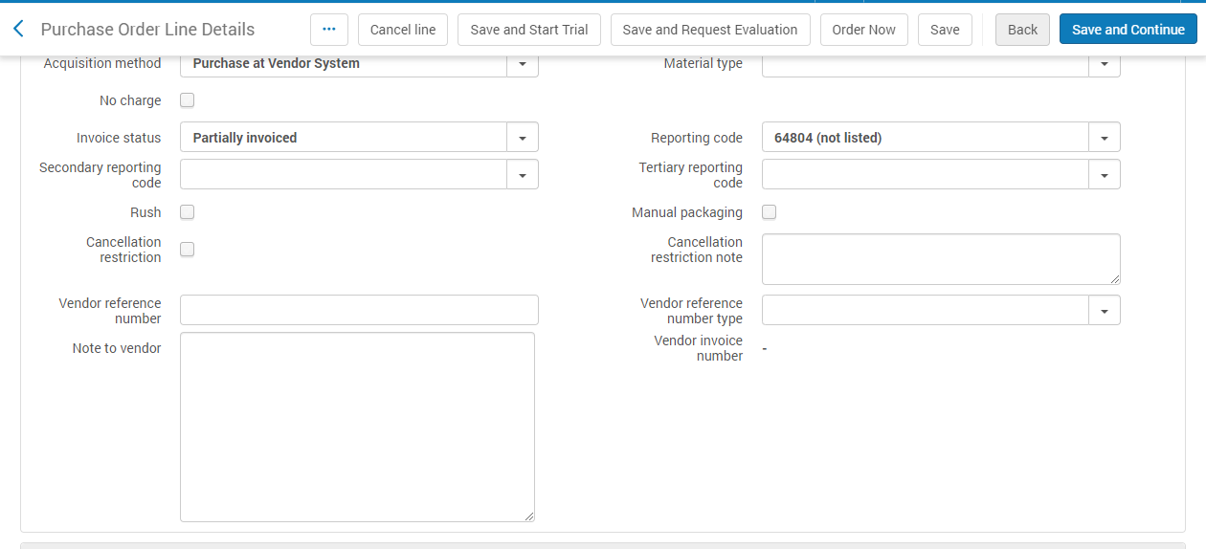
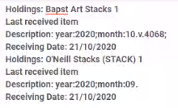
Change vendor in order – Note to vendor
For continues orders which were moved from the source to the target vendor, the “Note to vendor” field will be populated with information regarding the last received item, in this example the PO line was associated with 2 holdings

Slide 40
Change vendor in order – Additional
Automatically send orders to new vendor - For Onetime PO Lines - When selected, all the PO Lines that were sent to the previous vendor (status "Sent") will be removed from the PO and start their workflow. In any case of failure in PO Line’s workflow the PO Line will be set to "In Review". PO Lines in status "Closed", "Waiting for Invoice", "Cancelled" will remain with the PO and will NOT have their Vendor changed. (PO may change its status)

Slide 41
Change vendor in order – Additional
Automatically send orders to new vendor - For continuous PO Lines - when selected Alma will automatically send the PO lines under the PO to the new vendor. If all the PO Lines under the PO are in status "Waiting for Renewal"/Waiting for Manual Renewal" the PO Lines will be removed from the PO and start their workflow (will attempt to pack each PO Line to a PO and send it to the new vendor). In any case of failure in PO Line's workflow the PO Line will be set to In Review.
IF the source PO contains some Closed/Cancelled PO Lines they will remain with the PO and will NOT have their Vendor changed (PO Status will then be updated to "Closed"/"Cancelled").

Slide 42
What’s new – Manage acquisitions alerts
Notes:
In review invoices –invoice number PO-140214

Slide 43
Manage acquisitions alerts
“Unnecessary error messages (alerts!) that show up during manual invoice processing can’t be switched off – this really disturbs the workflow efficiency and needs to be configurable. Staff users will not pay enough attention to serious alerts if too many of them are not relevant to them”
The 2 main entities within the acquisitions model are the PO line and the Invoice.
A new configuration screen allows institutions to define the alerts which are relevant for their workflow and more importantly define which alerts can be disabled.

Slide 44
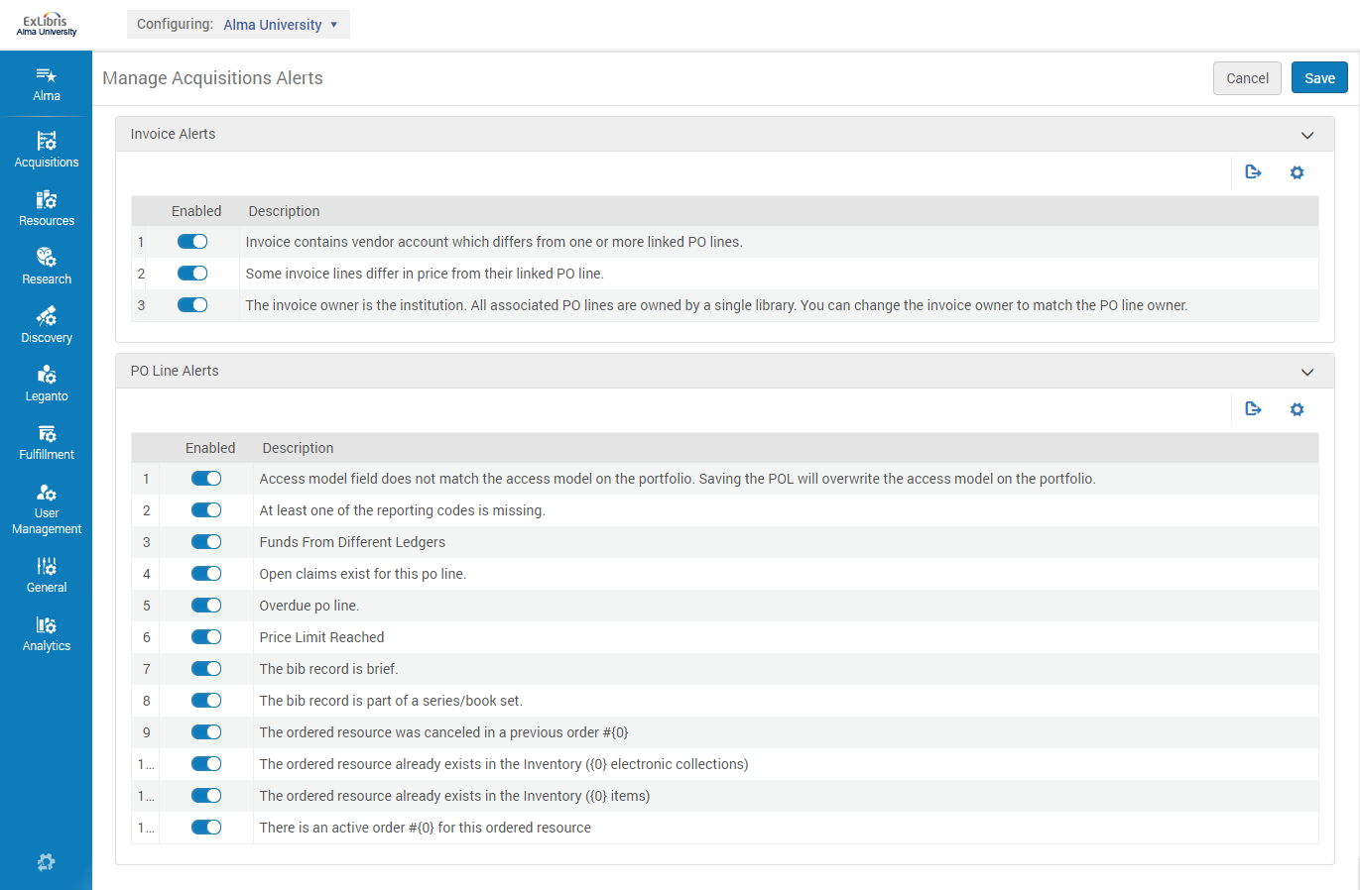
Manage acquisitions alerts
Configuration -> Acquisitions -> Manage Acquisitions Alerts

Slide 45
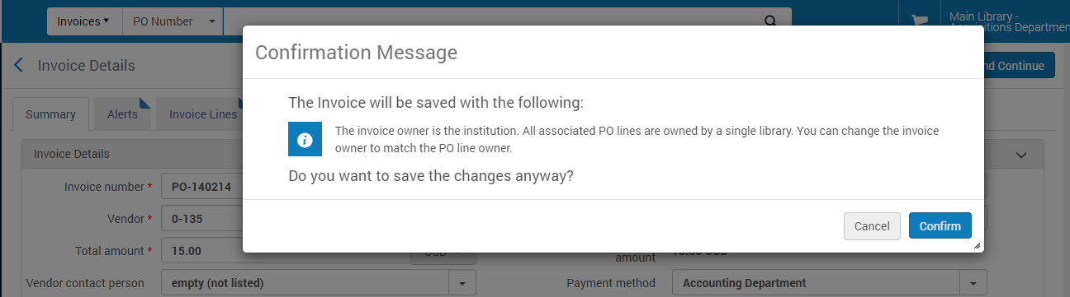
Manage acquisitions alerts
Example – invoice editing screen

Slide 46
More?

Slide 47
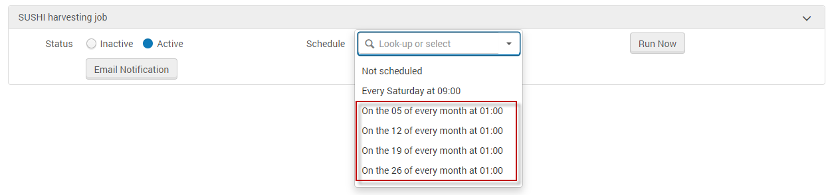
Additional developments done in 2020
Currency Exchange Rate Overrides (Fixed exchange rate) – Video
Access Model – documentation
When reviewing a PO line in view mode – Edit in a single click
SUSHI harvesting – additional scheduling options

Slide 48
What’s next?

Slide 49
Replace resource in electronic PO lines
ACQUISITIONS
What’s Coming
Users will be able to replace an electronic resource associated with a PO line, with another electronic resource
Impact
Allowing users to alternate existing PO lines instead of deleting it and creating new ones will ease the overall workflow and will preserve the PO line’s history track
Highlights
This functionality will be efficient in cases where a PO line was created for a local resource and there is a need to associate the PO line to a resource managed by the Community/Network zone (or to another local resource). This will prevent the user from the need to delete the PO line and create a new one.
When relevant, users will be able to decide whether to delete the previous resource or maintain it

Slide 50
SUSHI – Allow users to indicate the time period which should be harvested
ACQUISITIONS
What’s Coming
When a user manually request a particular SUSHI account/report to be harvested, the user will be given an option to define the exact time period from which they would like to harvest usage data
Impact
As we see increase use of automated SUSHI harvesting using Alma, enhancing the manual harvesting function will prevent institutions from the need to go to the vendor website in order to retrieve past usage
Highlights
The option to select the time frame when using the manual harvest option will allow users to:
Harvest usage data from greater than 12 months ago for newly configured accounts
When troubleshooting data errors, users could ask Alma to harvest just a single month at a time
Notes:
Idea exchange

Slide 51
Incorporate the use of the “quantity for pricing” and “Access Model” information in EDI for electronic “One Time” POLs
ACQUISITIONS
What’s Coming
Users will be able to pass the vendor via EDI 2 pieces of information regarding the Access needs for the ordered electronic resource : Quantity for pricing and Access model
Impact
Highlights
There are 2 licensing use cases when ordering electronic resources
Vendor does not have the option to provide access for 3 concurrent users and can only grant access to 1 concurrent user for each purchased resource - so there is a need to have the quantity for pricing be "3" be reflected in the EDI file sent to the vendor
Vendor has the option to provide access for 3 concurrent users for each purchased resource - so there is a need to have the quantity for pricing be "1" and have the “Access Model” be set to 3 concurrent users
As there is an increased use of electronic resources – it is important to reflect to the material supplier as much information as possible regarding the licensing needs for ordered electronic resource
Notes:
Idea exchange

Slide 52
New workflow for the Receiving workbench
ACQUISITIONS
What’s Coming
Refactoring of the Receiving workflow will allow users to receive items quicker and with fewer navigation
Impact
A better utilization of the Receiving workflow will save users from unnecessary navigation in and from the receiving workbench
Highlights
“Search before you work” option will save the users from waiting time until the Receiving page loads
New “side by side” presentation will save the users from accessing a designated page in order to review the items list
Brief item editing will allow users to edit specific information of inventory items without leaving the receiving workbench

Slide 53
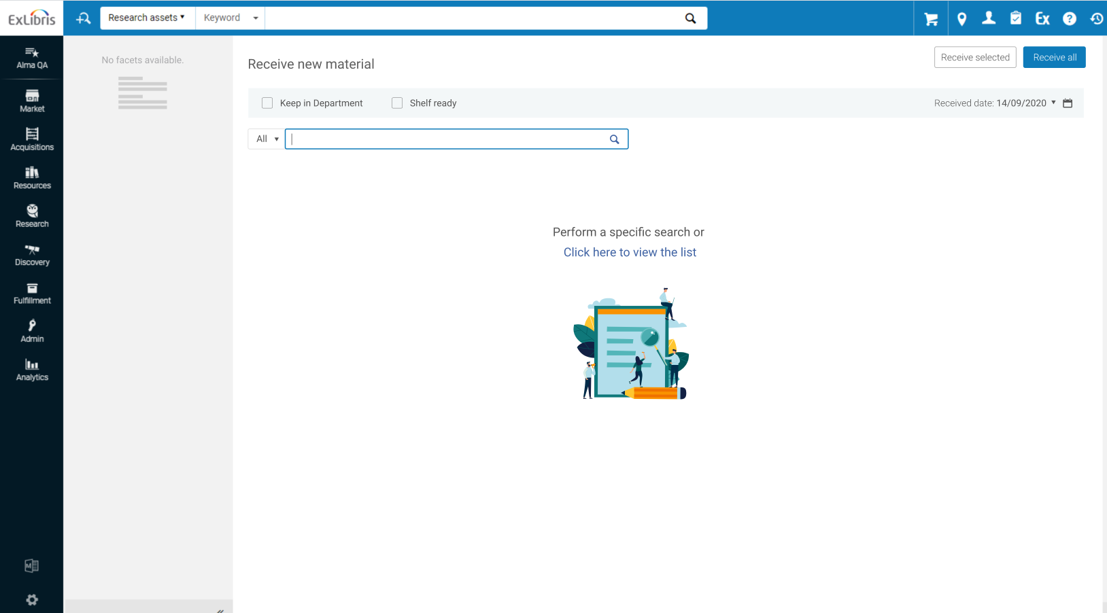
New workflow for the Receiving workbench

Slide 54
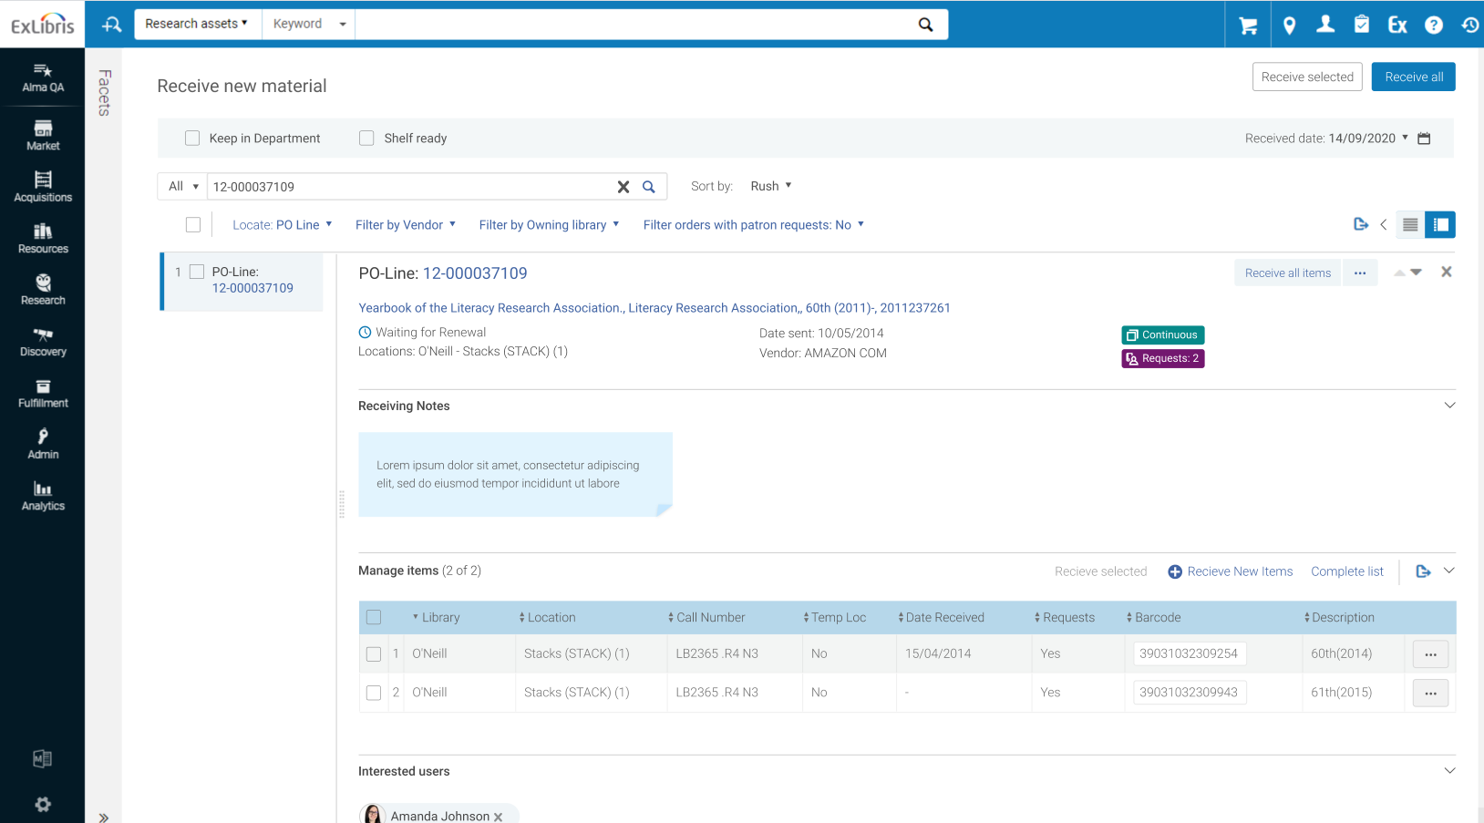
New workflow for the Receiving workbench

Slide 55
Thank you!

